Slide 1
Team17 RF-3
Amanda goodridge, Will schottler, brandon baugh

Slide 2
Overview of project
Updates
Modernize NATS halls
Replace old 70s looking displays in LF and PS buildings with large touch screen display(s)
Will show info on faculty, programs, etc.
Started researching potential displays
Working on creating a budget
Working on creating a timeline for setting everything up

Slide 3
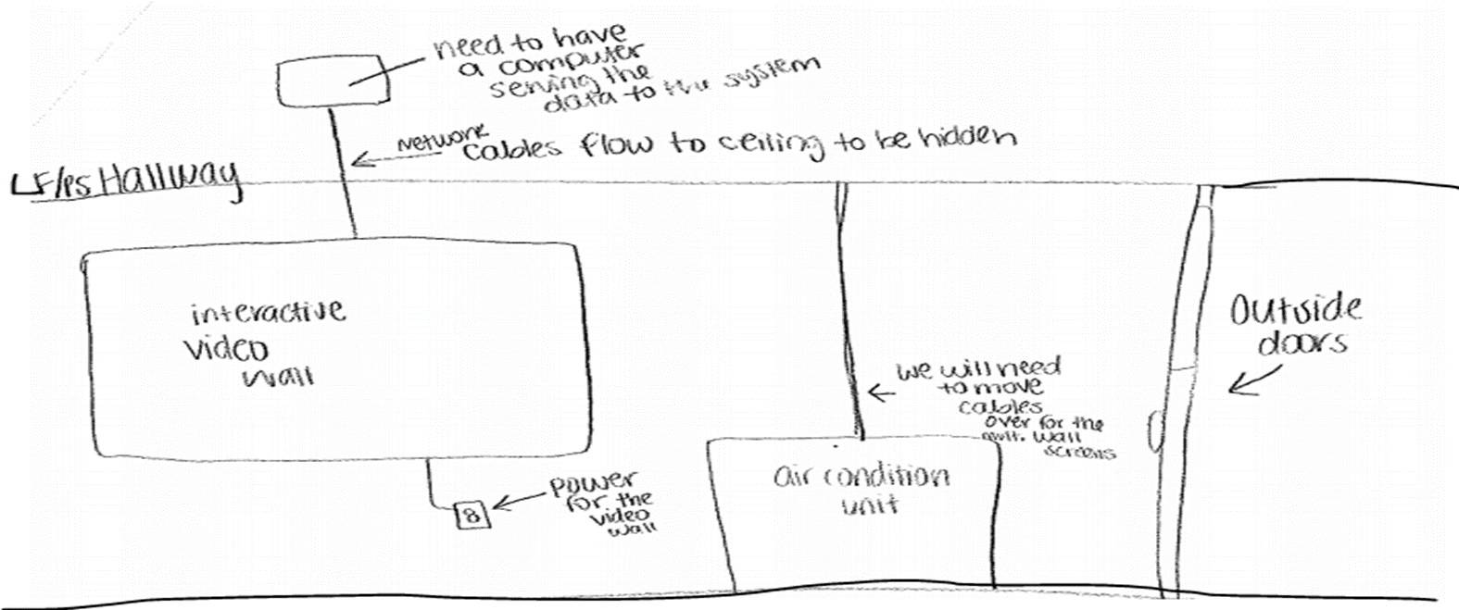
System Design
Hardware/software mapping
Subsystem decomposition
Wall will be made up of either one large display or multiple displays combined as one (similar to large video wall in library)
Need to purchase hardware, software for displays.
Access control and security
Anyone will be able to access system physically, on campus
Network will be secured, data will be stored on server elsewhere
Files will be password protected

Slide 4
Questions

