Slide 1


Slide 2
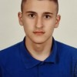
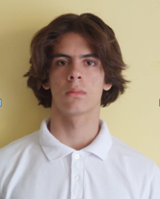
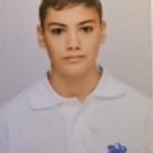

Team members
Ivan Andreev
IVAndreev21@codingburgas.bg
Scrum trainer
Dimitur Dimov
DRDimov21@codingburgas.bg
Front-end
Boyan Kiovtorov
BKKyovtorov21@codingburgas.bg
Back-end
Dobril Peev
DDPeev21@codingburgas.bg
Designer

Slide 3
01
02
03
04
Think of an idea
Write the code for the idea
Test the code
Present the game

Slide 4
Game Idea

Slide 5








Used technologies

Slide 6
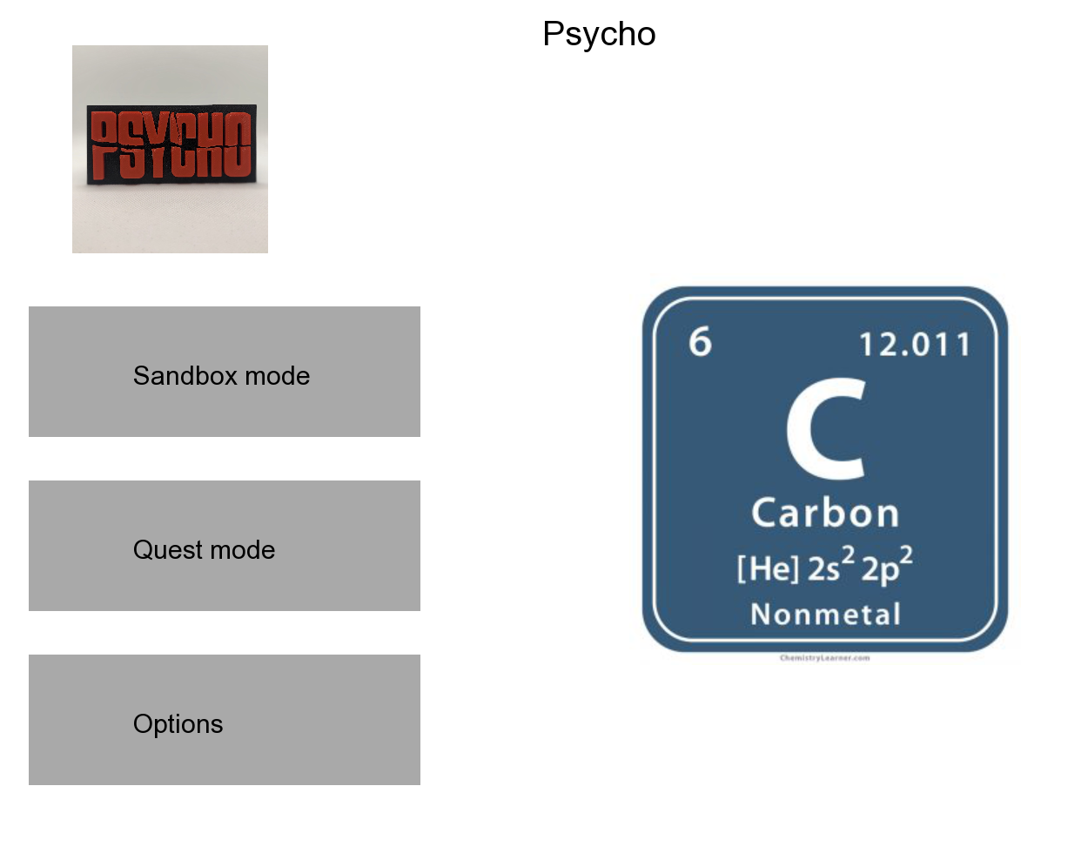
Let’s move to the game

