Slide 1
YRT
About our team

Slide 2
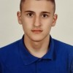
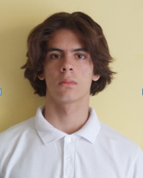
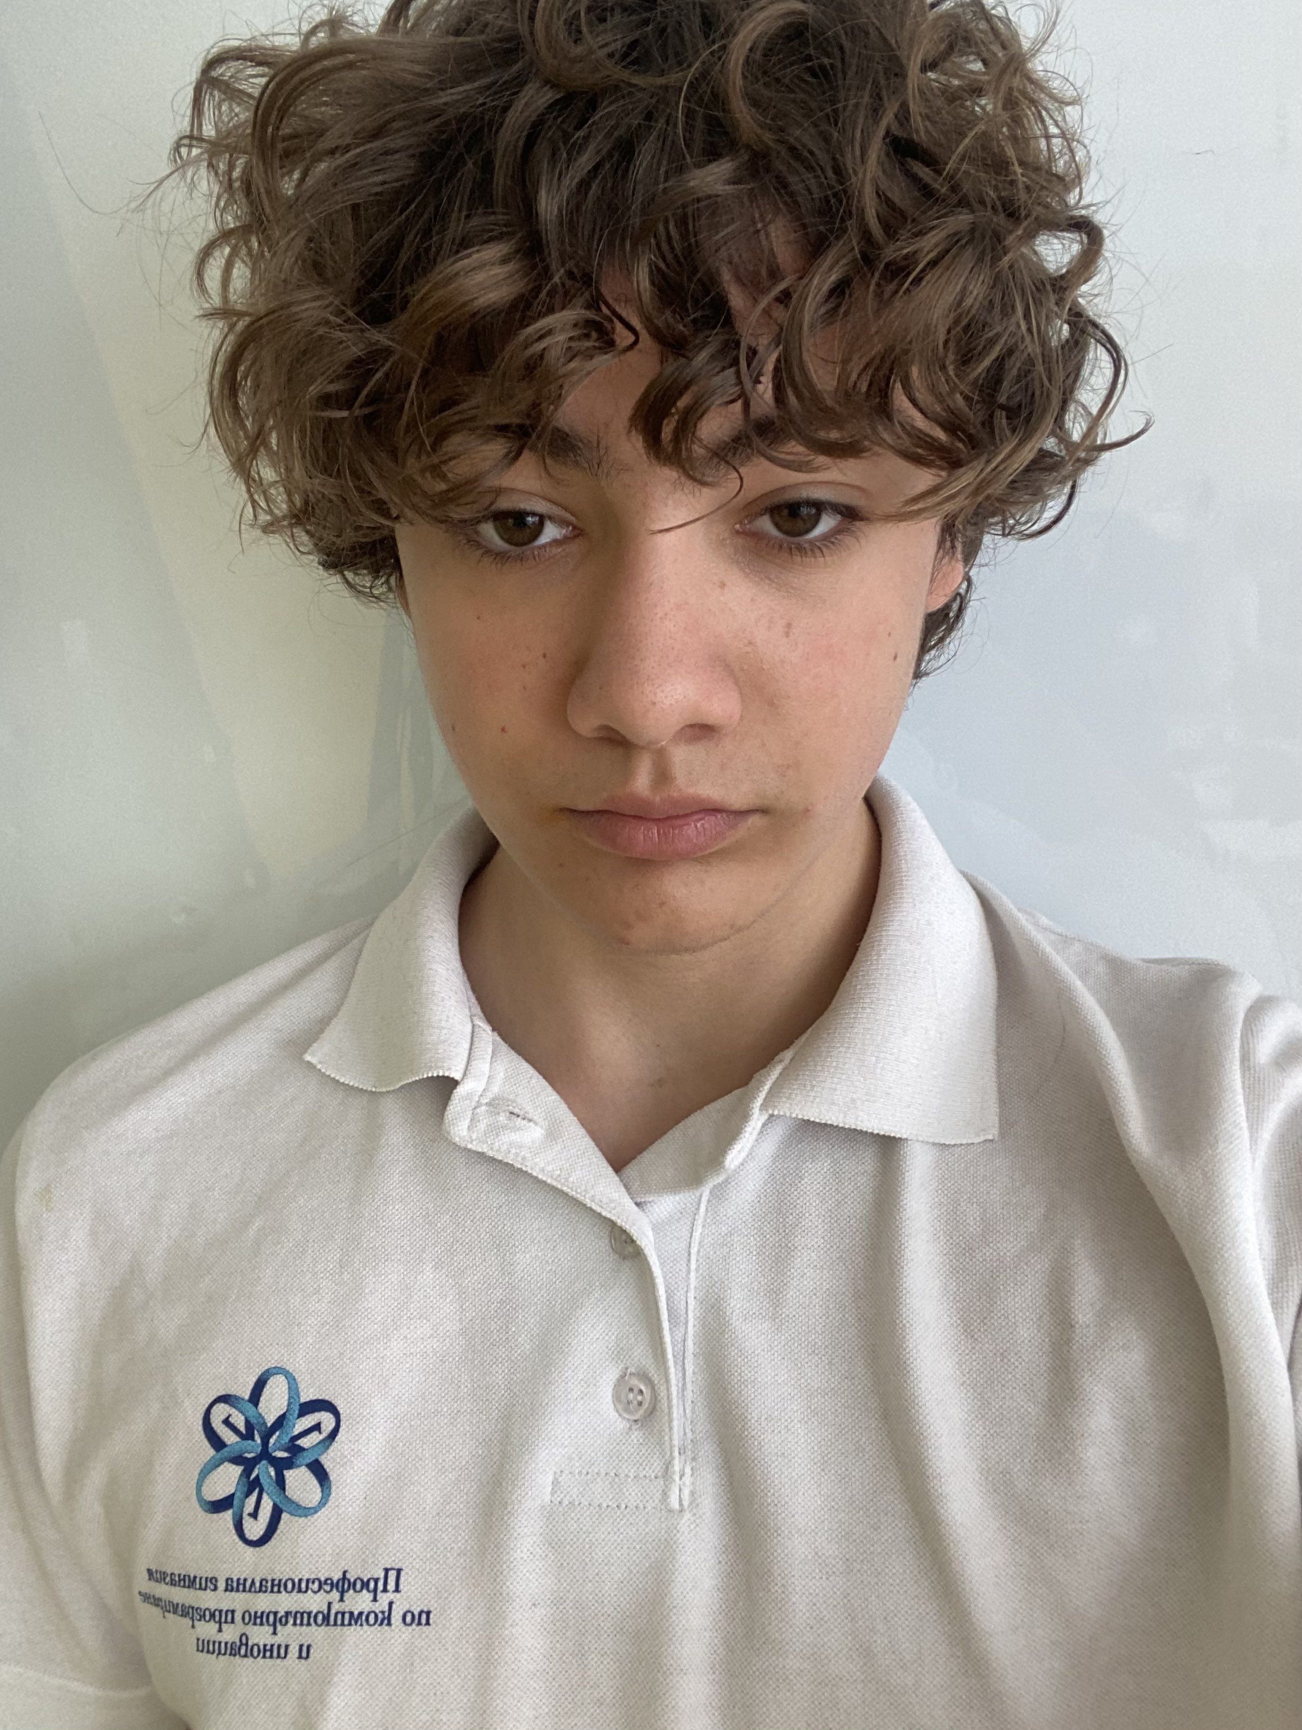

Team members
Ivan Andreev
Dimitur Dimov
IVAndreev21@codingburgas.bgScrum trainer
DRDimov21@codingburgas.bg
Front end
Boyan Kyovtorov
Dobril Peev
BKKyovtorov21@codingburgas.bg Back end
DDPeev21@codingburgas.bg
Designer

Slide 3












Used technologies

Slide 4
The process
01.
02.
03.
Brainstorming
Have a team meeting
Write the code for the app
04.
05.
06.
Test all of the functions
Create documentations
Present

Slide 5
Our Idea
Our idea is to make a bank application based on digital will where in case of sudden accident all assets will go to a predefined heir

Slide 6
Let’s move to the game

