Slide 1


Slide 2
Table of contents
01
02
Team
Idea
03
04
Work stages
Game

Slide 3
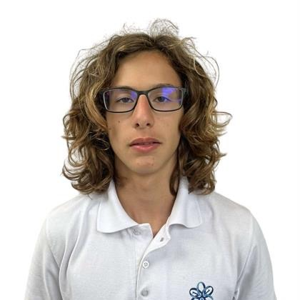
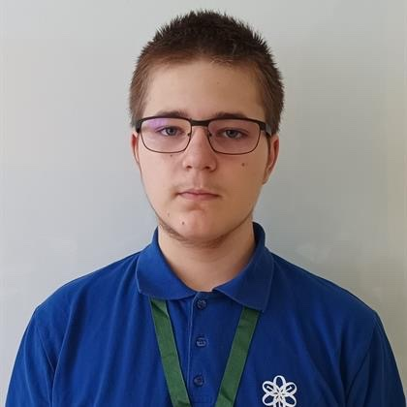
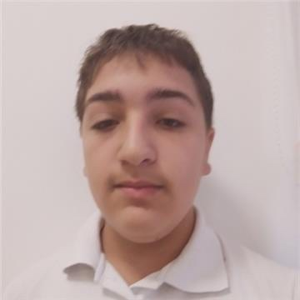
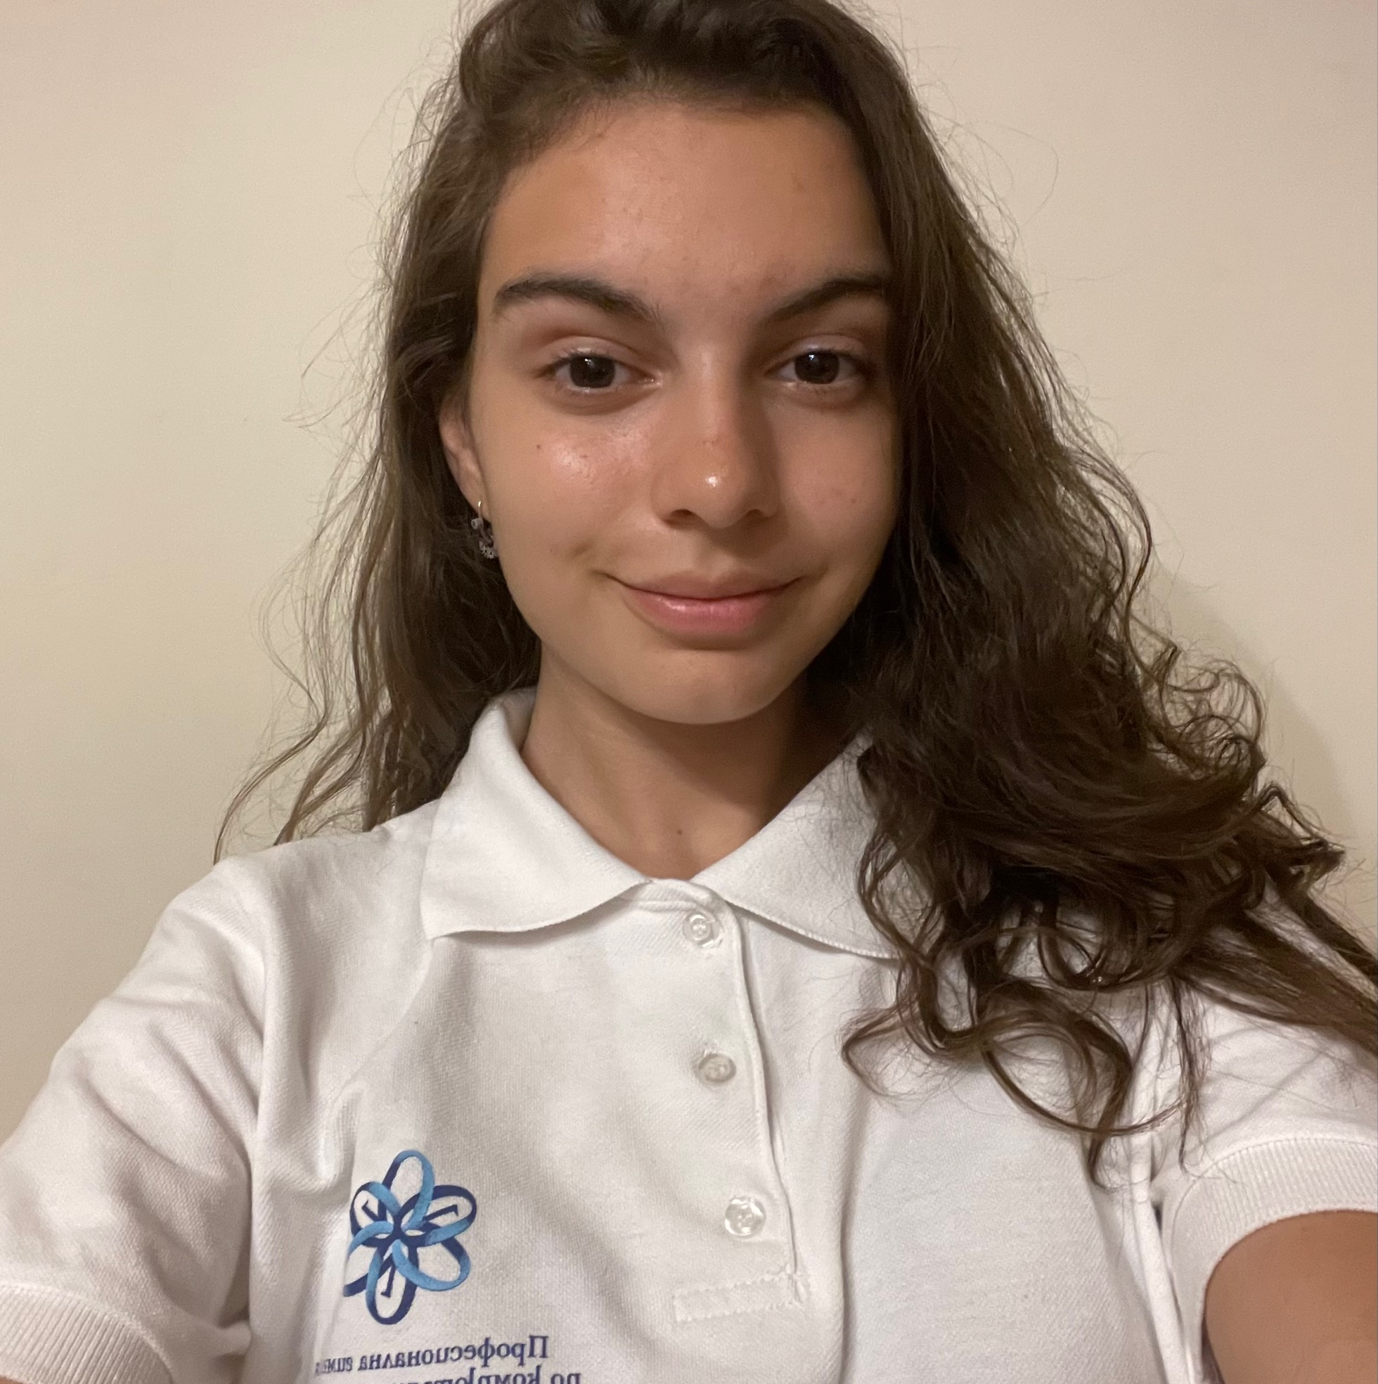
Team
Ivo Badalov
Scrum trainer
Martin Belchev
Backend developer
Simeon Syarov
Backend developer
Kristina Zheleva
Frontend developer

Slide 4
Idea
A clicker game where the main game mechanic is to get garbage bags into recycling bins, which rewards the player with in-game currency that they can use to buy upgrades. The game is aimed at a younger audience, where we use the gained currency as a way to subliminally instill the idea of the importance of recycling.

Slide 5
Work stages
Form a team
Develop an idea
Work on project
Finish the game
Project documentation
Rehearsal for the project presentation

Slide 6








Used technologies

Slide 7
