Slide 1
AI Operating Model Transformation
Strategic Recommendations Briefing Deck
Ivana Gibson – Q2 2025

Slide 2
Executive Summary
Phased AI transformation roadmap for a global professional services firm.
Focus: Business value, stakeholder alignment, and scalable enablement.
Includes maturity model, CoE framework, and change management strategy.

Slide 3
Strategic Objectives
Leverage AI for operational agility and scalability
Improve stakeholder alignment and decision transparency
Ensure ethical, secure, and scalable AI deployment
Achieve measurable business value through phased execution

Slide 4
AI Maturity Model
Level 1: Ad Hoc – Isolated pilots, no strategy
Level 2: Emerging – Executive interest, early data pipelines
Level 3: Defined – AI aligned to KPIs, initial policies and roadmap
Level 4: Integrated – Cross-functional delivery, tracked metrics
Level 5: Optimized – Strategic advantage, continuous learning

Slide 5


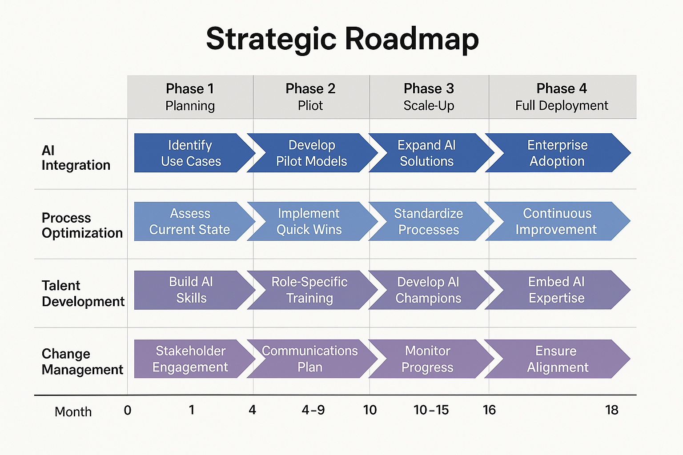



Strategic Roadmap

Slide 6
AI Center of Excellence Framework
Functions: Governance, Innovation, Tools, Talent, Risk Management
Structure: Federated with central CoE + business line liaisons
Deliverables: AI policy handbook, training, dashboards, reusable assets

Slide 7
Change Management Strategy
Phase-based engagement, communication, and capability building
Comms tailored by audience (execs, managers, end users)
Metrics: adoption, sentiment, training, alignment with KPIs

Slide 8
Final Recommendations
AI Use Case Targeting – Prioritize high-impact, low-effort cases
Governance & Risk – Establish AI Governance Council
Org Design & Talent – Create hybrid roles (AI translators, etc.)
Measurement – Track adoption and KPIs aligned to value

Slide 9
Next Steps & Measurement
Proceed to KPI definition and dashboarding (Folder 08)
Set AI usage, efficiency, and sentiment targets
Launch quarterly value realization reviews to track ROI

