Slide 1
AI Opportunity Scoring by Process Area
Insight: Onboarding and Document Processing are high-impact, low-effort AI opportunities.
Focus first on use cases with high Priority Scores (green bars).

Slide 2
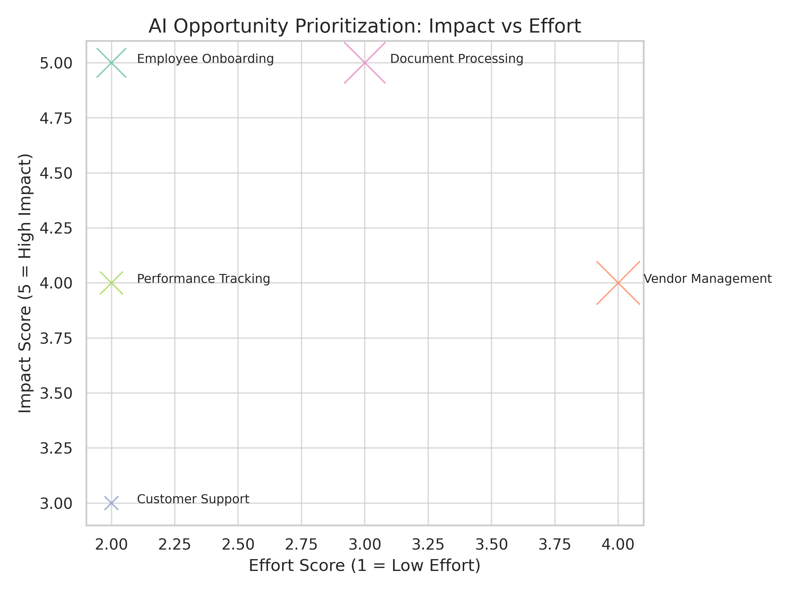
AI Fit: Impact vs Effort Prioritization

Slide 3
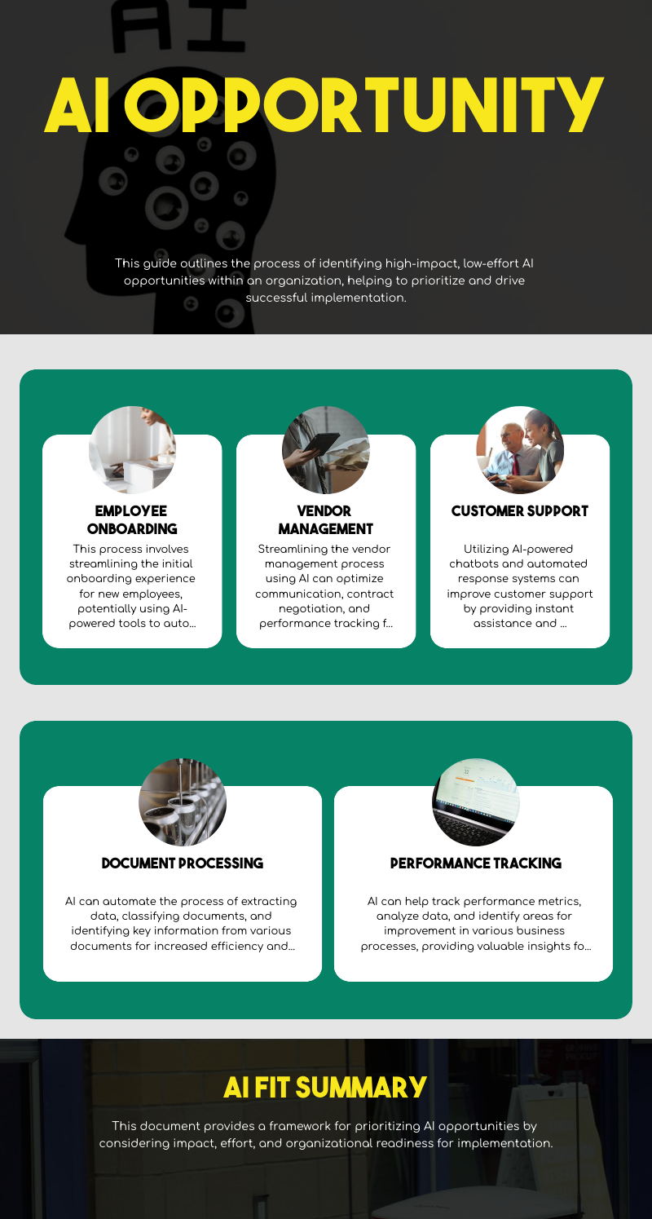
Overview of AI Opportunity Areas

