Slide 1

CAVE app: Shiny/R
Coronavirus Adverse Vaccine Events
Jason Morphett, PhD

Slide 2
Outline
Motivation for CAVE (MHRA ‘Yellow Card’)
CAVE Data source: CDC / FDA data (VAERS)
CAVE Implementation: demo and code dive
Further information
CAVE website: https://vaccines.shinyapps.io/cave/
CAVE on GitHub: https://github.com/onmas59/cave
MHRA (Yellow Card): https://www.gov.uk/government/publications/coronavirus-covid-19-vaccine-adverse-reactions
VAERS: https://vaers.hhs.gov/data/datasets.html
Substack: https://jasonmorphett.substack.com/

Slide 3
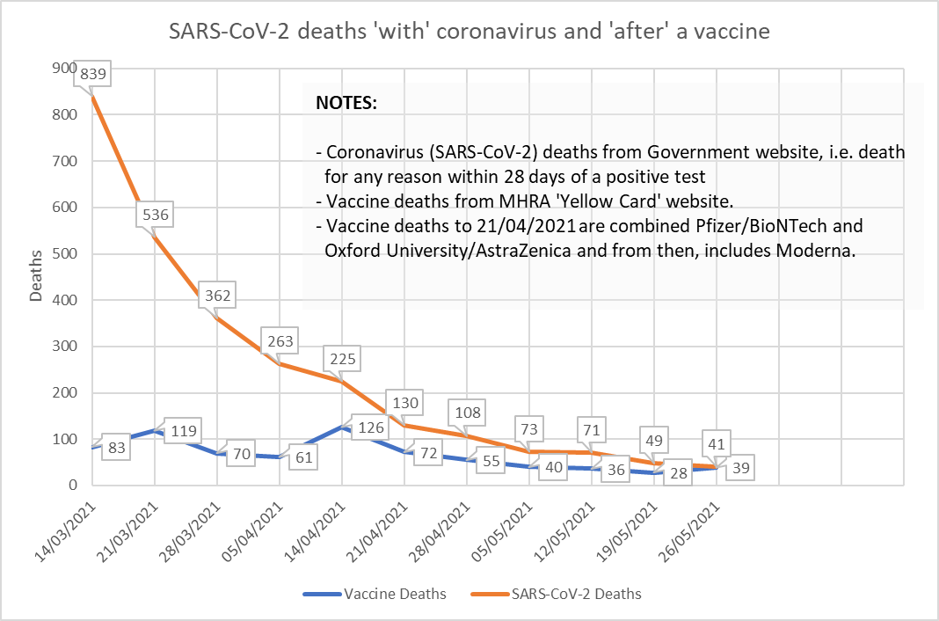
Motivation for CAVE (MHRA ‘Yellow Card’)
The Yellow Card is the UK’s primary pharmacovigilance scheme. It is run by the Medicines and Healthcare products Regulatory Agency (MHRA) which is a government organisation.
The MHRA produce WEEKLY report but overwrite pdfs ☹ …
From February-May 2021, I began researching my personal vaccination risk:benefit using the Yellow Card and calculating weekly deltas to aid my own decision making.
In ~August 2021, I released CAVE
There must be a better way than this for the general public to assess their risks of adverse events from the data?

Slide 4
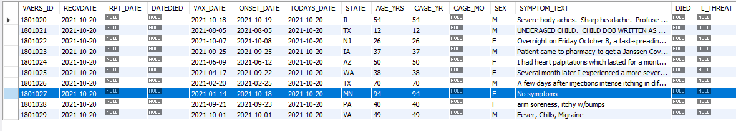
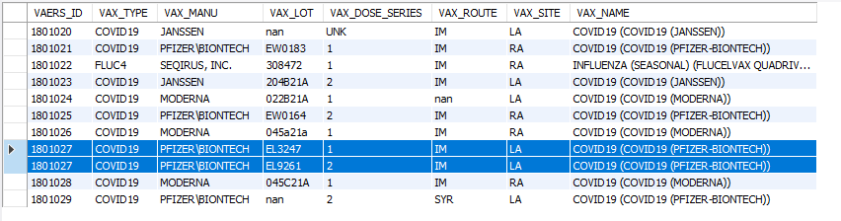
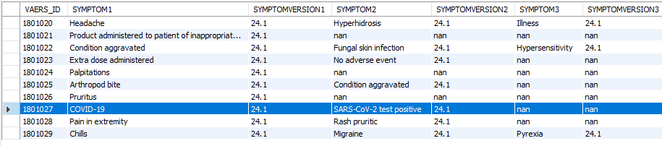
CAVE Data source: CDC / FDA data (VAERS) https://vaers.hhs.gov/data/datasets.html
Table: VAERSDATA – 35 columns This is the Primary table
VAERSDATA: This holds 1 entry
per person (VAERS_ID)
and should only hold static information such as age, gender etc. It should not hold dates pertaining to vaccine adverse event reports such as VAX_DATE or symptom text as this is dose specific information
Table: VAERSVAX – 8 columns – Adverse events for each dose of a vaccine
VAERSVAX: This holds vax dose specific information pertaining to each dose of any vaccine report, for each VAERS_ID. It should hold dates pertaining to vaccine adverse event reports
Table: VAERSSYMPTOMS* – 5 columns for entering symptoms but NOT linked to vax dose or manufacturer
VAERSSYMPTOMS : Holds symptoms for each VAERS_ID. It should associate symptoms with each AE report but does not.
*Symptoms are lookups from MedDRA codebook

Slide 5
CAVE Implementation: demo and code dive
https://vaccines.shinyapps.io/cave/

