Slide 1
3Q 2021 Excess Mortality
Have vaccine adverse reactions contributed to the excess mortality?
Geoffrey Friesen, PhD
Associate Professor of Finance, University of Nebraska-Lincoln

Slide 2
Why look at Group Life Insurance?
Group Life Insurance
Stable population
Little or no adverse selection or moral hazard issues
Employed
Stable & consistent policy dollar amounts per person
Notes:
Advantages of group life insurance:
Adverse selection refers to situations where people buy insurance b/c they know they are sick or likely to die. This is a big issue with individual insurance; not so with group insurance;
It is a stable population of employed adults. Relatively low background mortality rates so that abnormal changes are easier to spot.
Dollar amounts are usually a % of salary.

Slide 3
Key Findings
Starting Q3 2021, being employed became a mortality risk relative to not being employed (e.g. relative to the overall US population).
Excess mortality concentrated mainly in Southeast US states.
These states had lower vaccination levels going into 3Q.
They also had higher vaccination uptake during 3Q.
They also had a large spike in vaccine related deaths reported to the VAERS system beginning in 3Q.

Slide 4
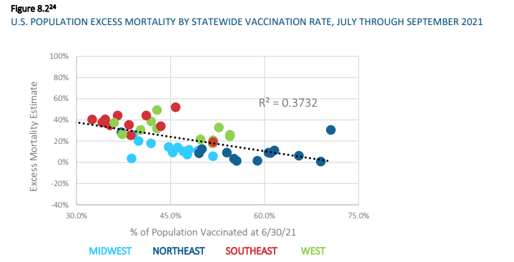
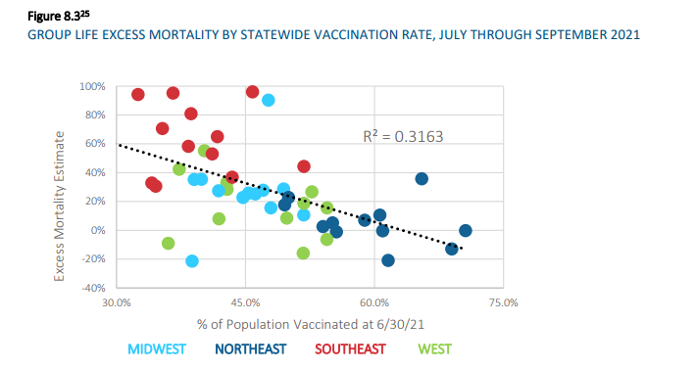
Excess mortality vs. vaccination % by state

Slide 5
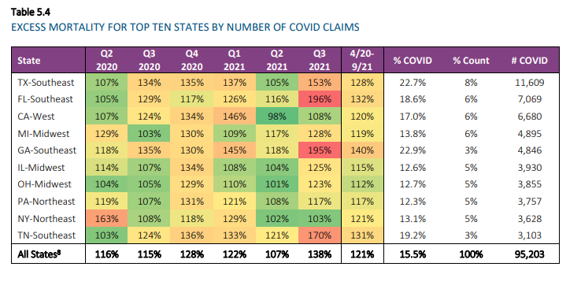
Summary of Results – equally weighted top 10 COVID Death States
Lower vaccination level explain 58% of excess mortality variation (univariate R²=58%)
Excess vaccine death reports in VAEARS explain an additional 13% of excess deaths (multivariate R²=71%)

Slide 6
Vaccination % and Excess Mortality – Ten largest states

Slide 7
Q3 2021 VAERS Deaths and Excess Mortality – Ten largest states

Slide 8
Summary of Results for 10 states with largest number of overall COVID Deaths (identified by SOA Group Life Data)
Lower vaccination level explain 58% of excess mortality variation (univariate R²=58%)
Excess vaccine death reports in VAEARS explain an additional 13% of excess deaths (multivariate R²=71%)
Regression estimate of vaccination % -3.1
Every 1% increase in vaccination percentage reduces excess mortality by 3.1%
VAERS Death Reports coefficient 0.21
Every 100 VAERS deaths increases excess mortality by 0.21%
 | Coefficients | Standard Error | t Stat
Intercept | 1.584936 | 0.736549 | 2.151839
Fully Vaccinated as of 6/30/21 | -3.12528 | 1.441928 | -2.16743
Q3 VAERS Deaths | 0.002119 | 0.001215 | 1.743598

Slide 9
Highest Excess Mortality %s:
Notes:
Zero in on the highest mortality

Slide 10
No Effect of Vaccination % on excess mortality
Notes:
Slight positive association here among the states with the largest excess mortality (not stat sig)

Slide 11
No impact of VAERS Deaths and excess mortality
Notes:
Slight positive association here among the states with the largest excess mortality (not stat sig)

Slide 12
THIRD TYPE OF SORT: Looking only at states with High VAERS reports
Lower vaccination rates level explain 29% of excess mortality variation (univariate R²=29%)
VAERS deaths alone explain 45% of excess mortality variation (univariate R²=45%)
Multivariate regression with both variables explains 58% of excess deaths (multivariate R²=58%)

Slide 13
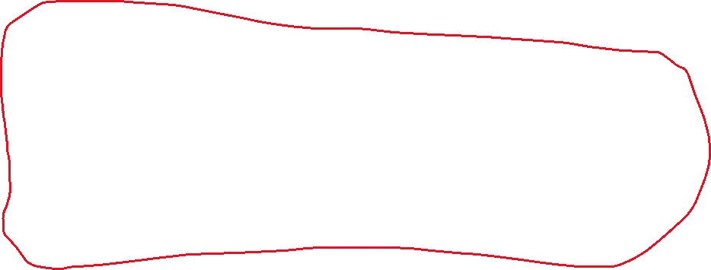
Highest PER capita VAERS death reports
Notes:
Where it gets interesting is if we look at the states with the highest number of VAERS claims per capita.
Hypothesis: if there are a lot of vaccine-related deaths, and especially if this is occurring in working ages with low background mortality, then this may spill into excess mortality calculations

Slide 14
Highest raw count of VAERS death reports

Slide 15
Excess Mortality% vs. per capita VAERS Deaths

Slide 16
Excess Mortality% vs. total count of VAERS Deaths

Slide 17
R-squared = 40%

Slide 18
R-squared = 34%

Slide 19
Multivariate Regression R-squared = 58%
SUMMARY OUTPUT
Regression Statistics
Multiple R | 0.759182
R Square | 0.576357
Adjusted R Square | 0.482215
Standard Error | 0.241561
Observations | 12
ANOVA
 | df | SS | MS
Regression | 2 | 0.714476 | 0.357238
Residual | 9 | 0.525165 | 0.058352
Total | 11 | 1.239641
 | Coefficients | Standard Error | t Stat
Intercept | 0.885892 | 0.412907 | 2.145502
Fully Vaccinated as of 6/30/21 | -1.6792 | 0.748295 | -2.24403
3Q Vaers Death Reports | 0.002153 | 0.001124 | 1.91526

Slide 20
Key Conclusion
Starting Q3 2021, being employed became a mortality risk relative to not being employed (e.g. relative to the overall US population).
Higher vaccination rates:
Associated with lower excess mortality
Higher VAERS Death reports:
Associated with higher excess mortality

Slide 21
But higher vaccination NOT related to higher VAERS deaths

Slide 22
Follow-up Questions
Does toxicity vary by lot? By month?
Are specific lots shipped to specific geographic zip codes?
Do people in the SE have higher contraindications to vaccine adverse effects? Other diseases?

Slide 23
3Q 2021 VAERS Deaths
Notes:
Huge variation

Slide 24
Summary of Results, cont.
This analysis limited to 3Q 2021 (due to current data availability from Society of Actuaries).
4Q 2021 had dramatically higher single-state VAERS death totals than any prior quarter.

Slide 25
United States
Notes:
Dowloaded from CDC wonder.cdc.gov on February 18, 2022
Total Deaths from
26008
COVID19 (COVID19 (PFIZER-BIONTECH)) 1200 16996
COVID19 (COVID19 (MODERNA)) 1201 6775
COVID19 (COVID19 (JANSSEN)) 1203 2134

Slide 26
California

Slide 27
New York

Slide 28
Pennsylvania

Slide 29
Ohio

Slide 30
Florida

Slide 31
Georgia

Slide 32
Kentucky

Slide 33
Texas

Slide 34
Tennessee
September, 2021
October, 2021
January, 2022

Slide 35
Michigan
December, 2021
January, 2022

Slide 36
Top single-state reported VAERS deaths – by month
Vaccine | Vaccine Code | Month Reported |  | State | state code | Events
COVID19 (COVID19 (PFIZER-BIONTECH)) | 1200 | 11/1/2021 | 11/1/2021 | Kentucky | 21 | 94
COVID19 (COVID19 (PFIZER-BIONTECH)) | 1200 | 1/1/2022 | 1/1/2022 | Texas | 48 | 86
COVID19 (COVID19 (PFIZER-BIONTECH)) | 1200 | 9/1/2021 | 9/1/2021 | Texas | 48 | 78
COVID19 (COVID19 (PFIZER-BIONTECH)) | 1200 | 9/1/2021 | 9/1/2021 | Kentucky | 21 | 68
COVID19 (COVID19 (PFIZER-BIONTECH)) | 1200 | 10/1/2021 | 10/1/2021 | Kentucky | 21 | 68
COVID19 (COVID19 (PFIZER-BIONTECH)) | 1200 | 8/1/2021 | 8/1/2021 | Texas | 48 | 65
COVID19 (COVID19 (PFIZER-BIONTECH)) | 1200 | 10/1/2021 | 10/1/2021 | Texas | 48 | 62
COVID19 (COVID19 (PFIZER-BIONTECH)) | 1200 | 9/1/2021 | 9/1/2021 | Georgia | 13 | 58
COVID19 (COVID19 (PFIZER-BIONTECH)) | 1200 | 12/1/2021 | 12/1/2021 | Kentucky | 21 | 58
COVID19 (COVID19 (MODERNA)) | 1201 | 12/1/2021 | 12/1/2021 | Michigan | 26 | 56
COVID19 (COVID19 (PFIZER-BIONTECH)) | 1200 | 8/1/2021 | 8/1/2021 | Florida | 12 | 54
COVID19 (COVID19 (MODERNA)) | 1201 | 10/1/2021 | 10/1/2021 | Kentucky | 21 | 54
COVID19 (COVID19 (MODERNA)) | 1201 | 9/1/2021 | 9/1/2021 | Kentucky | 21 | 53
COVID19 (COVID19 (MODERNA)) | 1201 | 3/1/2021 | 3/1/2021 | California | 06 | 51
COVID19 (COVID19 (PFIZER-BIONTECH)) | 1200 | 6/1/2021 | 6/1/2021 | Washington | 53 | 51
COVID19 (COVID19 (MODERNA)) | 1201 | 1/1/2022 | 1/1/2022 | Michigan | 26 | 47
COVID19 (COVID19 (PFIZER-BIONTECH)) | 1200 | 8/1/2021 | 8/1/2021 | Tennessee | 47 | 47
COVID19 (COVID19 (MODERNA)) | 1201 | 10/1/2021 | 10/1/2021 | Georgia | 13 | 45
COVID19 (COVID19 (MODERNA)) | 1201 | 1/1/2022 | 1/1/2022 | Texas | 48 | 45
COVID19 (COVID19 (PFIZER-BIONTECH)) | 1200 | 2/1/2022 | 2/1/2022 | Texas | 48 | 45
COVID19 (COVID19 (PFIZER-BIONTECH)) | 1200 | 10/1/2021 | 10/1/2021 | Georgia | 13 | 42
COVID19 (COVID19 (PFIZER-BIONTECH)) | 1200 | 7/1/2021 | 7/1/2021 | Kentucky | 21 | 42
COVID19 (COVID19 (PFIZER-BIONTECH)) | 1200 | 9/1/2021 | 9/1/2021 | Tennessee | 47 | 42
COVID19 (COVID19 (PFIZER-BIONTECH)) | 1200 | 4/1/2021 | 4/1/2021 | California | 06 | 41
COVID19 (COVID19 (PFIZER-BIONTECH)) | 1200 | 1/1/2022 | 1/1/2022 | Michigan | 26 | 41
COVID19 (COVID19 (PFIZER-BIONTECH)) | 1200 | 12/1/2021 | 12/1/2021 | Wisconsin | 55 | 41
COVID19 (COVID19 (MODERNA)) | 1201 | 3/1/2021 | 3/1/2021 | Illinois | 17 | 40
COVID19 (COVID19 (MODERNA)) | 1201 | 12/1/2021 | 12/1/2021 | Kentucky | 21 | 40
COVID19 (COVID19 (MODERNA)) | 1201 | 10/1/2021 | 10/1/2021 | Tennessee | 47 | 38
COVID19 (COVID19 (PFIZER-BIONTECH)) | 1200 | 1/1/2022 | 1/1/2022 | Wisconsin | 55 | 38
COVID19 (COVID19 (MODERNA)) | 1201 | 8/1/2021 | 8/1/2021 | Florida | 12 | 37

Slide 37
Geography, Time and Employment-status risks:
Concentrated in SE
Concentrated in 3Q2021
Concentrated in employed, working age adults.
Majority of excess mortality not explained by COVID
SOA hypothesized factors:
Climate differences
Social practices (masking, social distancing)

Slide 38
Follow up questions demanding investigation:
Positive correlation between (# of deaths reported to VAERS by month) and (Excess mortality) in the Southeast states.
Not just a direct function of vaccination rate.
Heterogeneous properties of vaccines that vary by region and time period.
Does toxicity vary by lot?
Is there a serious quality control issue here?

Slide 39
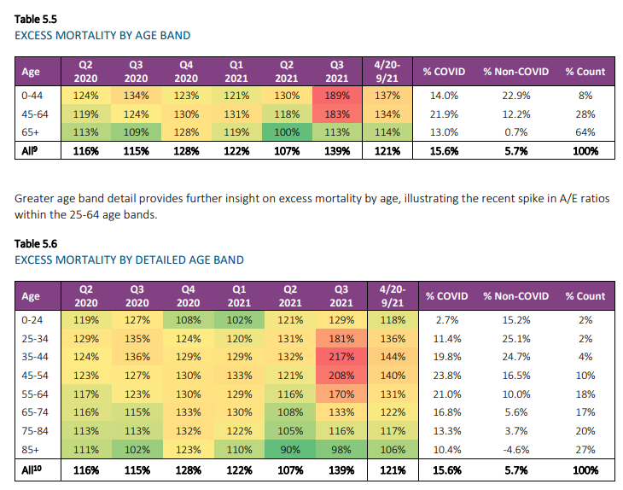
Age based excess mortality
Notes:
Here it gets very interesting…we see that it is primarily the working age adults (but not 0-24) driving this.

Slide 40
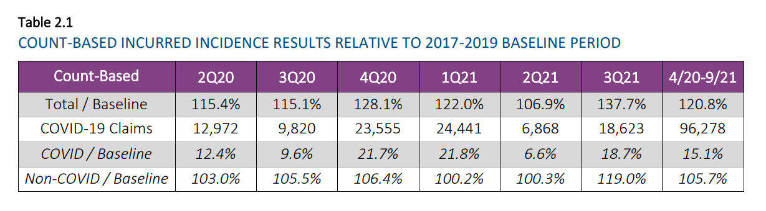
Baseline – Excess Mortality using “Counts” (e.g. count of number of group life claims)
SOURCE: https://www.soa.org/globalassets/assets/files/resources/research-report/2022/group-life-covid-19-mortality.pdf
Notes:
We can see that since 2Q2021, excess mortality has been positive, which means that actual mortality has exceeded expected mortality. The SOA breaks this down into COVID and non-COVID, and we can see that up through 2Q2021 most of the excess mortality was approximately the same magnitude as the COVID/baseline. One interpretation is that without COVID, overall mortality was about what we expected, and the COVID deaths contributed to excess mortality almost one-for-one.

Slide 41
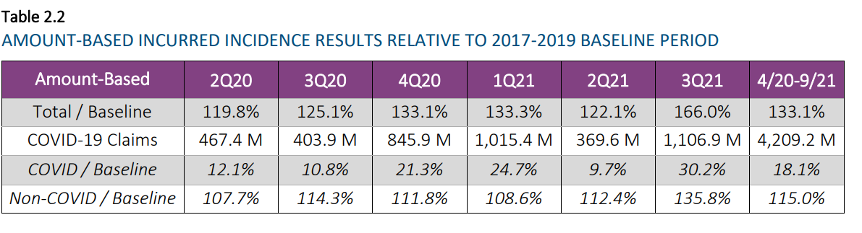
Baseline – “Amounts” or dollar value
Notes:
Here, we can see excess mortality again spikes in 3Q2021. The excess in “amounts” is larger than the excess in “counts”, which all else equal suggests that the excess mortality was not randomly distributed among the working population but skewed toward higher wage earners, perhaps managerial / professionals.

Slide 42
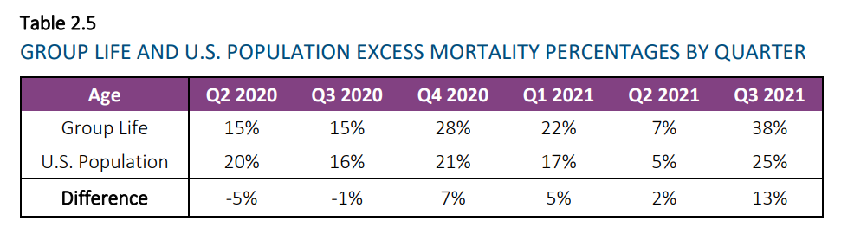
Group Life vs. US Population
Notes:
In 3Q 2021, the Excess mortality for group life dramatically exceeded that of the overall US population. The Q3 group numbers are preliminary, but this suggest that being fully employed became a risk factor in 3Q2021.

Slide 43
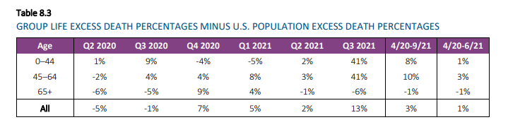
Excess mortality by ages
Notes:
Being of working age actually became a mortality risk.

Slide 44
Final take-away
Higher vaccination = lower excess mortality
Higher vaccination rates ≠ Higher VAERS reports
Higher VAERS deaths = higher excess mortality
Does NOT prove that vaccine deaths (proxied for by VAERS death reports) are causing all excess mortality.
DOES suggest that VAERS deaths are not uniformly or randomly distributed, and DOES suggest that in clusters where VAERS deaths are high, excess mortality among working age adults is also high.

