Slide 1
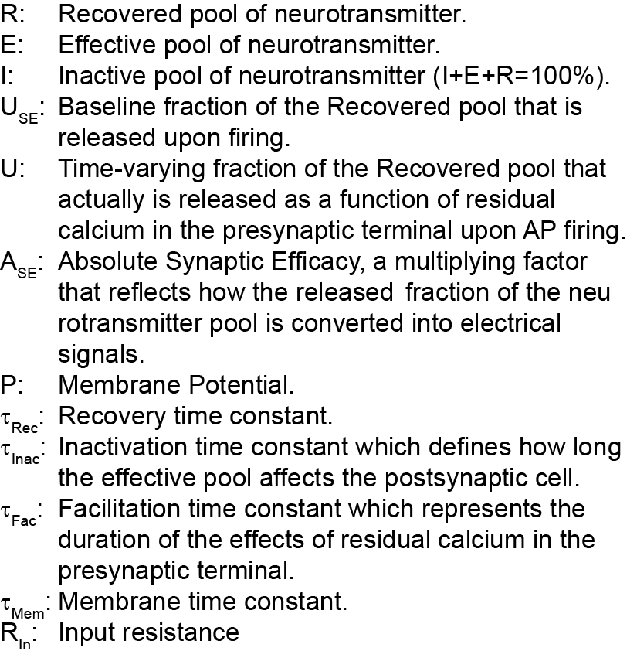
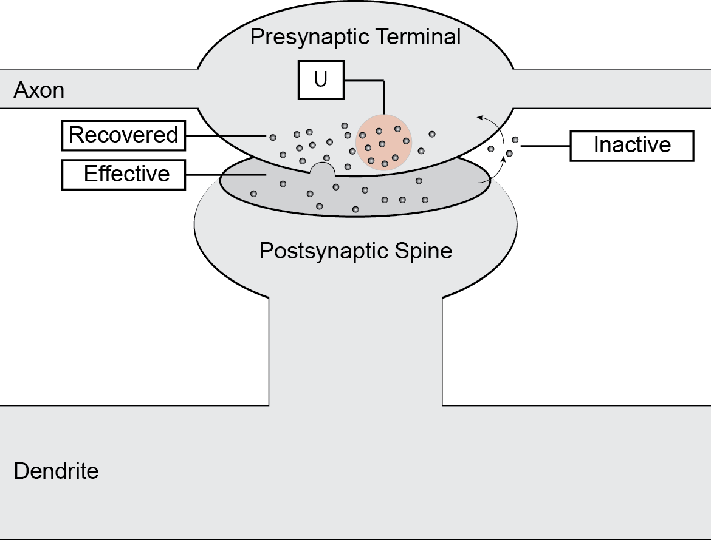
Tsodyks-Markram model of STP
Tsodyks and Markram, PNAS, 1997

Slide 2
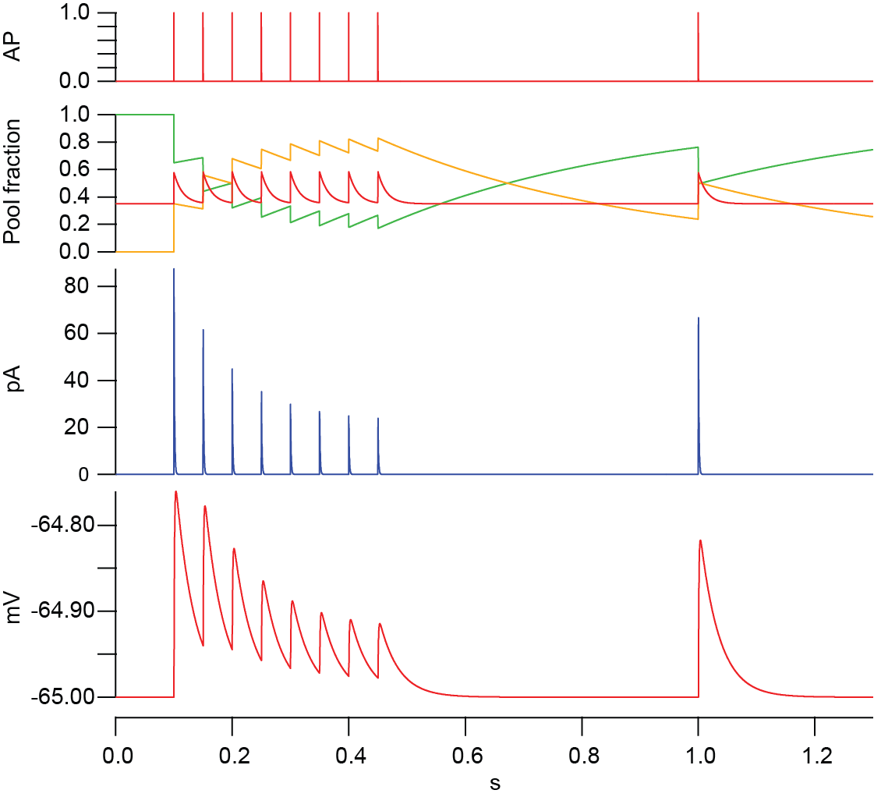
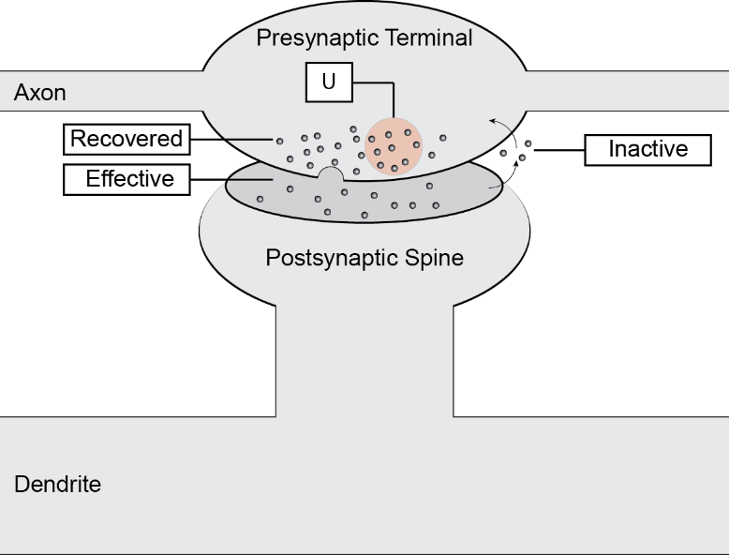
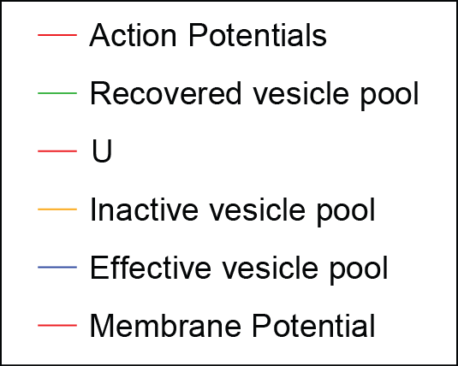
Tsodyks Markram Model of STP
R[0]=1
E[0]=0
P[0]=0
U[0]=Use
for (i=1; i<tf; i+=1)
R[i] = R[i-1]+ dx*(1-R[i-1]-E[i-1])/Trec - U[i-1]*R[i-1]*AP[i-1]
E[i] = E[i-1] - dx*E[i-1]/Tinac + U[i-1]*R[i-1]*AP[i-1]
U[i] = U[i-1] -dx*(U[i-1]-Use)/Tfac+Use*(1-U[i-1])*AP[i-1]
P[i] = P[i-1] +dx*(Rin*Ase*E[i-1] - P[i-1])/TauMem
endfor

