Slide 1
Introduction to Functional Programming with F#
Scott Wlaschin
Notes:
Based on http://fsharpforfunandprofit.com/series/why-use-fsharp.html

Slide 2
Overview of today
Basic syntax
Thinking functionally
Algebraic types
Lunch
Designing for correctness
A complete use-case

Slide 3
Goals
Demystify functional programming
Show you some new ways of thinking about code
Have fun
Blow your mind a few times

Slide 4

Warning
Exploding heads

Slide 5
Myths about functional programming

Slide 6
Object oriented programming is easy
Factory
Singleton
Observer
Visitor
Decorator
Facade

Slide 7
Functional programming is scary
Functor
Currying
Catamorphism
Applicative
Monad
Monoid

Slide 8
FP languages are useful in the real world
Not just for parallelism
Not just for mathematical tasks
Not just for PhDs in computer science
Good for general business apps
Good for games
Good for utilities
Good for clear expression of requirements

Slide 9
How to learn functional programming
A completely different way of thinking about programming
Have a beginners mind
Don’t complain that it is not like what you already know
no variables, no loops, no objects
Be prepared for your brain to hurt (for a while)

Slide 10
Four things that are very different
Function-oriented
Not object oriented
Expressions
rather than statements
Have to learn them all at the same time! ☹
Algebraic Types
for domain models
Pattern matching
for control flow

Slide 11
Why use F#?

Slide 12
Why use F#?
Conciseness
Convenience
Correctness
Concurrency
Completeness
Fun!!!

Slide 13
Simple function in C#
public static class SumOfSquaresHelper
{
public static int Square(int i)
{
return i * i;
}
public static int SumOfSquares(int n)
{
int sum = 0;
for (int i = 1; i <= n; i++)
{
sum += Square(i);
}
return sum;
}
}
Simple function in F#
let square x = x * x
let sumOfSquares n =
[1..n] |> List.map square |> List.sum

Slide 14
Conciseness
No coding "noise”
Type inference
Explicit type annotations are rare!
Takes fewer lines of code to solve the same problem

Slide 15
Class definition in C#
class PersonalName
{
public PersonalName(string firstName, string lastName)
{
this.FirstName = firstName;
this.LastName = lastName;
}
public string FirstName { get; private set; }
public string LastName { get; private set; }
}
Type definition in F#
type PersonalName = {FirstName:string; LastName:string}

Slide 16
Equality in C#
class PersonalName
{
public override int GetHashCode()
{
return this.FirstName.GetHashCode() +
this.LastName.GetHashCode();
}
public override bool Equals(object other)
{
return Equals(other as PersonalName);
}
public bool Equals(PersonalName other)
{
if ((object) other == null)
{
return false;
}
return FirstName == other.FirstName &&
LastName == other.LastName;
}
Equality in F#
← nothing to do

Slide 17
Convenience
Complex type definitions in one line
Comparison and equality for free
List processing
Reusable code using functions as parameters
Combine existing functions to create new functionality

Slide 18
Correctness
A powerful type system which prevents many common errors
Values are immutable by default
You can often encode business logic using the type system itself
Yes, really

Slide 19
Concurrency
Asynchronous programming is very easy
Built-in actor model
Excellent support for event handling and functional reactive programming
Sharing state and avoiding locks is much easier because of immutability
Won’t cover today

Slide 20
Completeness
F# supports styles which are not 100% pure
F# can do virtually everything that C# can do
F# is part of the .NET ecosystem
Integrated with Visual Studio

Slide 21
Coding: Part 1a
Basic Syntax

Slide 22
Coding Part 1a - Review
Printing
Let
Simple functions
Piping
Passing in a function as a parameter

Slide 23
Time in coding vs. testing (C# vs. F#)

Slide 24
Collections
Lists, sequences and arrays

Slide 25
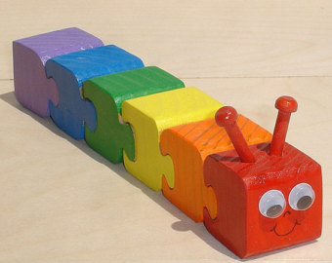
Lists
Can only add/remove at head
Immutable
Written with square brackets:
let myList = [1;2;3]

Slide 26

Sequence
Lazy – only get what you need as you need it
Same as IEnumerable
Written with curly braces:
let mySeq = seq { yield 1; yield 2}

Slide 27
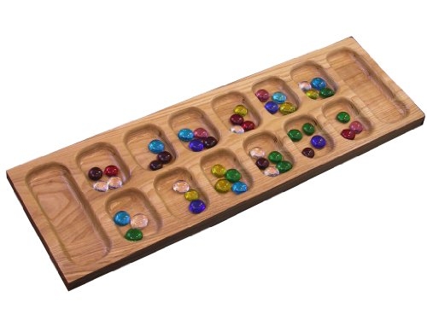
Array
Direct access to slots
Mutable (read/write)
Square brackets plus bar:
let myArr = [| 1;2;3 |]

Slide 28
Other available collection types
ResizeArray (same as List<T>)
map
set
Plus all .NET collections such as Dictionary

Slide 29
Lists
1
2
3
[]
[]
3::[]
1::2::3::[]
2::3::[]

Slide 30
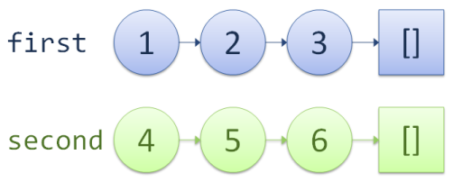
Lists

Slide 31
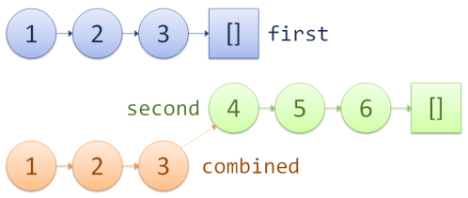
Lists

Slide 32
Coding: Part 1b
Lists, sequences and arrays

Slide 33
Coding Part 1b - Review
Lists, sequences
Filter, map, sortBy, reduce
Google for “msdn list module”

Slide 34
Extracting boilerplate
Using functions as parameters

Slide 35
Loops in C#
public static int Product(int n)
{
int product = 1;
for (int i = 1; i <= n; i++)
{
product *= i;
}
return product;
}
public static int SumOfOdds(int n)
{
int sum = 0;
for (int i = 1; i <= n; i++)
{
if (i % 2 != 0) { sum += i; }
}
return sum;
}

Slide 36
Extracting the logic
Function | Initial value | Inner loop logic
Product | product=1 | Multiply the i'th value with the running total
SumOfOdds | sum=0 | Add the i'th value to the running total if not even

Slide 37
Introducing “fold”
let product n =
let initialValue = 1
let action productSoFar x =
productSoFar * x
[1..n] |> List.fold action initialValue
//test
product 10
let sumOfOdds n =
let initialValue = 0
let action sumSoFar x =
if x%2=0 then sumSoFar else sumSoFar+x
[1..n] |> List.fold action initialValue
//test
sumOfOdds 10

Slide 38
Coding: Part 1c
Using functions as parameters

Slide 39
Review so far
Concise
Interactive
Syntax for standard types
Piping
Passing in functions
Lists and list functions
Extracting common behaviour into functions

Slide 40
Questions?

