Slide 1
Thinking Functionally
Changing the way you think
Notes:
Based on http://fsharpforfunandprofit.com/series/thinking-functionally.html

Slide 2
Four things that are very different
Function-oriented
Not object oriented
Expressions
rather than statements
Algebraic Types
for domain models
Pattern matching
for control flow

Slide 3
Mathematical Functions
Domain (integers)
Range (integers)
…
-1
0
1
2
3
…
…
0
1
2
3
4
…
Function Add1(x) input x maps to x+1
let add1 x = x + 1
val add1 : int -> int

Slide 4
Key properties of mathematical functions
Domain (integers)
Range (integers)
…
-1
0
1
2
3
…
…
0
1
2
3
4
…
Function Add1(x) input x maps to x+1
A function always gives the same output value for a given input value
A function has no side effects

Slide 5
Same output value for a given input value
Domain (integers)
Range (integers)
…
-1
0
1
2
3
…
int add1(int input)
{
switch (input)
{
case 0: return 1;
case 1: return 2;
case 2: return 3;
case 3: return 4;
etc ad infinitum
}
}
…
0
1
2
3
4
…
Function Add1(x) input x maps to x+1

Slide 6
Free from side effects
x = 5
y = x+1
y is 6 what is x now?

Slide 7
Other domains
Domain (days of week)
Range (hours)
…
Sun MonTue Wed …
int workingHours(int input)
{
switch (input)
{ case Sun: return 0;
case Mon: return 8;
case Tue: return 8;
case Wed: return 8;
etc
}
}
…
0
1
2
3
4
…
Function WorkingHours(x) input Day maps to hours

Slide 8
Functions != mathematical
Domain (customer)
Name (string)
…
Cust1 Cust2 Cust3 Cust3 …
int CustomerName(int input)
{
switch (input)
{ case Cust1: return “Alice”;
case Cust2: return “Bob”;
case Cust3: return “Sue”;
etc
}
}
…
Alice Bob
Sue John
Pam…
Function CustomerName(x) input Customer maps to string

Slide 9
The power of pure functions
Trivially parallelizable
Lazy - only evaluate it when I need the output
Cacheable – same answer every time
No dependencies – I can evaluate them in any order I like

Slide 10
"Unhelpful" properties of mathematical functions
The input and output values are immutable
A function always has exactly one input and one output

Slide 11
Values vs. Variables
Accept some value from the input domain and label it with the name ”x”
let add1 x = x + 1
“Binding”
Refer to the same value later using “x”
add1 5
6 // result is 6
5 + 1 // replace "x" with "5"

Slide 12
Simple values and function values
Simple Value let x = 1
Function Value let add1 x = x + 1

Slide 13
Values vs. Objects
A “value” is just a member of a domain or range
Values have no behaviour
Values are immutable
Changes done by external functions
A “object” is an encapsulation of a data structure …
… with its associated behavior
Objects are expected to have state (that is, be mutable)
All operations that change the internal state must be provided by the object itself (via "dot" notation).

Slide 14
Types and values
All values have a type
Simple values let x = 1
Simple types val aName: type = constant val x : int = 1
Function values let add1 x = x + 1
Function types val functionName : domain -> range val add1 : int -> int

Slide 15
Function Signatures
let add1 x = x + 1
let intToString x = sprintf "%i" x
let stringToInt x = System.Int32.Parse(x)
let isOdd n = (n%2 =1)
String.length
let isTwoCharsLong s = (String.length s = 2)
let intToFloat x = float x

Slide 16
Type annotations
let stringLength x = x.Length
error FS0072: Lookup on object of indeterminate type
let stringLength (x:string) = x.Length
let stringLengthAsInt (x:string) :int = x.Length

Slide 17

What types are available in F#?
Primitive types: int, float, bool, string, etc.
.NET classes: DateTime, Enum, etc.
Built-in F# collections: list, seq, map, etc.
Functions
Unit type
Generics
Algebraic types. Combine existing types in various ways: Tuples, Records, Union types

Slide 18
Function types as parameters
let evalWith5ThenAdd2 fn = (fn 5) + 2
Domain
val evalWith5ThenAdd2 : (int -> int) -> int
Range
let add1 x = x + 1 // define a function of type (int -> int)
evalWith5ThenAdd2 add1 // test it

Slide 19
Functions as output
let adderGenerator numberToAdd = fun x -> x + numberToAdd
val adderGenerator : int -> (int -> int)
val adderGenerator : int -> int -> int
let add1 = adderGenerator 1
let add2 = adderGenerator 2
val add1 : (int -> int)
val add2 : (int -> int)

Slide 20
The unit type
Domain (integers)
Range
…
-1
0
1
2
3
…
?
Function PrintInt(x) input x maps to ?
let printInt x = printf "x is %i" x
val printInt : int -> unit

Slide 21
Unit is not void
let whatIsThis = ()
val whatIsThis : unit = ()
let printHello = printfn "hello world"
val printHello : unit
let printHelloFn() = printfn "hello world"
val printHelloFn : unit -> unit
printHelloFn ()
let add1 x = (x+1) |> ignore
val add1 : int -> unit

Slide 22
Generic types
Notice the tick
let same x = x
val same : 'a -> 'a
let listCount list = List.length list
val listCount : 'a list -> int
List.filter
('a -> bool) -> 'a list -> 'a list
let swap (x,y) = (y,x)
val swap : 'a * 'b -> 'b * 'a
List.map
('a -> 'b) -> 'a list -> 'b list

Slide 23
Generics are type-safe
List.filter filterFn -> input list -> result list ('a -> bool) -> 'a list -> 'a list
let isEven x = (x%2=0)
List.filter isEven [1..10] // OK
List.filter isEven ["hello";"bye"]

Slide 24
Generics are type-safe
List.filter filterFn -> input list -> result list ('a -> bool) -> 'a list -> 'a list
let containsH = String.exists (fun c-> c='h')
List.filter containsH ["hello";"bye"] // OK
List.filter containsH [1..10]

Slide 25
Test your understanding of types
let testA = float 2
let testB x = float 2
let testC x = float 2 + x
let testD x = x.ToString().Length
let testE (x:float) = x.ToString().Length
let testF x = printfn "%s" x
let testG x = printfn "%f" x
let testH = 2 * 2 |> ignore
let testI x = 2 * 2 |> ignore
let testJ (x:int) = 2 * 2 |> ignore
let testK = "hello"
let testL() = "hello"
let testM x = x=x
let testN x = x 1 // hint: what kind of thing is x?
let testO x:string = x 1 // hint: what does :string modify?

Slide 26
Using signatures to find a library function
Say you have two lists and you are looking for a function to combine them into one. What is the signature?
'a list -> 'a list -> 'a list
Say you want to know if any element matches a condition. What is the signature?
('a -> bool) -> 'a list -> bool

Slide 27
How can a function have more than one param?
let printTwoParams x y = printfn "x=%i y=%i" x y
val printTwoParams : int -> int -> unit
printTwoParams 2 3
let printTwoParams x = fun y -> printfn "x=%i y=%i" x y
val printTwoParams : int -> (int -> unit)
printTwoParams 2
(printTwoParams 2) 3

Slide 28
How can a function have more than one param?
let addTwoParams x y = x + y
val addTwoParams : int -> int -> int
addTwoParams 2 3
let addTwoParams x = fun y -> x + y
val addTwoParams : int -> (int -> int)
addTwoParams 2
(addTwoParams 2) 3

Slide 29
Every function is really a one parameter function!
(+)
val (+) : int -> int -> int
2 + 3 (+) 2 3
( (+) 2 ) 3
let add2 = (+) 2
val add2 : int -> int
add2 3

Slide 30
Functions with more than two parameters
let multiParamFn i b s f =
printfn "i=%i. b=%b. s=%s. f=%f" i b s f
multiParamFn 1
multiParamFn 1 true
multiParamFn 1 true "hello"
multiParamFn 1 true "hello" 3.14

Slide 31
Partial application
let add1 = (+) 1
let add1ToEach = List.map add1
add1ToEach [1;2;3;4]
let filterEvens =
List.filter (fun i -> i%2 = 0) // fix the filter function
filterEvens [1;2;3;4]

Slide 32
Designing functions for partial application
Put earlier: parameters more likely to be static
Put last: the data structure or collection (or most varying argument)
For well-known operations such as “subtract”, put in the expected order

Slide 33
Wrapping BCL functions for partial application
let replace oldStr newStr (s:string) =
s.Replace(oldValue=oldStr, newValue=newStr)
let startsWith lookFor (s:string) =
s.StartsWith(lookFor)
let result =
"hello"
|> replace "h" "j"
|> startsWith "j"
["the"; "quick"; "brown"; "fox"]
|> List.filter (startsWith "f")

Slide 34
Coding: Part 2a
Playing with partial application

Slide 35
Partial application suggestions
Write wrappers for System.String replace, startsWith, contains, split, trim
Use partial application to filter and map lists of strings
Find the longest string that contains both “h” and “e”
Split a string into words and find the most frequent word

Slide 36
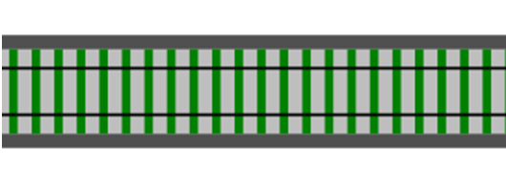
Railway oriented programming
Function domain -> range
Input
Output

Slide 37

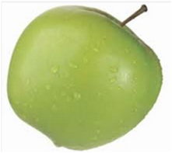

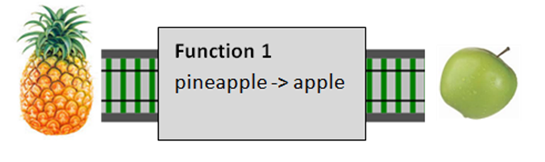
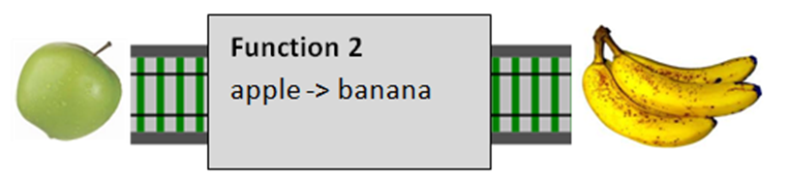
Connecting functions together
Function 1 pineapple -> apple
Function 2 apple -> banana
>>
Composition

Slide 38
Connecting functions together
Combined Function pineapple -> banana

Slide 39
Type-safe connections
>>
☹

Slide 40
Coding: Part 2b
Playing with composition

Slide 41
Stack based calculator
Operation
“1”
“3”
“+”
“2”
“×”
3
2
Stack
Contents
1
1
4
4
8

Slide 42
Pushing on the stack
type Stack = StackContents of float list
let push x (StackContents contents) =
StackContents (x::contents)
val push : float -> Stack -> Stack
let emptyStack = StackContents []
let stackWith1 = push 1.0 emptyStack
let stackWith2 = push 2.0 stackWith1

Slide 43
Pushing on the stack
let ONE stack = push 1.0 stack
let TWO stack = push 2.0 stack
let ONE = push 1.0
let TWO = push 2.0
let THREE = push 3.0
val ONE : (Stack -> Stack)
val TWO : (Stack -> Stack)
val THREE : (Stack -> Stack)
let EMPTY = StackContents []
let stackWith1 = ONE EMPTY
let stackWith2 = TWO stackWith1
let stackWith3 = THREE stackWith2
let result123 = EMPTY |> ONE |> TWO |> THREE
let result312 = EMPTY |> THREE |> ONE |> TWO

Slide 44
Connecting functions together
ONE stack -> stack
TWO stack -> stack
ONE stack -> stack
>>
TWO stack -> stack
Composition

Slide 45
Making a new function
let ONE stack = push 1.0 stack
let TWO stack = push 2.0 stack
let ONE_TWO = ONE >> TWO
val ONE_TWO : (Stack -> Stack)
let result123 = EMPTY |> ONE _TWO |> THREE
let result312 = EMPTY |> THREE |> ONE_TWO

Slide 46
Functions are interfaces
val ONE : (Stack -> Stack)
val TWO : (Stack -> Stack)
val ONE_TWO : (Stack -> Stack)
Any compatible function can go here!
let result123 = EMPTY |> ONE _TWO |> THREE
let result312 = EMPTY |> THREE |> ONE_TWO
interface IStackChanger
{
Stack ChangeStack(Stack input);
}

Slide 47
Popping the stack
let pop (StackContents contents) =
match contents with
| top::rest ->
top
let pop (StackContents contents) =
match contents with
| top::rest ->
let newStack = StackContents rest
(top,newStack)
| [] ->
failwith "Stack underflow"
let pop (StackContents contents) =
match contents with
| top::rest ->
let newStack = StackContents rest
(top,newStack)
val pop : Stack -> float * Stack
let initialStack = EMPTY |> ONE |> TWO
let popped1, poppedStack = pop initialStack
let popped2, poppedStack2 = pop poppedStack

Slide 48
Adding some operations
let ADD stack =
let x,s = pop stack //pop the top of the stack
let y,s2 = pop s //pop the resulting stack
let result = x + y //do the math
push result s2 //push back on the doubly-popped stack
val ADD : stack:Stack -> Stack
let add1and2 = EMPTY |> ONE |> TWO |> ADD
let add2and3 = EMPTY |> TWO |> THREE |> ADD
let MUL stack = ??
let mult2and3 = EMPTY |> TWO |> THREE |> MUL

Slide 49
Connecting functions together
ONE stack -> stack
ADD stack -> stack
ONE stack -> stack
>>
ADD stack -> stack
Composition

Slide 50
Composition rather than piping
let ADD1 = ONE >> ADD
let ADD2 = TWO >> ADD
let ADD4 = ADD2 >> ADD2
EMPTY |> THREE |> ADD1
EMPTY |> THREE |> ADD4

Slide 51
More functions
let DUP stack =
let x,s = pop stack
push x (push x s)
let SQUARE = DUP >> MUL
let CUBE = DUP >> DUP >> MUL >> MUL
EMPTY |> THREE |> SQUARE
EMPTY |> THREE |> CUBE

Slide 52
Thinking Functionally: Review
Every function has one input and one output
Values are not variables
Functions are things!
Can be input to other functions
Can be output from other functions
Function signatures are important
Unit type is not the same as “void”
Generics are very common
Partial application for “baking in” parameters
Composition for combining functions
Composition for designing mini-languages

Slide 53
Questions?

