Slide 1
Handling a complete use case
Error handling in practice
Notes:
Based on http://fsharpforfunandprofit.com/series/a-recipe-for-a-functional-app.html

Slide 2
A simple use case
A user submits some data
Check to see that the name and email are valid.
The appropriate user record in a database is updated with the new name and email.
If the email has changed, send a verification email to that address.
Display the result of the operation to the user.

Slide 3
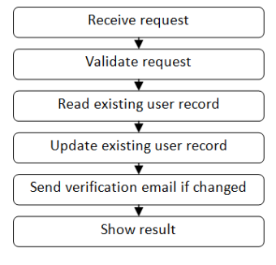
Happy path

Slide 4
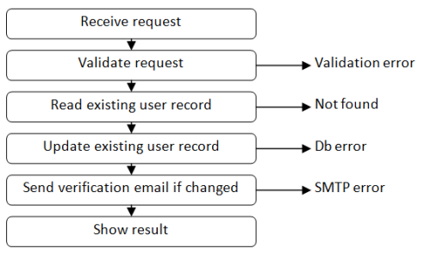
Things that could go wrong

Slide 5
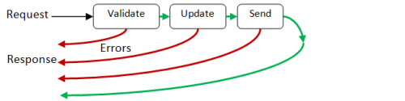
Imperative error handling

Slide 6

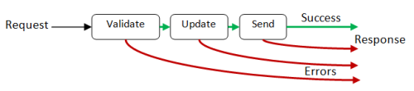
Functional error handling

Slide 7
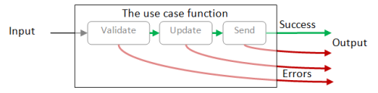
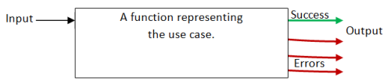
Functional error handling

Slide 8
Output type
type UseCaseResult =
| Success
| ValidationError
| UpdateError
| SmtpError

Slide 9


Simplifying the error handling
type UseCaseResult =
| Success
| Failure

Slide 10


A function that represents a step
type Result<'TSuccess,'TFailure> =
| Success of 'TSuccess
| Failure of 'TFailure

Slide 11
Validation example
type Request = {name:string; email:string}
let validateInput input =
if input.name = "" then Failure "Name must not be blank"
else if input.email = "" then Failure "Email must not be blank"
else Success input // happy path

Slide 12

Connecting the steps

Slide 13

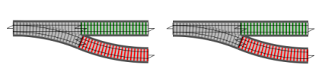


Railway oriented programming

Slide 14



Slide 15



Basic composition

Slide 16
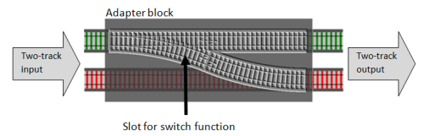
Converting switches to two-track inputs
let bind switchFunction =
fun twoTrackInput ->
match twoTrackInput with
| Success s -> switchFunction s
| Failure f -> Failure f

Slide 17
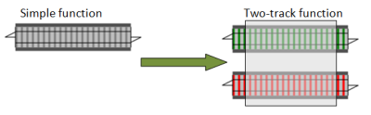
Creating two-track functions from one-track functions
let canonicalizeEmail input = { input with email = input.email.Trim().ToLower() }

Slide 18
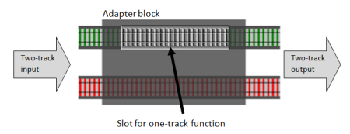
let map oneTrackFunction twoTrackInput =
match twoTrackInput with
| Success s -> Success (oneTrackFunction s)
| Failure f -> Failure f

Slide 19
Coding: Part 5a
Railroad oriented programming

Slide 20
The railway track functions: complete code
// the two-track type
type Result<'TSuccess,'TFailure> =
| Success of 'TSuccess
| Failure of 'TFailure
// convert a single value into a two-track result
let succeed x =
Success x
// convert a single value into a two-track result
let fail x =
Failure x
// apply either a success function or failure function
let either successFunc failureFunc twoTrackInput =
match twoTrackInput with
| Success s -> successFunc s
| Failure f -> failureFunc f

Slide 21
The railway track functions: complete code
// convert a switch function into a two-track function
let bind f =
either f fail
// convert a one-track function into a two-track function
let map f =
either (f >> succeed) fail
// convert a dead-end function into a one-track function
let tee f =
f x; x

Slide 22
Use-case: Review
Success/Failure type
Railroad oriented programming

Slide 23
Questions?

