Slide 1
#bd(g)d
A (brief) worked example of Behavioural Driven Games Development, in a Microsoft.NET environment.

Slide 2
BDD recap
Conversations between:
Developer
Tester
Expert
Gherkin – a shared human readable language
Written requirements
User stories
Specifications by example
Requirements are executable tests:
For acceptance
For regression

Slide 3
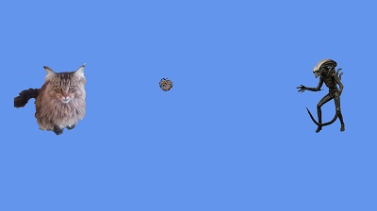
Our game… catte!

Slide 4
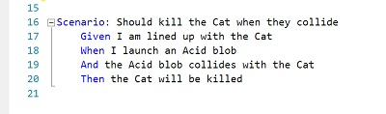
New feature

Slide 5
example

