Slide 1
Python 101
Lecture 3

Slide 2
Dictionaries
A dictionary is a set of key-value pairs
Keys must be unique within a dictionary (No duplicate keys)
Keys must be immutable. Use strings, numbers or tuples as keys.
>>> age = {'Alice':25, 'Bob':25}
>>> age['Alice']
25
>>> purse = {} # purse = dict()
>>> purse['money'] = 12
>>> purse['candy'] = 3
>>> purse['tissues'] = 75
>>> purse
{'money': 12, 'tissues': 75, 'candy': 3}
>>> purse['candy'] # purse.get('candy')
3
>>> purse['candy'] = purse['candy'] + 2
>>> purse
{'money': 12, 'tissues': 75, 'candy': 5}

Slide 3
Dictionaries (cont.)
Displaying Contents:
>>> age = {'Alice' : 25, 'Carol': 'twenty-two'}
>>> list(age.items())
[ ('Alice', 25), ('Carol', 'twenty-two') ]
>>> list(age.keys())
[ 'Alice', 'Carol' ]
>>> list(age.values())
[25, 'twenty-two']
Updating Dictionaries:
>>> age = {'Alice': 26 , 'Carol' : 22}
>>> age.update({'Bob' : 29})
>>> age
{'Bob': 29, 'Carol': 22, 'Alice': 26}
>>> age.update({'Carol' : 23})
>>> age
{'Bob': 29, 'Carol': 23, 'Alice': 26}
>>> age['Alice'] = 27
>>> age
{'Bob': 29, 'Carol': 23, 'Alice': 27}
Removing an item:
>>> age = {'Alice' : 25, 'Carol': 'twenty-two'}
>>> age.pop('Carol')
'twenty-two'
>>> age
{'Alice': 25}
>>> del age['Alice']
>>> age
{}
Test a Key with in
>>> age = {'Alice': 26 , 'Carol' : 22}
>>> 'Alice' in age
True
>>> 'Bob' not in age
True

Slide 4
Sets
A set is an unordered collection of unique elements.
some_numbers = set([2, 1, 3, 3]) same_numbers = set([3, 2, 1]) other_numbers = set([4, 3, 1])
print(some_numbers) # {1, 2, 3} print(some_numbers == same_numbers) Result: ? print(len(some_numbers)) Result: ? print(other_numbers.issubset(some_numbers)) Result: ? print(other_numbers.union(some_numbers)) # {1, 2, 3, 4} print(other_numbers.difference(some_numbers)) # {4} print(5 in some_numbers) # False
some_numbers.add(-5)

Slide 5
Tuples
A tuple is a comma-separated, ordered sequence of immutable elements.
tup1 = ('physics', 'chemistry', 3, 8, 15.2) tup2 = (1, 2, 3, 4) tup3 = 'a', 'b', 'c' tup4 = () tup5 = (50,) a_list = ["15", "25"] tup6 = tuple(a_list) # Convert a list into a tuple (x, y) = (4, 'Maths') # x, y = (4, 'Maths') print(tup2[0]) # 1 print(tup2[-2]) # 3 print(tup2[1:3]) # (2,3) print(len(tup5)) # 1 print(tup2 + tup3) # (1, 2, 3, 4, 'a', 'b', 'c') print(3 in (1, 2, 3)) # True for x in (1, 2): # Iteration over a tuple print(x) print(('a','b') * 3) # ('a', 'b', 'a', 'b', 'a', 'b')

Slide 6
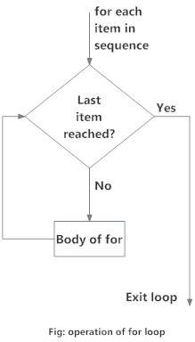
The for loop
Syntax:
for variableName in groupOfValues:
statements
Example:
for i in range(3):
print("Hello!")
print("Good bye!")

Slide 7
range
The range function specifies a range of integers:
range(start, stop)
for i in range(2, 4): print(i)
range(start, stop, step)
for i in range(2, 17, 3): print(i)
range(stop)
for i in range(17): print(i)

Slide 8
Loops with List
movie_list = [ “Mad Max”, “Interstellar”, “Taxi Driver”, “Whiplash”, “The Prestige” ]
for i in range(len(movie_list)):
print(movie_list[i])
for m_name in movie_list:
print(m_name)

Slide 9
for vs while
Iteration based
Only increment / decrement
Specific range → Safe
Automatic iterator initialization
for i in range(1,10,2): print(i**2)
for ch in ‘hello’: print(ch)
for color in [‘blue’,’red’]: print(color)
for n in range(10): if n % 3 == 0: continue else:
print(n)
Condition(s) based
Any type of operations on iterator
Infinite loops possible → Dangerous
Manual iterator initialization
while True: if … : # Exit condition break
x = 2 while x <= 20: print(x) x = x**2 x = 20
y = 1
while x > 5 and y < 8:
x /= 2
y *= 3 print(x+y)

Slide 10
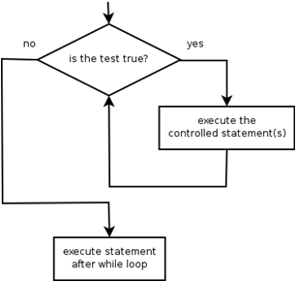
The while loop
while loop: Executes a group of statements as long as a condition is True.
good for indefinite loops (repeat an unknown number of times)
Syntax:
while condition:
Statements
Example:
number = 1
while number < 200:
print(number)
number = number * 2
Output:
1 2 4 8 16 32 64 128
Notes:
infinite loop; 1 == 1, or simply True

Slide 11
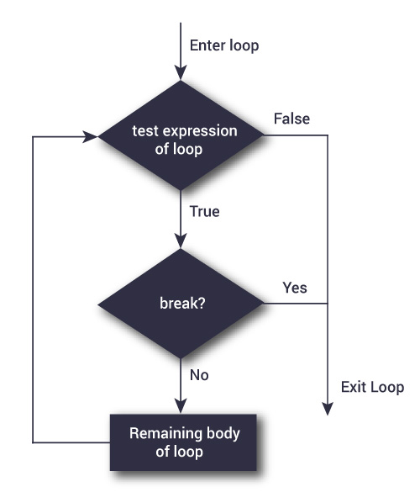
break
while test_expression:
#code inside while loop
if condition:
break
#code inside while loop
#code outside while loop
for var in sequence:
#code inside for loop
if condition:
break
#code inside for loop
#code outside for loop
Notes:
break scenario: searching for an element with certain property

Slide 12
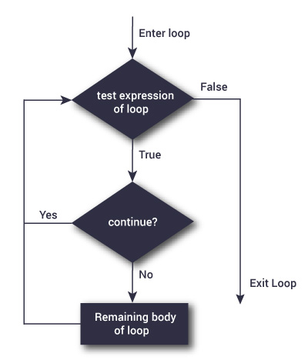
continue
while test_expression:
#code inside while loop
if condition:
continue
#code inside while loop
#code outside while loop
for var in sequence:
#code inside for loop
if condition:
continue
#code inside for loop
#code outside for loop
Notes:
continue scenario: ignoring elements with certain property

Slide 13
Examples of break and continue
# Use of break statement inside loop
for val in "hello":
if val == "l":
break
print(val)
print("The end")
# Use of continue statement inside loop
for val in "hello":
if val == "l":
continue
print(val)
print("The end")

Slide 14
Exercises

Slide 15
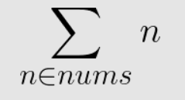
Sum of list
Write a Python program which calculates sum of the elements of a given list.
nums = [8, 60, 43, 55, 25, 134, 1]

Slide 16
Employees
Assume that there is a company with 5 employees.
Assume that each employee has a different name.
Take each employee’s name and salary from the user, and store them in a dictionary “employees”.
Print the names of the employees with the highest three salaries.

