Slide 1

Find A Tour !!
Easiest way to travel!!

Slide 2


For Whom ?
No matter who you are either tourist or tour guide!

Slide 3

The Problem according to Customer
Expensive Tours

Slide 4

The Problem according to Tour Guide
Everybody gains expect for you

Slide 5
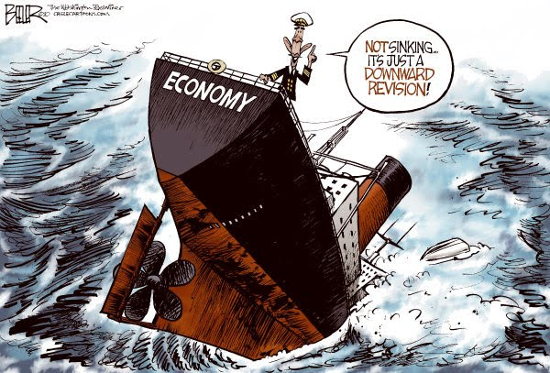
Solution
Throw out the agencies and companies

Slide 6
If You Are a Tour Guide
You can organise a tour that suits your time period
You are independent from agencies and companies
You can decide what you want to present
Of course, you will save your «Real Endorsment»

Slide 7
If You Are a Tourist
You can find out the cheapest tours !!
You are independent from agencies and companies
You can attend the free tours !!

Slide 8
How it work for Tour Guide
Register the app
Create a tour
Go to the Meeting Point on time
Enjoy!!

Slide 9
How it works for Turists
Register the app
List the available tours
Go to the Meeting Point
Enjoy !!

Slide 10

Thank You !!

