Slide 1
Maze Game
Seren SEYVAN
Hakan TONGUR
Serhat CANER

Slide 2
PROBLEM STATEMENTS
There was no beautiful maze game until we made it.

Slide 3
PURPOSE
In this Project, we made a game which is entertaining besides mind developing.
We did not want to make a game which is only solving a maze. Therefore
We tried something new.

Slide 4
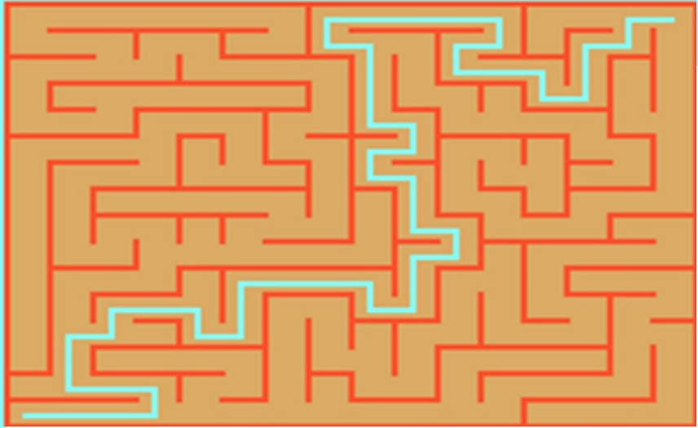
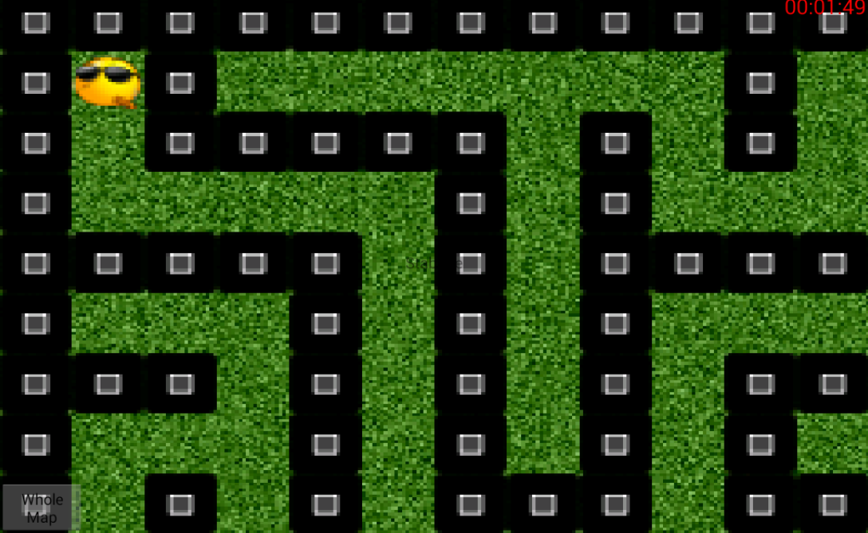
WHY US?
THEIRS→
BUT OURS→

Slide 5
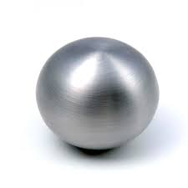
Which characters do you play with the maze game?
THEIRS→
OURS→

Slide 6
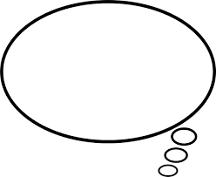


We asked to 25 people which maze game do you want to play?
Of course they chose us

Slide 7
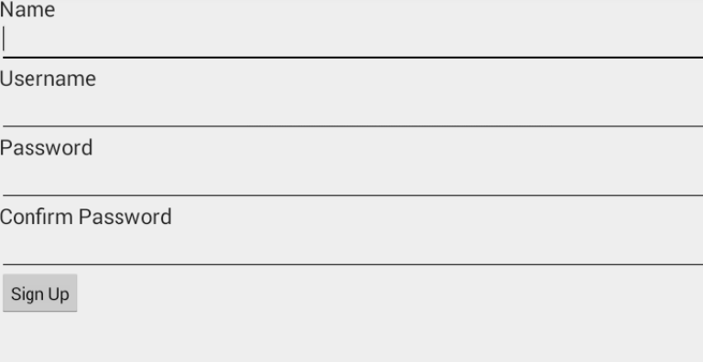
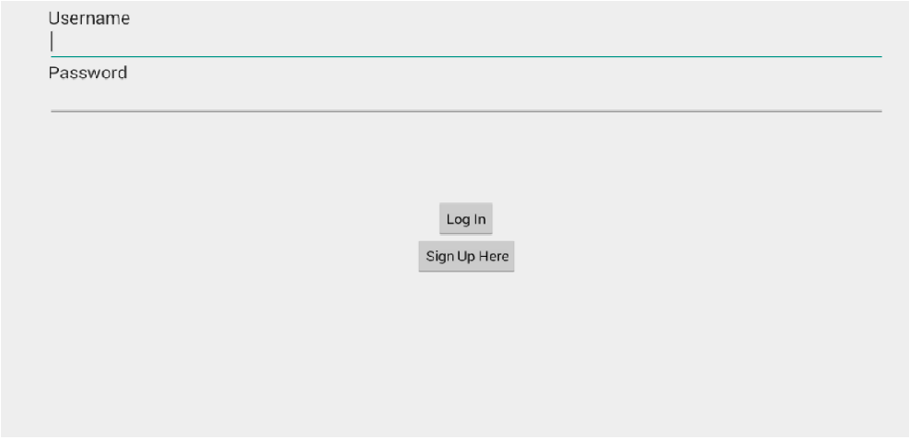
What we did?
In Sprint 1 :
We planned that player play game basicly with 2 levels and only one characters .We only make playable maze game in first sprint.
In Sprint 2 :
In this sprint we planned that make game funnier with some characters and more complicated levels. Also we made registeration and login

Slide 8
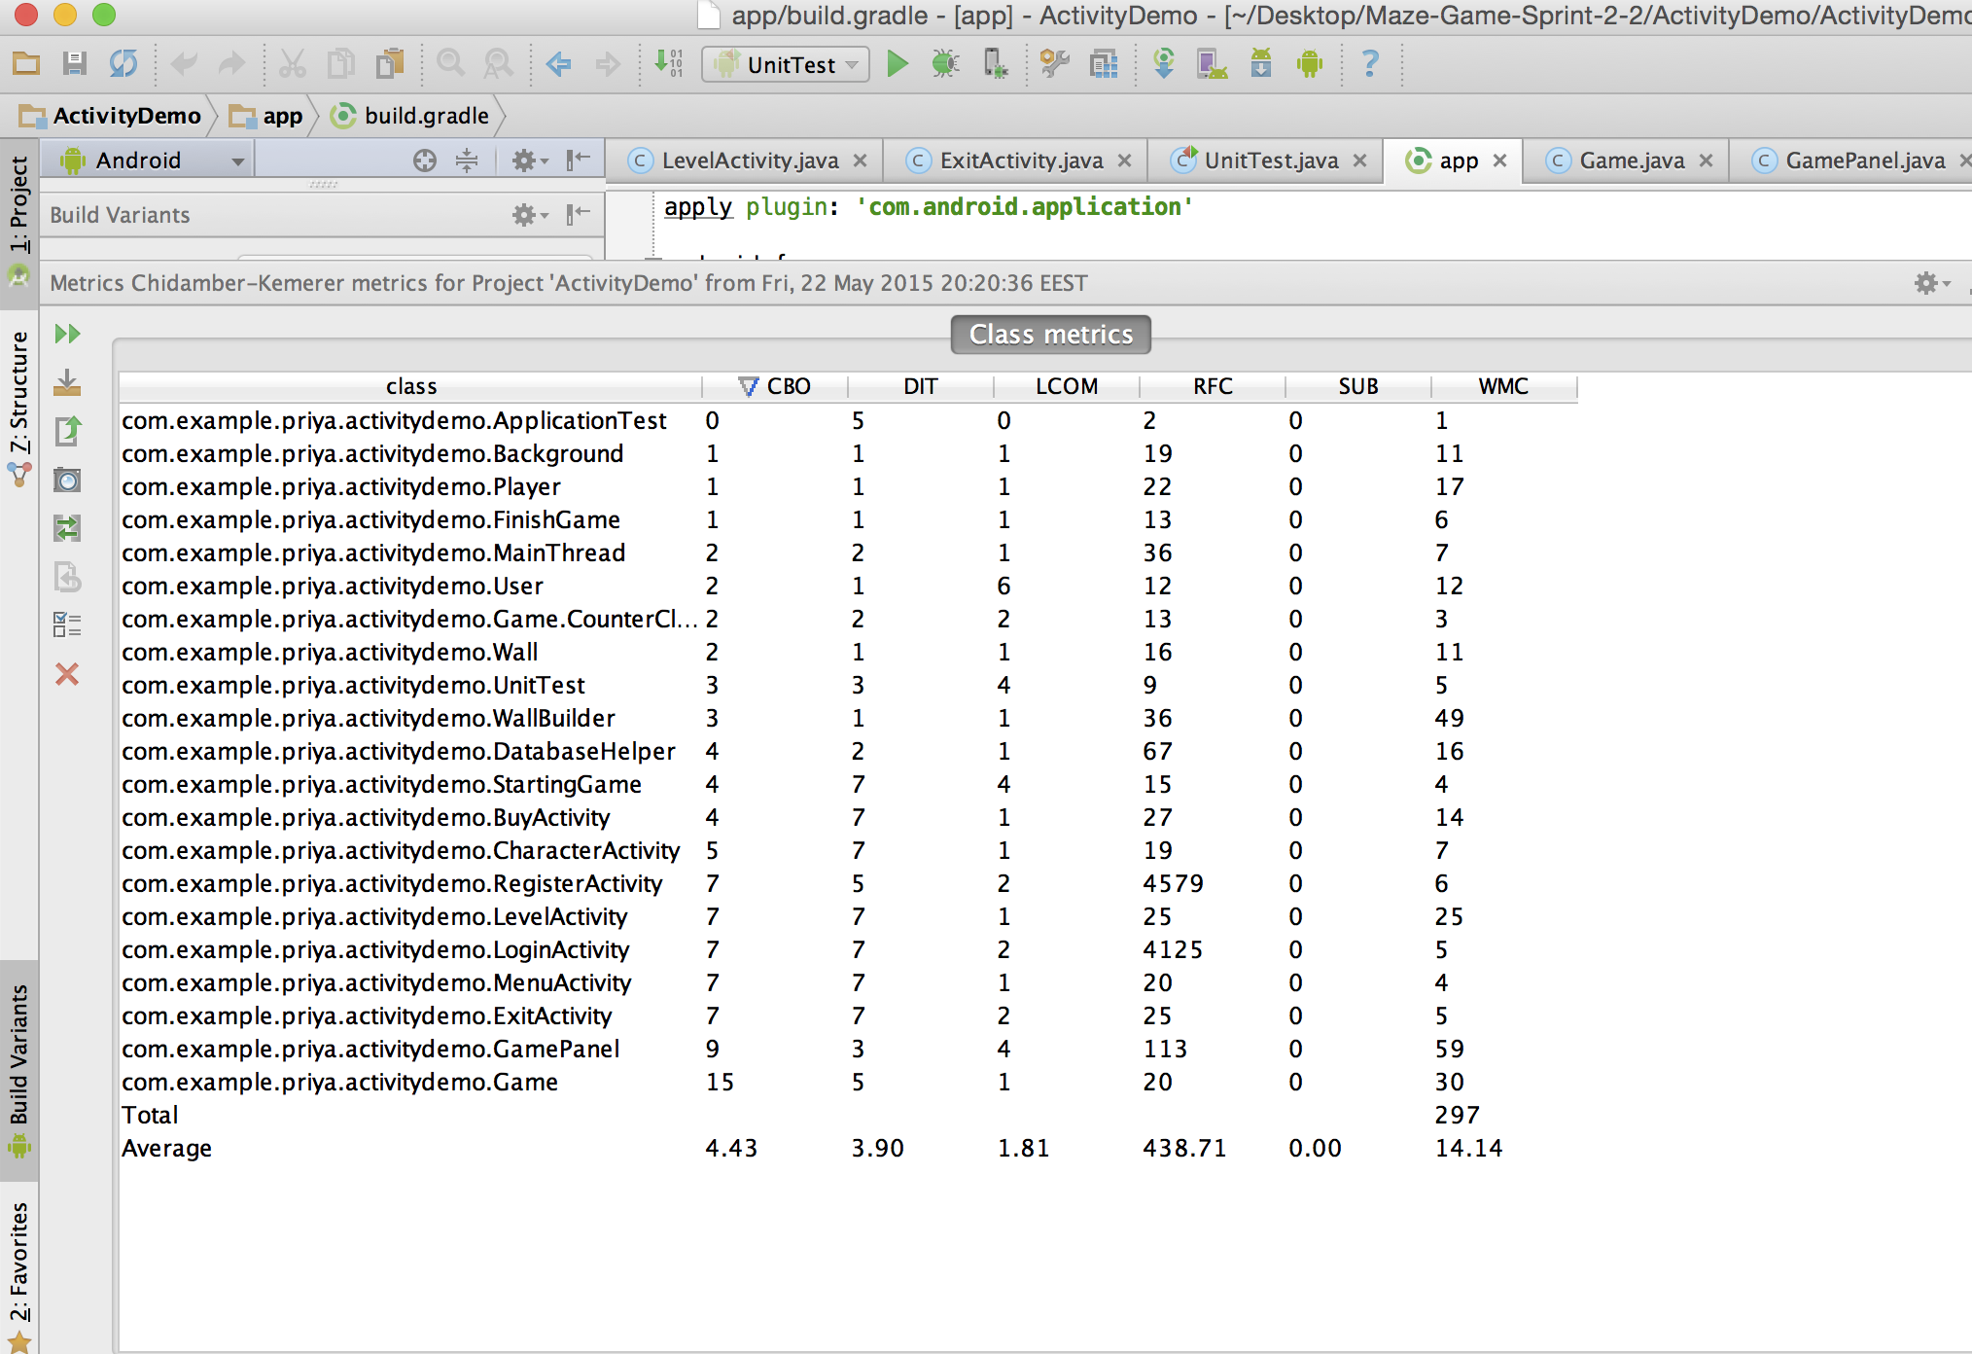
METRICS

Slide 9
STRUCTURE
User Layer
Android Layer
Database Layer

Slide 10
BURNDOWN CHARTS

Slide 11
THANK YOU FOR PAYING ATTENTION

