Slide 1

Website about robotics.

Slide 2
Contents:
Home page
“Comments” page
“Creators” page
“About Us” page
Back-end development

Slide 3
Our team
Ivan Tikhonov (Scrum Trainer)
Nikita Balandin (Front-end developer)
Aleksander Harakchiyski (Front-end developer)
Daniel Hristov (Designer)

Slide 4
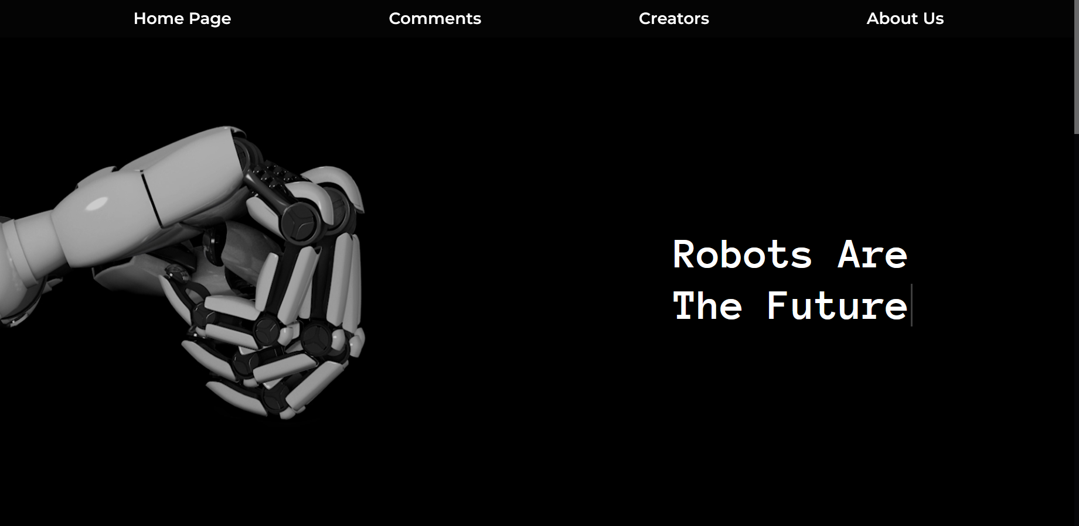
Home page
Home page is the first page the user will see when opening our website. On it you can see an example of an article posted on the website. This page was created by Ivan Tikhonov.

Slide 5
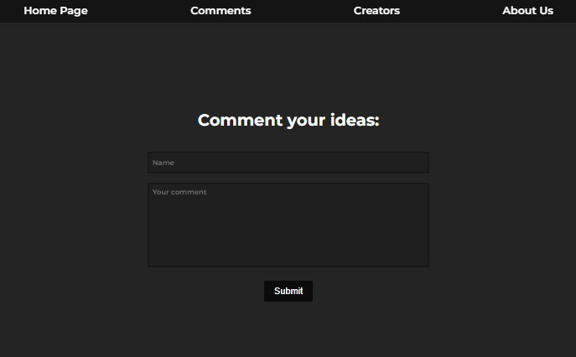
Comments
“Comments” page is a place where the user can leave a comment. This page was created by Aleksander Harakchiyski.

Slide 6
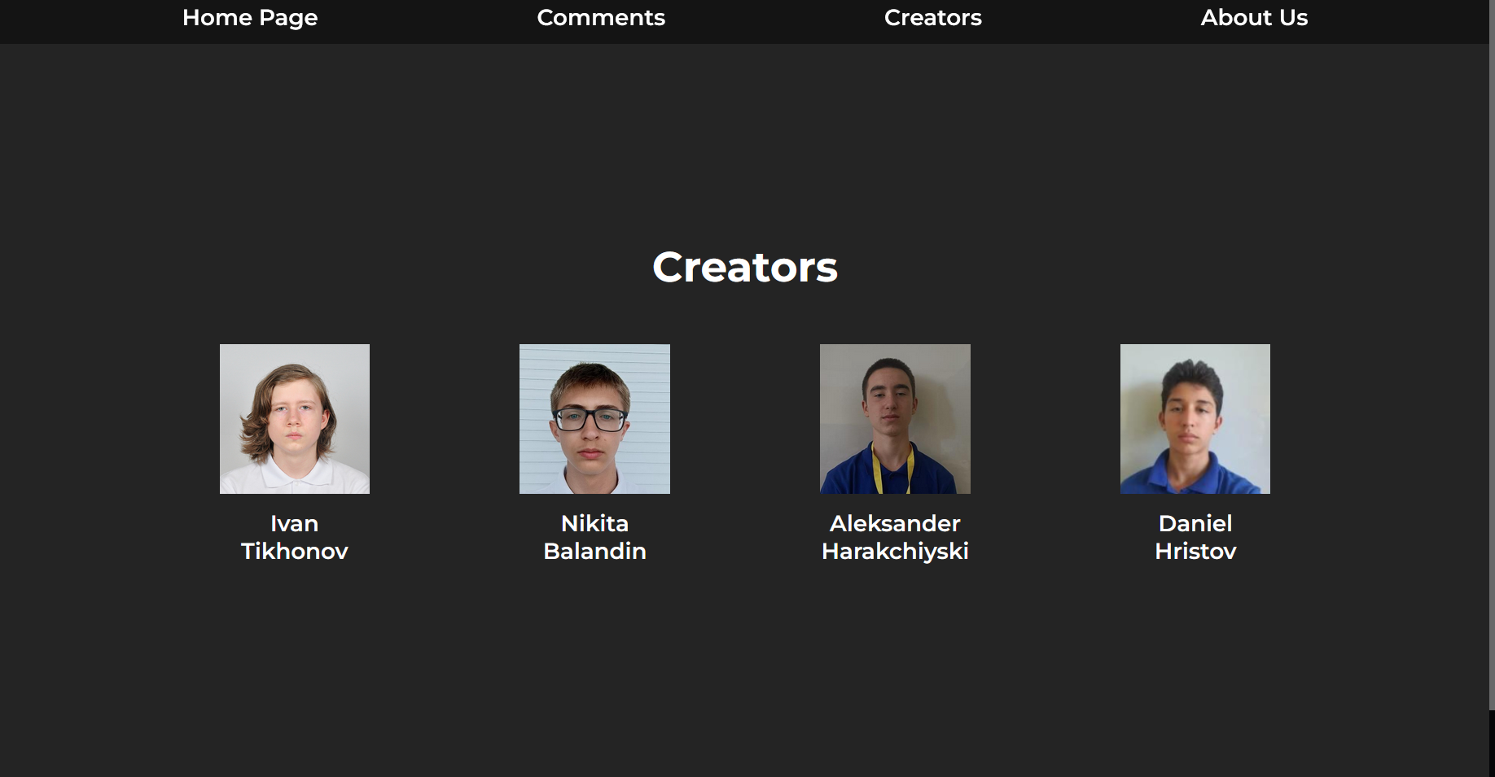
Creators page
On the “Creators” page you can see our team together with our roles in the project (on hover). This page was created by Aleksander Harakchiyski.

Slide 7
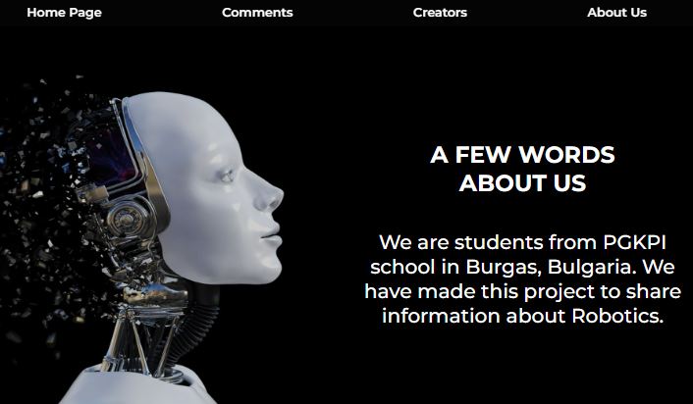
About us page
“About Us” page has some general information about the project and our team. This page was created by Nikita Balandin.

Slide 8
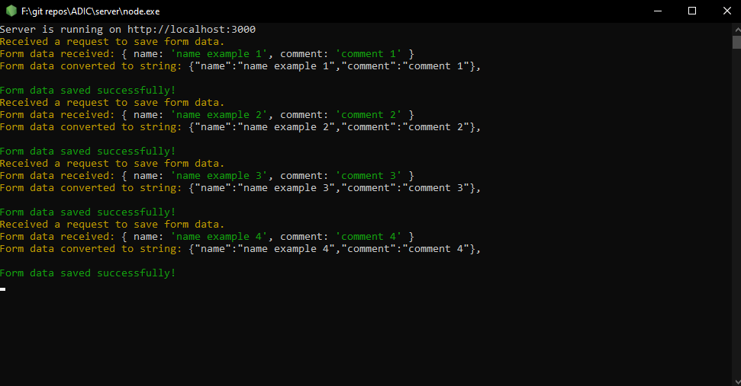
Back-end development
The back-end side of the website allows users to leave comments on the “Comments” page that will then be stored in a text file. The back-end was coded by Ivan Tikhonov.

Slide 9
Used programs and languages
FIGMA
VS CODE
MICROSOFT TEAMS
WORD
POWERPOINT
HTML
CSS
JAVASCRIPT
NODE.JS

Slide 10
Thanks for your attention!

