Slide 1
Case Study on Agile Practices in E-Learning Platforms
Presented by Iyyappan

Slide 2
Case Study Summary
This case study examines the implementation of Agile practices in two e-learning platforms: NeoLearn Technologies and EduFlex Startup.
NeoLearn Technologies aimed to enhance learner engagement through features like a badge system, dashboard, and progress sync.
EduFlex Startup adopted XP Feedback Loops to improve OTP recovery, grading transparency, and quick timetable adaptation.

Slide 3
Model Used
Agile Model for Incremental Development
Extreme Programming (XP) for Continuous Improvement
The Agile model was chosen for its ability to facilitate incremental development and continuous feedback.
Scrum Framework was used for sprint reviews and backlog adaptation, ensuring structured collaboration and transparency.
XP was implemented for feedback loops that drive continuous improvement.
Agile practices ensured flexibility, stakeholder involvement, and adaptability in both scenarios.

Slide 4
Applying Scrum in NeoLearn
The sprint goal was to improve learner engagement through badges, dashboard, and sync features.
Sprint reviews involved the Scrum Master, Product Owner, Developers, and Stakeholders.
The backlog was updated based on feedback, including the addition of a leaderboard and mobile-friendly graphs.

Slide 5
Scrum Outcomes in NeoLearn
Achievements included badges, a redesigned dashboard, and partial sync functionality.
Challenges faced were staging issues and incomplete features.
The next steps involve fixing sync issues, adding a leaderboard, and improving mobile usability.
Transparency and stakeholder alignment were ensured throughout the process.

Slide 6
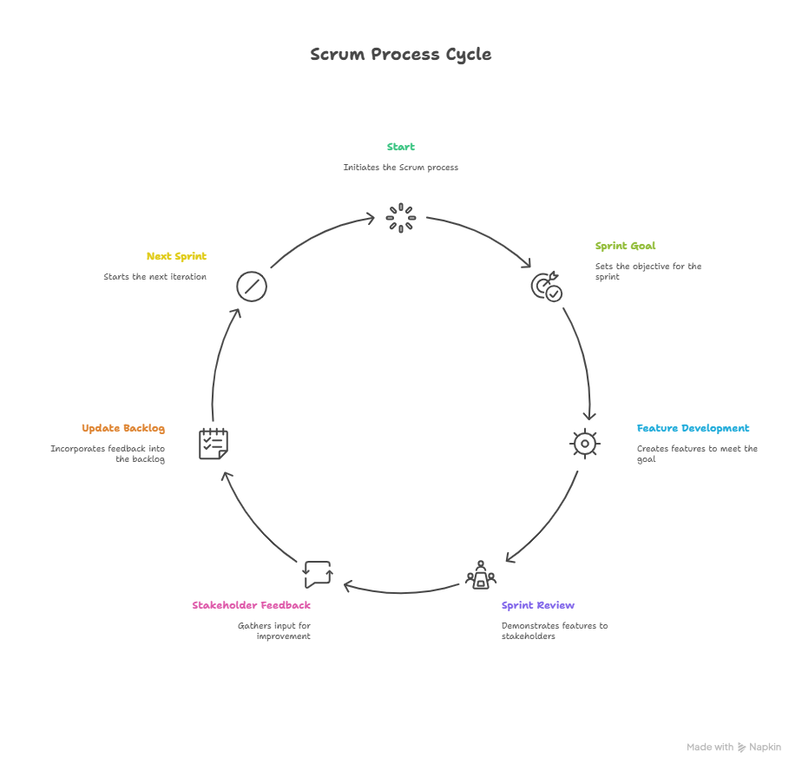

Slide 7
Applying XP Feedback Loops in EduFlex
Unit tests were used for quick bug detection.
Continuous Integration ensured automated stable builds.
Weekly customer demos validated the product.
Student feedback led to usability improvements.
Bi-weekly retrospectives refined the process.

Slide 8
XP Feedback Examples in EduFlex
OTP password recovery was implemented based on student feedback.
Faculty grading concerns were addressed with an explanation button.
The university timetable change was adapted within 2 days.

Slide 9
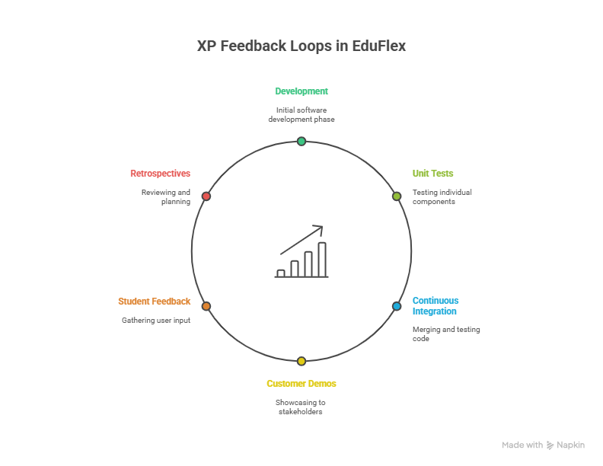

Slide 10
Benefits and Challenges of XP Loops
Benefits
Challenges
Early bug detection improved product quality.
Faculty trust was built through transparency.
Usability was enhanced through iterative improvements.
Conflicting feedback required careful management.
Last-minute changes put pressure on developers.
A balance between speed and stability was necessary.

Slide 11
Conclusion

