Slide 1
Target Tracking and Stabilization using MRAC
Physics-Based 2-DOF Gimbal System | Iram Zubair

Slide 2
Project Overview
Simulated a 2-DOF gimbal system (Pitch & Yaw)
Applied Model Reference Adaptive Control (MRAC) to both axes
Integrated actuator limits and sensor noise
Visualized tracking accuracy, errors, and gain adaptation

Slide 3
Gimbal System Modeling
Pitch and Yaw modeled using rotational inertia and damping
Actuator torque limited to ±1 Nm
Sensor noise added to simulate IMU readings
Reference model is a stable 2nd order system

Slide 4
MRAC Control Strategy
MRAC independently controls pitch and yaw
•Control Law: u = θᵗ·φ where φ = [angle; rate]
Update Rule: θ̇ = -γ·φ·e, γ = 30
Targets tracking performance and adapts in real time

Slide 5
Simulation Setup
• Time: 30s | Step: 0.01s
• Inputs: Sinusoidal commands for pitch & yaw
• Method: Euler integration for plant and reference model
• Noise injected, torque limited, and states recorded

Slide 6
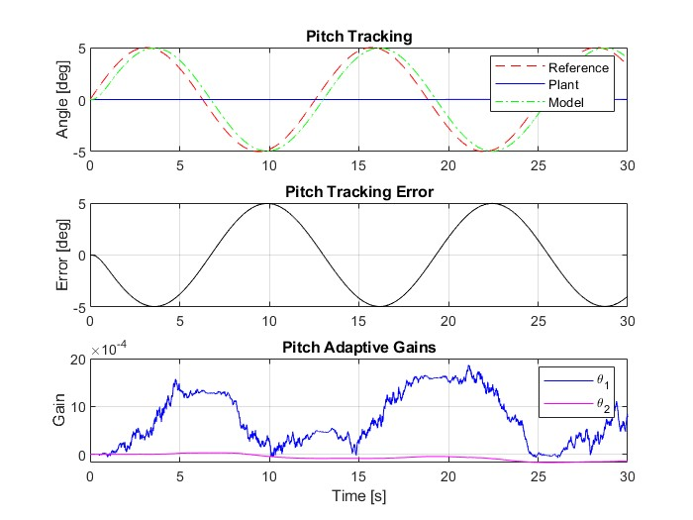
Pitch Axis Results

Slide 7
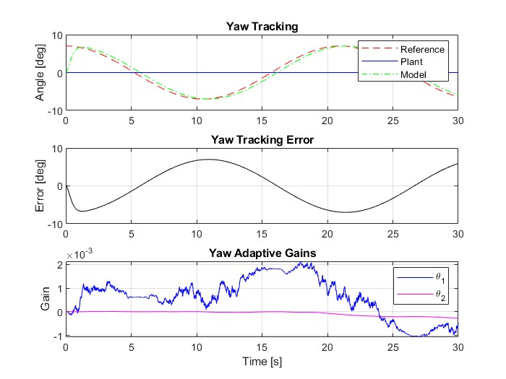
Yaw Axis Results

Slide 8
Key Takeaways
• MRAC enables robust tracking in presence of model uncertainty
• Both axes achieved high accuracy and stability
• Adaptive gains behave smoothly with noise-resilience
• Ideal for real-time EO tracking and stabilization platforms

Slide 9
Contact
Iram Zubair
Flight Control Engineer
Email: iz.syed22@gmail.com
GitHub: IZ1209 (Iram Zubair)

