Slide 1
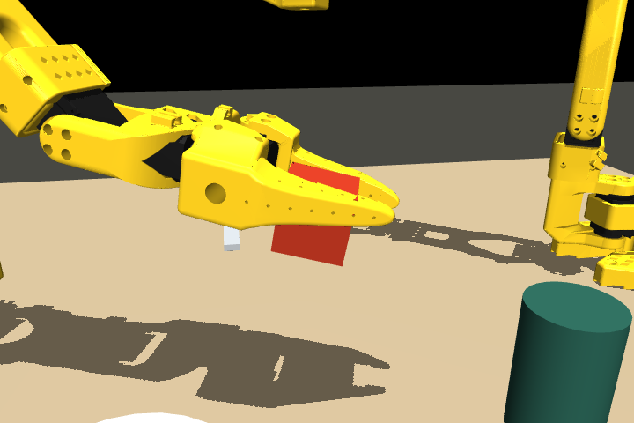
AHSAN MAQBOOL / IZAQ · SOLO BUILDER
LineProof
Make robot progress
verifiable.
A contact-verified SO-101 simulation prototype with an Intel OpenVINO runtime preflight.
CURRENT STATUS: SCRIPTED PROTOTYPE
LINEPROOF / AI INFRA SUMMIT 2026
01
Notes:
Actual simulation frame. This is not a learned robot policy or a completed dinner-table task.
Evidence repository: https://github.com/IZAQ18/infra-summit/tree/73aeea56ecc08f155c4372474fd8b5c7d8f0ffd8

Slide 2
THE PROBLEM
A plausible ending can hide a failed grasp.
A cube can slip out, land near its target and still pass an endpoint-only check.
LineProof checks the journey:
01 Held by both jaws
02 Carried above the table
03 Lowered with support
04 Released and stable
LINEPROOF / AI INFRA SUMMIT 2026
02
Notes:
An actual false positive was found during tuning. Scorer v3 rejects the recorded slipped-object trace; regression test covers it. Evidence: docs/evidence/contact-slip-trajectory.json and tests/test_simulation.py. Contact checks sampled every 50 ms, not continuous proof.
Evidence repository: https://github.com/IZAQ18/infra-summit/tree/73aeea56ecc08f155c4372474fd8b5c7d8f0ffd8

Slide 3
BUILT AND REPRODUCIBLE
Two arms. Real contacts. Auditable traces.
SIMULATION
CONTROL
VERIFICATION
MuJoCo + pinned SO-101 assets
Two cameras, 12 joint targets
Contact-driven object motion
Scripted IK teacher
Finite and bounded commands
Stop/reset with stale-action rejection
Versioned scoring
State/action evidence
Recorded failure regression
Left arm manipulates one cube. Right arm is parked. IK uses simulator state.
LINEPROOF / AI INFRA SUMMIT 2026
03
Notes:
Source: simulation/scene.py, simulation/teacher.py, tools/contact_probe.py; 13 tests pass. Generated jaw collision parts approximate the source mesh; inertias and actuator limits retained. No object teleport or grasp weld.
Evidence repository: https://github.com/IZAQ18/infra-summit/tree/73aeea56ecc08f155c4372474fd8b5c7d8f0ffd8

Slide 4
MEASURED ON 16 SEPTEMBER
A verified baseline, with visible limits.
79.54 mm
9.14 mm
minimum sustained lift in the nominal trial
final horizontal placement error
6 / 10 passed
Small cube perturbations: XY ±5 mm; yaw ±0.12 rad. Four failures retained.
LINEPROOF / AI INFRA SUMMIT 2026
04
Notes:
Sources: docs/evidence/contact-report.json and contact-seeds.json; scorer v3. Each trial covers 19 simulated seconds. These are ten scripted single-cube perturbations, not ten complete dinner-table task variations, and do not demonstrate generalization. Nominal trial is separate.
Evidence repository: https://github.com/IZAQ18/infra-summit/tree/73aeea56ecc08f155c4372474fd8b5c7d8f0ffd8

Slide 5
INTEL DEPLOYMENT PREFLIGHT
OpenVINO runs the ACT model on Intel CPU.
42.649 ms
OpenVINO median / five measured calls
Native PyTorch: 60.634 ms
FP32 agreement: max absolute error 0.000001386
Intel i5-1245U · four CPU threads · fixed input shapes
Random weights. No model action executed. This proves runtime compatibility only.
LINEPROOF / AI INFRA SUMMIT 2026
05
Notes:
Source: docs/evidence/policy-preflight-report.json and BENCHMARKS.md. One warmup, five samples; two numerical parity fixtures. ACT 51,569,548 parameters, LeRobot 0.6.0, PyTorch 2.11.0+cpu, OpenVINO 2026.3.1. Initial probe yielded different medians, so no production speedup claimed. No Core Ultra or NPU measured.
Evidence repository: https://github.com/IZAQ18/infra-summit/tree/73aeea56ecc08f155c4372474fd8b5c7d8f0ffd8

Slide 6
READINESS AND NEXT GATE
The learned full-task system is unfinished.
DELIVERED
NOT YET DEMONSTRATED
Reproducible contact simulation
Nominal pick/carry/release recording
Ten perturbation reports + failure trace
13 passing tests + OpenVINO preflight
Task-trained policy or VLM planning
Model-driven robot actions
Coordinated table-setting sequence
Physical robot or Core Ultra execution
Next gate: collect verified demonstrations → train a bounded policy → test closed-loop control.
LINEPROOF / AI INFRA SUMMIT 2026
06
Notes:
Prototype is partial and does not meet all online track requirements. Intel track Discord guidance allows Intel XPU execution beyond Core Ultra; exact i5-1245U eligibility has not been individually confirmed. Do not describe scripted results as VLA performance. Sources: docs/DEPLOYMENT_FALLBACK.md and docs/FEASIBILITY.md.
Evidence repository: https://github.com/IZAQ18/infra-summit/tree/73aeea56ecc08f155c4372474fd8b5c7d8f0ffd8

Slide 7
REVIEW AND REPRODUCE
Every claim has a trace.
github.com/IZAQ18/infra-summit
Start: README.md and docs/LOCAL_FEASIBILITY.md
Manipulation: docs/CONTACT_EXPERIMENT.md
Measurements: BENCHMARKS.md + docs/evidence/
Licenses: MIT code; Apache-2.0 upstream SO-101 assets
LineProof · Ahsan Maqbool / IZAQ
Reproducibility first. No completed-task claim.
LINEPROOF / AI INFRA SUMMIT 2026
07
Notes:
Code baseline commit 73aeea56ecc08f155c4372474fd8b5c7d8f0ffd8. Snapshot includes evidence and reproducibility tools. Exact pinned upstream provenance is in THIRD_PARTY.md and simulation/upstream_manifest.json.
Evidence repository: https://github.com/IZAQ18/infra-summit/tree/73aeea56ecc08f155c4372474fd8b5c7d8f0ffd8

