Slide 1
CONQUERS
PRESENT
Logic Game 2022

Slide 2
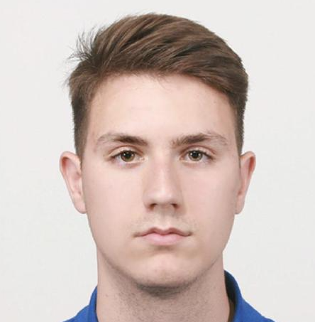
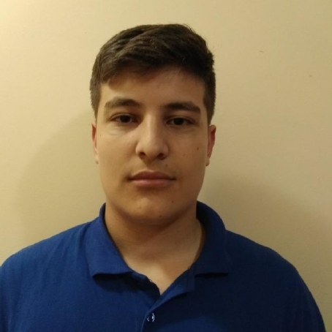
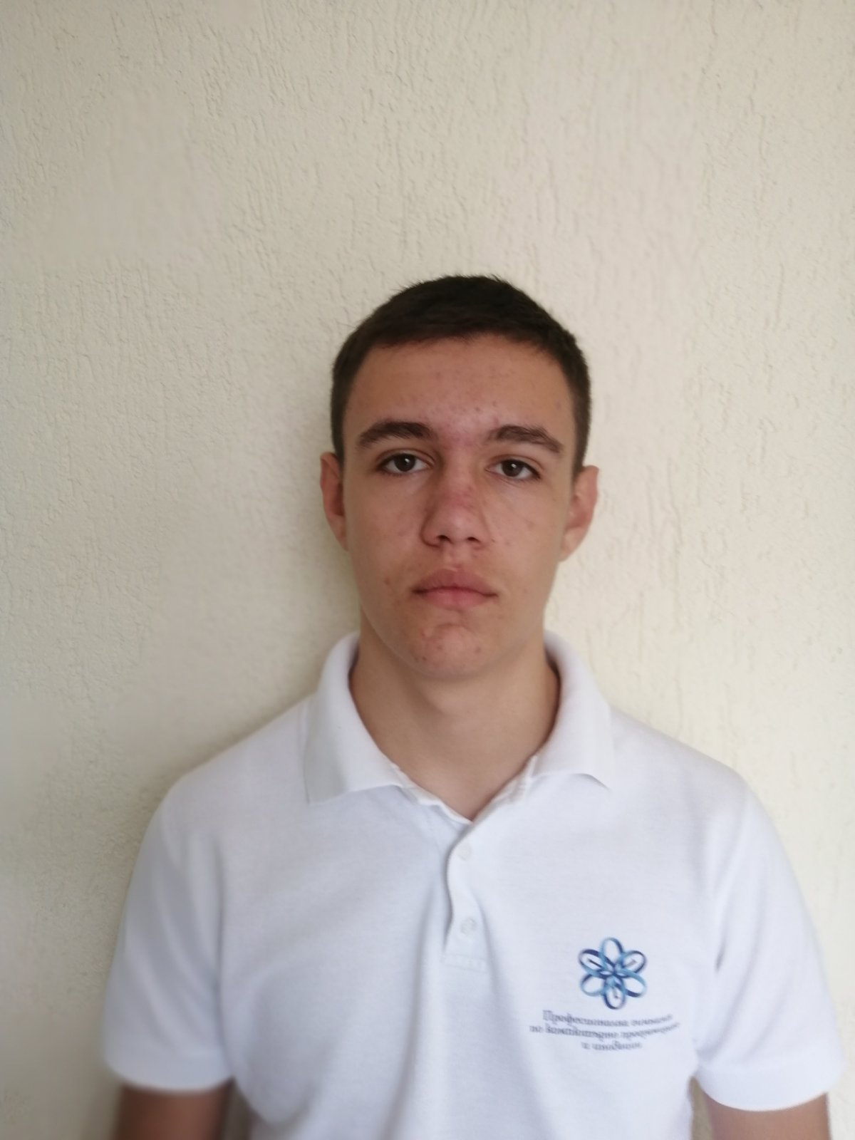
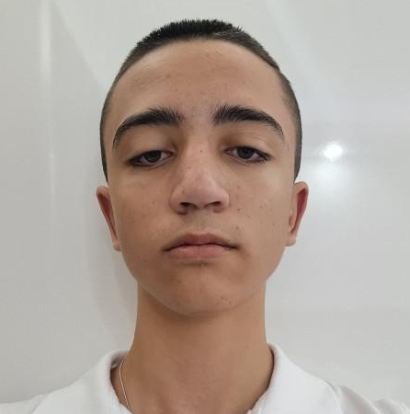
Our Team
Atanas
Apostolov
Ivailo
Dandarinov
Nikola
Paskov
Kevin
Rusev

Slide 3

Our Idea

Slide 4




Stages of development
1. Role Assignment
2. Working Period
3. Final Stage

Slide 5









Used Technologies

Slide 6
Lets jump into the project !

