Slide 1

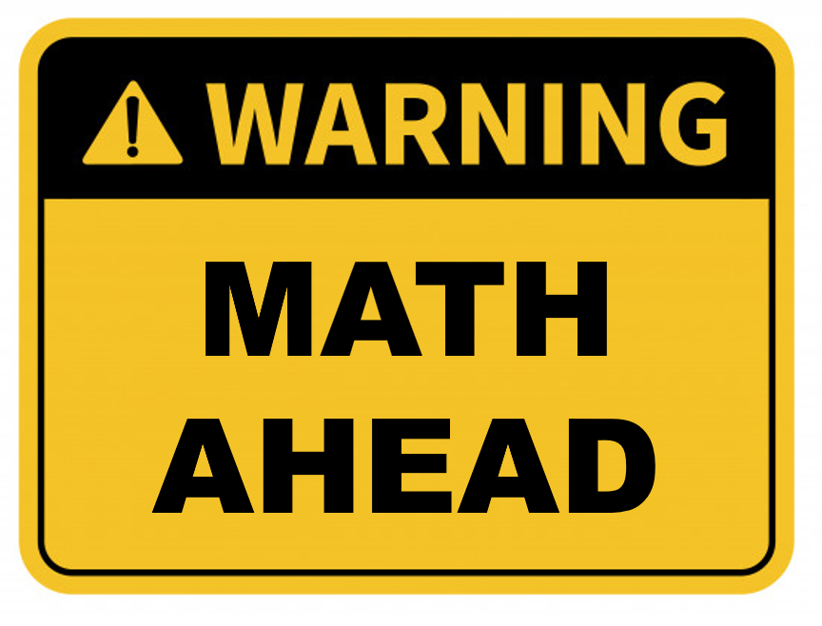
Finding & Generating Prime Numbers. Generating Keys for the Public Key Cipher
IT 20.01
Week 10
2022
Aziz Ahmadov
Roman Tolstosheyev
Mahammad Aghakishiyev
Azer Sadykhzadeh
Ravan Gajievi
Huseyn Aghazada

Slide 2
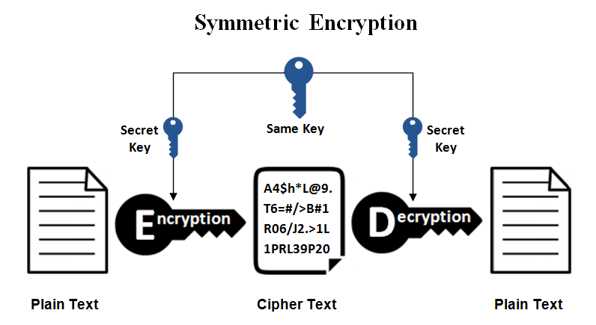
Symmetric Encryption
A single, shared key
Encrypt with the key
Decrypt with the same key
If it gets out, you'll need another key
Secret key algorithm
A shared secret
Doesn't scale very well
Difficult to distribute
Very fast to use
Often combined with asymmetric encryption

Slide 3
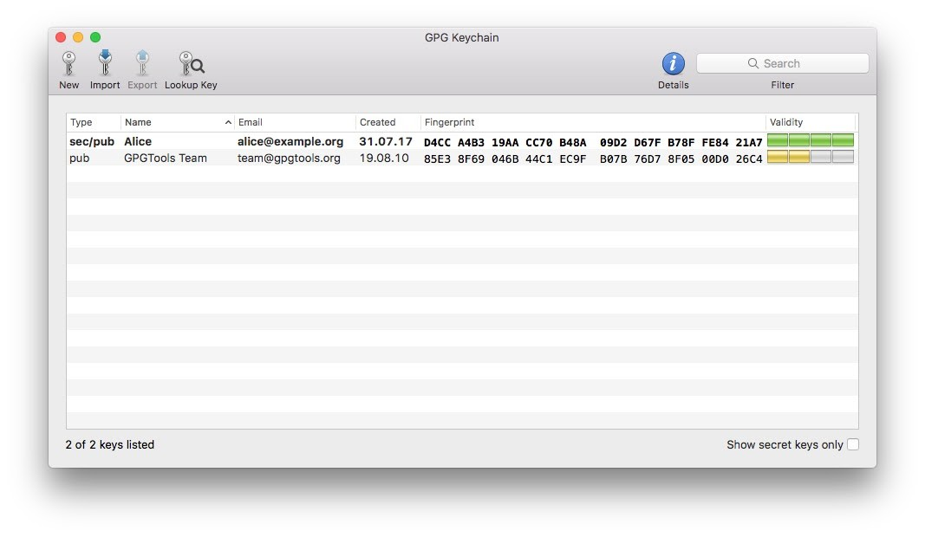
Asymmetric Encryption
Public key cryptography
Two (or more) mathematically related keys
Private key
Keep this private
Public key
Anyone can see this key
Give it away
GPG keychain

Slide 4
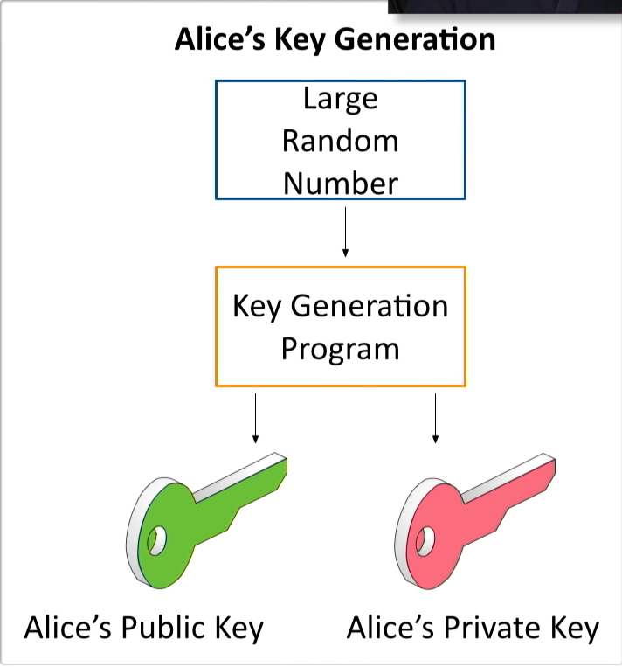
The key pair
Asymmetric encryption
Public key cryptography
Key generation
Generate both public and private key at the same time
Randomization
Prime numbers
Mathematical functions

Slide 5
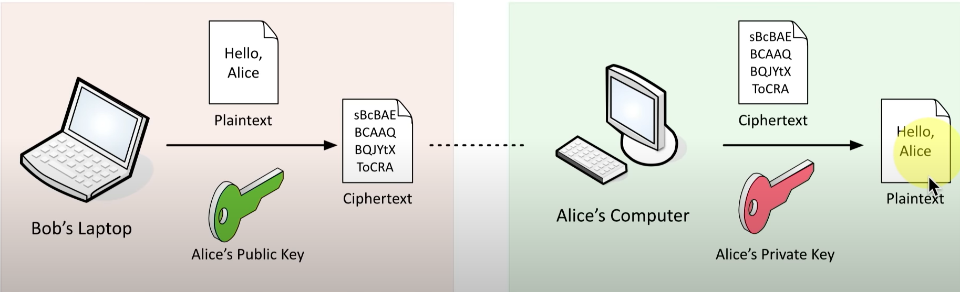

Asymmetric Encryption

Slide 6
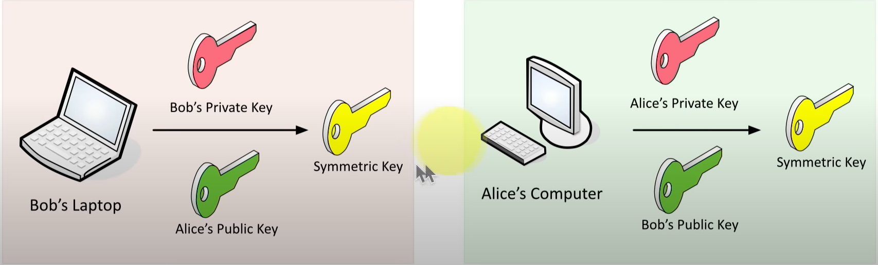
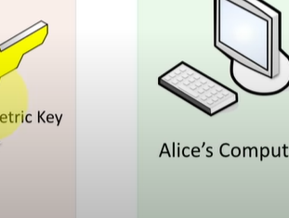
Asymmetric Encryption

Slide 7
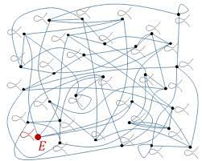
Elliptic curve cryptography (ECC)
Asymmetric encryption
Requires large integers composed of two or more large prime numbers
Instead of numbers, use curves !!!
Smaller storage and transmission requirements
Perfect mobile devices

Slide 8
Public Key Cryptography
There is a huge difference between private key crytography and public key
cryptosystems: the aspiration itself !!!
ASYMMETRIC CRYPROGRAPHY (public key cryptosystems)
→ we use trapdoor functions: so we rely heavily on the fact that there are some operations
that are extremely hard to do (exponential running time complexity)
→ this is why we have to talk about modular arithmetic
For example: prime factorization or the discrete logarithm problem
PUBLIC KEY CRYPTOSYSTEMS ARE ABOUT PRIME NUMBERS !!!

Slide 9

Modular Arithmetic
„Modular arithmetic is a system of arithmetic for integers where numbers
wrap around upon reaching a certain value - the modulus”
dividend
remainder
9 mod 4 = 1 because 9 = 2x4+1
13 mod 10 = 3 because13=1x10+3
$$\frac{a}{b}$$
= q remainder r
divisor
quotient
in modular arithmetic we are only interested in the remainder
to get the remainder we can use the modulo operator (%)
a mod b = remainder when we divide a by b

Slide 10
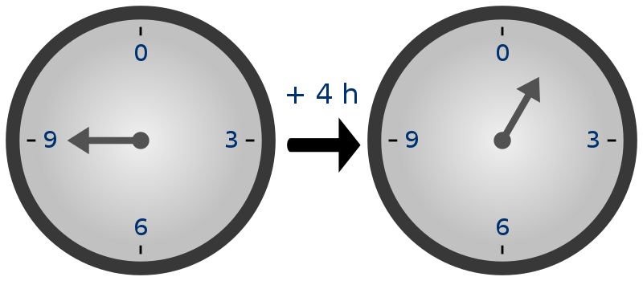

Slide 11
Modular Arithmetic
CONGRUENCE
Two integers (a and b) are said to be congruent if they have the same
remainder when divided by a specified integer m
a ≡ b (mod m)
17 ≡ 32 (mod 5)
congruence is not an operation it just defines a relationship between a and b
the mod m operation partition all the natural numbers into m subgroups
For example: the mod 2 operator decides whether a given number is
even or odd (so 2 groups)

Slide 12
Modular Arithmetic
FERMAT’S LITTLE THEOREM
What is a prime number?
A prime number greater than 1 whose only factors are 1 and itself
~ numbers that have more than 2 factors are called composite numbers
Let p be a prime number then for any integer a (a is not divisible by p) the number
a is an integer multiple of p.
p-1
p-1
p-1
a ≡ 1 (mod p) or
a -1 ≡ 0 (mod p)
„Fermat’s little theorem”

Slide 13
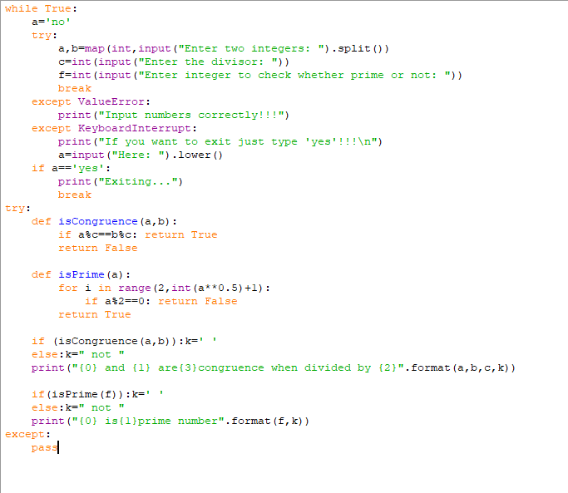
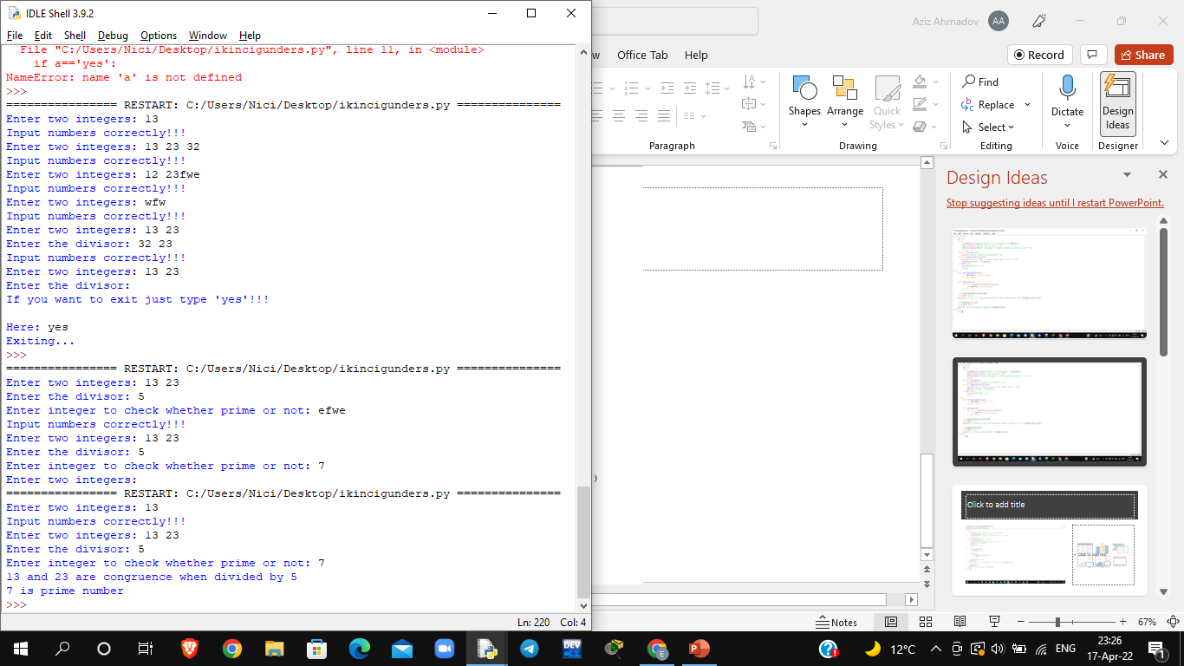

Slide 14
Modular Arithmetic
FINDING PRIME NUMBERS
Running time complexity:
→ in other algorithms and data structures running time analysis the
size of the input is straightforward
Sorting: the input is the N numbers we want to sort and
the running time complexity is O(NlogN)
Shortest path: input is the N vertexes in the graph
→ now the input is a large number BUT we represent the numbers
in binary in computer science

Slide 15
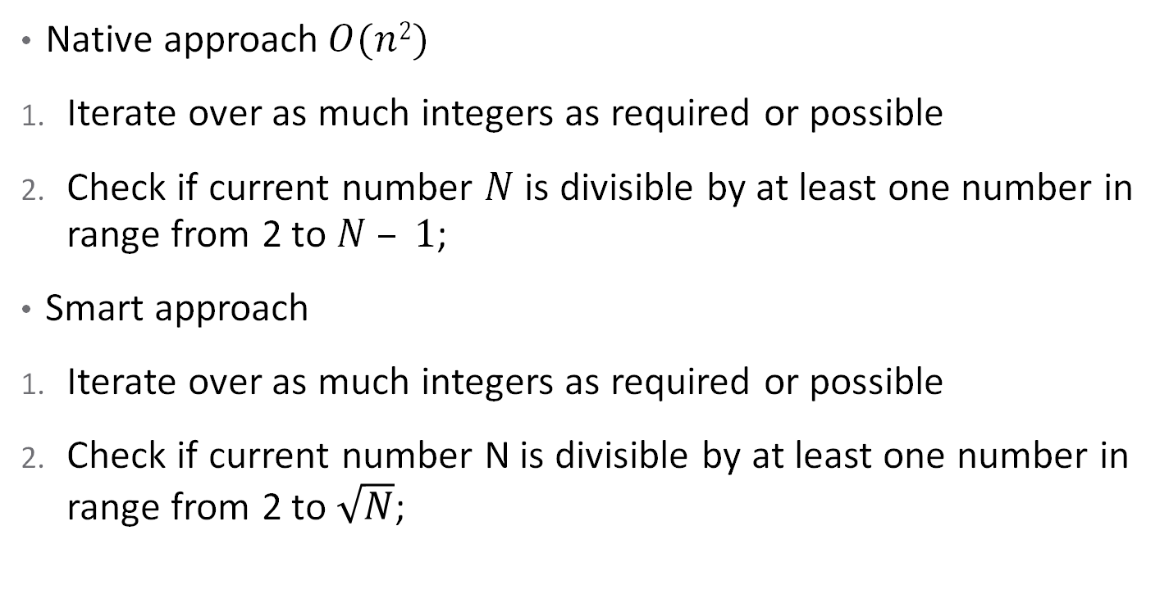
Modular Arithmetic
FINDING PRIME NUMBERS
Native approach$O(n2)$
Iterate over as much integers as required or possible
Check if current number $N$ is divisible by at least one number in range from 2 to $N – 1$;
Smart approach
Iterate over as much integers as required or possible
Check if current number N is divisible by at least one number in range from 2 to $\sqrt{N}$;

Slide 16
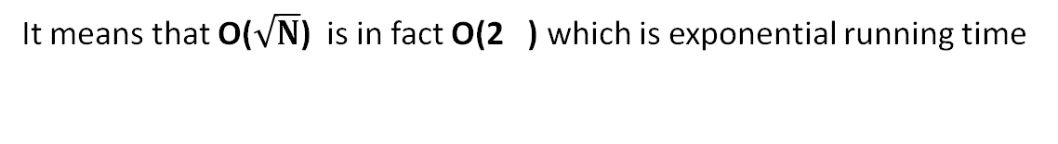
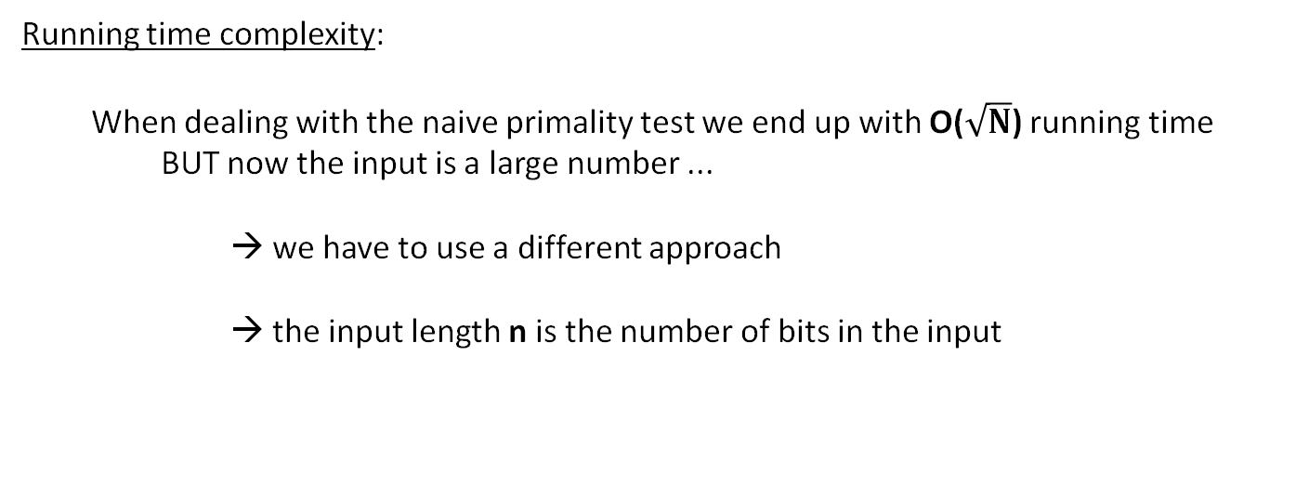

Modular Arithmetic
FINDING PRIME NUMBERS
Running time complexity:
When dealing with the naive primality test we end up with O($\sqrt{N}$) running time
BUT now the input is a large number ...
→ we have to use a different approach
→ the input length n is the number of bits in the input
So in our examples the input is a decimal number. So first of all we have to
define the number of bits of a decimal number
The input length in binary is n = log N
deciding whether a number is
prime is crucial in RSA so
exponential running
time is too slow
2
$$\frac{n}{2}$$
It means that O($\sqrt{N}$) is in fact O(2 ) which is exponential running time
~ of course it makes sense because the naive primality testing
algorithm is quite a slow approach

Slide 17
Modular Arithmetic
FINDING PRIME NUMBERS
Eratosthenes sieve
Create a list of consecutive integers from 2 through n: (2, 3, 4, ..., n).
Initially, let p equal 2, the smallest prime number.
Enumerate the multiples of p by counting in increments of p from 2p to n, and mark them in the list (these will be 2p, 3p, 4p, ...; the p itself should not be marked).
Find the smallest number in the list greater than p that is not marked. If there was no such number, stop. Otherwise, let p now equal this new number (which is the next prime), and repeat from step 3.
When the algorithm terminates, the numbers remaining not marked in the list are all the primes below n.

Slide 18
Modular Arithmetic
FINDING PRIME NUMBERS
Fermat’s algorithm: we can use Fermat’s little theorem to check
whether a given N number if prime or not
„number a is the witness
for compositeness of N”
N-1
a ≡ 1 (mod N)
If this relation is true than we know that N is a prime
In other words: if N is a prime number then for every 1 <= a < N number
a ≡ 1 (mod N) which means in programming that a % N = 1
N-1
N-1
4
For example: since 5 is prime thats why 2 % 5 = 1 so 5 is prime
Running time complexity: O(k log n)
3

Slide 19
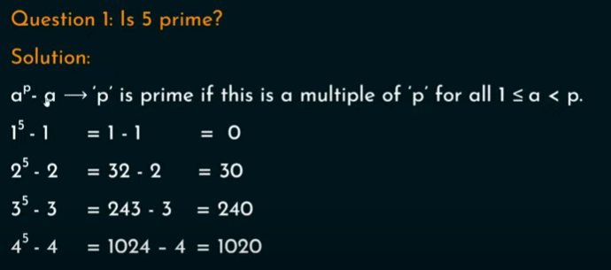
Modular Arithmetic
FINDING PRIME NUMBERS

Slide 20
Modular Arithmetic
FINDING PRIME NUMBERS
Fermat’s algorithm: we can use Fermat’s little theorem to check
whether a given N number if prime or not
N-1
a ≡ 1 (mod N)
repeat k times:
generate a random number in the range [2,N-2]
if a % N = 1 then N is probably prime
this test fails with
Carmichael numbers
PROBLEM
N-1
if gcd(a,n) = 1 then
Fermat test is not valid
FERMAT’S ALGORITHM IS PROBABILISTIC !!!
~ the probability of producing incorrect results for composite numbers is
low and can be reduced by doing more k iterations

Slide 21
Modular Arithmetic
INTEGER FACTORIZATION
„Integer factorization is the decomposition of a composite number into
a product of smaller integers: usually we are interested in prime numbers”
THIS IS CALLED PRIME FACTORIZATION
Fundamental Theorem of Arithmetic
This theorem states that every positive integer can be written uniquely
as a product of prime numbers
For example: 210 = 2 x 3 x 5 x 7
prime factorization is a „trapdoor-function”
extremely easy to compute the result by multiplying the factors
but extremely hard to find the factors for large numbers

Slide 22
Modular Arithmetic
INTEGER FACTORIZATION
Trapdoor-functions are crucial in cryptography: the difficulty of factoring large integers
is the basis of some modern cryptographic algorithms (RSA)
→ SSL encryption used for TCP/IP connections relies on
the security of the RSA algorithm
→ if a fast approach is invented to factor large integers then
internet sites would no longer be secure

Slide 23
Modular Arithmetic
DISCRETE LOGARITHM PROBLEM
Calculating the discrete logarithm is another trapdoor-function
c
a ≡ b (mod m)
If we know b, c and m then this is called modular exponentiation
which is not that hard to solve
→ what is the inverse of this operation?
If we know a, b and m then this is called the discrete logarithm problem
which is a very difficult problem to solve

Slide 24
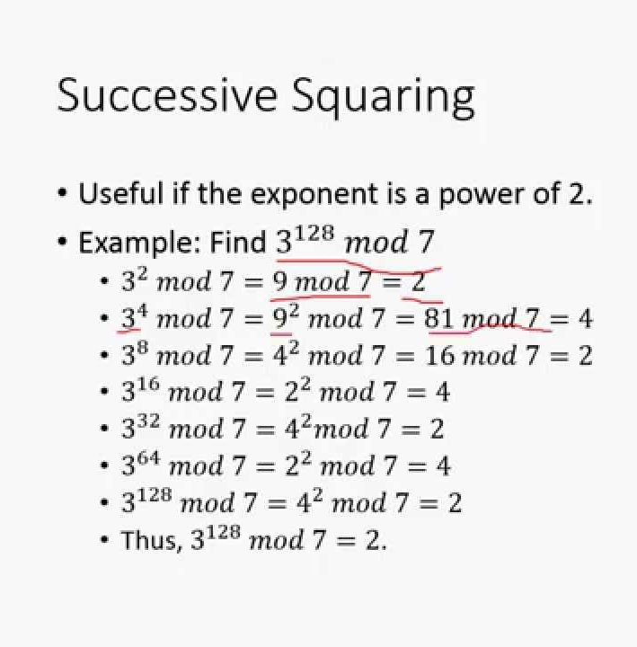
Modular Exponentiation
It is a type of exponentiation performed over a modulus

Slide 25
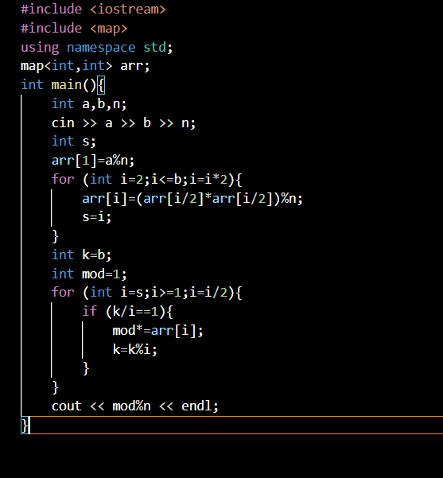

Slide 26
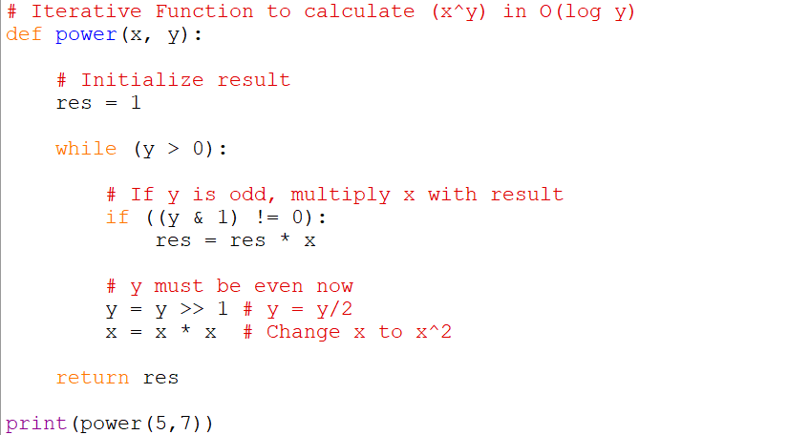

Slide 27
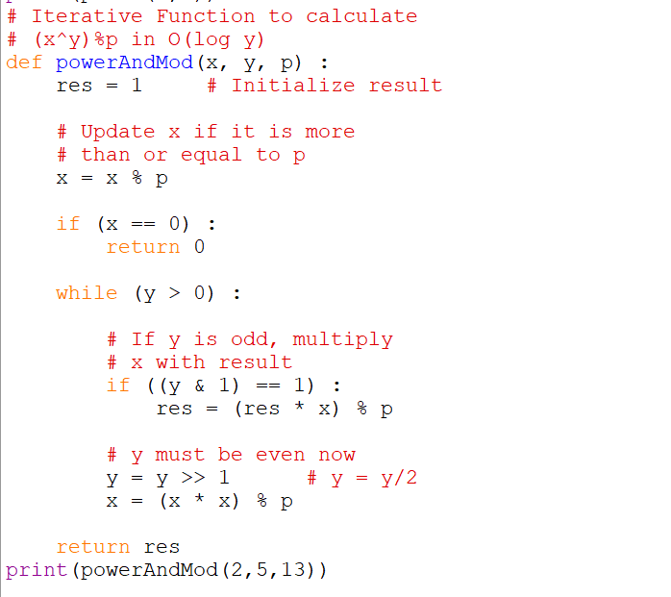

Slide 28
Modular Arithmetic
DISCRETE LOGARITHM PROBLEM
Calculating the discrete logarithm is another trapdoor-function
What is the running time complexity of modular exponentiation?
Modular exponentiation is relatively straightforward operation
~ have to use exponentiation with modulo operator
O(e) running time complexity
In this case e is the number of digits in the exponent !!!
What is the running time complexity of discrete logarithm problem?
Finding the right exponent for the discrete logarithm problem is
extremely hard: it has exponential running time complexity

Slide 29
Discrete Logarithm Problem
The discrete logarithm problem is used in cryptography. Given values for a, b, and n (where n is a prime number), the function x = (a^b) mod n is easy to compute. For example, if a = 3, b = 4, and n = 17, then x = (3^4) mod 17 = 81 mod 17 = 81 mod 17 = 13. But if you have values for x, a, and n, the value of b is very difficult to compute when the values of x, a, and n are very large.
If you set a value for a and n, and then compute x iterating b from 1 to n-1, you will get each value from 1 to n in scrambled order — a permutation. For example, if a = 3 and n = 17, then:
b = 1, x = 3^1 % 17 = 3 b = 2, x = 3^2 % 17 = 9 b = 3, x = 3^3 % 17 = 27 % 17 = 10 b = 4, x = 3^4 % 17 = 81 % 17 = 13 . . . b = 16, x = 3^16 % 17 = 43046721 % 17 = 1

Slide 30
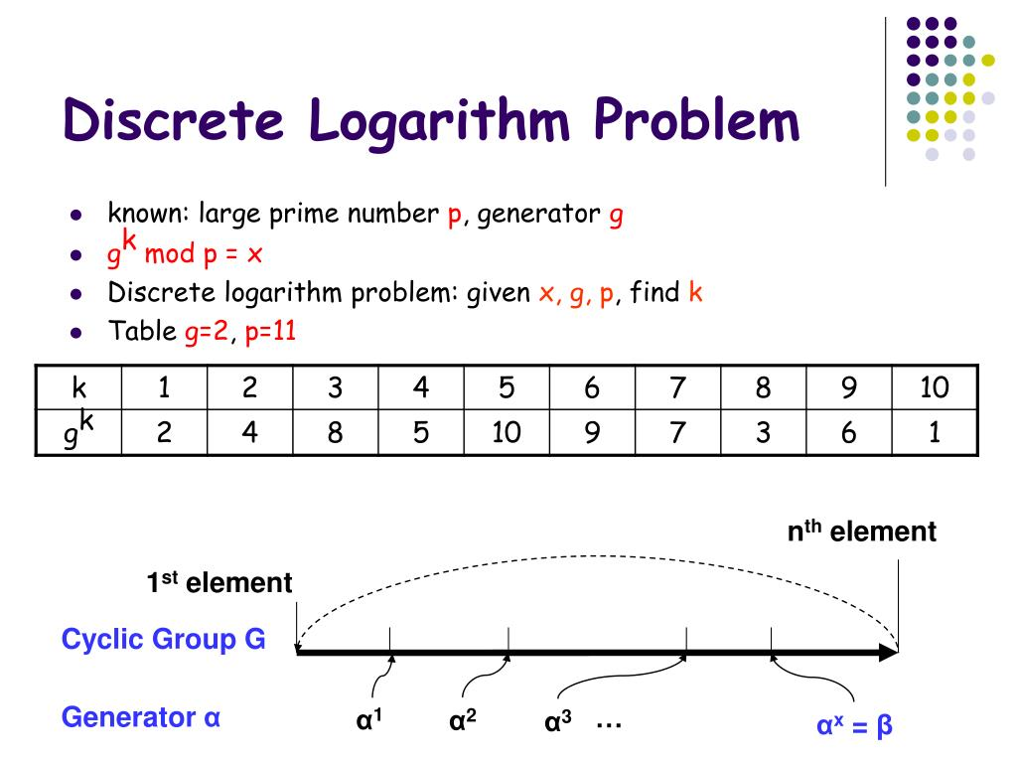

Slide 31
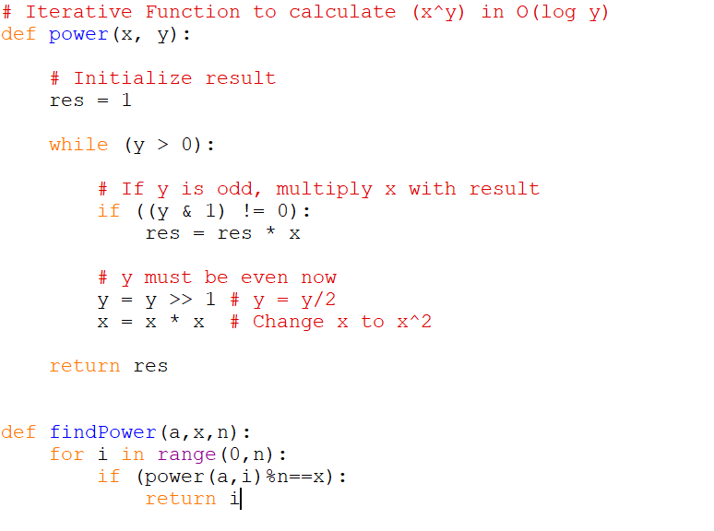

Slide 32
Public Key Cryptography
„A cryptosystem should be secure even if everything
about the system except the key is public knowledge”
→ this is called the Kerckhoff’s principle
→ it is the fundamental principle of crytography
This is why we like prime numbers:
If we have two prime numbers p and q then multiplying them is quite easy M = p x q
but calculating the factors if we have M is extremely hard
~ this is called integer factorization
Public key cryptosystem: integer factorization is a good „trapdoor-function” which means it is
easy to verify (we just have to multiply the numbers) but calculating the
factors is almost impossible (without quantum computers)

Slide 33
Public Key Cryptography
Why is it important to use prime numbers at all?
factoring large numbers is usually hard: but not always
if a given number has smaller factors then it may happen that the factors can be found
within hundreds or thousands of iterations
So somehow we have to make sure the prime factors will be large ...
This is where prime numbers have been proved to be important: if we have p and q large prime numbers
then we can calculate N = p*q quite fast
What are the factors of N? Of course the factors are p and q and we know
that these are large primes (this is exactly why we chose them)
THE REASON WHY WE USE PRIME NUMBERS IS TO MAKE SURE FACTORIZATION IS PRACTICALLY IMPOSSIBLE

Slide 34

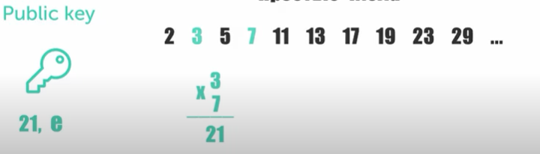
Generating public key

Slide 35
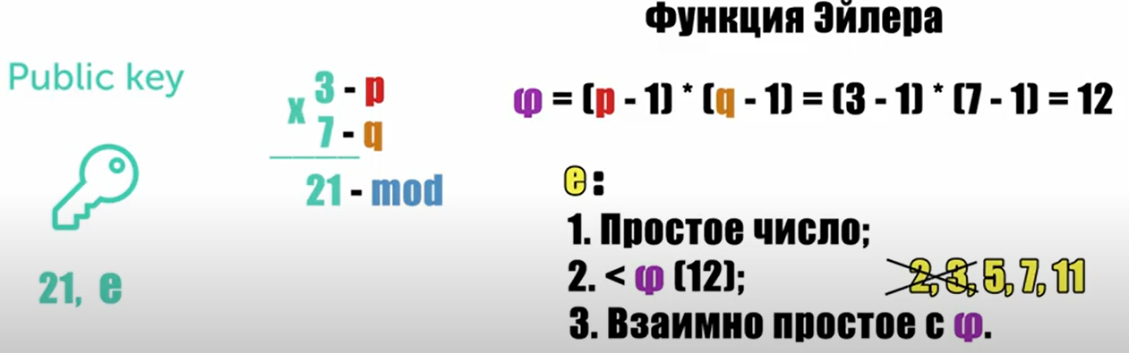

Generating public key
Euler (phi-) function
Prime number;
Coprime with
Public key:

Slide 36
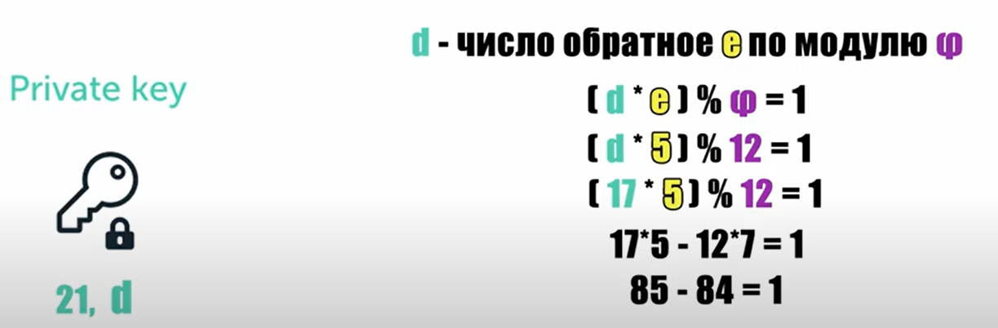

Generating private key
reverse mod of
by
Private key:

Slide 37
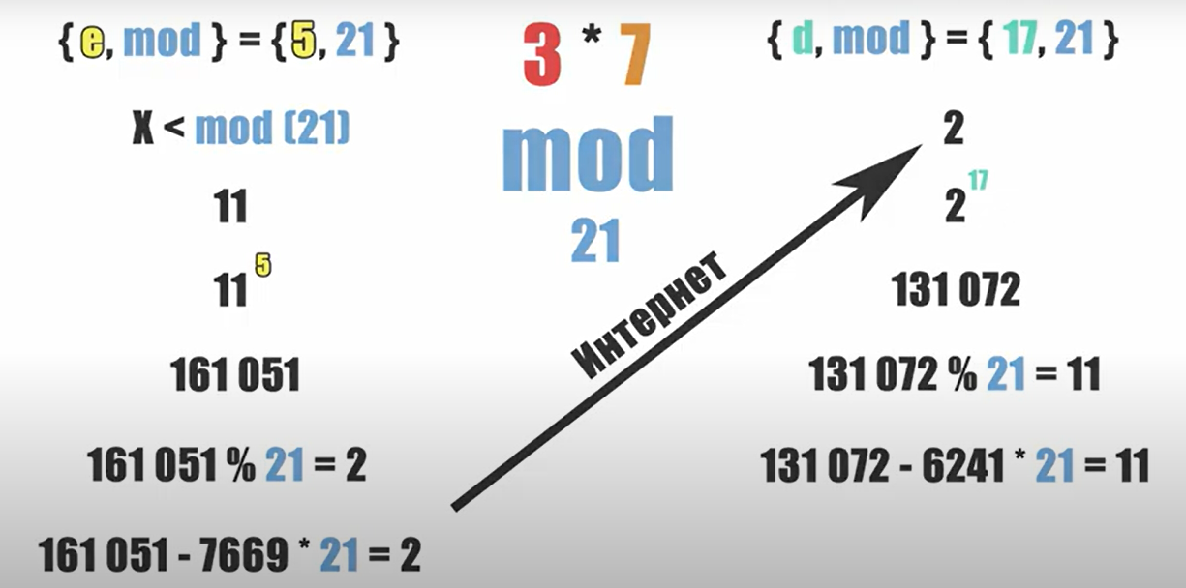
Testing of key pair
Public key:
Private key:
Send message

Slide 38

Sources
https://en.wikipedia.org/wiki/Sieve_of_Eratosthenes
https://www.geeksforgeeks.org/sieve-of-eratosthenes/
https://www.geeksforgeeks.org/primality-test-set-2-fermet-method/
https://www.geeksforgeeks.org/modular-exponentiation-power-in-modular-arithmetic/
https://www.youtube.com/watch?v=sDrXeCs3ghQ
https://www.youtube.com/watch?v=xqPgE-hPIfE
https://github.com/IZOBRETATEL777/Cryptography-lesson

Slide 39
Thank you for your attention!

