Slide 1

Research PRESENTATION
Mobile Application
Beta
Testing
Presented By - James Rogers

Slide 2
Research PRESENTATION
Contents
9
Feedback Collection
3
Introduction
6
Approaches
10
Reward for the Testers
4
Objectives
7
Entry and Exit Criteria
11
Timeline
5
Types of Testing
8
Target Platforms
12
Conclusion

Slide 3
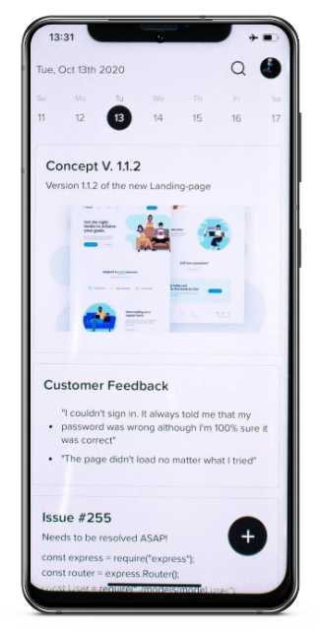


Research PRESENTATION
Introduction
We are running the beta testing of our mobile application to get it
tested by real users in the production environment. It will help us get
effective feedback for our application’s improvement before
launching it into the market for a larger set of audience.
Continuous improvement is an ongoing process and continues with an
aim to consistently evaluate and improve our application over time.

Slide 4







Research PRESENTATION
Objectives
Get prompt feedback on our application and improve its user experience
Reduce the product
failure risk
Test the usability, robustness
or our application
Increase customer
satisfaction
Cover bugs which have been
missed during testing cycles
Improve the
overall quality

Slide 5





Types
of Testing
The types of testing involved in our beta testing program include:
Public beta testing
Technical beta testing
Focused beta testing
Post-release beta testing

Slide 6






Research PRESENTATION
Approaches
01
User experience
testing
03
Device and platform compatibility testing
02
Content
testing
04
Load and stress testing

Slide 7







Entry Criteria
Exit Criteria
Positive results from alpha testing
All the serious bugs has
been identified
The beta version is ready to be tested
User manuals are ready to be published
Feedback reports from the testers are ready
No bugs are present
Beta sites are ready for installation
All the bugs have been fixed
Regression testing of the bug fix
is complete
Notified the raised issues
to the developers

Slide 8


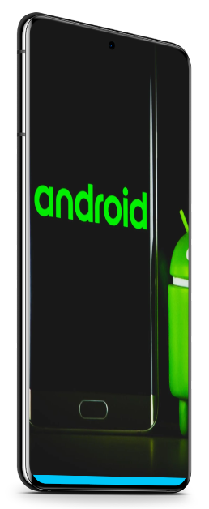
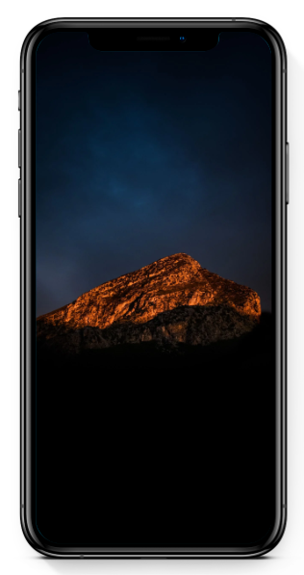


Target
Platforms
Android
iOS

Slide 9






Feedback
Collection
Here are the ways to collect feedback from our beta testers:
Reporting bugs
Journaling
Submitting feature
requests
Discussing on Forums

Slide 10




Reward
For The Testers
$25 App store gift card
1 month free premium
subscription
20% lifetime discount on
the premium subscription

Slide 11















Beta Testing
Timeline
Set goals, write
plan, sign off
Select and
notify testers
Distribute testers
Exit survey, tally results, final report
Run program
1st Dec 2021 to
8th Dec 2021
5th Dec 2021 to
22nd Dec 2021
22nd Dec 2021 to
26th Dec 2021
27th Dec 2021 to
20th Jan 2022
21th Jan 2022 to
3oth Jan 2022

Slide 12

Conclusion
Beta testing is a crucial stage in our mobile
application development. THe intensity of the beta
testing can vary according to our application, but the
main motive should be to improve customer
experience and overall quality of the app.
https://www.formpl.us/blog/exploratory-research#:~:text=For%20tech%20products%2C%20it%20is%20called%20the%20beta%20testing%20stage%20of%20product%20development.%C2%A0
https://www.testingxperts.com/blog/beta-testing#How%20to%20create%20a%20Beta%20Test%20Strategy?

