Slide 1



iLAB Corporations
Investment Analysis Report
Prepared By,
Sarah J. Simmons
CFO

Slide 2

iLAB Corporations
Company
Background:
ULAD Tech
Investment Analysis Report

Slide 3



Producers of Gadgets, Radios, Mobile Phones and Kitchen Appliances.

Slide 4
iLAB Corporations
Distribution
Zones
Investment Analysis Report

Slide 5





Europe
Asia
Americas

Slide 6
iLAB Corporations
Investment, Trends and Analysis
Investment Analysis Report

Slide 7




Profit rates were
higher during the
earlier stages.
There are around 239 institutions
which hold shares with the company.

Slide 8



Fluctuations in the financial
performance of the company.
A review of the financial blogs made in respect to the company’s performance show that the company has had various financial implications, especially in the year 2015.

Slide 9
iLAB Corporations
Valuation of
The Company
Investment Analysis Report

Slide 10




Market capacity of the
company is approximately:
685.33 million
The enterprise value of the
company is estimated to be:
764.23 million

Slide 11
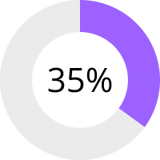
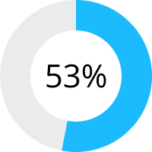

The profit margin of the entity has been estimated to be:
The operating margin is:

Slide 12
iLAB Corporations
Outcomes
Investment Analysis Report

Slide 13
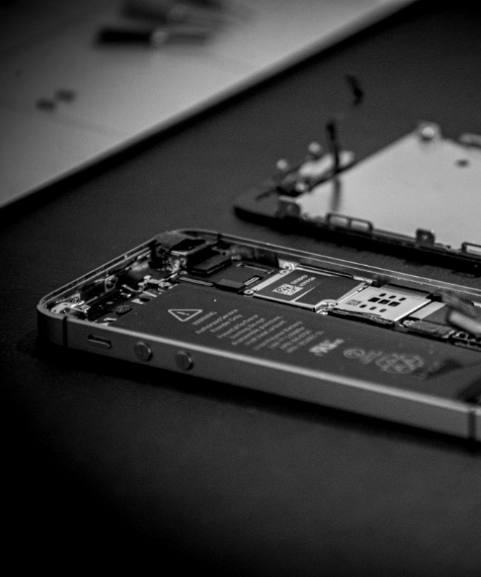

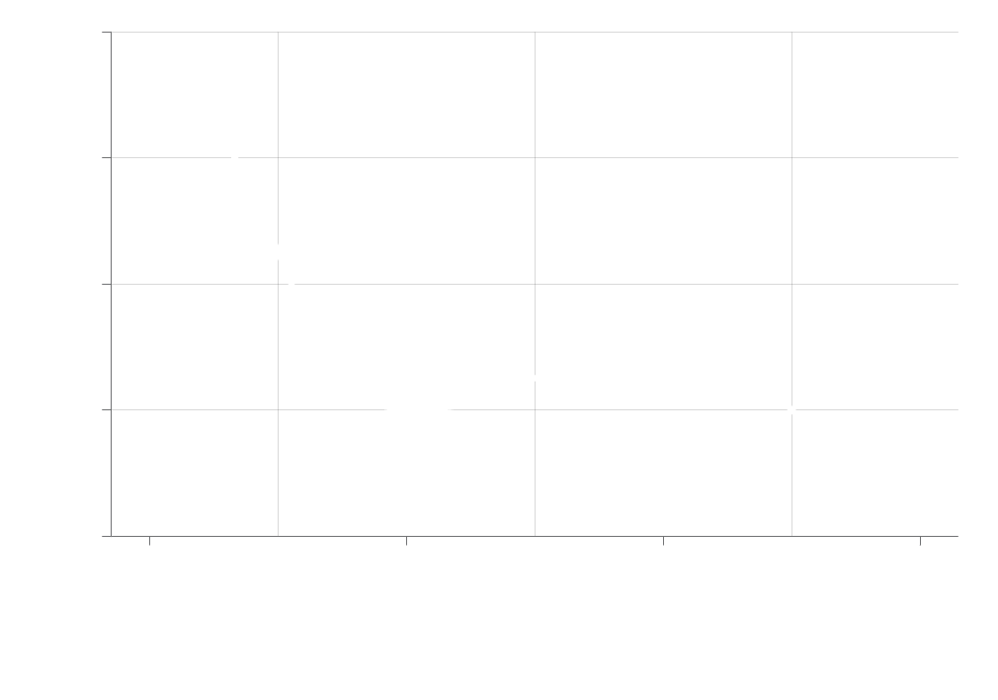
Decrease in the shareholders
equity and the common stock in the company for concurrent years.

Slide 14


Healing process throughout the
years may attract potential investors.

Slide 15
Thank You
iLAB Corporations

