Slide 1
序号 | 方法和参数 | 结果 | 链接
1 | normal image processing to 256X256, augmenting class 1, 2, 3 and 4. VGG style architecture, trained with 10 epoch, batch size 32 | Kepler K20c GPU. It runs for about 2 days Kappa of 0.38 | https://github.com/hitchpy/Kaggle-Diabetic-Retinopathy-Detection
2 | 512x512 pixel input images. Balance Architecture:? batch size 128 theano | GTX970,GTX980i,7-10days. Kappa:0.839 | https://github.com/sveitser/kaggle_diabetic
3 | Oversampling,augmentation. Architecture:http://jeffreydf.github.io/diabetic-retinopathy-detection/ 512x512 pixel input images. theano | GRID K520 on AWS Kappa:0.824 | https://github.com/JeffreyDF/kaggle_diabetic_retinopathy
4 | theano data augmentation balance | Kappa:0.74 | https://github.com/ilyakava/kaggle-dr
5 | Keras. Augmentation. | QWK:0.426 | https://github.com/timothyman/diabetic_retinopathy

Slide 2
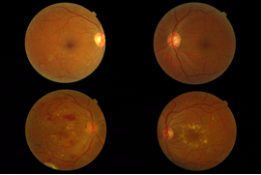
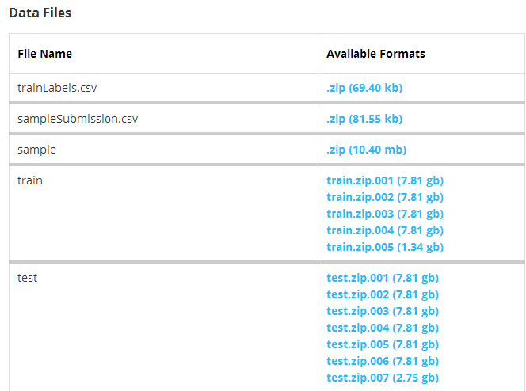
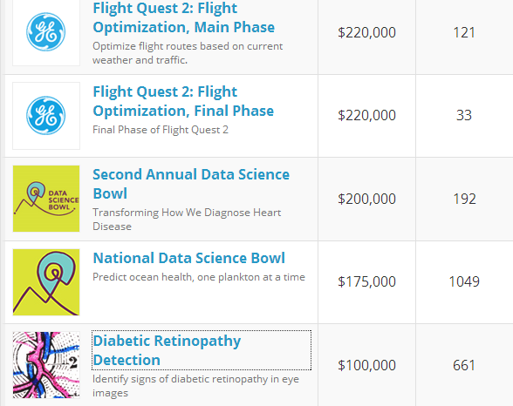
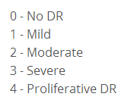
Database
Messidor:1200 images
Grade | Description | Number of Images
R0 | NMA = 0) AND (NHE = 0) | 546
R1 | (0 < NMA _ 5) AND (NHE = 0) | 153
R2 | (5 < NMA < 15) AND (0 < NHE < 5) AND (NNV = 0) | 247
R3 | (NMA≥15) OR (NHE≥5) OR (NNV > 0) | 254
Kaggle:35126 training images
0 | 25810
1 | 2443
2 | 5292
3 | 873
4 | 708

