Slide 1
Morrison Group Services
MGS SFDC Enhancement and Support

Slide 2
Morrison Group Services Overview
MGS is the leading Utility service provider company in UK
MGS (Graeme Cross)
MUS
MTS
MDS
Transport
Plant and Fleet
Andy Carter
> Apps (Derek)
> Security
> Others (regions and Orgs)

Slide 3





MGS Overview
MGS business is centred upon the provision, replacement, repair and maintenance of network infrastructure for blue chip utility companies in the UK and Ireland
The Morrison Group provides services across Utilities, Telecom, Transport and Data.
Morrison Utility Services is the UK and Ireland’s leading utility service provider. Morrison work with utility company clients in the electricity, gas, rail, water and telecommunications sectors helping them renew, refurbish and maintain their infrastructure and networks
Their biggest clients are likes of BT, E-on, Thames Water, etc.
The scale of MGS operational footprint is vast they work on behalf of their 16 utility sector clients
Their work spans the majority of the UK as they undertake around 1 million excavations in each year

Slide 4
Salesforce Organizations and respective contracts
Central
South
North
MUSMART
Live Org/Regions
CSB
SSB
NSB
SMARTFULL2
UAT Full Copy Sandbox
TRIIO
SCCCentral
BT
TRACKER
CWA
NDS
UKPNDev
WGA
TWM
TW
NCES
CMS
EONSMDev
MRS
DAMAGE
BPS
MAM
NPG
SWAPOS
EDF
SPSC
SW
POSNorth
WPD
SWA
AW
TWXX
WelshWater
SCCSouth
Contracts/ Development Sandbox

Slide 5
Major Applications Supported as per work inflow
OptiMUS BT
ONSA
Skill Matrix
SQL migration
RA Apps
MTS App Store
BT Monitoring
MGS Sharepoint
Thames Water
TW Progressive Metering
TW Data Services
TWIA MCW
TW CSL
TW Meter mobilization
TW daily Monitoring
MTS RA App
MTS App Store
HR .Net
SCCP
Xactium Risk Manager
TRiiO
EON
Tracker
Oracle
HR .Net
Notes:
Separate the contracts
Chk Xtium
System testing automation
Test class coverage > what is it? Is it Regression Testing. > can it be automated > resuable.

Slide 6
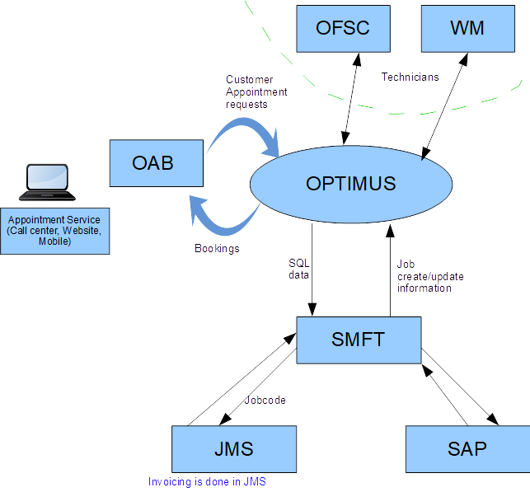
TW Contract for Beginner

Slide 7
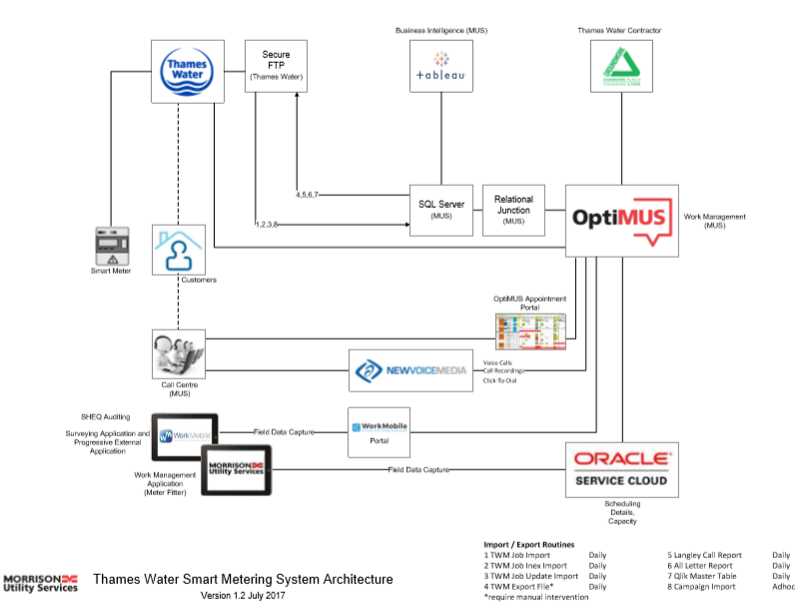
TW Contract for Developers

Slide 8
Typical SR flow for Zensar
Typical SR flow is as per below document

Slide 9
Key People in Business and Offshore
Contracts
Business
Zensar Offshore
TWM/TWXX – Craig
BT – Arun
TRIIO – Philip
SCCP – Kate
EON – Daniel/ Trevor
Tracker – Derek/ Daryl
TWDS – Catherine
TWM/TWXX – Shruti/Snehal/Rangnath
BT – Shruti/Rangnath
BOXIT – Tabish
TRIIO – Mahadev
SCCP – Ashay/Priya/Mahadev
EON – Shruti
Tracker – Mahadev/Ashay/Priya
TWDS – Shruti

