Slide 1
King County House Sells Model
A regression model for analyzing house sales in Northwestern County.

Slide 2

Goal: To come up with a regression model which can help with the prediction of house prices.

Slide 3

Business problem
Stakeholders at King County Real Estate company, have been having problems determining which house features have the most impact on house sales.
By going through various linear regression models and coming up with a good model, this problem will be solved.

Slide 4

The solution
By selecting two of the best correlated features with the price and constructing various models till the best model is recognized. This is how the problem will be solved.

Slide 5
Milestones
Monday - 27 - 06
Wednesday - 29 - 06
Friday - 1 - 07
Tuesday - 28 - 06
Saturday - 2 - 06
Thursday - 30 - 06
Business Understanding,importing libraries and the data
Data preparation: Dealing with null values, datatypes and outliers.
Came up with a final model and interpretation
Mon | Tue | Wed | Thur | Fri | Sat
Data Understanding and some few data preparation
Modelling
Brushing up on some areas, committing to github and creation of slides

Slide 6
The 21 Columns
Data Understanding
id - unique identifier for a house
dateDate - house was sold
price - is prediction target
bedrooms - of Bedrooms/House
bathrooms - of bathrooms/bedrooms
sqft_livingsquare - footage of the home
sqft_lotsquare - footage of the lot
floors - floors (levels) in house
waterfront - House which has a view to a waterfront
view - Has been viewed
condition - How good the condition is ( Overall )
grade - overall grade given to the housing unit, based on King County grading system
sqft_above - square footage of house apart from basement
sqft_basement - square footage of the basement
yr_built - Built Year
yr_renovated - Year when house was renovated
zipcode - zip
lat - Latitude coordinate
long - Longitude coordinate
sqft_living15 - The square footage of interior housing living space for the nearest 15 neighbors
sqft_lot15 - The square footage of the land lots of the nearest 15 neighbors
Given for analysis is a King County house sells in the northwestern county.
It has 21597 records and 21 columns.

Slide 7
Data Preparation
Dealing with outliers
Dealing with data types
Data Cleaning
Find any outliers in the dataset and removing them. This will help produce a good model.
Rectifying any column which is given a wrong data type and giving it the appropriate one.
This involves identifying null values or duplicates in each column and dealing with them appropriately

Slide 8
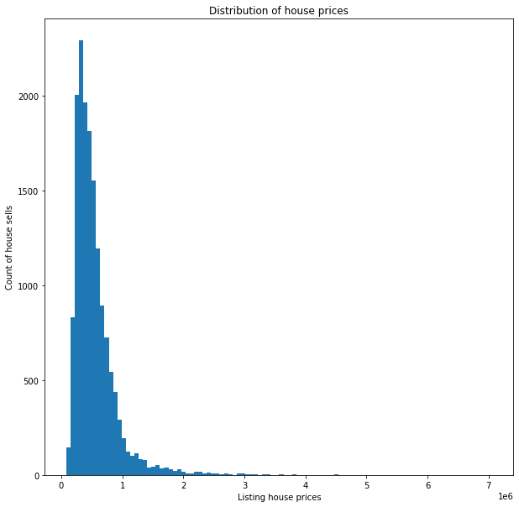
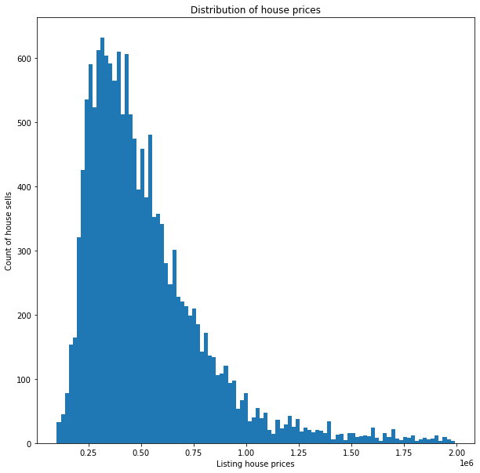
Dataset distribution before and after removal of outliers
Before removing outliers
After removing outliers

Slide 9
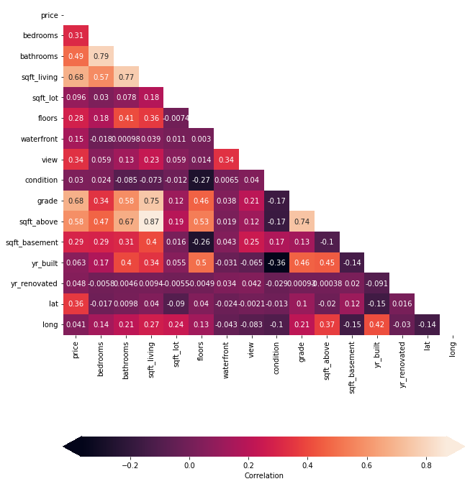
Modelling
For the modelling process, I settled with a heatmap to help me show the most correlated features with price.
As from the heatmap, living area square foot living and grade are the most correlated features with house prices.
It is from this features I tested with some models, till came up with the best of them all.

Slide 10
Final Model
Model Used
Interpretation
The model of the best fit was a polynomial curve of degree 3.
It scored a good training score and a better testing score, compared to other models making it the go to model.
This model is off by with $ 189967.67.
Prices of houses as start from $ 293956.31
A good number of points passed the normality check.
Existence of high multicollinearity.

Slide 11
Conclusion
Confidence in this model should not be that much it should only be used for predictive purpose, the reason is some of the linear regression rules are being violated.
This makes prediction of houses not 100% efficient but roughly 52% efficient.

