Slide 1

Tunza Jamii, Water Point Prediction Model
A machine learning model to help predict water points in need of repair in Tanzania

Slide 2
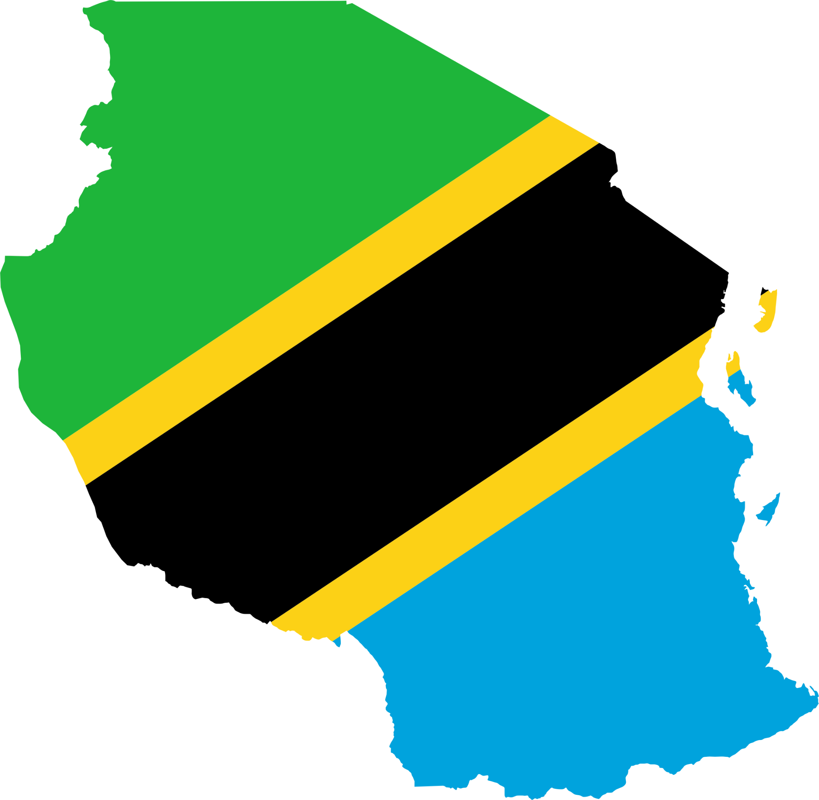
Tanzania as a developing country, struggles with providing clean to its over 57 million population. There are already many water points set up across the country, but some are in need of repair while others have failed completely.

Slide 3
How does this project help solve this problem?
With training various machine learning model and evaluating them. One which scores the best will help solve this problem.

Slide 4
The Results
The best model scored the following results:
Precision Score: 88%
Recall Score : 83.6%
Accuracy Score : 76.4%
F1 Score : 85.7%

Slide 5
Scores Interpretation
Precision-Score - If the model assigns a water pump as non functional then there is an 88% chance it is actually true.
Recall-Score - If a given water pump is actually non-functional then there is a 83.6% that this model will label it as non-functional, and a 16.4% chance that it will incorrectly label it as 0 functional but need repair.
Accuracy-Score - The model accurately assigns 76.4% to the correct label.

Slide 6
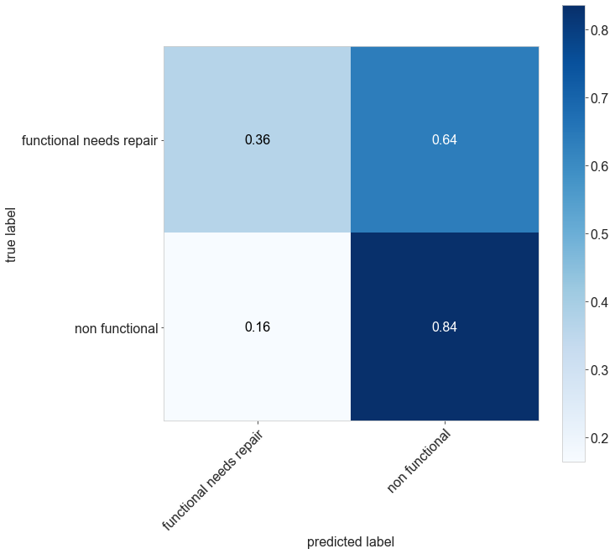
Confusion Matrix

Slide 7
Conclusion
This is definitely the go to model for Tunza Jamii, since it has the lowest False Positive Rate. (Scored the highest recall score compared to other trained models)

