Slide 1
Machine Learning in The Chapel Programming Language
Iain Moncrief
Oregon State University
Computer Science BS & Mathematics Minor, 2024
Computer Science MS, 2025
Chapel Team, Summer Intern

Slide 2

Chapel
Built for high performance computing
Includes many language constructs that support parallel computing
Distributed array programming
Many computers and CPUs can operate on the same array
Automatically utilize available resources on a machine or cluster
Programs will scale to maximize the allotted CPUs or nodes
Easily write parallel programs
Significant speedup just by rewriting a program in Chapel
Applying Chapel to machine learning
Chapel does not have an existing machine learning library
Utilize Chapels array programming features
Notes:
Chapel has no ML library
Distributed array programming, useful for ML.

Slide 3




Background
Lightweight tensor and linear algebra library
Extends NumPy to support ML needs
(backpropogation, CUDA implementation)
Fully featured ML tools (uses TensorFlow)
Notes:
Pytorch is a motivation/goal for this project

Slide 4
My Project
Implement ML programs in Python, only using NumPy
Basic ML library in a style like PyTorch or Keras
Translate the Python programs to Chapel programs
Using parallel features whenever possible
Performance comparisons between the two versions
How do these novel implementations perform with respect to one another?
See what aspects of Chapel make it easier/harder to implement ML programs
Compile a report that summarizes this and my experience learning Chapel
Notes:
Is this okay?

Slide 5

My Chapel ML Implementation
Tensor Library (intended NumPy equivalent)
Attempts to replicate much of NumPy’s functionality
Arithmetic and linear algebra operations
Supporting helper functions
Machine Learning Library (translation of my Python library)
Implements various layer types: Dense, Conv2d, MaxPool, SoftMax, ReLU, TanH, Sigmoid, Flatten, …
Offers similar user interface as PyTorch or Keras
model = Sequential(
Dense(4),
Sigmoid(),
Dense(3),
Sigmoid(),
)
var model = new Sequential(
new Dense(4),
new Sigmoid(),
new Dense(3),
new Sigmoid()
);
Notes:
Should I name my libraries so that I can refer to them more easily?

Slide 6
Performance Comparisons
Classifier implementation via Python
and NumPy (using C backend)
Classifier implementation using Chapel ML library
github.com/Iainmon/ml-chapel-summer-23/python
github.com/Iainmon/ml-chapel-summer-23/chapel
Notes:
Plain Python+NumPy acts as a baseline benchmark since it is free of advanced numerical optimizations.
Name libraries?

Slide 7
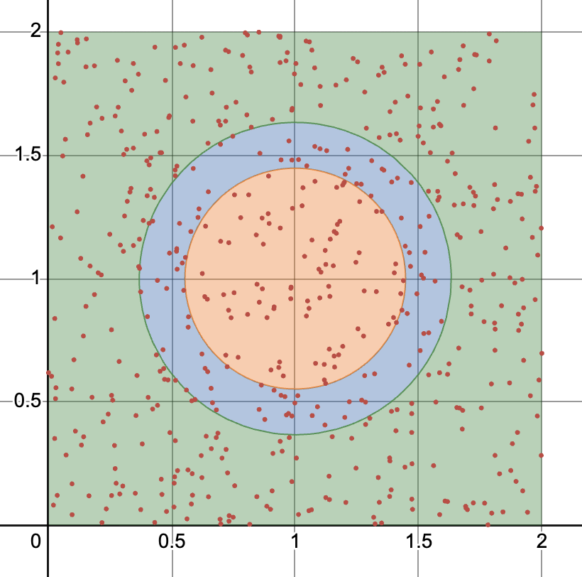
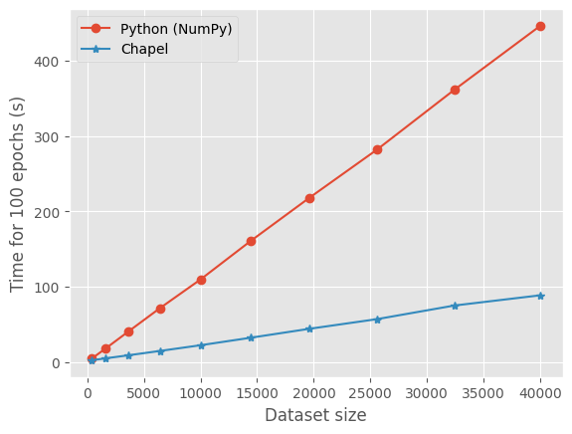
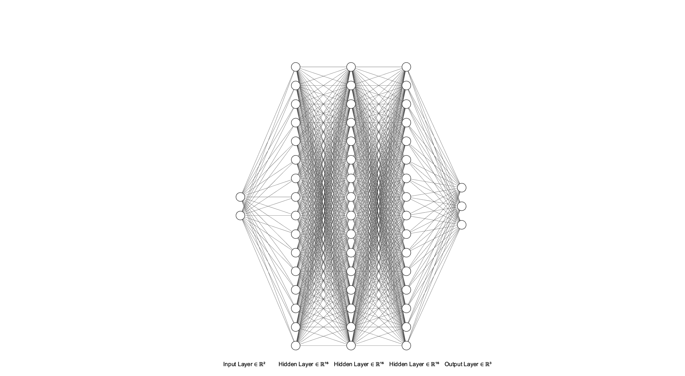
Speed Comparison (Simple Classification)
Input: N samples from [0,2] x [0,2]
Output: 3 different categories
Notes:
Why is there a speedup?
I am comparing Chapel code to python code that I have written using NumPy, not PyTorch.
Sufficient motivation?
32 core milan CPU, 128gb ram

Slide 8
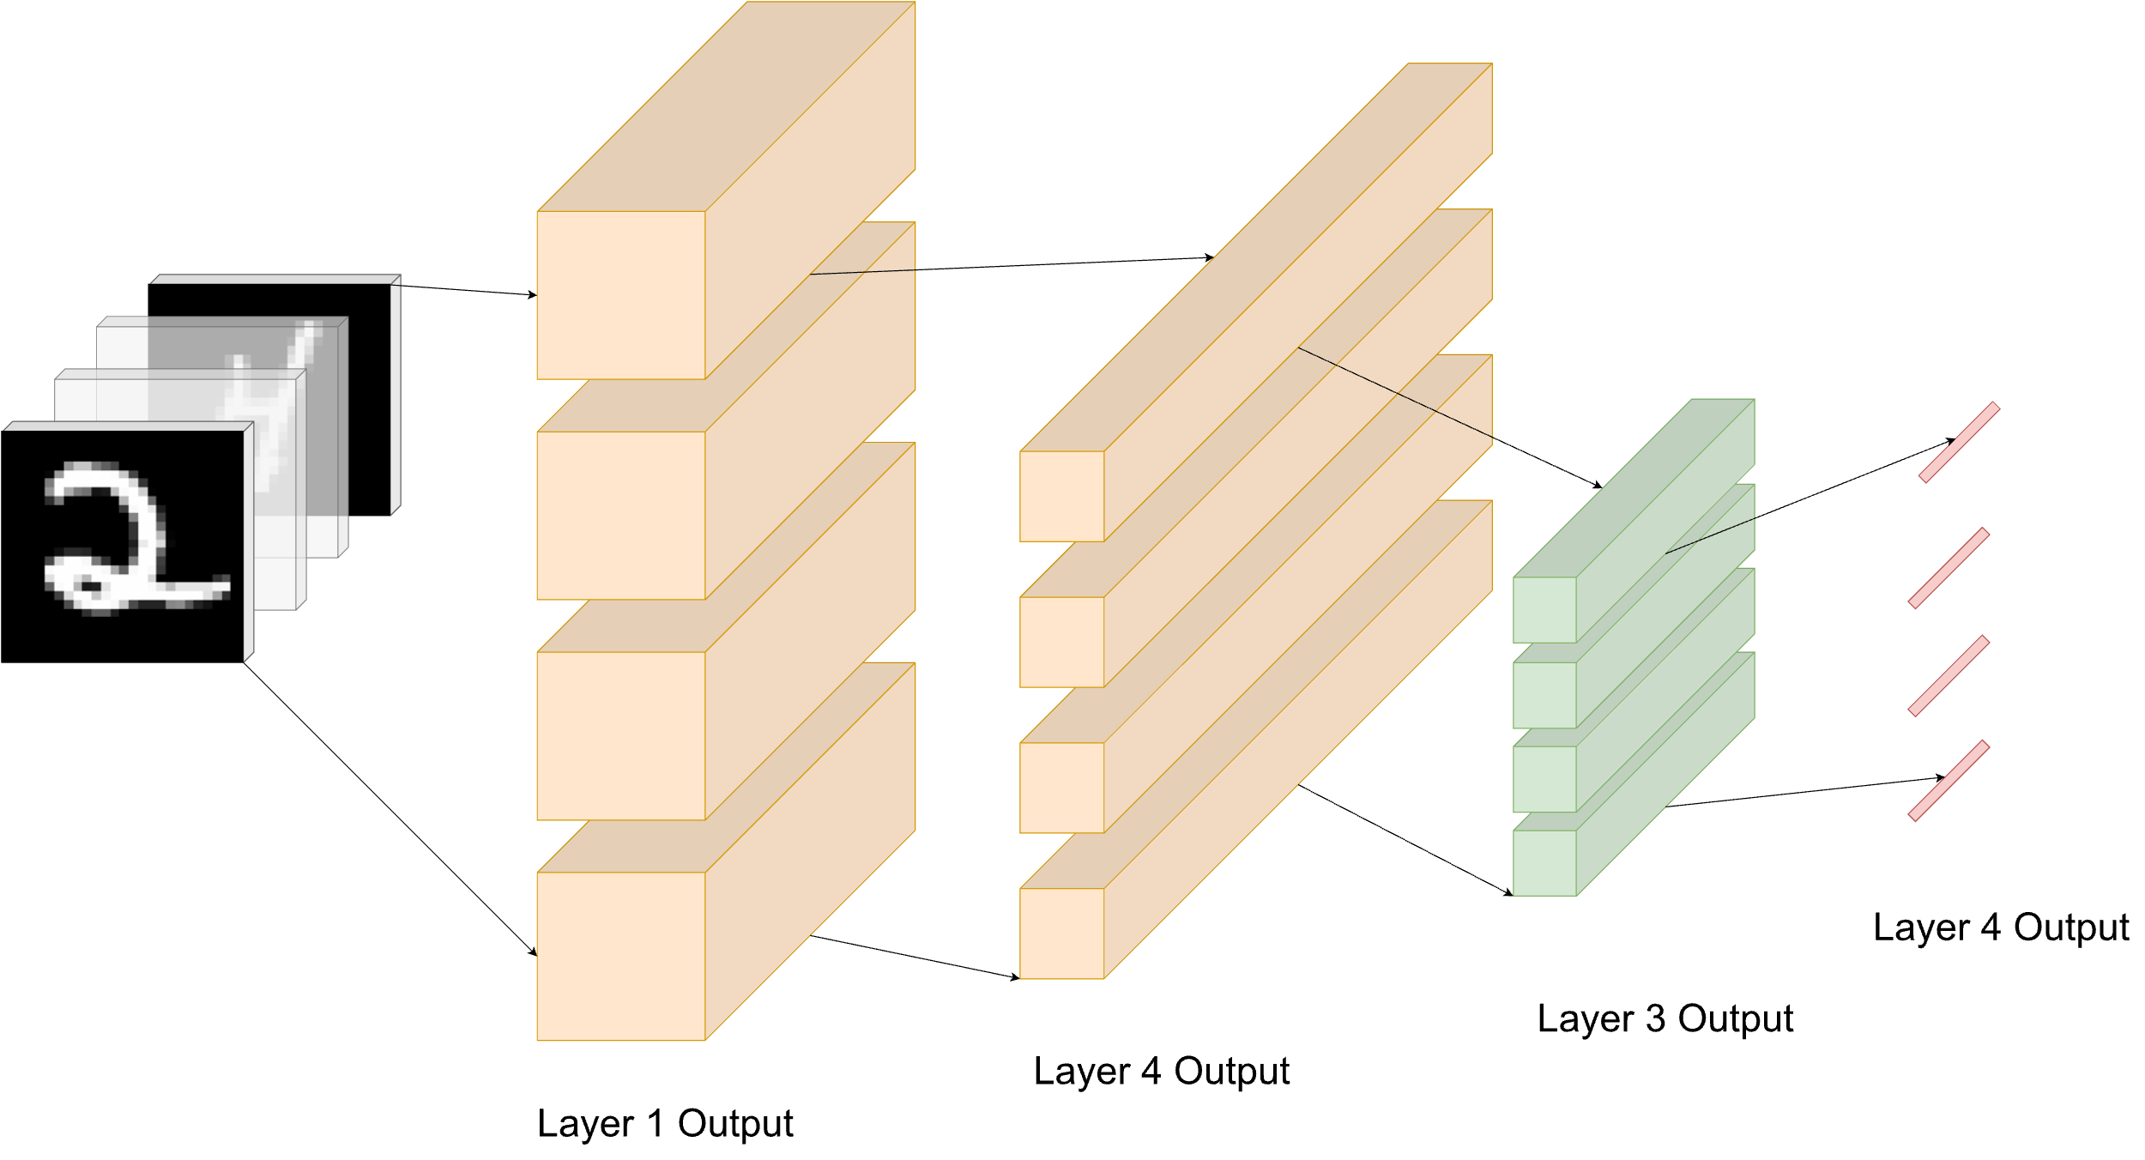
Utilizing Chapel’s Parallelism Constructs

Slide 9
Easy Parallelism
// Processes single input vector
proc forwardProp(input: Tensor(1)): Tensor(1) {
return (weights * input) + bias;
}
// Processes a batch of input vectors in parallel proc forwardPropBatch(batch: [?dom] Tensor(1)): [] Tensor(1) {
var activations: [dom] Tensor(1);
forall i in dom do
activations[i] = forwardProp(batch[i]);
return activations;
}
Notes:
Doing this sequentially is slow

Slide 10


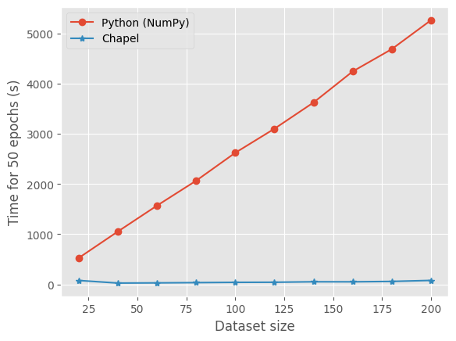
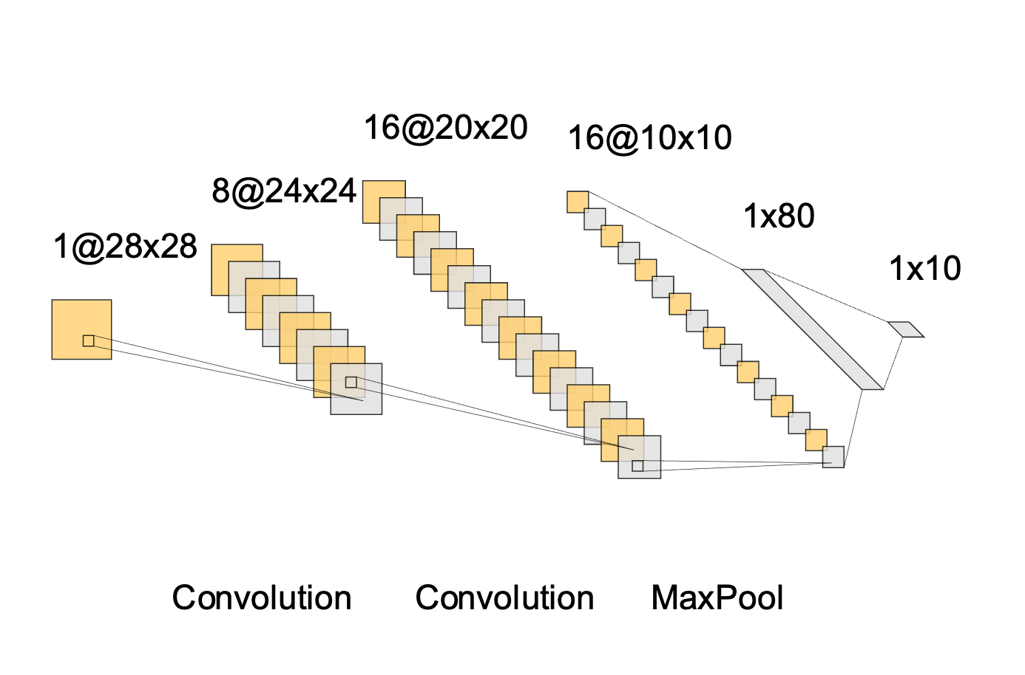
Speed Comparison (MNIST Classification)
Input:
Output: 0,1,2,3,…,9
Notes:
Python is much slower here because not all of the computations can be done in plain numpy.

Slide 11
Thank you
Thank you to my mentor, Jeremiah!

Slide 12
Summary
Proof of concept for ML library in Chapel
Submitted library to the Chapel repository
Identified pain points of implementing ML programs
Influenced language design choices via this project
Participated in design discussions
Consolidated final report (in progress)

Slide 13
Resources
CNN From Scratch With NumPy (https://www.kaggle.com/code/milan400/cnn-from-scratch-numpy)
Neural Networks from Scrath (http://neuralnetworksanddeeplearning.com/chap1.html)
Backpropagation Simplified (https://towardsdatascience.com/back-propagation-simplified-218430e21ad0)
Dive Into Deep Learning (https://d2l.ai/chapter_convolutional-neural-networks/padding-and-strides.html)
A Survey on the New Generation of Deep Learning in Image Processing (https://www.researchgate.net/publication/337746202_A_Survey_on_the_New_Generation_of_Deep_Learning_in_Image_Processing)

