Slide 1
Machine Learning in The Chapel Programming Language
Iain Moncrief
August 6, 2023

Slide 2




Background
Lightweight tensor and linear algebra library
Extends NumPy to support ML needs
(backpropogation, CUDA implementation)
Fully featured ML tools (uses TensorFlow)

Slide 3

Chapel
High performance computing
Distributed array programming
Automatically utilize maximal resources
Easily program parallel computations

Slide 4
My Project
Implement ML programs in Python, only using NumPy
Translate those programs to Chapel
Performance comparisons between the two versions
See what aspects of Chapel make it easier/harder to implement ML programs

Slide 5

My Chapel ML Implementation
Tensor Library (intended NumPy equivalent)
Attempts to replicate much of NumPy’s functionality
Arithmetic and linear algebra operations
Supporting helper functions
Machine Learning Library (translation of my Python library)
Implements various layer types: Dense, Conv2d, MaxPool, SoftMax, ReLU, TanH, Sigmoid, Flatten, …
Offers similar user interface as PyTorch or Keras
model = Sequential(
Dense(4),
Sigmoid(),
Dense(3),
Sigmoid(),
)
var model = new Sequential(
new Dense(4),
new Sigmoid(),
new Dense(3),
new Sigmoid()
);

Slide 6
Performance Comparisons
Classifier implementation via Python
and NumPy (using C backend)
Classifier implementation using Chapel ML library
github.com/Iainmon/ml-chapel-summer-23/python
github.com/Iainmon/ml-chapel-summer-23/chapel
Notes:
Plain Python+NumPy acts as a baseline benchmark since it is free of advanced numerical optimizations

Slide 7
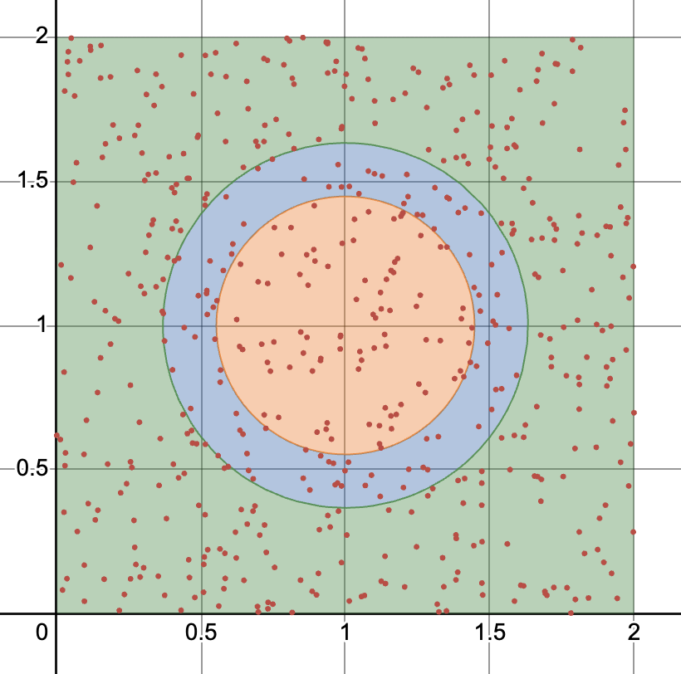
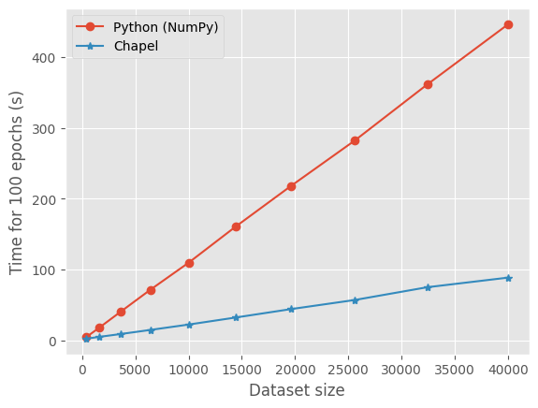
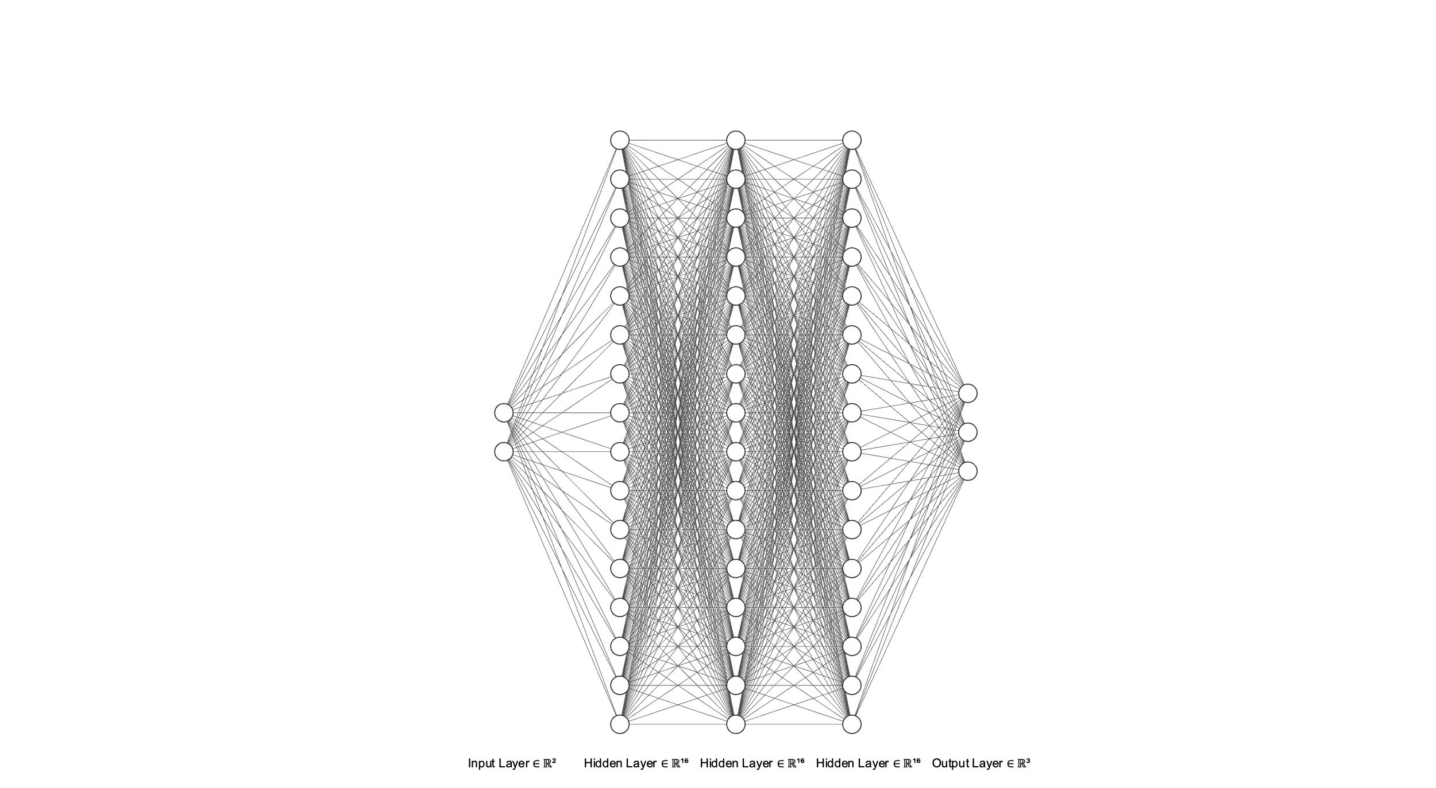
Speed Comparison (Simple Classification)
Input: N samples from [0,2] x [0,2]
Output: 3 different categories
Notes:
Why is there a speedup?
I am comparing Chapel code to python code that I have written using NumPy, not PyTorch.

Slide 8
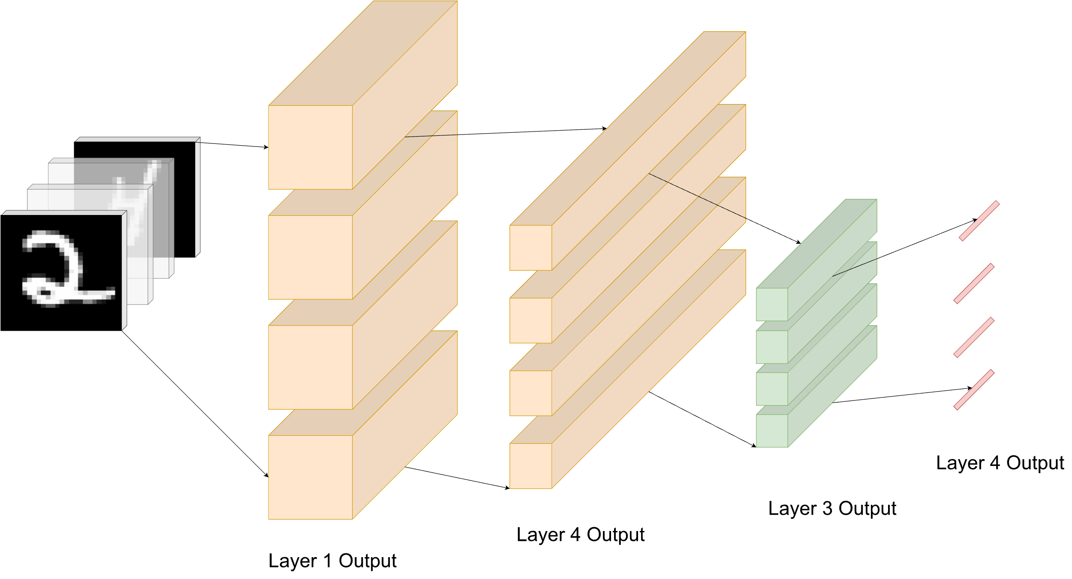
Utilizing Chapel’s Parallelism Constructs

Slide 9
Easy Parallelism
// Processes single input vector
proc forwardProp(input: Tensor(1)): Tensor(1) {
return (weights * input) + bias;
}
// Processes a batch of input vectors in parallel proc forwardPropBatch(batch: [] Tensor(1)): [] Tensor(1) {
var activations: [batch.domain] Tensor(1) = new Tensor({0..#numNeurons});
forall i in batch.domain do
activations[i] = forwardProp(batch[i]);
return activations;
}

Slide 10


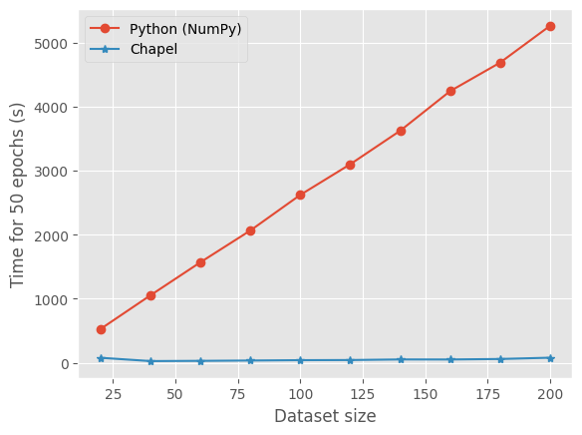
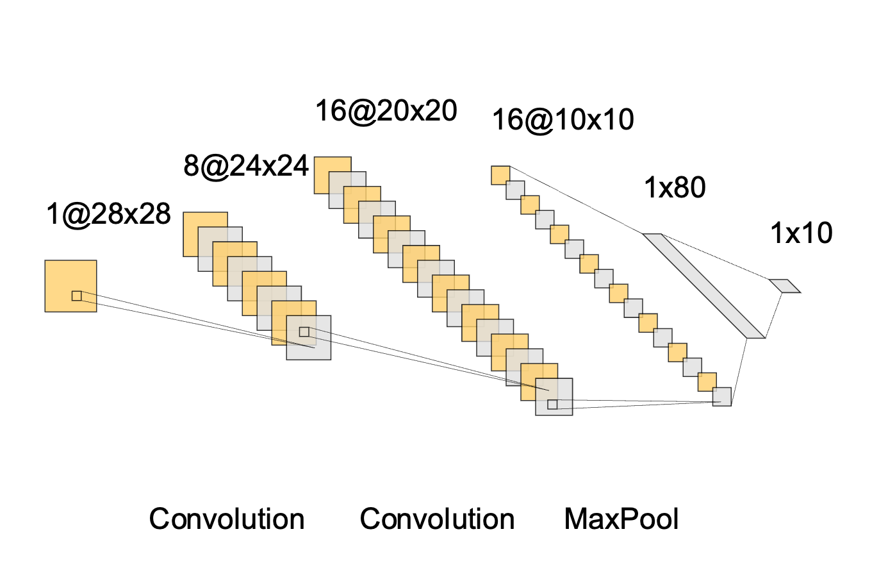
Speed Comparison (MNIST Classification)
Input:
Output: 0,1,2,3,…,9
Notes:
Python is much slower here because not all of the computations can be done in plain numpy.

Slide 11
Thank you

