Slide 1
Machine Learning in The Chapel Programming Language
Iain Moncrief
August 6, 2023

Slide 2




Background
Lightweight tensor and linear algebra library
Extends NumPy to support ML needs
(backpropogation, CUDA implementation)
Fully featured ML tools (uses TensorFlow)

Slide 3

Chapel
High performance computing
Sophisticated array programming
Automatically utilize maximal resources
Easily program parallel computations

Slide 4
My Project
Implement ML programs in Chapel
See what aspects of Chapel make it easier/harder to implement ML programs
Performance comparison

Slide 5
My Chapel ML Implementation
Tensor Library
Attempts to replicate much of NumPy’s functionality
Arithmetic and linear algebra operations
Supporting helper functions
Machine Learning Library
Implements various layer types: Dense, Conv2d, MaxPool, SoftMax, ReLU, TanH, Sigmoid, Flatten, …
Offers similar user interface as PyTorch or Keras
model = Sequential(
Dense(4),
Sigmoid(),
Dense(3),
Sigmoid(),
)
var model = new Sequential(
new Dense(4),
new Sigmoid(),
new Dense(3),
new Sigmoid()
);

Slide 6
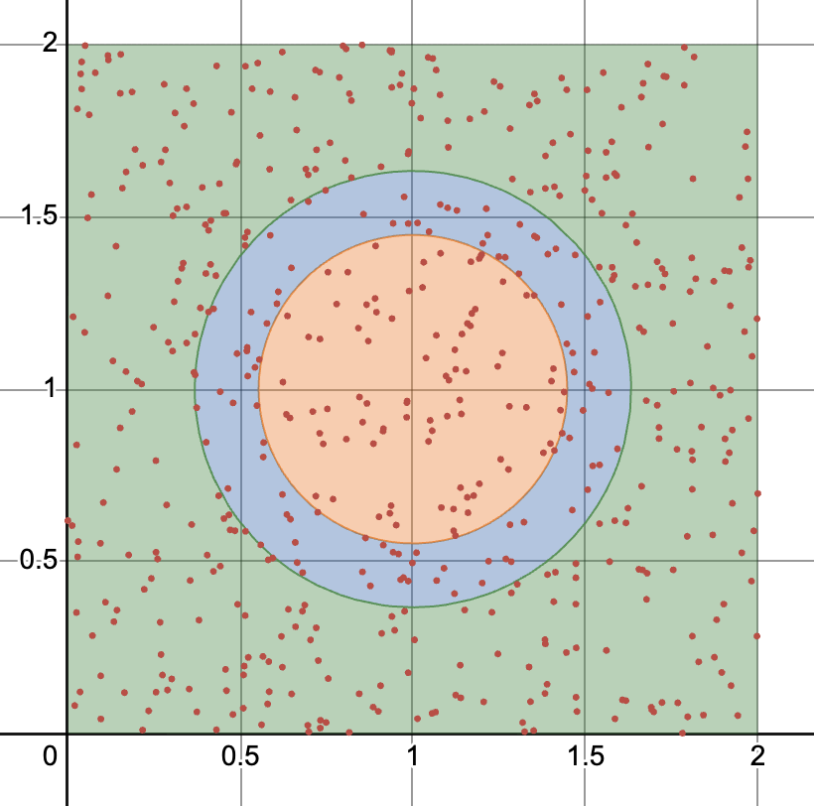
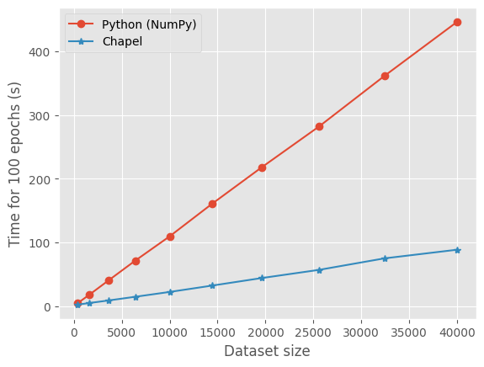
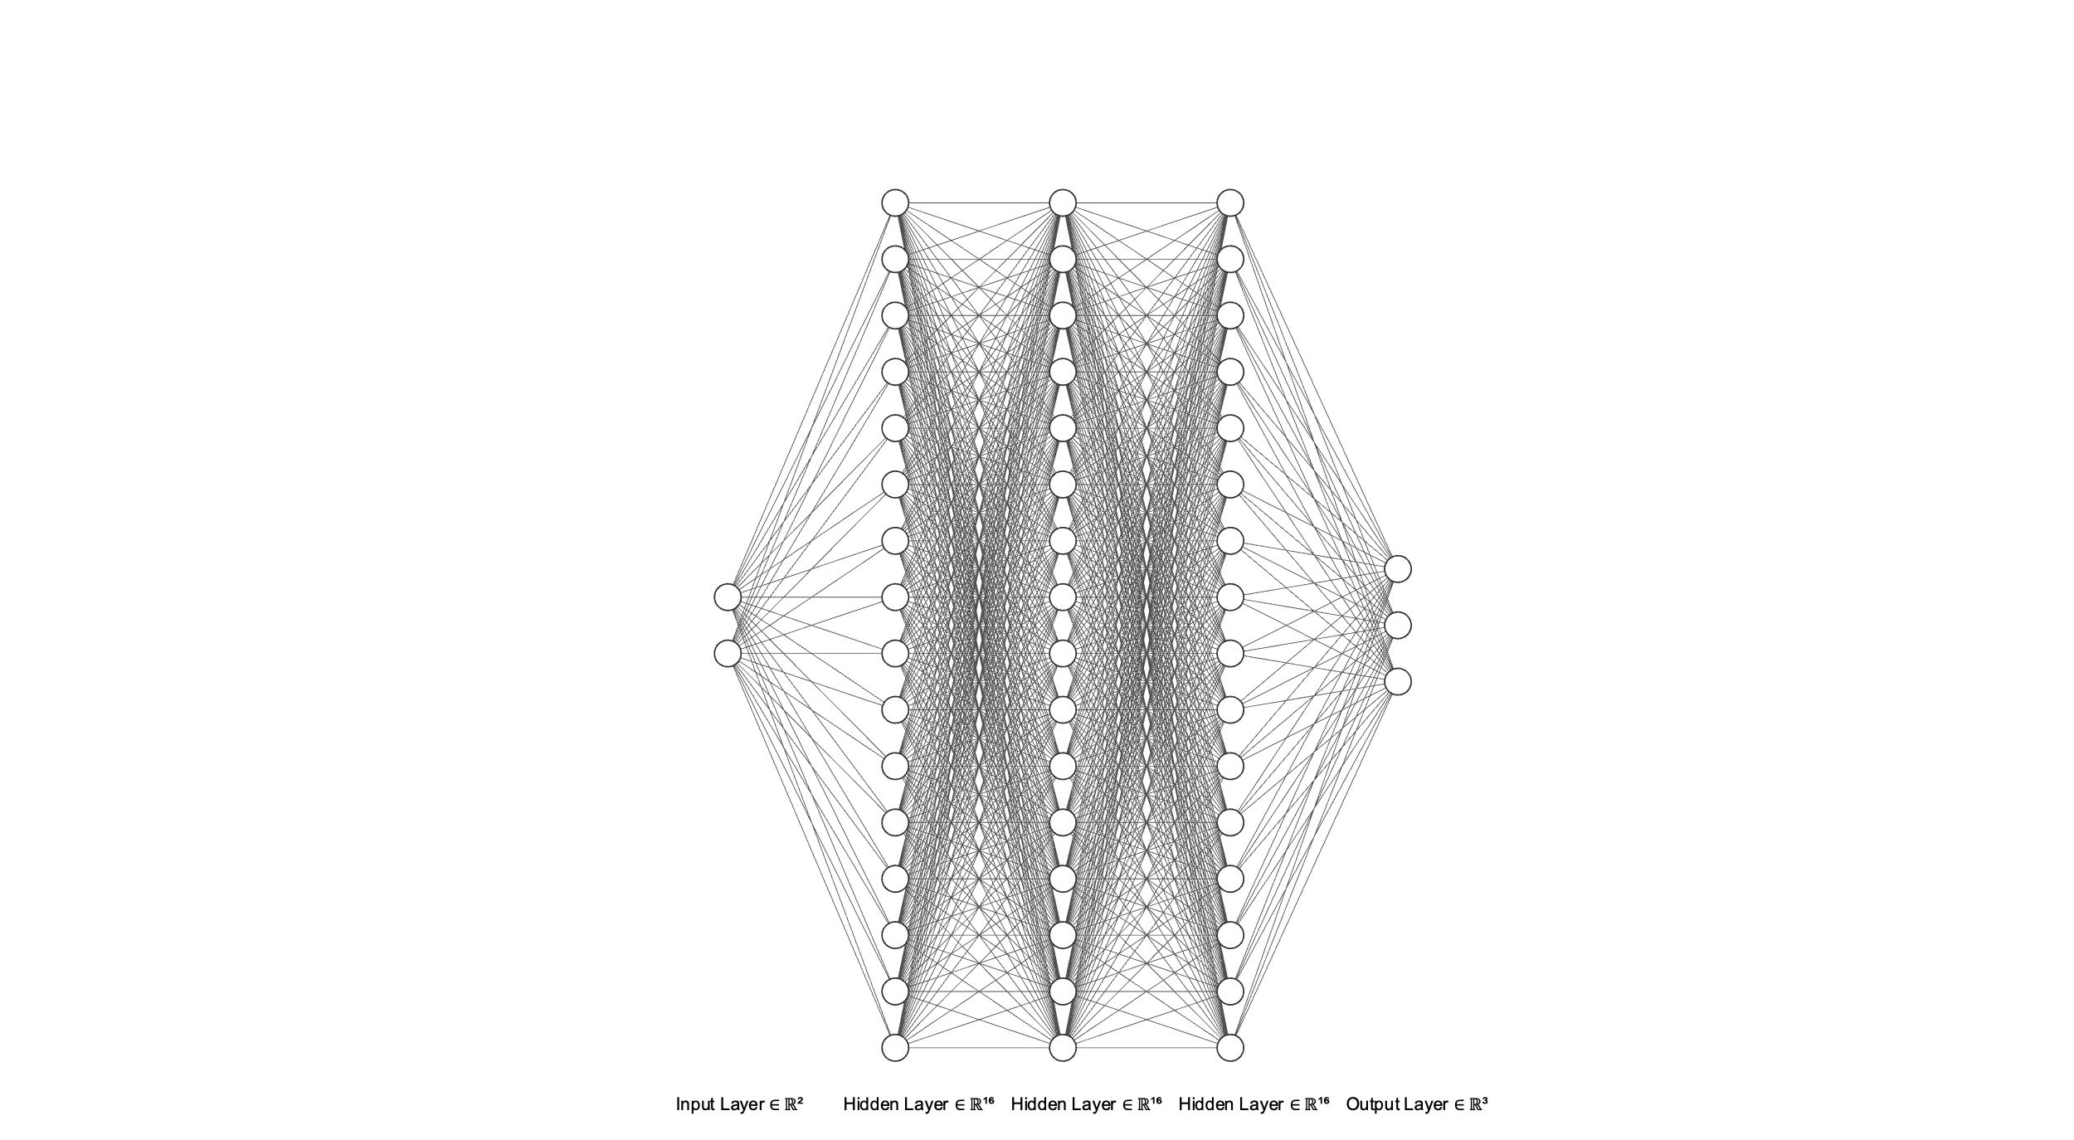
Speed Comparison (Simple Classification)
Input: N samples from [0,2] x [0,2]
Output: 3 different categories

Slide 7
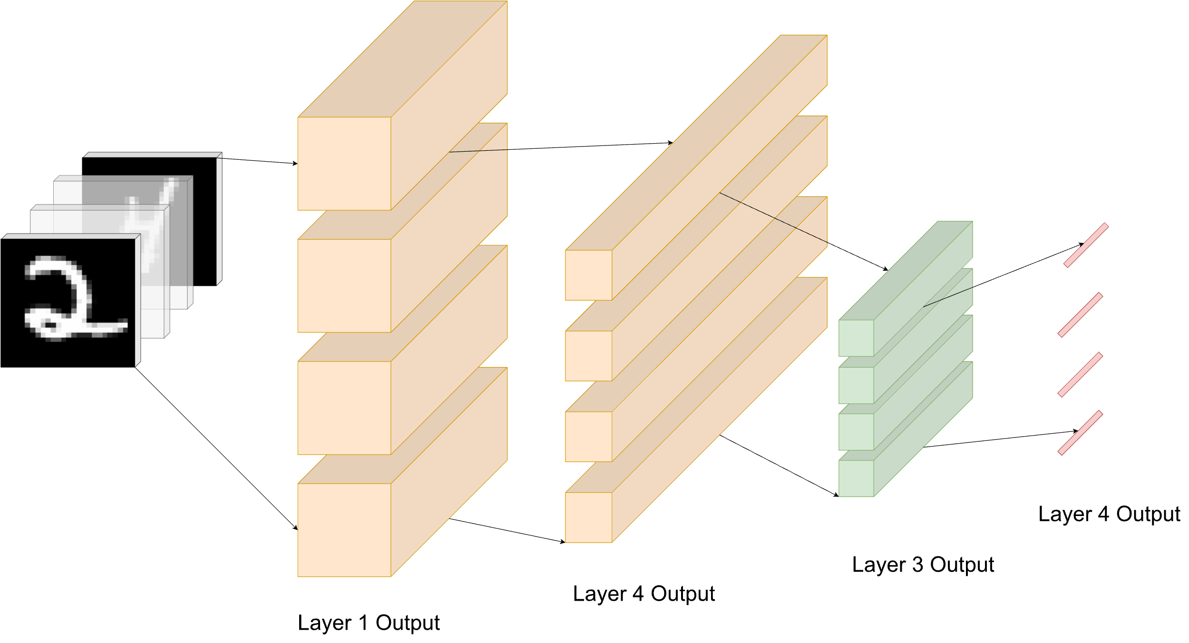
Utilizing Chapel’s Parallelism Constructs

Slide 8


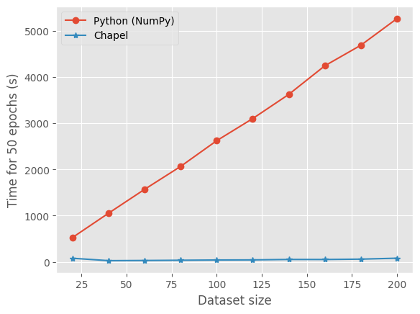
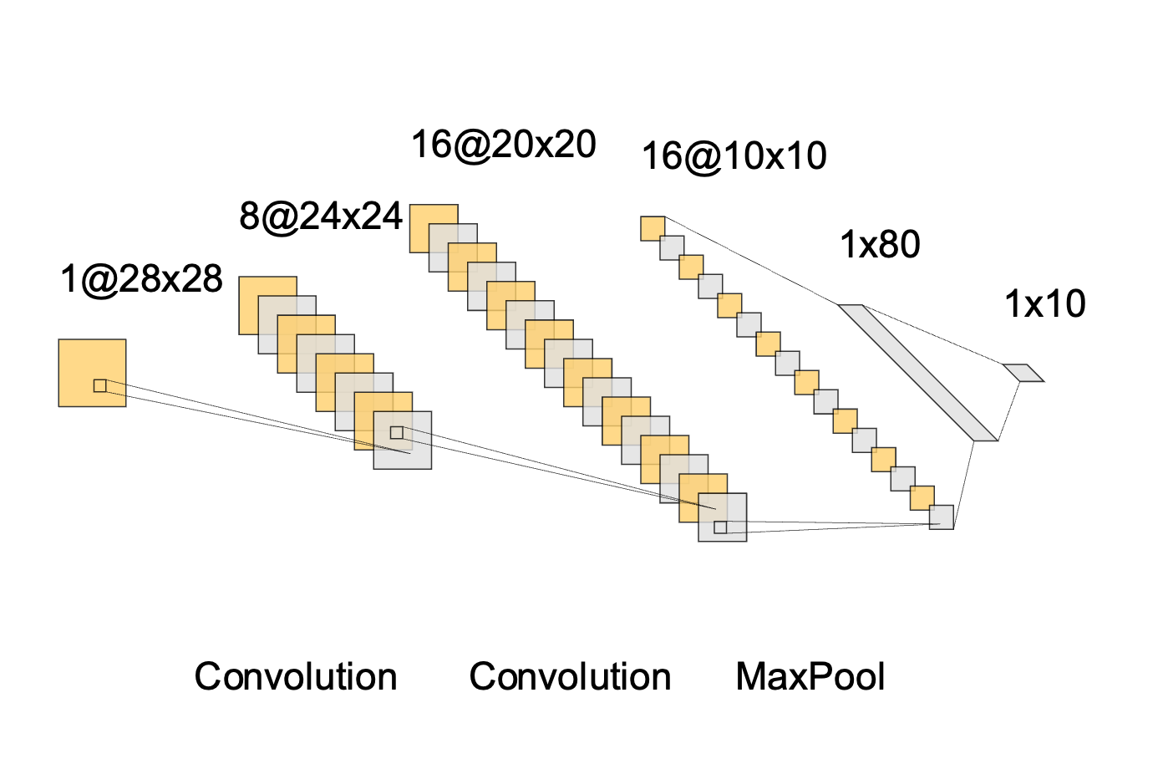
Speed Comparison (MNIST Classification)
Input:
Output: 0,1,2,3,…,9

Slide 9
Thank you

Slide 10
