Slide 1
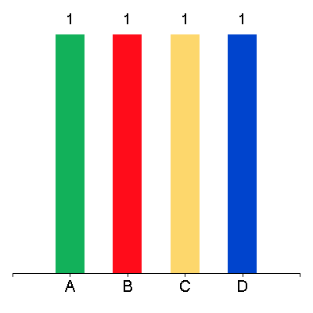
Which is not the part of process Dojo?
Process Stations
Process Flow Diagram
Shop Floor
Work Instructions
00:30

Slide 2
Which are the parts of 4M??
Man
Master
Manufacturing
Metal Fabrication
00:30

Slide 3
Which are the material handling identification points?
00:30
OK
NG
On Hold
Pause

Slide 4
How Many elements of production rule Dojo are there?
00:30
3
6
4
5

Slide 5
Do 5s rules help systematically to achieve a totally organized, cleaned & standardized workplace?
Yes
No
Both A & B
Others
00:30

Slide 6
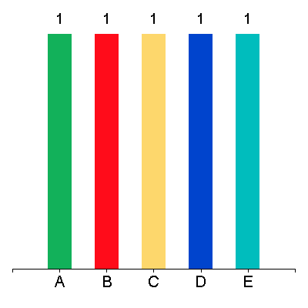
+what
Op
Opt
Opti
Optio
Option

