Slide 1
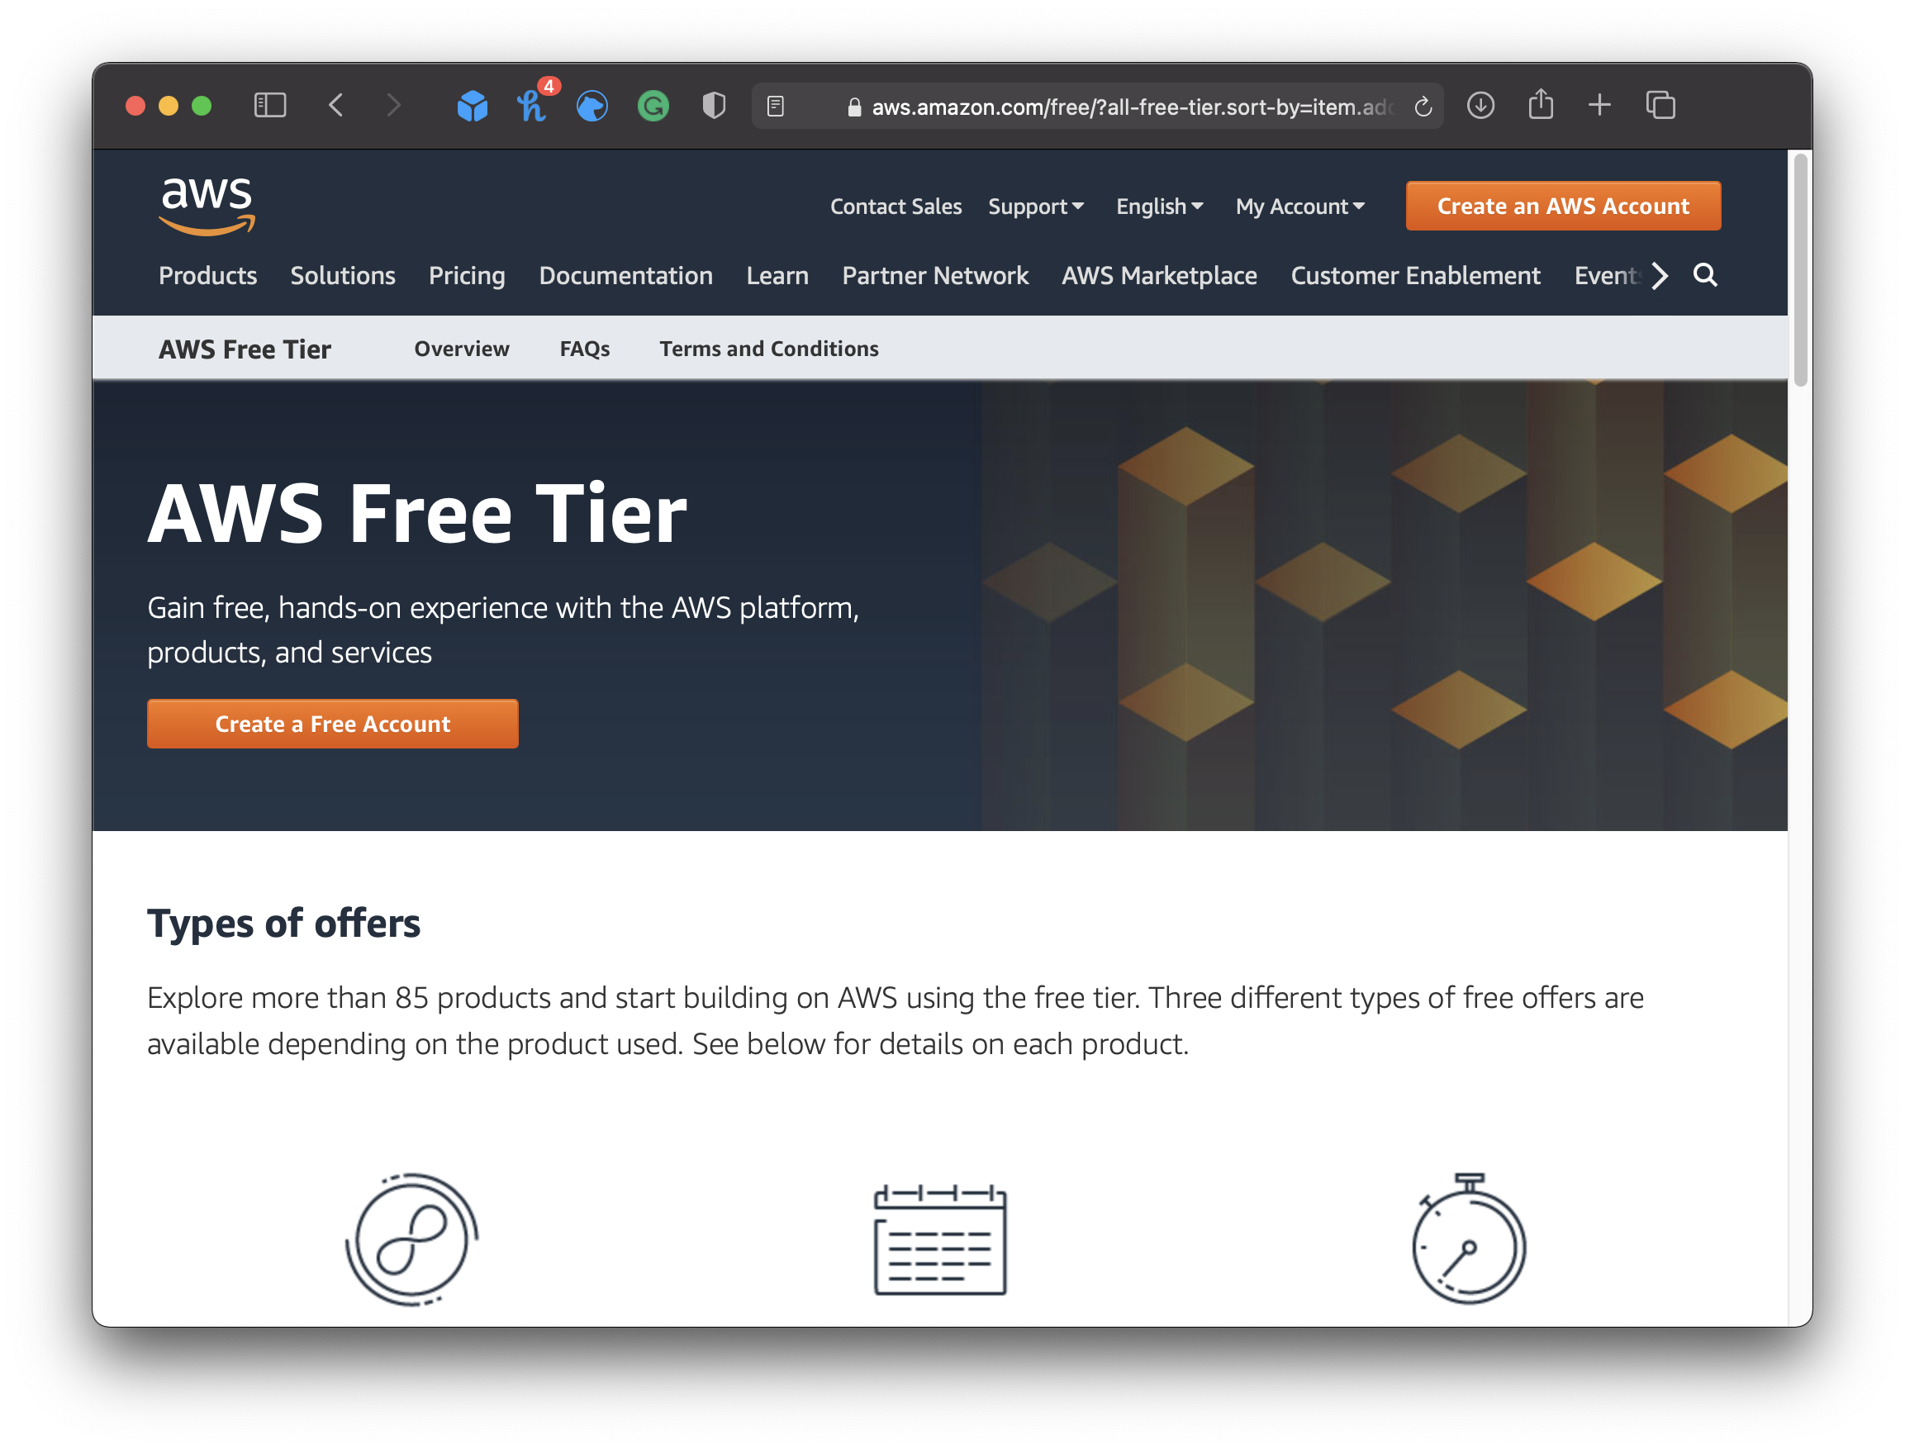
Getting Started with AWS Free Tier
Step1: go to any browser and launch this Url : https://aws.amazon.com/

Slide 2
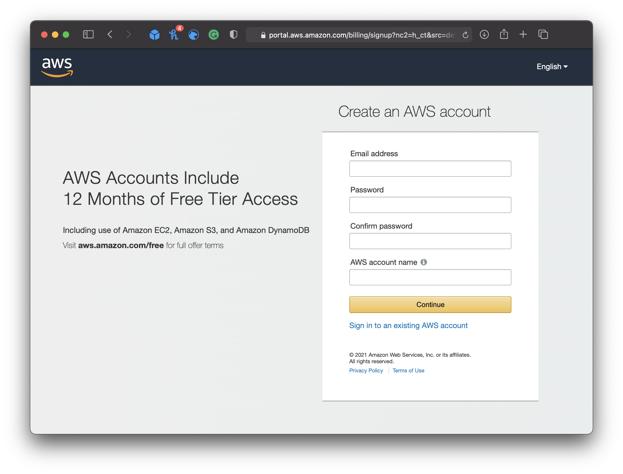
Accessing AWS Free Tier
Step2. After Launching the Url
-we are able to see Create tier Account just click On that one
please provide Valid email and Password and enter the name you want to your account and click continue.

Slide 3
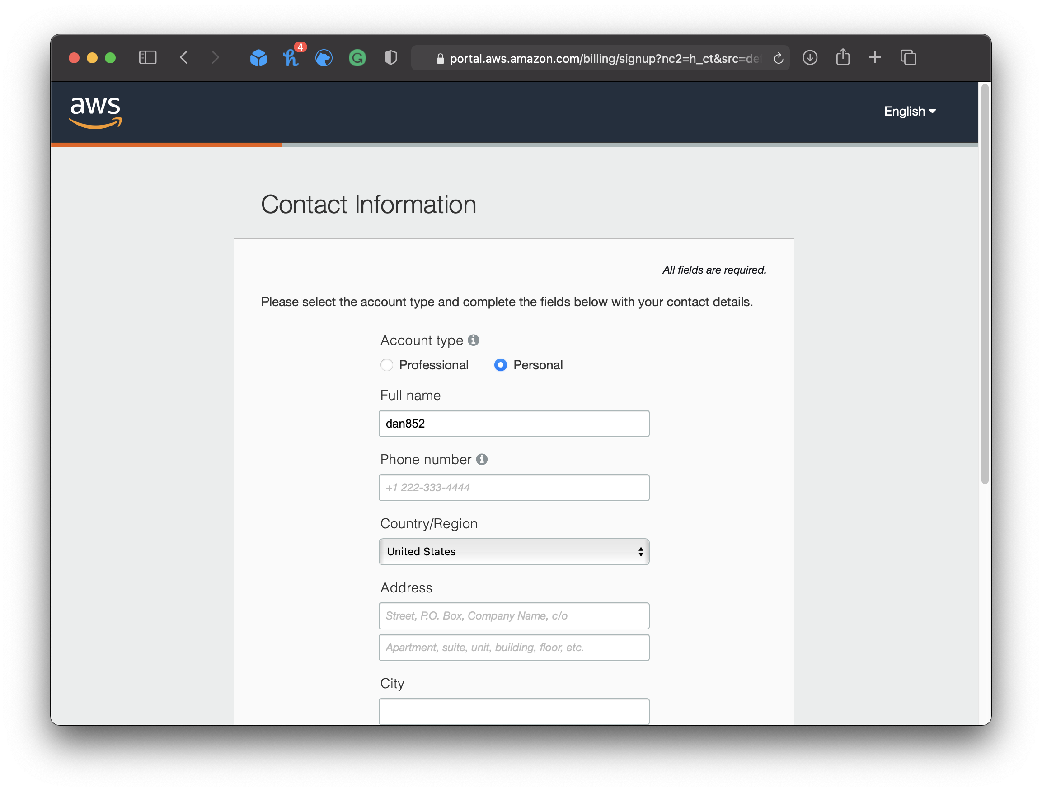
Entering the Contact infromation
Step3:after clicking you will navigate to the contact information provide the contact the information

Slide 4
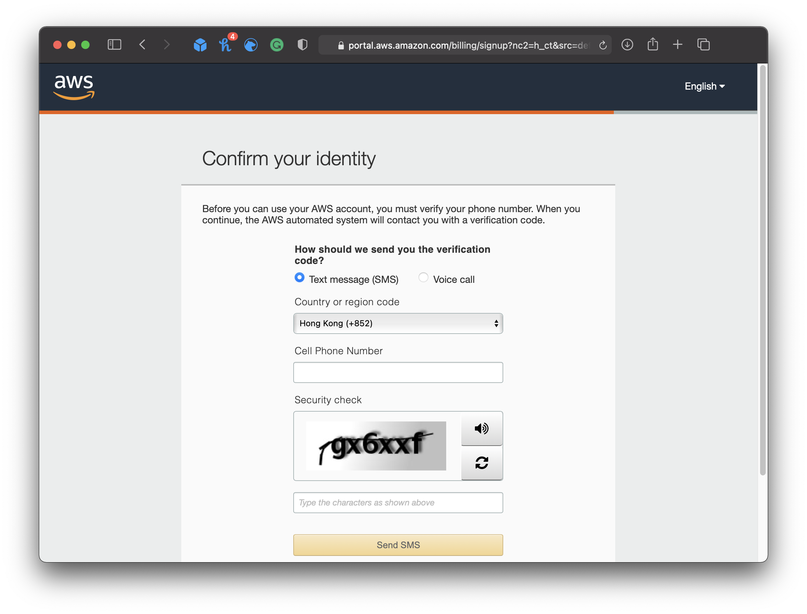
Confirm your Identity
Enter the valid Phone number and enter the verification code that you recieved and enter Captcha.

Slide 5
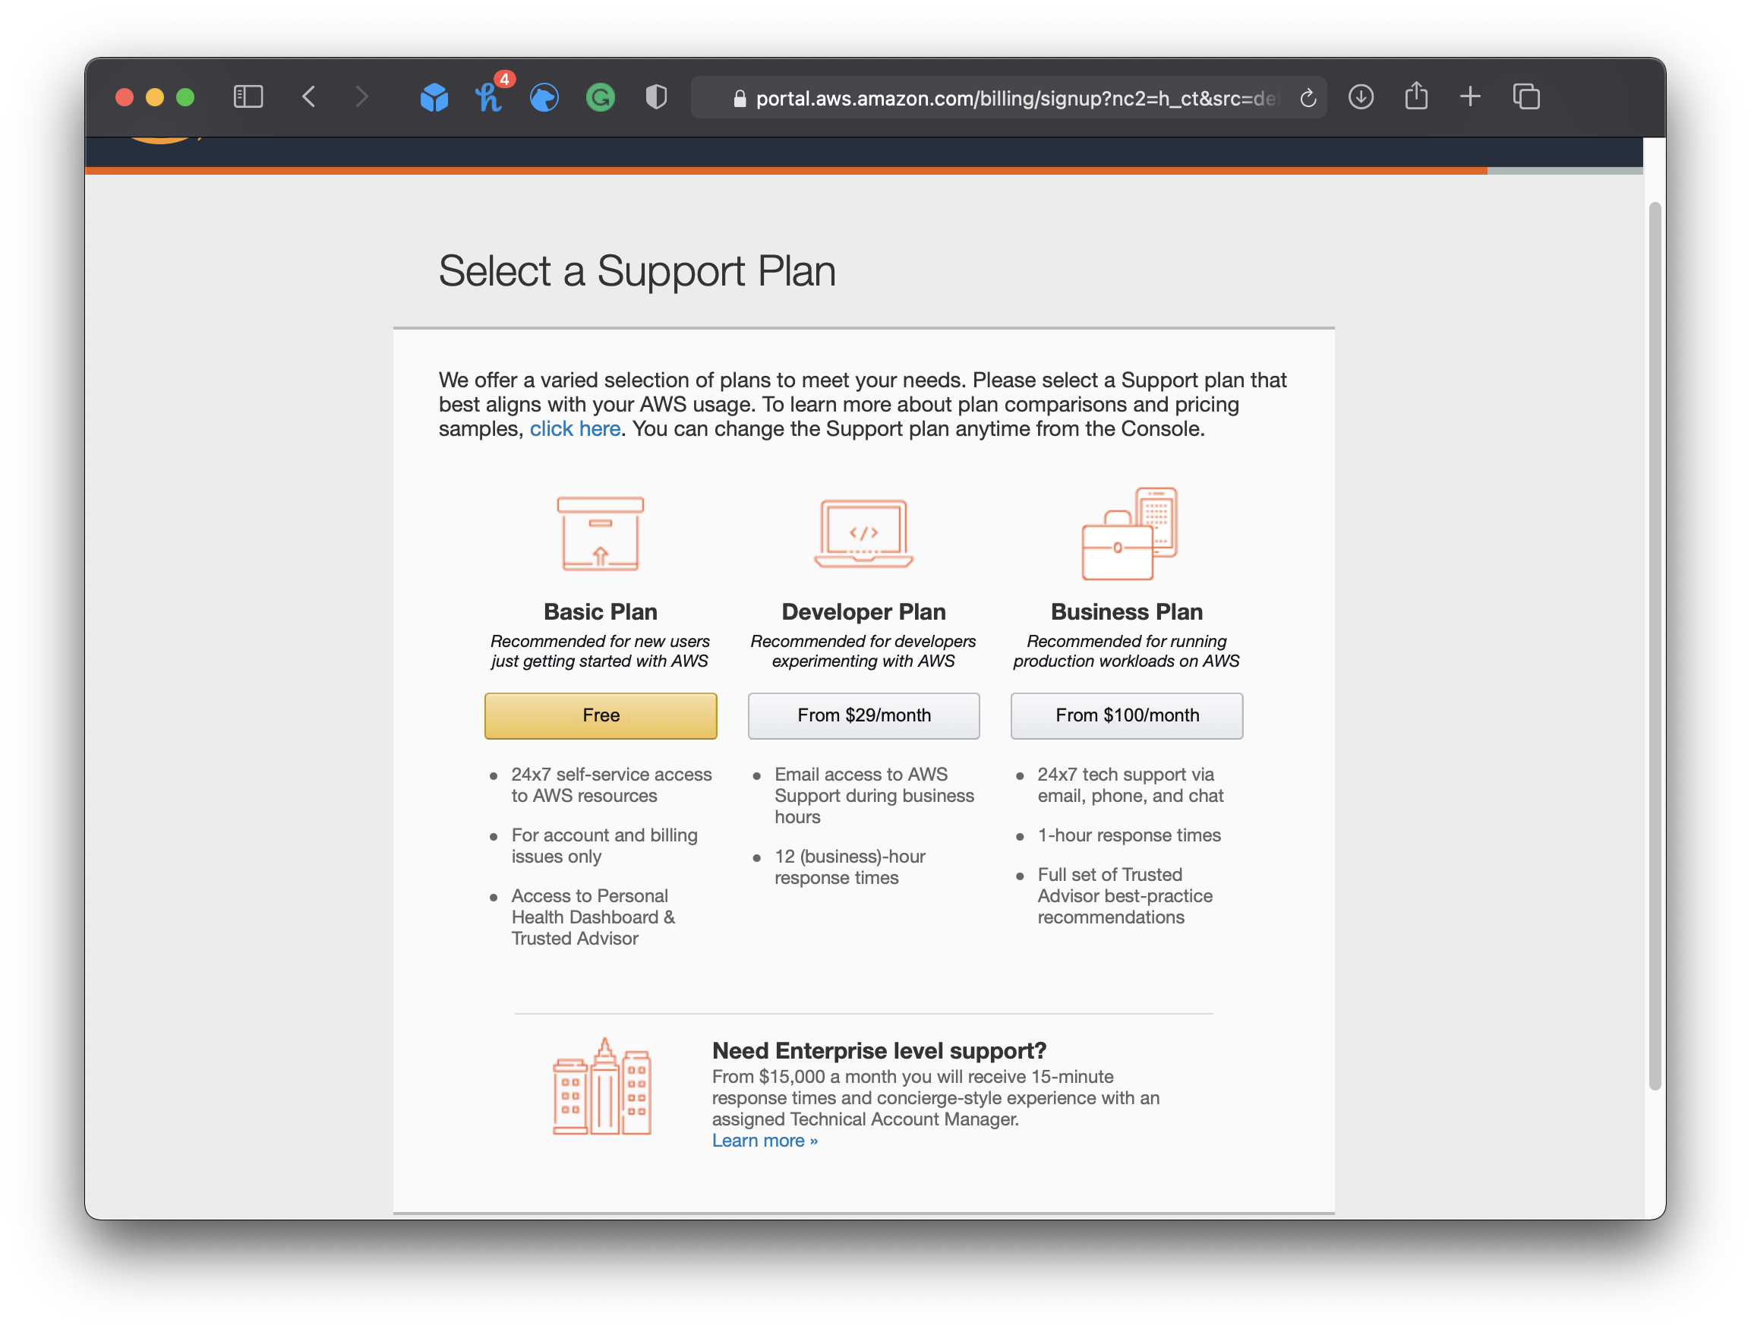
Choosing the Right Selection Plan
Explanation of phone verification process.
after validating the one time password you will able to see the plans like
And you need to chose Basic Plan - Free Tier

Slide 6
Key Points Remeber When you are using the credit and Debit Cards
1.First you need to login internet banking section
2. you need to enable international Trasactions
3. Then only your Trascation will not proceed and you are not able to access the aws account.

Slide 7
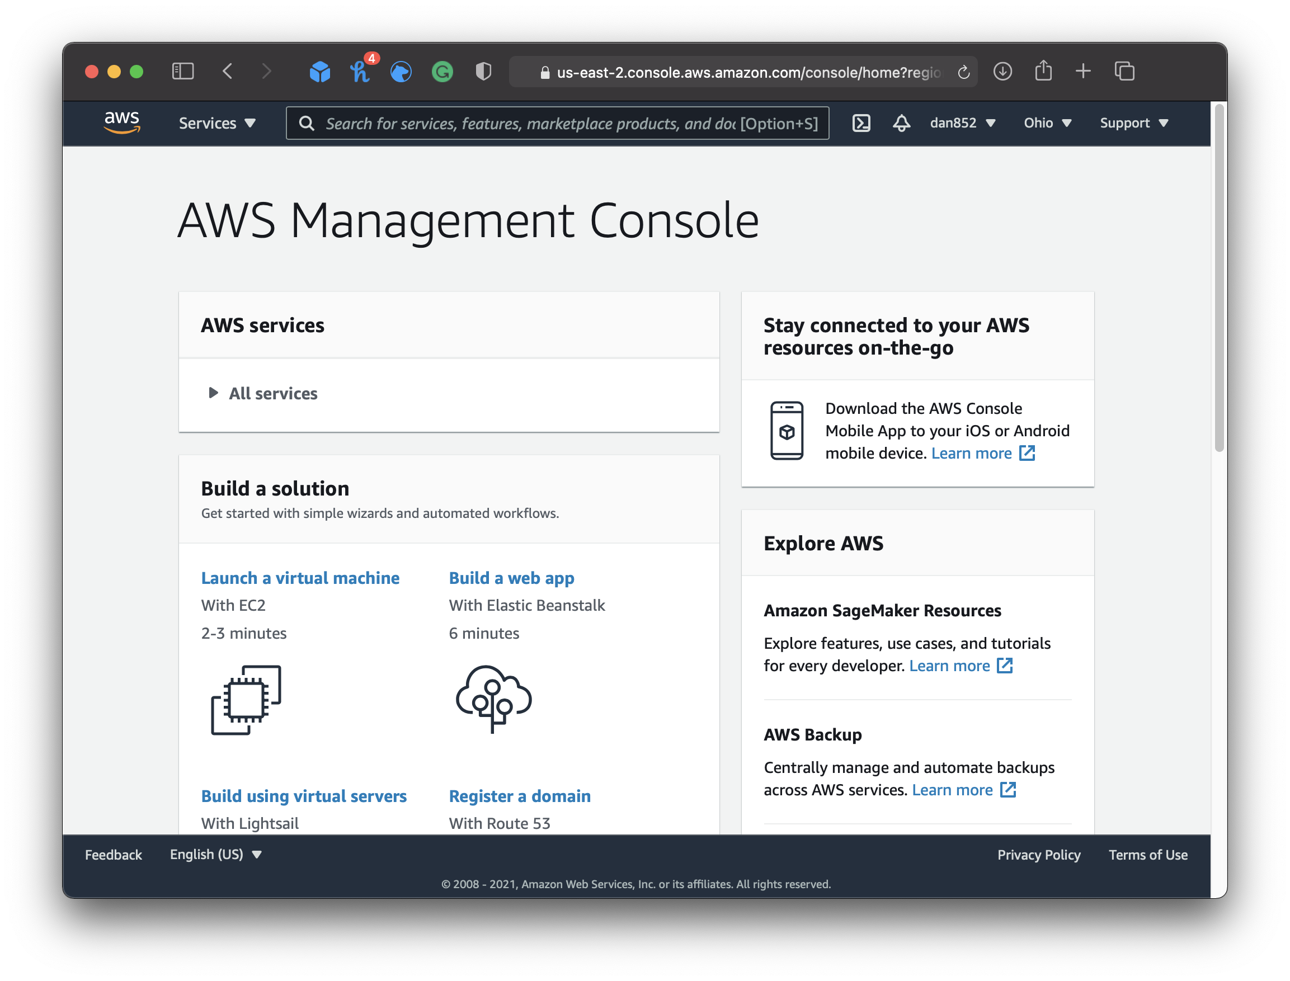
AWS Management Console
Introduction to AWS Console and its features.

Slide 8
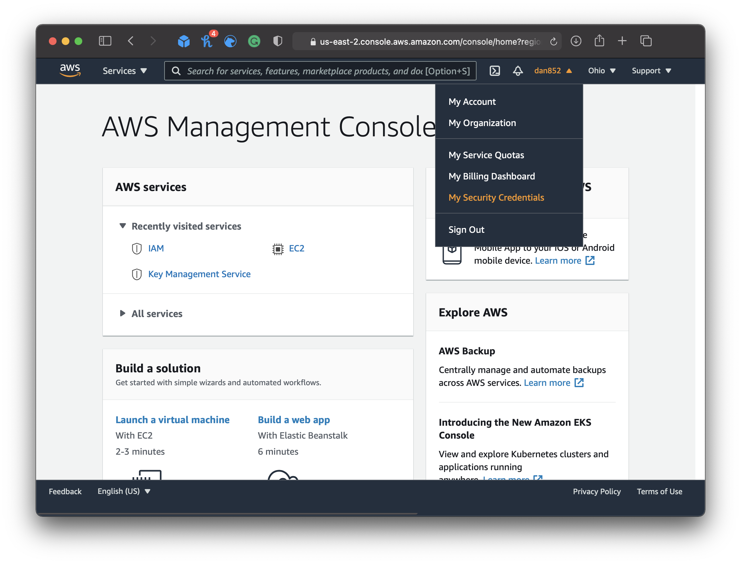
Creating AWS Access Keys
Steps to generate Secret Key and Access Key ID.

Slide 9
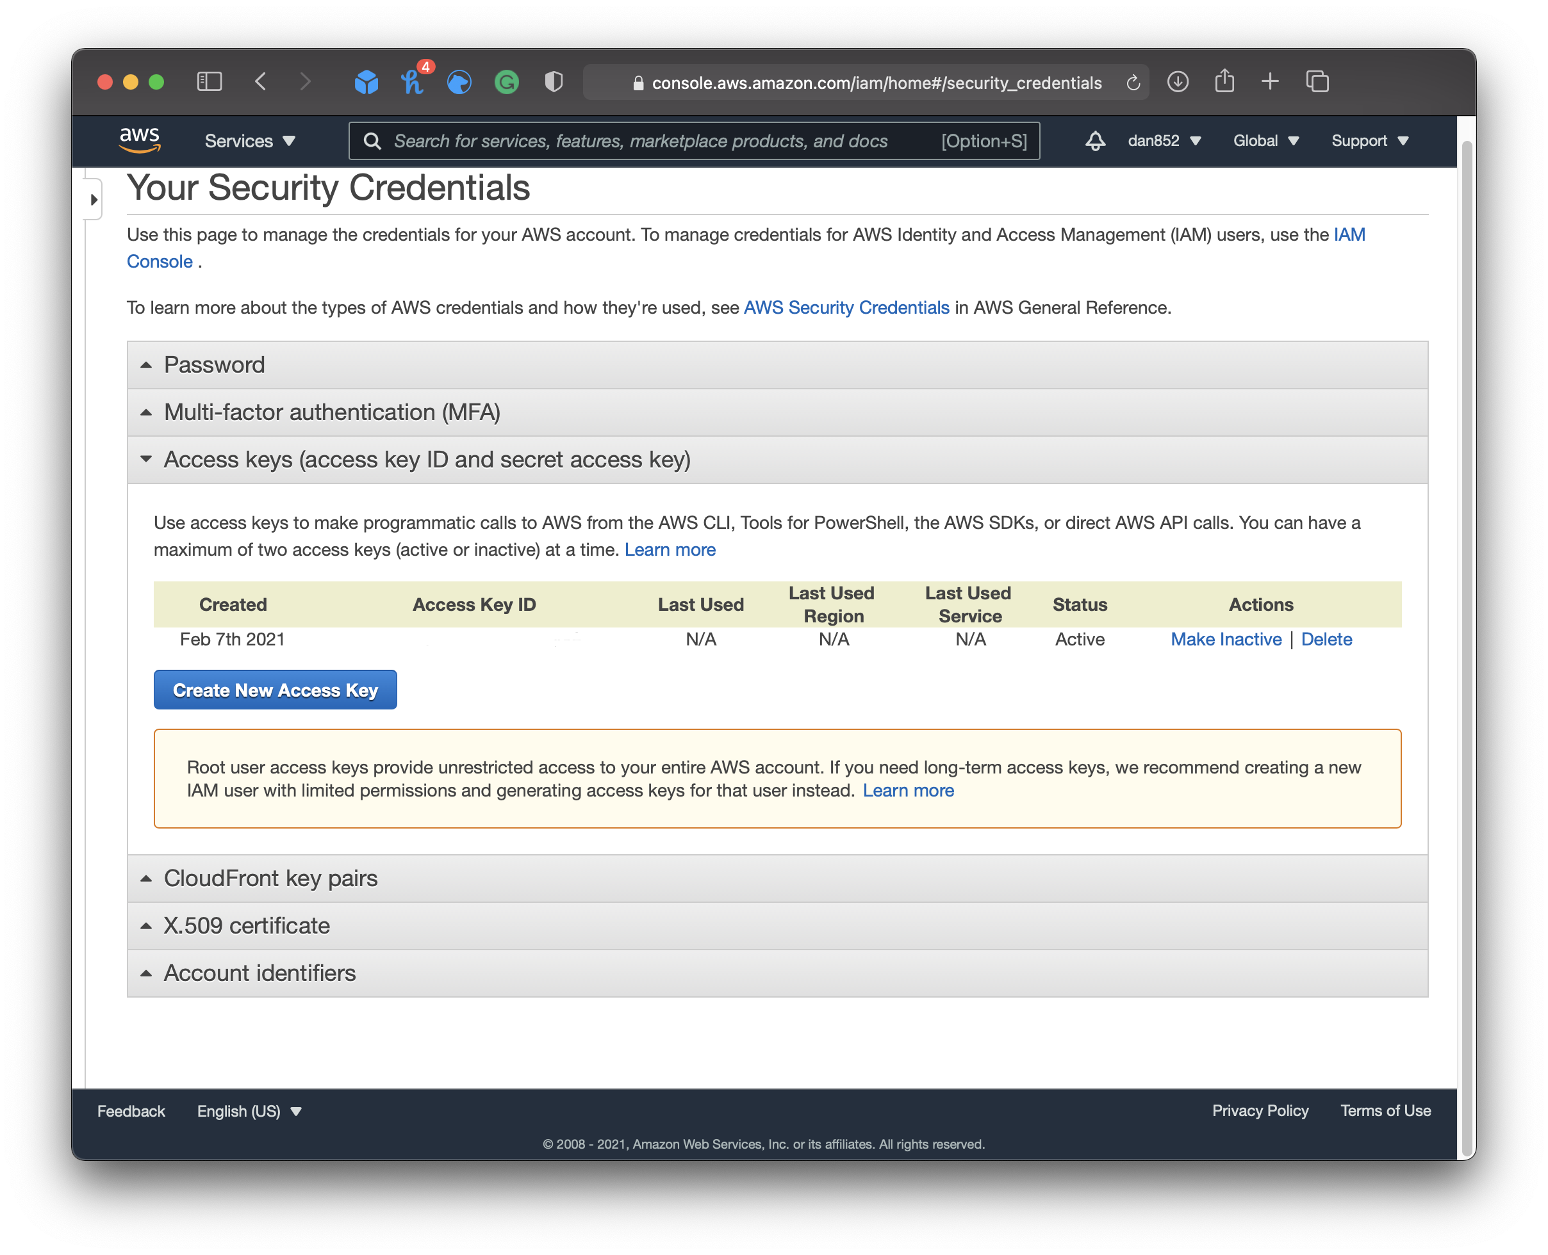
Creating Access Key
click on Create New Access Key and

Slide 10
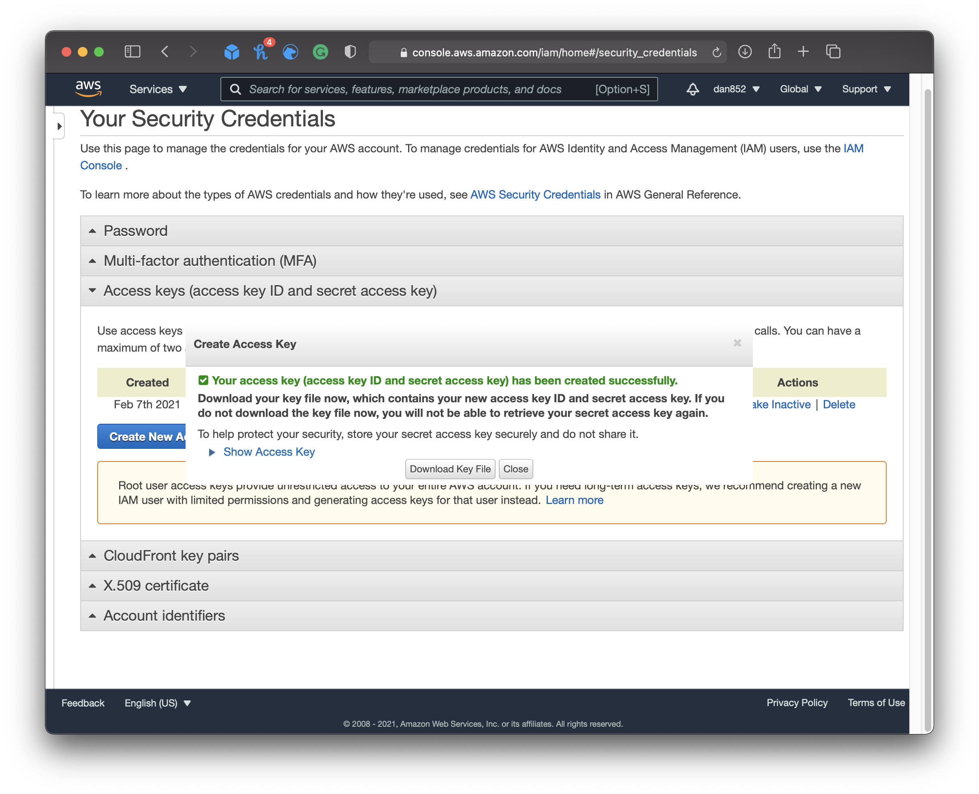
Store the Access keys
Recap of steps and encouragement to explore AWS services.

