Slide 1
OptiServe: AI-Driven Task Prioritization for Enhanced Service Delivery

Slide 2
Objective
Enhance the order workflow to improve efficiency and boost revenue. Following the completion of a series of tasks, an order is initiated. During this process, delays may occur due to reasons such as task failures, fallout tasks, or inaccurately updated dates.
Proposed Solution
We have implemented order prioritization, followed by task prioritization within those orders. This approach significantly reduces the overall time required to complete the orders. Leveraging various machine learning models, we efficiently prioritize both orders and their associated tasks.

Slide 3


TP-Architecture
DATABRICKS
Fetch data
DATABASE
User
Dashboard
PYTHON SCRIPTS
WM_TASK_DATA
MEASURED_DATA
WIP_BLOCKER
VM_TASK_DATA
TACTICAL_WIP
Data preprocessing
Fetch data
ML Models
Estimated Time Prediction
Fallout Rate Prediction
Prioritization Script
Save data
Order priority prediction
TP_RESULTS_ORDER
Estimated Task Time Forecast
Fetch ML
Models
Task Priority prediction
Save data
TP_RESULTS_TASK
Overall priority

Slide 4
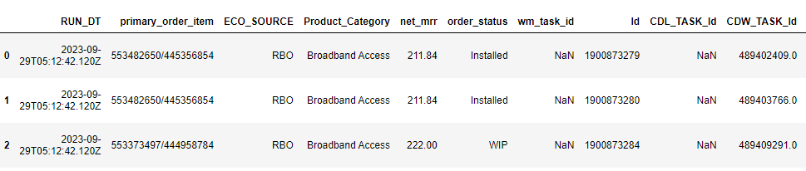
Dataset Description
1 year of data (2023)
41.9 L rows of data with 64 columns which includes information about the order on a task level, proposed customer dates, revenue, fallouts etc.
Detailed Report – [dataset description report]

Slide 5
Data Preparation
1. SOURCE
VW_TASK_DATA_WIP_ORDER
MEASURED_DATA
VM_TASK_DATA
WIP_ORDER_BLOCKER
TACTICAL_WIP_DETAIL
2. PRE-PROCESSING
Encoding of categorical variables.
Dropping missing values.
Identifying outliers using IQR Method.
Derivation of new features using existing features.

Slide 6
ML Models
Description | ML Model Type | Algorithm | Accuracy
Task Time forecasting | Regression | Random Forest Regressor
Estimated time prediction | Regression | Support Vector Regressor | 83%
Fallout rate prediction | Regression | Random Forest Regressor
Order priority prediction | Regression | Random Forest Regressor
Detailed report – [ml models accuracy report]

Slide 7
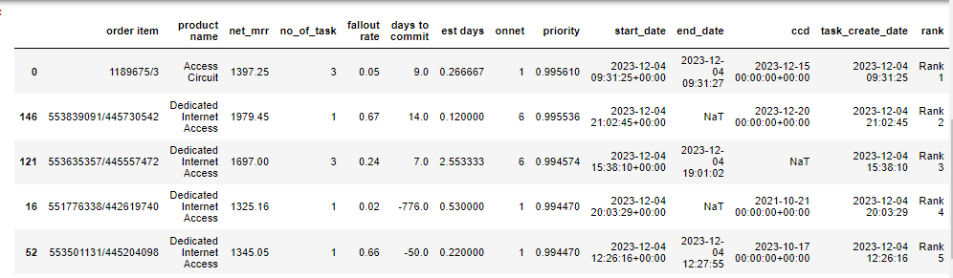
Order Prioritization
Prioritized the orders based on the important features from all the models mainly revenue, no of tasks, fallout rate, days forecasting, days to commit to the customer.

Slide 8
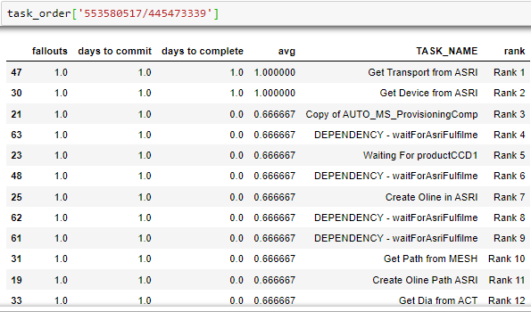
Task Prioritization for order - 553580517/445473339

Slide 9
Metrics for order Prioritization
Top 10 Orders picked by each method for Jan 2024
method name | Total orders | Total time taken | Total Revenue | CCD difference | Total fallouts | Pred Days | Pred Fallouts
weightage | 1198 | 261 | 34470.76 | 462 | 104 | 384.578529 | 57.442495
ranking | 1198 | 449 | 3632.65 | 703 | 135 | 545.419712 | 77.940305
net_mrr/ccd | 1198 | 534 | 2970.85 | 670 | 101 | 523.89795 | 66.334513
regression | 1198 | 265 | 36952.51 | 505 | 67 | 403.088273 | 51.569491
cluster | 1198 | 492 | 9149.69 | 716 | 147 | 529.589537 | 98.318605
Detailed Report – [metrics derivation in lumen mail]

Slide 10
Business Outcome
Data driven decision making – Tasks and orders are prioritized based on data driven AI’s decision model.
Forecasting – Forecasting estimated time taken for order installation and forecasts the fallouts that might occur.
Adaptability – AI model adapts and continuously learns and evolves based on new data. As the business landscape changes, these models adjust their prioritization strategies dynamically.
Efficiency – Quick and efficient service delivery which results in increased revenue, efficient usage of resources and time management.

