Slide 1


ACCESS CONTROLS

Slide 2







INTRODUCTION
USERS FIRST MUST BE IDENTIFIED AS AUTHORIZED USER, SUCH AS BY LOGGING IN WITH USER NAME AND PASSWORD TO LAPTOP COMPUTER
BECAUSE LAPTOP CONNECTS TO CORPORATE NETWORK THAT CONTAINS CRITICAL DATA, IMPORTANT ALSO TO RESTRICT USER ACCESS TO ONLY SOFTWARE, HARDWARE, AND OTHER RESOURCES FOR WHICH USER HAS BEEN APPROVED
THESE TWO ACTS—AUTHENTICATING ONLY APPROVED USERS AND CONTROLLING THEIR ACCESS TO RESOURCES—ARE IMPORTANT FOUNDATIONS IN INFORMATION SECURITY

Slide 3











WHAT IS ACCESS CONTROL?
ACCESS CONTROL - GRANTING OR DENYING APPROVAL TO USE SPECIFIC RESOURCES; IT IS CONTROLLING ACCESS
PHYSICAL ACCESS CONTROL - FENCING, HARDWARE DOOR
LOCKS, AND MANTRAPS THAT LIMIT CONTACT WITH DEVICES
TECHNICAL ACCESS CONTROL - TECHNOLOGY RESTRICTIONS THAT LIMIT USERS ON COMPUTERS FROM ACCESSING DATA

Slide 4







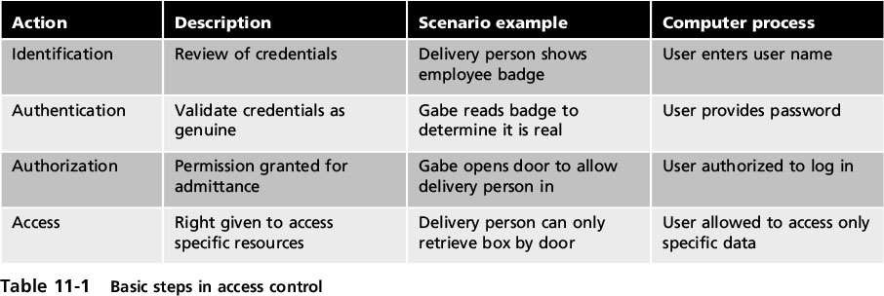
ACCESS CONTROL TERMINOLOGY
IDENTIFICATION - PRESENTING CREDENTIALS (EXAMPLE: DELIVERY DRIVER PRESENTING EMPLOYEE BADGE)
AUTHENTICATION - CHECKING CREDENTIALS (EXAMPLE: EXAMINING THE DELIVERY DRIVER’S BADGE)
AUTHORIZATION - GRANTING PERMISSION TO TAKE ACTION
(EXAMPLE: ALLOWING DELIVERY DRIVER TO PICK UP PACKAGE)

Slide 5

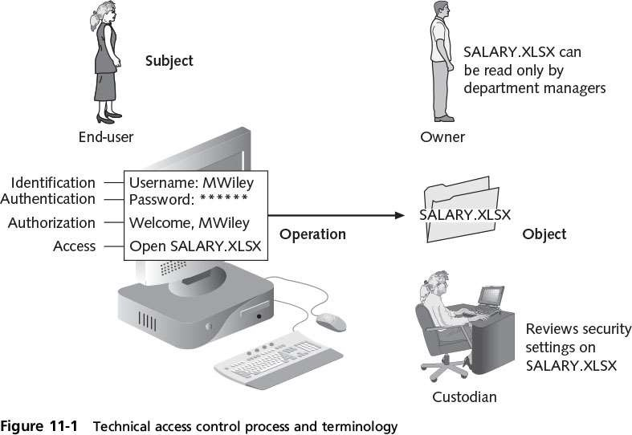
TECHNICAL ACCESS CONTROL PROCESS

Slide 6

















ACCESS CONTROL MODELS
ACCESS CONTROL MODEL - HARDWARE AND SOFTWARE PREDEFINED FRAMEWORK THAT CUSTODIAN CAN USE FOR CONTROLLING ACCESS
ACCESS CONTROL MODELS USED BY CUSTODIANS FOR ACCESS CONTROL ARE NEITHER CREATED NOR INSTALLED BY CUSTODIANS OR USERS; INSTEAD, THESE MODELS ARE ALREADY PART OF SOFTWARE AND HARDWARE.
ACCESS CONTROL MODELS
DAC - LEAST RESTRICTIVE MODEL
MAC - OPPOSITE OF DAC AND IS MOST RESTRICTIVE ACCESS CONTROL MODEL
UAC - USER/ADMIN LEVEL MODEL THAT NOTIFIES OR REQUIRES AUTHENTICATION PRIOR TO GRANTING ACCESS

Slide 7








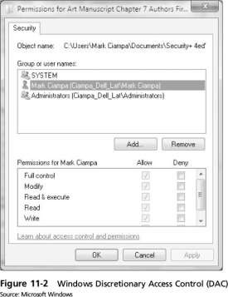











DISCRETIONARY ACCESS CONTROL (DAC)
DISCRETIONARY ACCESS CONTROL (DAC) - LEAST RESTRICTIVE MODEL
EVERY OBJECT HAS OWNER, WHO HAS TOTAL CONTROL OVER THAT OBJECT
OWNERS CAN CREATE AND ACCESS THEIR OBJECTS FREELY
OWNER CAN GIVE PERMISSIONS TO OTHER SUBJECTS OVER THESE OBJECTS
DAC USED ON OPERATING SYSTEMS LIKE UNIX AND MICROSOFT WINDOWS
DAC HAS TWO SIGNIFICANT WEAKNESSES:
DAC RELIES ON DECISIONS BY END-USER TO SET PROPER LEVEL OF SECURITY; INCORRECT PERMISSIONS MIGHT BE GRANTED TO SUBJECT OR PERMISSIONS MIGHT BE GIVEN TO UNAUTHORIZED SUBJECT
SUBJECT’S PERMISSIONS WILL BE “INHERITED” BY ANY PROGRAMS THAT SUBJECT EXECUTES; ATTACKERS OFTEN TAKE ADVANTAGE OF THIS INHERITANCE BECAUSE END-USERS

Slide 8




















MANDATORY ACCESS CONTROL (MAC)
MANDATORY ACCESS CONTROL (MAC) - OPPOSITE OF DAC AND IS MOST RESTRICTIVE ACCESS CONTROL MODEL
MAC ASSIGNS USERS’ ACCESS CONTROLS STRICTLY
ACCORDING TO CUSTODIAN’S DESIRES AND USER HAS NO FREEDOM TO SET ANY CONTROLS
TWO KEY ELEMENTS TO MAC:
LABELS - EVERY ENTITY IS AN OBJECT (LAPTOPS, FILES, PROJECTS, AND SO ON) AND ASSIGNED CLASSIFICATION LABEL (CONFIDENTIAL, SECRET, AND TOP SECRET) WHILE SUBJECTS ASSIGNED PRIVILEGE LABEL (A CLEARANCE)
LEVELS - HIERARCHY BASED ON LABELS IS ALSO USED, BOTH FOR OBJECTS AND SUBJECTS (TOP SECRET HIGHER LEVEL THAN SECRET)

Slide 9

















MANDATORY ACCESS CONTROL (MAC): MAJOR IMPLEMENTATIONS
LATTICE MODEL - SUBJECTS AND OBJECTS ARE ASSIGNED
“RUNG” ON LATTICE AND MULTIPLE LATTICES CAN BE PLACED BESIDE EACH OTHER
BELL-LAPADULA - SIMILAR TO LATTICE MODEL BUT SUBJECTS MAY NOT CREATE NEW OBJECT OR PERFORM SPECIFIC FUNCTIONS ON LOWER LEVEL OBJECTS
BIBA INTEGRITY MODEL - GOES BEYOND BLP MODEL AND ADDS PROTECTING DATA INTEGRITY AND CONFIDENTIALITY
MANDATORY INTEGRITY CONTROL (MIC) - BASED ON BIBA MODEL, MIC ENSURES DATA INTEGRITY BY CONTROLLING ACCESS TO SECURABLE OBJECTS

Slide 10
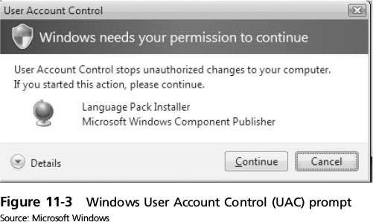
WINDOWS USER ACCOUNT CONTROL (UAC)

Slide 11






ROLE BASED ACCESS CONTROL (RBAC)
ROLE BASED ACCESS CONTROL (RBAC) - CONSIDERED MORE “REAL-WORLD” ACCESS CONTROL THAN OTHER MODELS BECAUSE ACCESS BASED ON USER’S JOB FUNCTION WITHIN ORGANIZATION
INSTEAD OF SETTING PERMISSIONS FOR EACH USER OR GROUP ASSIGNS PERMISSIONS TO PARTICULAR ROLES IN ORGANIZATION AND THEN ASSIGNS USERS TO THOSE ROLES
OBJECTS ARE SET TO BE A CERTAIN TYPE, TO WHICH SUBJECTS WITH THAT PARTICULAR ROLE HAVE ACCESS
SUBJECTS MAY HAVE MULTIPLE ROLES ASSIGNED TO THEM

Slide 12






RULE BASED ACCESS CONTROL (RBAC)
RULE BASED ACCESS CONTROL (RBAC) - DYNAMICALLY ASSIGN ROLES TO SUBJECTS BASED ON SET OF RULES DEFINED BY CUSTODIAN
EACH RESOURCE OBJECT CONTAINS SET OF ACCESS PROPERTIES BASED ON RULES
WHEN USER ATTEMPTS TO ACCESS THAT RESOURCE, SYSTEM CHECKS RULES CONTAINED IN OBJECT TO DETERMINE IF ACCESS IS PERMISSIBLE

Slide 13
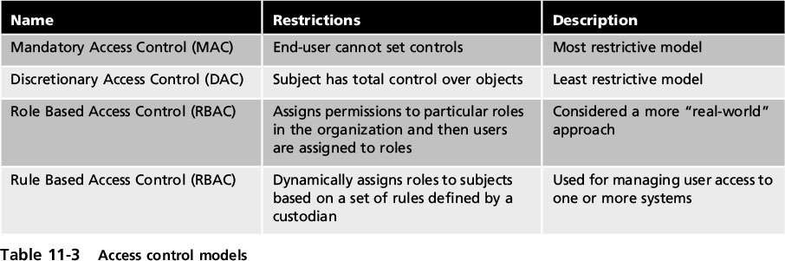
ACCESS CONTROL MODELS

Slide 14











BEST PRACTICES FOR ACCESS CONTROL
ESTABLISHING BEST PRACTICES FOR LIMITING ACCESS CAN HELP SECURE SYSTEMS AND DATA
A FEW BEST PRACTICES:
SEPARATION OF DUTIES - NOT TO GIVE ONE PERSON TOTAL CONTROL
JOB ROTATION - INDIVIDUALS PERIODICALLY MOVED BETWEEN JOB RESPONSIBILITIES
LEAST PRIVILEGE - LIMITING ACCESS TO INFORMATION BASED ON WHAT IS NEEDED TO PERFORM A JOB FUNCTION
IMPLICIT DENY - IF CONDITION IS NOT EXPLICITLY MET, ACCESS REQUEST IS REJECTED
MANDATORY VACATIONS - LIMITS FRAUD, BECAUSE PERPETRATOR MUST BE PRESENT DAILY TO HIDE FRAUDULENT ACTIONS

Slide 15





IMPLEMENTING ACCESS CONTROL
NOW THAT WE HAVE DISCUSSED THE MODELS THAT CAN BE IMPLEMENTED IT IS TIME TO EXAMINE THE TECHNOLOGIES USED TO IMPLEMENT ACCESS CONTROL:
ACCESS CONTROL LISTS
GROUP POLICY
ACCOUNT RESTRICTIONS

Slide 16





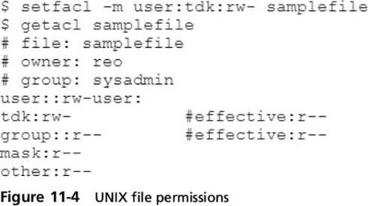





ACCESS CONTROL LISTS (ACLS)
ACCESS CONTROL LIST (ACL) - SET OF PERMISSIONS ATTACHED TO AN OBJECT
SPECIFIES WHICH SUBJECTS MAY ACCESS THE OBJECT AND WHAT OPERATIONS THEY CAN PERFORM
WHEN SUBJECT REQUESTS TO PERFORM AN OPERATION SYSTEM CHECKS ACL FOR AN APPROVED ENTRY
ACLS USUALLY VIEWED IN RELATION TO OPERATING SYSTEM FILES
EACH ENTRY IN THE ACL TABLE IS CALLED ACCESS CONTROL ENTRY (ACE)
ACE STRUCTURE (WINDOWS)
SECURITY IDENTIFIER FOR THE USER OR GROUP ACCOUNT OR LOGON SESSION
ACCESS MASK THAT SPECIFIES ACCESS RIGHTS CONTROLLED BY ACE
FLAG THAT INDICATES TYPE OF ACE

Slide 17








ACCESS CONTROL LIST (ACLS): LIMITATIONS
ALTHOUGH WIDELY USED, ACLS HAVE LIMITATIONS:
USING ACLS IS NOT EFFICIENT - ACL FOR EACH FILE, PROCESS, OR RESOURCE MUST BE CHECKED EVERY TIME THE RESOURCE IS ACCESSED.
CAN BE DIFFICULT TO MANAGE IN AN ENTERPRISE SETTING WHERE MANY USERS NEED TO HAVE DIFFERENT LEVELS OF ACCESS TO MANY DIFFERENT RESOURCES; SELECTIVELY ADDING, DELETING, AND CHANGING ACLS ON INDIVIDUAL FILES, OR EVEN GROUPS OF FILES, CAN BE TIME-CONSUMING AND OPEN TO ERRORS, PARTICULARLY IF CHANGES MUST BE MADE FREQUENTLY

Slide 18









GROUP POLICIES
GROUP POLICY - MICROSOFT WINDOWS FEATURE THAT PROVIDES CENTRALIZED MANAGEMENT AND CONFIGURATION OF COMPUTERS AND REMOTE USERS USING ACTIVE DIRECTORY (AD)
USUALLY USED IN ENTERPRISE ENVIRONMENTS
SETTINGS STORED IN GROUP POLICY OBJECTS (GPOS)
LOCAL GROUP POLICY HAS FEWER OPTIONS THAN A GROUP POLICY AND USED TO CONFIGURE SETTINGS FOR SYSTEMS NOT PART OF AD

Slide 19


























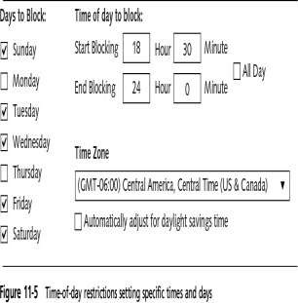
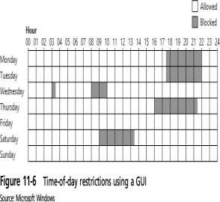




ACCOUNT RESTRICTIONS
ACCOUNT EXPIRATION
RESTRICTIONS
ORPHANED ACCOUNTS - ACCOUNTS THAT REMAIN ACTIVE AFTER EMPLOYEE HAS LEFT ORGANIZATION
DORMANT ACCOUNTS – ACCOUNTS NOT
ACCESSED FOR LENGTHY PERIOD OF TIME
BOTH CAN BE SECURITY RISKS
ACCOUNT EXPIRATION - PROCESS OF SETTING A USER’S ACCOUNT TO EXPIRE
ACCOUNT EXPIRATION CAN BE EXPLICIT (ACCOUNT EXPIRES ON A SET DATE) OR BASED ON SPECIFIC NUMBER OF DAYS OF INACTIVITY
TIME OF DAY RESTRICTIONS
TIME OF DAY RESTRICTIONS - LIMITS THE TIME OF DAY A USER MAY LOG ONTO A SYSTEM
TIME BLOCKS FOR PERMITTED ACCESS ARE CHOSEN
CAN BE SET ON INDIVIDUAL SYSTEMS

