Slide 1
DATABASE MANAGEMENT SYSTEMS
Tula’s Institute Dehradun
II B. Tech CSE IV Semester UNIT-I PPT SLIDES
Prepared by Sandeep kumar
Text Books: (1) DBMS by Raghu Ramakrishnan
(2) DBMS by Sudarshan and Korth

Slide 2
INDEX
UNIT-1 PPT SLIDES
S.NO
Module as per Session planner
Lecture No
PPT
Slide NO
------------------------------------------------------------------------------------------
1. DBS Application and L1 L1- 1 to L1- 9 DBMS Vs File Systems
2. View of DATA | L2 | L2- 1 to L2- 7
3. DB Language (DML, DDL) | L3 | L3- 1 to L3- 6
4. DB Users and Administrator | L4 | L4- 1 to L4- 3
5. Data storage and Querying | L5 | L5- 1 to L5 -5
6. DBMS Architecture | L6 | L6- 1 to L6- 3

Slide 3
Database System Applications
•
DBMS contains information about a particular enterprise
Collection of interrelated data
Set of programs to access the data
An environment that is both convenient and efficient to use Database Applications:
Banking: all transactions
Airlines: reservations, schedules
Universities: registration, grades
Sales: customers, products, purchases
Online retailers: order tracking, customized recommendations
Manufacturing: production, inventory, orders, supply chain
•
– Human resources: employee records, deductions
Databases touch all aspects of our lives
salaries, tax
•

Slide 4
What Is a DBMS?
A very large, integrated collection of data.
Models real-world enterprise.
–
–
Entities (e.g., students, courses)
Relationships (e.g., Madonna is taking CS564)
A Database Management System (DBMS) is a software package designed to store and manage databases.

Slide 5
Purpose of Database Systems
•
In the early days, database applications were built directly on top of file systems
Drawbacks of using file systems to store data:
Data redundancy and inconsistency
Multiple file formats, duplication of information in different files
Difficulty in accessing data
Need to write a new program to carry out each new task
Data isolation — multiple files and formats
Integrity problems
Integrity constraints (e.g. account balance > 0) become “buried” in program code rather than being stated explicitly
Hard to add new constraints or change existing ones
•

Slide 6
Purpose of Database Systems (Cont.)
Drawbacks of using file systems (cont.)
Atomicity of updates
Failures may leave database in an inconsistent state with partial updates carried out
Example: Transfer of funds from one account to another should either complete or not happen at all
Concurrent access by multiple users
Concurrent accessed needed for performance
Uncontrolled concurrent accesses can lead to inconsistencies
– Example: Two people reading a balance and updating it at the same time
Security problems
Hard to provide user access to some, but not all, data Database systems offer solutions to all the above problems
•

Slide 7
Levels of Abstraction
•
Physical level: describes how a record (e.g., customer) is stored.
Logical level: describes data stored in database, and the relationships among the data.
type customer = record
customer_id : string; customer_name : string; customer_street : string; customer_city : string;
end;
View level: application programs hide details of data types. Views can also hide information (such as an employee’s salary) for security purposes.
•
•

Slide 8
Schemas and Instances
Similar to types and variables in programming languages
Schema – the logical structure of the database
Example: The database consists of information about a set of customers and accounts and the relationship between them)
Physical schema: database design at the physical level
Logical schema: database design at the logical level

Slide 9
Instances and Schemas
Instance – the actual content of the database at a particular point in time

Slide 10
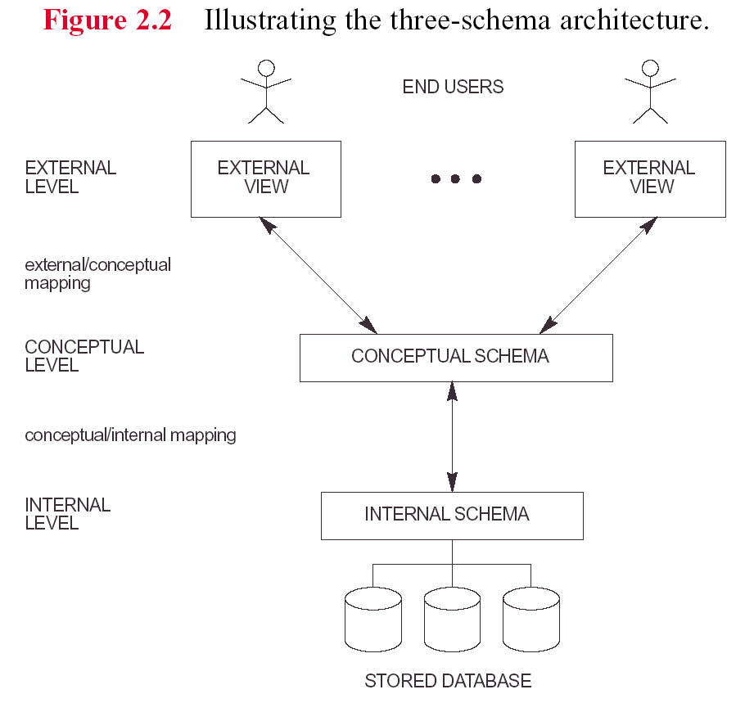

Slide 11
Data Independence
Physical Data Independence – the ability to modify the physical schema without changing the logical schema
Applications depend on the logical schema
In general, the interfaces between the various levels and components should be well defined so that changes in some parts do not seriously influence others
Logical Data Independence
Logical data is data about database, that is, it stores information about how data is managed inside. For example, a table (relation) stored in the database and all its constraints, applied on that relation.
Logical data independence is a kind of mechanism, which liberalizes itself from actual data stored on the disk. If we do some changes on table format, it should not change the data residing on the disk.

Slide 12
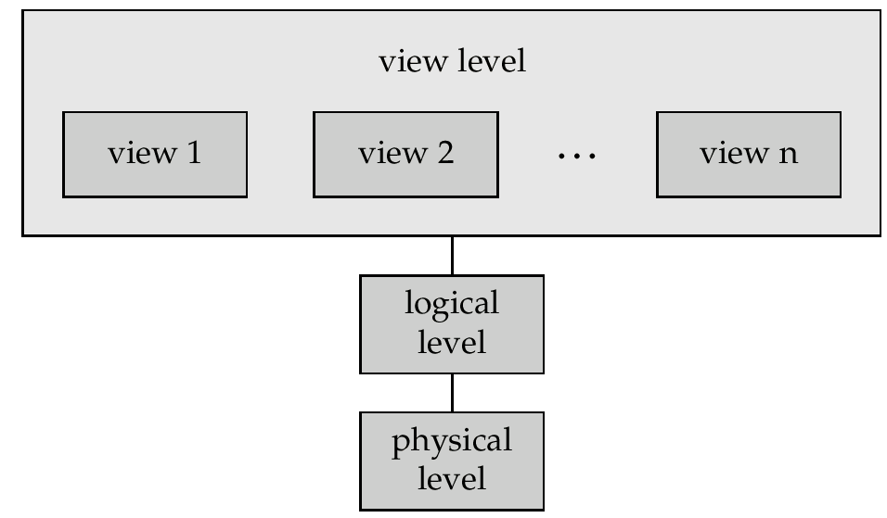
View of Data
Data Base(DISK)

Slide 13
DATA BASE LANGUAGE
Data Manipulation Language (DML)
Language for accessing and manipulating the data organized by the appropriate data model
DML also known as query language
Two classes of languages
Procedural – user specifies what data is required and how to get those data
Declarative (nonprocedural) – user specifies what data is required without specifying how to get those data
SQL is the most widely used query language

Slide 14
Data Definition Language (DDL)
•
Specification notation for defining the database schema
Example:
create table account (
account_number
branch_name balance
char(10),
char(10), integer)
•
DDL compiler generates a set of tables stored in a data dictionary
Data dictionary contains metadata (i.e., data about data)
Database schema
Data storage and definition language
Specifies the storage structure and access methods used
Integrity constraints
Domain constraints
Referential integrity (e.g. branch_name must correspond to a valid branch in the branch table)
Authorization
•

Slide 15
SQL
•
SQL: widely used non-procedural language
– Example: Find the name of the customer with customer-id 192-83-7465
select customer.customer_name
from customer
where customer.customer_id = ‘192-83-7465’
– Example: Find the balances of all accounts held by the customer with customer-id 192-83-7465
select account.balance
from where
and
depositor, account depositor.customer_id = ‘192-83-7465’
depositor.account_number = account.account_number

Slide 16
Data Models
•
A collection of tools for describing
Data
Data relationships
Data semantics
Data constraints
Relational model
Entity-Relationship data model (mainly for database design)
Object-based data models (Object-oriented and Object-relational)
Semi structured data model (XML) Other older models:
Network model
Hierarchical model
•
•
•
•
•

Slide 17
Data Models
A data model is a collection of concepts for describing data.
A schema is a description of a particular collection of data, using the a given data model.
The relational model of data is the most widely used model today.
– Main concept: relation, basically a table with rows and columns.
Every relation has a schema, which describes the columns, or fields.
–

Slide 18
Example: University Database
Conceptual schema:
– Students(sid: string, name: string, login: string,
age: integer, gpa:real)
Courses(cid: string, cname:string, credits:integer)
Enrolled(sid:string, cid:string, grade:string)
–
–
Physical schema:
–
–
Relations stored as unordered files. Index on first column of Students.
External Schema (View):
– Course_info(cid:string,enrollment:integer)

Slide 19
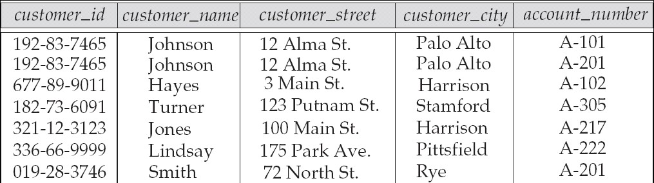
Relational Model
Example of tabular data in the relational model
Attributes

Slide 20
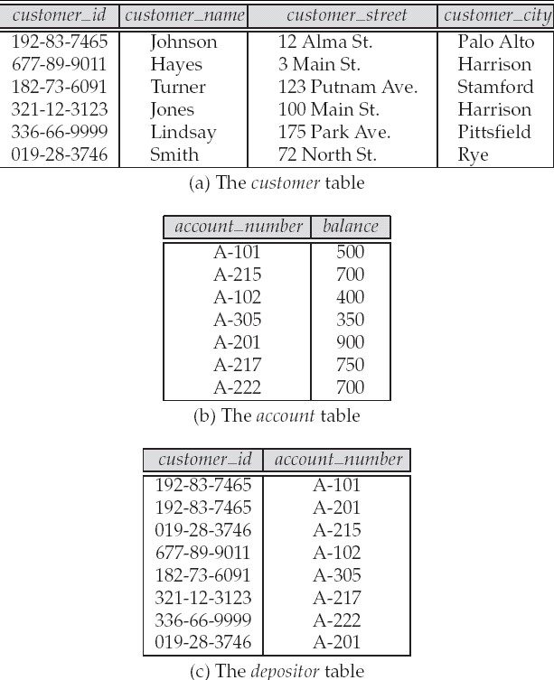
A Sample Relational Database

Slide 21
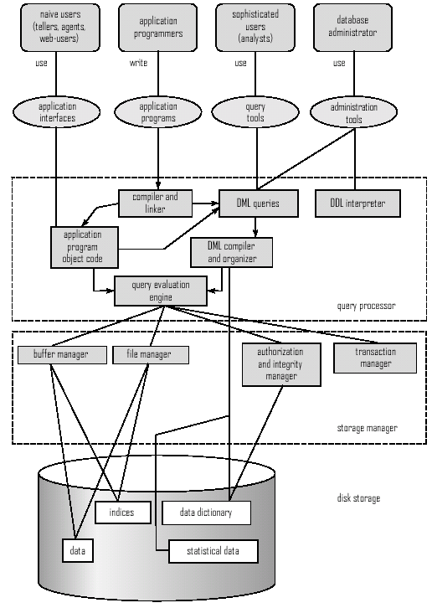
Overall System Structure

Slide 22
Database Users
Users are differentiated by the way they expect to interact with the system
Application programmers – interact with system through DML calls
Sophisticated users – form requests in a database query language
Specialized users – write specialized database applications that do not fit into the traditional data processing framework
Naïve users – invoke one of the permanent application programs that have been written previously
– Examples, people accessing database over the web, bank tellers, clerical staff
•
•
•

Slide 23
Database Administrator
•
Coordinates all the activities of the database system
has a good understanding of the enterprise’s information resources and needs.
Database administrator's duties include:
Storage structure and access method definition
Schema and physical organization modification
Granting users authority to access the database
Backing up data
Monitoring performance and responding to changes
Database tuning
•

Slide 24
Data storage and Querying
Storage management
Query processing
Transaction processing

Slide 25
Storage Management
•
Storage manager is a program module that provides the interface between the low-level data stored in the database and the application programs and queries submitted to the system.
The storage manager is responsible to the following tasks:
Interaction with the file manager
Efficient storing, retrieving and updating of data Issues:
Storage access
File organization
Indexing and hashing
•
•

Slide 26
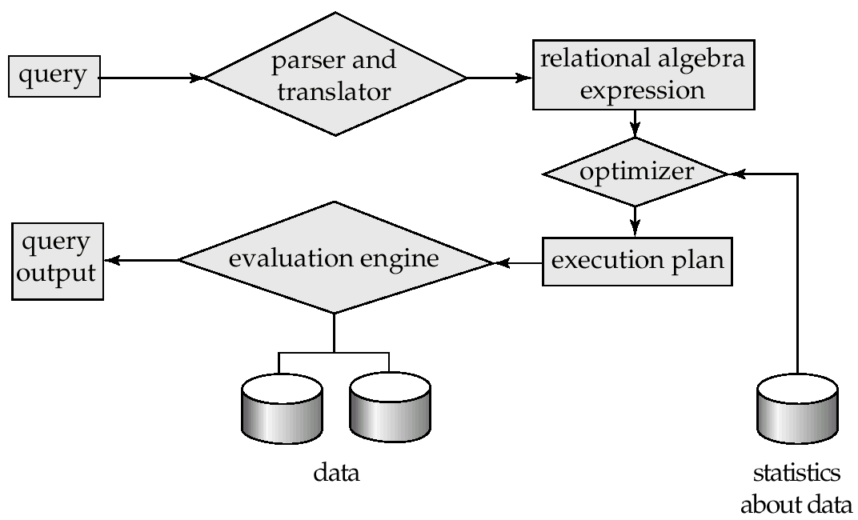
Query Processing
Parsing and translation
Optimization
Evaluation

Slide 27
Query Processing (Cont.)
Alternative ways of evaluating a given query
Equivalent expressions
Different algorithms for each operation
Cost difference between a good and a bad way of evaluating a query can be enormous
Need to estimate the cost of operations
Depends critically on statistical information about relations which the database must maintain
Need to estimate statistics for intermediate results to compute cost of complex expressions

Slide 28
Transaction Management
A transaction is a collection of operations that performs a single logical function in a database application
Transaction-management component ensures that the database remains in a consistent (correct) state despite system failures (e.g., power failures and operating system crashes) and transaction failures.
Concurrency-control manager controls the interaction among the concurrent transactions, to ensure the consistency of the database.

Slide 29
Database Architecture
The architecture of a database systems is greatly influenced by
the underlying computer system on which the database is running:
Centralized
Client-server
Parallel (multiple processors and disks)
Distributed

Slide 30
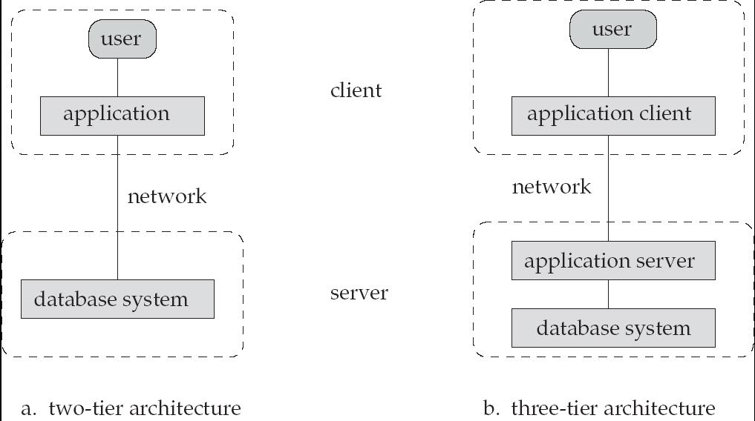
Database Application Architectures
(web browser)
Old
Modern

