Slide 1
Project presented by PEKINS AND LOVETT ON
HOSPITAL MANAGEMENT SYSTEMS

Slide 2
TABLE OF CONTENTS
INTRODUCTION
DEFINITION
OBJECTIVES
MODULES
ADVANTAGES
TOOLS USE
REMARK

Slide 3
INTRODUCTION
Ever Wondered What it Is like to manage an entire hospital? .IT definitely sounds difficult , Well if you’ve landed on this article , you know that efficiently running an entire hospital isn’t a walk in the park. Although it is essential , it gets overwhelming at times.
Time is the utmost importance when it comes to healthcare. Imagine the severity if there is even a minor delay or fault while sharing the results and diagnosis. To simplify operations and efficiently manage patient records, leading hospitals use a hospital management system , Employing hospital management software helps you reap the maximum benefits from your work.
Before discussing in detail how you can leverage an HMS to the fullest , let us understand what an HMS is and why it is needed

Slide 4
DEFINITION
A study showed that healthcare providers spend 35% of their time on documenting patient data. While paperwork is unavoidable in a hospital , you can automate the process and reduce the burden on the staff and doctors . Not just this, hundreds of other processes run parallel in a hospital . An HMS is a one-step solution to manage all hospital processes and data transfer . You can use it to digitize and simplify activities like :
Patient record management
Tracking and managing appointments
Maintaining staff records
Billing and insurance claims
Overall , an HMS helps you improve patient experience and quality of service provided in the hospital.

Slide 5
OBJECTIVES
The objectives of a good HMS or software is to ensure proper activities such as;
Patient record management
Tracking and managing appointments
Maintaining staff records
Billing and insurance claims
Reduce documentation and paperwork
Ensure the smooth running of the hospital

Slide 6
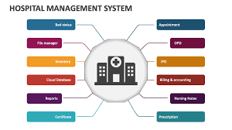
MODULES
11 Essential HMS
Below we have discussed the 11 hospital management system modules in the same order that a hospital would need them, according to a patient’s journey which are ;
Appointment management
Patient management
Facility management
Staff management
Supply management
Financial management
Insurance management
Laboratory management
Report management
Vaccination management
Support management

Slide 7
ADVANTAGES
Benefits of a hospital management
1) enhanced communication between the patient and the hospital
2)secured hospital data
3)improved access to patient
4)Reduced turnaround time
5) Cost-Effectives
6) Intelligent analytics with automated generated reports
7) Centralized administrative control
8) Reduced readmissions and rehospitalization rate

Slide 8


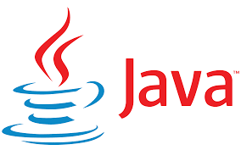
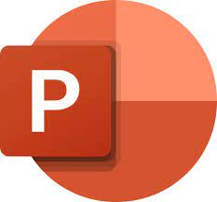
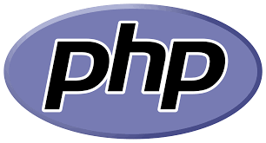


TOOLS USE

Slide 9
REMARKS
One to give a big thanks to the whole ZENVA family for giving me this project because it increased my level of thinking and reasoning of about 5% despite facing some difficulties in the project due to my low programming experience with JAVA
Also want to thank them for partially eradicating laziness as I was kept busy with the project

