Slide 1


Developed by
Good Manufacturing Practices

Slide 2
Agenda
  Good Manufacturing Practices
  Contamination
  General Employee Hygiene
  Food Handling Practices
Notes:
Today, we will discuss the following (read bullet points). It should take about one hour and we will be doing some exercises, to help you learn and so I can get feedback on what you understand

Slide 3
Good Manufacturing Practices
Deal with contamination
  by people
  by food materials
  by packaging materials
  by hazardous materials
  by miscellaneous materials
Notes:
As mentioned earlier, Good manufacturing Practices are those activities and practices that we do to prevent hazards or contamination from entering food products. Products can become contaminated by the actions of people, by other food materials such as undeclared allergens, by packaging materials, hazardous materials such as cleaning residues and chemicals and other things such as maintenance materials such as nuts and bolts, screws as well as a host of other things.

Slide 4
General Employee Hygiene
Notes:
First we will discuss how people can cause contamination by their physical presence or personal hygiene and then by their actions.

Slide 5
Hygiene
All employees working in direct contact with food, food contact surfaces and food packaging must conform to hygienic practices. This protects against food contamination by microorganisms or unwanted material.
Notes:
Personal hygiene is one of the most critical pieces. As people are the ones who handle the food products. In some industries, such as beverage bottling, much of the processing activities are quite automated. In others, such as bakeries, meat cutting, there is a lot of hand contact with the foods. So it is important that all employees practice proper hygiene. All employees working in direct contact with food, food contact surfaces and food packaging must conform to hygienic practices. This protects against food contamination by microorganisms or unwanted material.

Slide 6
Prevent contamination
Careless employee practices can cause product contamination.
The best way to avoid contamination is to prevent it.
Notes:
Careless employee practices can cause product contamination. The best way to avoid contamination is to prevent it.

Slide 7
How do we prevent contamination?
Notes:
Using the flipchart, ask people to answer this question. They should come up with a good list such as:
wearing clean uniforms
not wearing jewelry, watches, rings
Bathing before they come to work
Washing their hands regularly

Slide 8
Any behavior that could result in food contamination such as eating, use of tobacco, chewing gum or other unhygienic practices, is not allowed in food handling areas
Notes:
Thanks for all those great answers. In summary, any behavior that could result in food contamination such as eating, use of tobacco, chewing gum or other unhygienic practices, is not allowed in food handling areas.
State where company policies can be found.

Slide 9
Hygiene and Communicable Diseases
clothing
hair
personal habits
hand washing
personal effects and
jewelry
illness and disease
injuries
visitors
training
Notes:
In our company, we have policies and procedures to help prevent contamination. For example…… (You will need to customize this list so that it accurately reflects your company policies)
You are required to wear the uniforms provided when on the production floor
Your hair must be enclosed in a hair net and if you have a beard, a beard net
You must bathe daily before coming to work,
You must wash your hands regularly- can some one tell me when you need to wash your hands?
You can have personal effects such as watches, earrings, medication etc on the production floor
You must report illnesses to your supervisor, as you cannot handle food products if you have a communicable disease
All cuts and wounds must be covered by a metal detectable bandage and a glove.
Visitors must be accompanied by plant personnel and must follow the same rules – such as hair nets, no jewelry etc
And most importantly, we provide training such as today’s session, so that you understand the rules and practices that we expect you to follow.

Slide 10
Production employees
Bathe daily
No perfume, aftershave, fragrant creams
No jewellery
No false nails or nail polish
Fingernails should be trimmed short
Use metal detectable bandages covered with gloves
No eating, drinking or chewing gum
Notes:
Production employees must follow the rules. Specifically some of the things that we have previously mentioned..
Bathe daily so that you are clean when you come to work
No perfume, aftershave, fragrant creams that will affect our products
No jewellery or false nails or nail polish that can accidently fall into the products. Most consumers do not think it is a bonus to get a watch or something extra in their food.
Fingernails should be trimmed short
Use metal detectable, in case they fall off, they will be caught by the metal detector an the glove to help prevnt it form falling off.
No eating, drinking or chewing gum is allowed in production areas.

Slide 11
Clothing
Everyone must wear pants and covered sleeves.
Separate shoes (no open toes or high heels) are to be worn in the factory.
Personal belongings and street clothing must be stored in locker rooms.
Notes:
Everyone must wear pants and covered sleeves.
Open toes or high heels are not permitted in production areas, for safety reasons. You must also keep a pair of shoes at work that do not leave here. They are worn only in this facility.
Personal belongings and street clothing must be stored in locker rooms.

Slide 12
Illness
Doctor’s certificate on hiring
Inform your supervisor or HR if you are ill with symptoms that could contaminate ingredients or products
No medication allowed in factory
Ensure that a clean bandage covers any open wounds
Notes:
Many illnesses can be transferred form one person to another though food, therefore you must:
Provide a Doctor’s certificate when you are hired
Inform your supervisor or HR if you are ill with symptoms that could contaminate ingredients or products
No medication allowed in factory
Ensure that a clean bandage covers any open wounds

Slide 13
Hand washing
All employees must wash their hands thoroughly:
when they enter food handling areas
before starting work
after handling contaminated materials
after breaks
after using toilet facilities
Notes:
Poor handwashing is the number none cause for food borne illness.
All employees must wash their hands thoroughly:
when they enter food handling areas
before starting work
after handling contaminated materials
after breaks
after using toilet facilities

Slide 14
Food Handling Practices
Notes:
We have talked quite a bit about personal hygiene and now I would like to focus on good food handling practices.
You will need to customize the next 15 slides, so they reflect your company practices. Suggestions have been provided.

Slide 15
Personnel
Do not leave gloves, masks, etc. lying around while on break or at shift end.
Crates, boxes, containers or buckets must not be placed directly on the floor.
Store brooms and dust pans at stations provided.

Slide 16
Product
Keep hand contact with ingredients to a minimum.
Check ingredients for expiration dates to ensure that fresh ingredients are used.
Cooling product should always be kept covered.

Slide 17

Equipment, containers and utensils
Ensure that all containers, including those holding rework, are properly labelled and are kept covered.
Use white or brown containers to store ingredients and rework.
Use gray containers for garbage. Garbage containers must be kept covered.

Slide 18
Cloths
Use white cloths to wipe hands regularly and dispose of soiled cloths immediately. No moist cloths are to be left in the production area.
Use yellow cloths to clean the floor and objects (e.g. step stools) that come into contact with the floor.

Slide 19
Utensils
Scrapers for moulds and tabletops are not to be used on the floor.
Production equipment/utensils must be thoroughly cleaned and sanitized with alcohol after use.

Slide 20
Premises
Keep unscreened doors and windows closed.
Report any pests or evidence of pests such as flies, insects, mice droppings.

Slide 21
Equipment
Return tools and attachments to their proper place after use.
Check product surfaces before starting equipment. Remove any foreign objects or dirt.
Replace brushes that lose bristles.

Slide 22
Personnel Practices
Do not lean, sit or step on product surfaces.
Do not handle ingredients or products with either cut or infected hands.
Do not engage in horseplay.
Keep hand contact with ingredients and product to a minimum.

Slide 23
Sanitation
Keep contact surfaces clean and free of contamination from tools, cords, cleaning utensils, machine parts, lubricants and paper.
Clean all spills promptly.
Keep everything off the floor and the area clean and floors swept.

Slide 24
Work areas should be cleaned regularly throughout the shift.
Keep your immediate working area swept or dust mopped. Wipe or mop up spilled liquids promptly.
Scrape the floor around the work area after completing a job.
Leave your work area clean at the end of your shift.

Slide 25
Receiving and Storage
Ensure that all pallets and materials are kept at least 18” away from the walls.
Inspect torn bags and boxes and then repair if appropriate.
Brush off bags and boxes before opening them.
Store ingredients and products at the appropriate temperature.

Slide 26
Receiving & Storage
Use ingredients in the proper rotation (oldest stock first)
Handle ingredients or products carefully to avoid spilling
Do not return products or ingredients to the production line after they have touched the floor or any other surface that is not clean.

Slide 27
Maintenance and Repairs
Ensure area is segregated from production by use of tarps.
Do not leave maintenance supplies in the product zone.
Return all tools and attachments to their proper place after use.
Ensure the production area is clear of all tools and hazards before production starts

Slide 28
Retail store
Monitor and maintain proper temperatures
Rotate ingredients using FIFO and check for expired items.
Check best before dates and the quality of the food before using.
Refrigerate cold foods immediately upon receipt.
Sanitize equipment, cutting boards, work surfaces and utensils.
Always wash hands after handling money.

Slide 29
Visitors to Production Areas
Should always be accompanied.
Must be appropriately dressed - hair coverings, booties over street shoes, gloves, sleeve covers, etc.

Slide 30
Quiz
Spot the Hazards:
Good Manufacturing Practices
Notes:
You will now have 5-10 minutes to complete this short evaluation. Please circle all the actions and items that do not demonstrate good manufacturing practices. We will then review it as a group and you will mark your own.
In the review, ask each person to give one example and go around the group until all are mentioned.

Slide 31
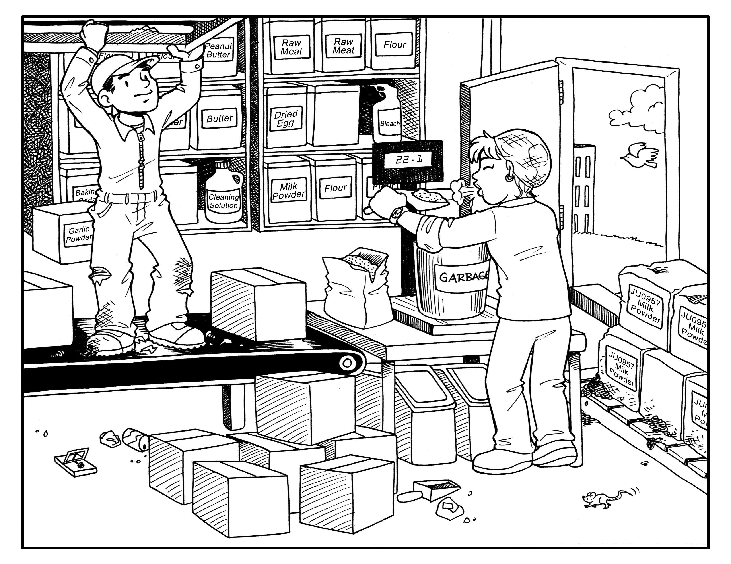

Slide 32
Practical application
Notes:
This is a good point to ask the participants for an example of an action that they practice as part of Good Manufacturing Practices. Involve each member of the group in the discussion by use of questions.

Slide 33
On the job.....
Think about food safety as you work
Watch for hazards and remove any that you find
Questions ?
Notes:
Summarize the learning concepts and ask for questions. Remember to thank them for their time. Tell them that these activities will be monitored.

