Slide 1

Analog mixed signal IC Lab
M.TECH. VDN
Topic: Design and simulation Degenerated common source amplifier
Submitted by: Akash Pandey
(2302102035)

Slide 2
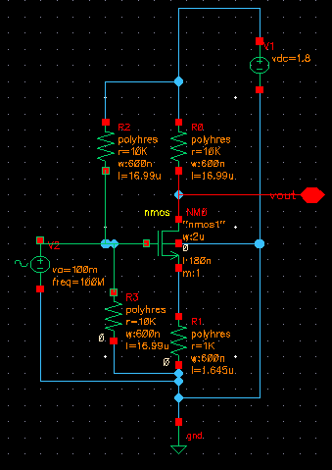
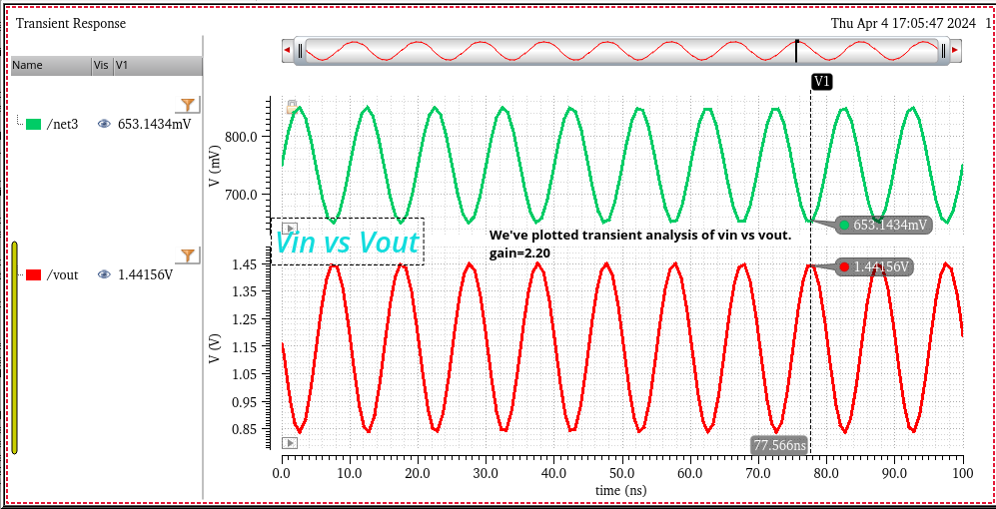
Degenerated common Source Amplifier
Schematic: Degenerated Common Source Amplifier
Output voltage Vout vs Input voltage Vin
Vin vs Vout plot @ vin amplitude of 100mv Gain=2.2

Slide 3
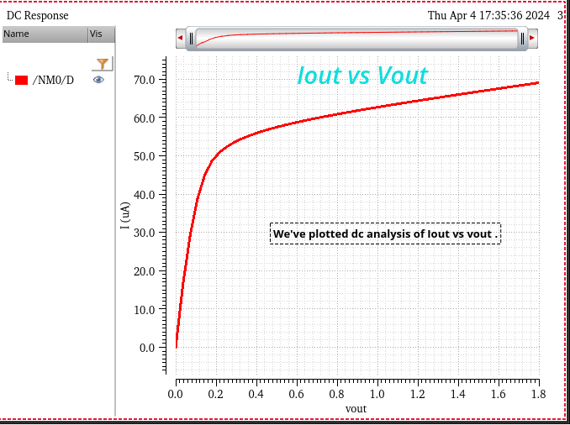
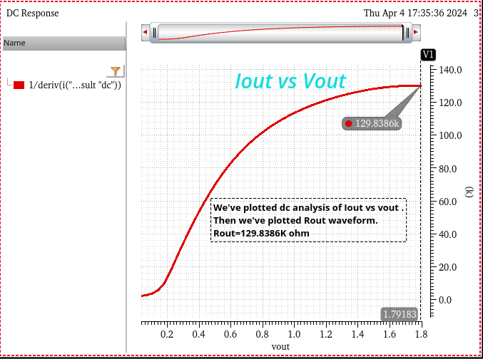
Output voltage , Vout vs Output current, Iout:
Output Resistance, Rout:
Output Resistance =129.8386 Kohm

Slide 4
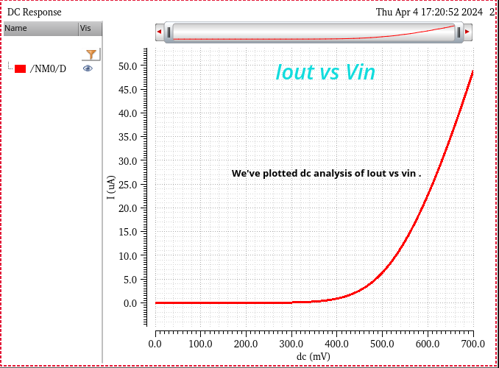
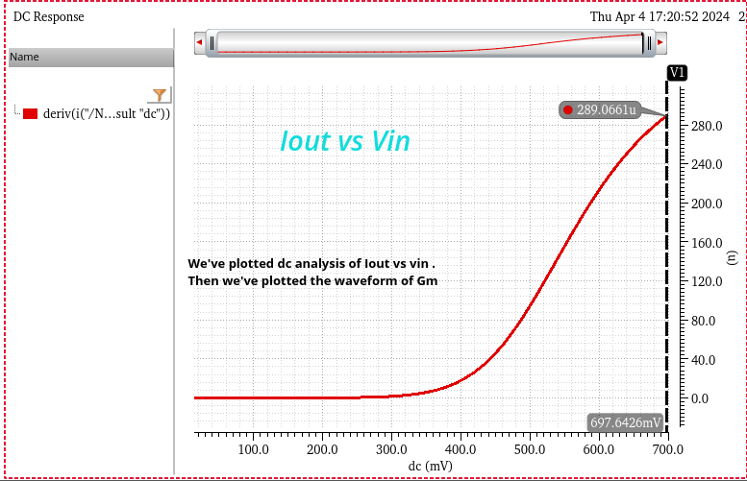
Input Voltage (Vin) vs Output Current (Iout)
Input Transconductance, Gm:
Gm=289.06 umho

