Slide 1
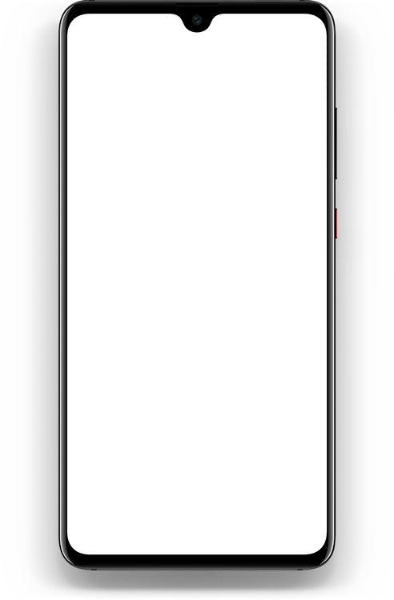









Globe
Talk ‘n Text
99%
11:16am
Globe
Talk ‘n Text
99%
11:16am
Globe
Talk ‘n Text
99%
11:16am
+
Full name
BitterSweet Taste
Address
Username
BitterSweet Taste
Contact Number
Password
. . . . .
Username
L O G I N
Password
or
Don’t have an Account? Sign up here.
Sign Up
Forgot password?

Slide 2
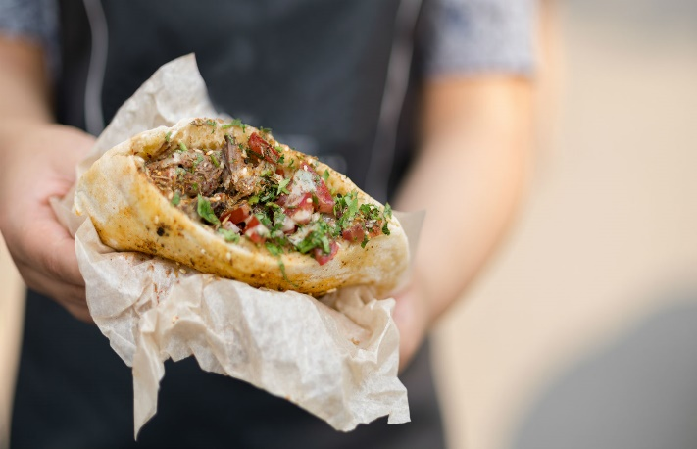
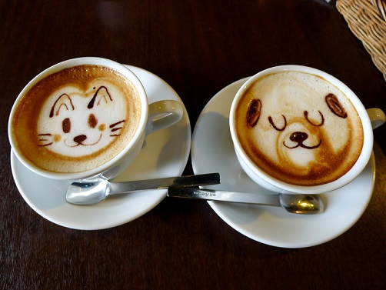





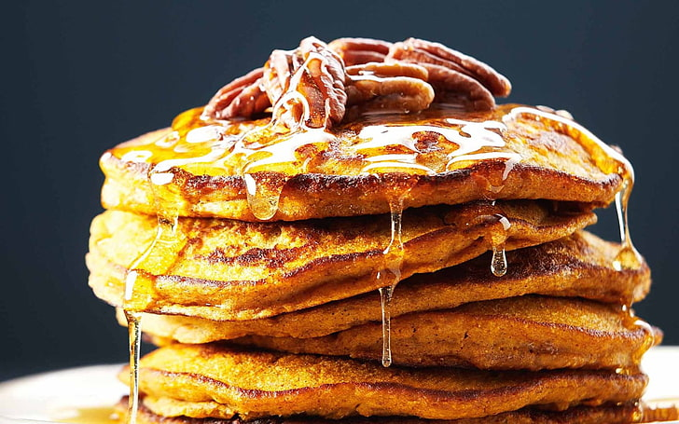
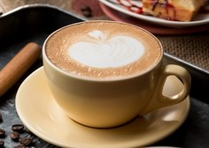



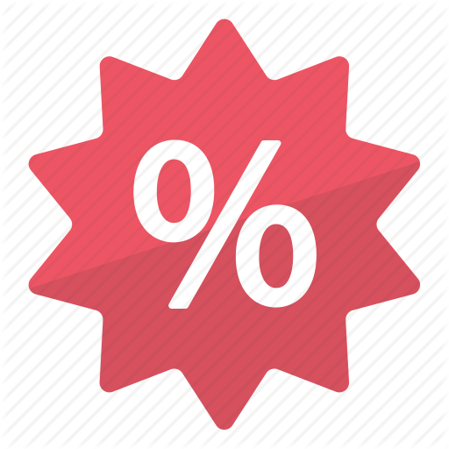
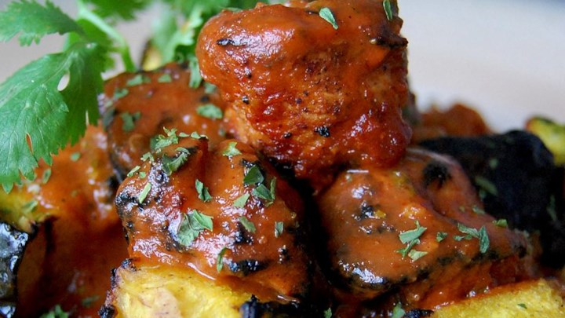
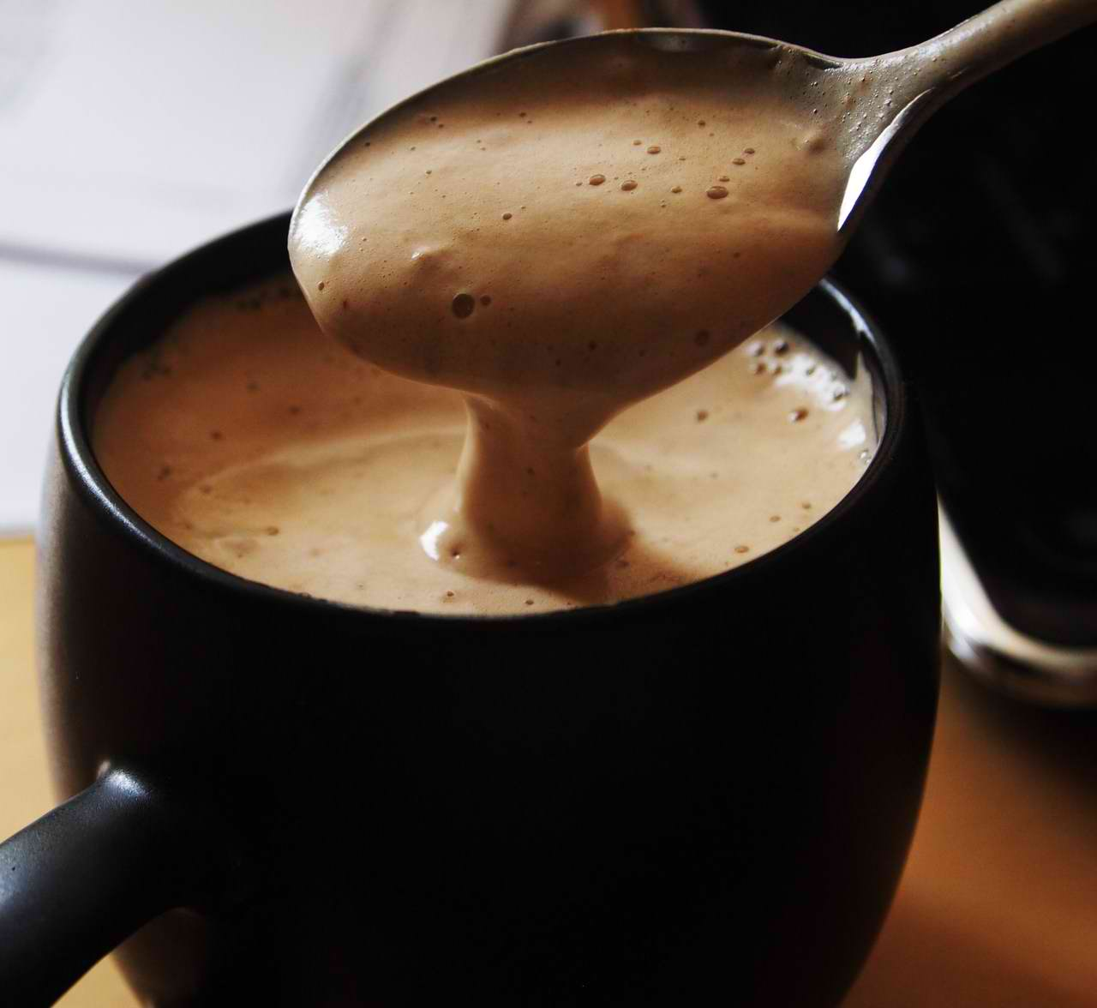

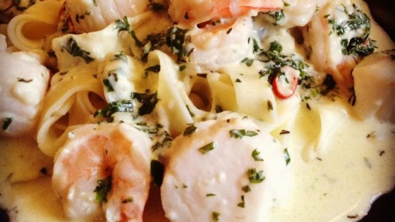
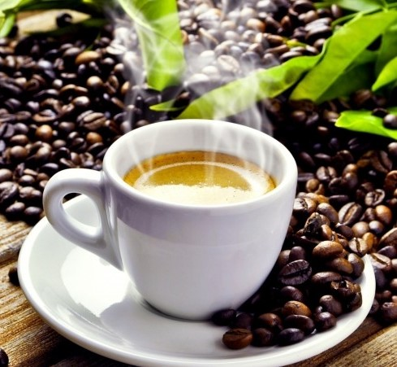
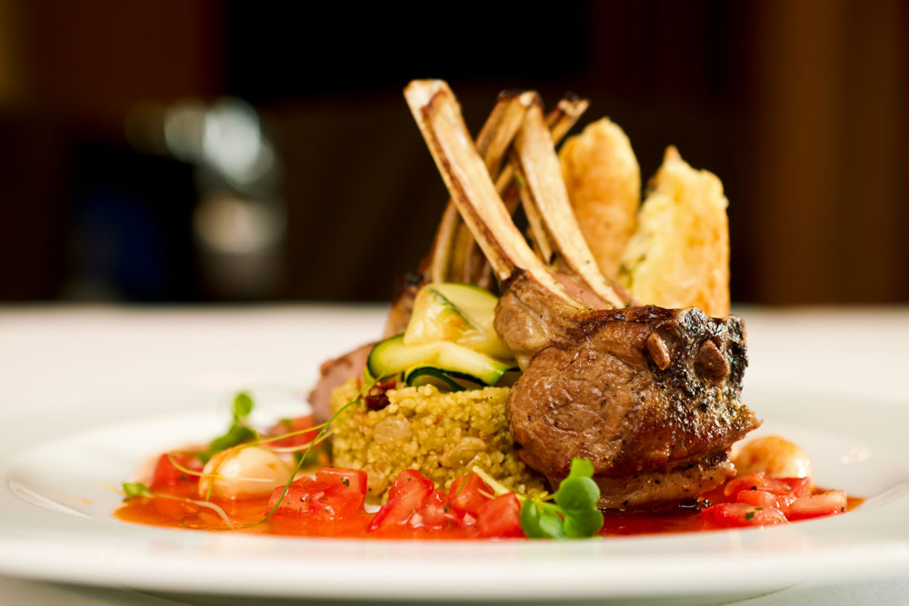
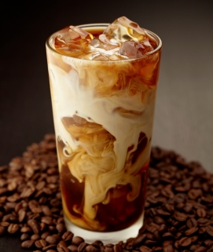
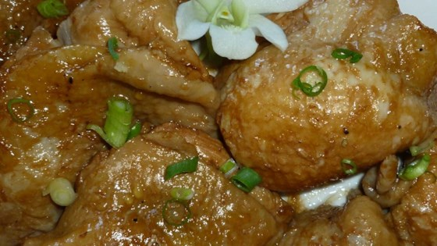
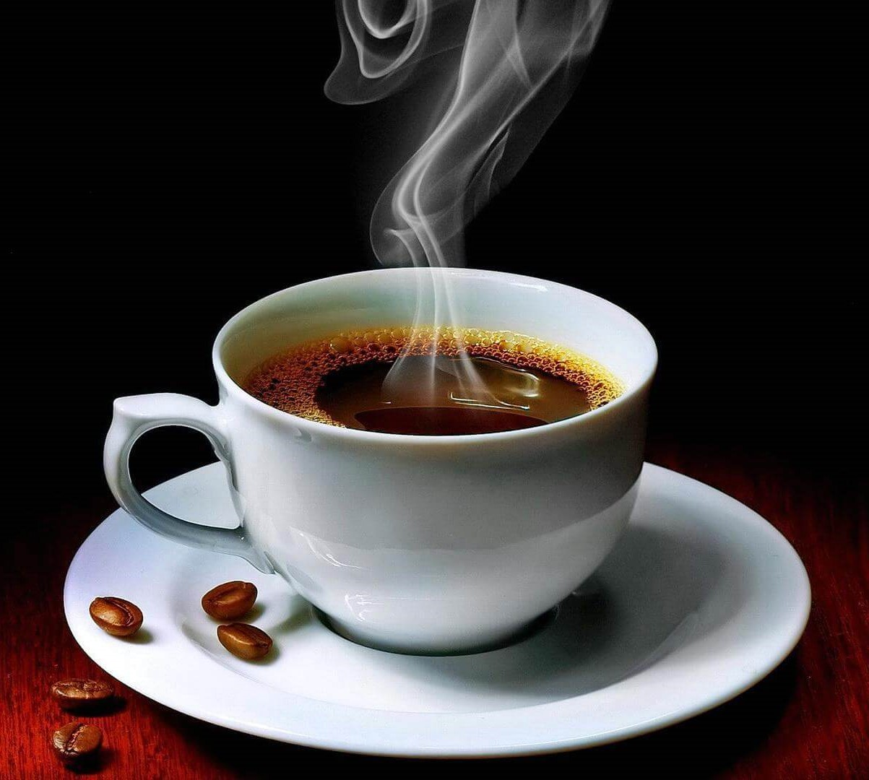
Globe
Talk ‘n Text
99%
11:16am
Globe
Talk ‘n Text
99%
11:16am
Globe
Talk ‘n Text
99%
11:16am
BitterSweet Taste
3
Me
Customized
your
own
coffee.
Gourmet Foodie
Hot Beverages
1
Pancake Honey Sweet Nuts
Cappuccino
Gourmet Foodie
Hot Beverages
Cold Beverages
Add to cart
Add to cart
3
4
Chicken Tikka Masala
Hot Choco
Special Request
Promo
Add to cart
Add to cart
1
Cajun Seafood Pasta
Brewed Coffee
Hot deals
Add to cart
Add to cart
2
1
Chicken Adobo with Ginger
Double Espresso

Slide 3

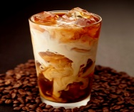
Globe
Talk ‘n Text
99%
11:16am
Globe
Talk ‘n Text
99%
11:16am
Shopping Cart
Home
Gourmet Foodie
₱299
Quantity
-
2
+
Pancake Honey Sweet Nuts
See more
>
Hot Beverages
Hot Beverages
₱299
₱109
see related price >
₱109
Quantity
Quantity
-
-
2
+
Honey wheat pancakes make a healthy start to your day. Instead of maple syrup, make this simple honey butter syrup for a fun change!
+
See more
See more
>
>
Cold Beverages
₱99
Quantity
-
2
+
See more
>
Add to Cart
Buy Now
Select all
Check out
Designed by:
Albert Daclangin BSIT301

