Slide 1
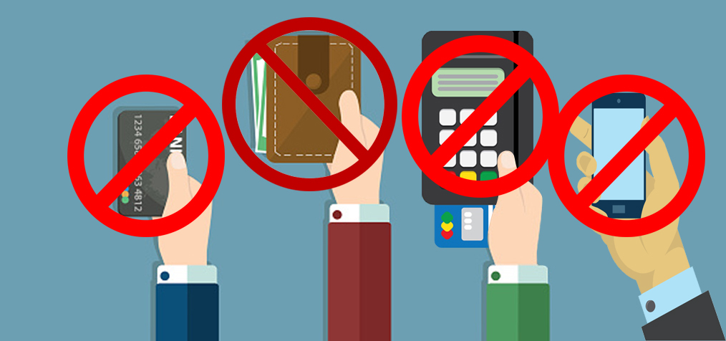
fpay
CARDLESS AND PHONELESS TRANSACTION APP
-ankit mehta

Slide 2
OBJECTIVE
The growth in online payment services has revolutionized the way we shop on a daily basis. Cardless and Cashless transactions have gained a lot of popularity. Smartphones have already replaced cash transactions on a large scale. Although these methods of transactions have reduced the use of cash or card, it is necessary for a user to carry a smartphone to perform any transaction. Our objective is to provide an alternative option that is hassle-free and does not require users to carry any device.

Slide 3
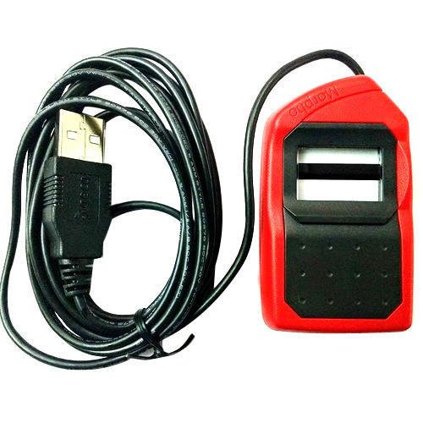
IMPLEMENTATION
We are proposing the idea of using biometric data stored in our Aadhar Card for these types of transactions. As it is a must to link our bank account to the Aadhar card, we can install biometric scanners approved by UIDAI in shops to perform transactions without having the need to carry any devices ourselves. For this, the shop or the merchant should have a UIDAI approved biometric scanner connected to a secure app. The user must imprint their fingerprint on the device after which the list of bank accounts linked with the Aadhar card is displayed. The user must select the desired bank and enter a pin (similar to the one in a card machine), after which a secure transfer of money to the merchant’s bank account takes place.

Slide 4
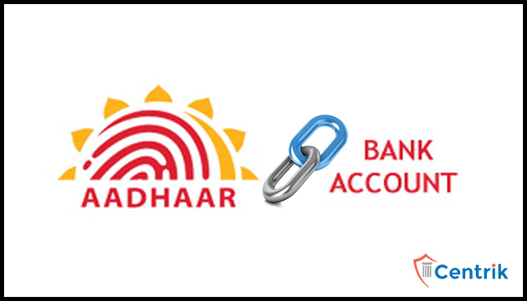

APPLICATIONS
>Easy and secure transaction
>Accessible to illiterate users
>Hassle-free and convenient
>Easily accessible
>Revolutionize financing

Slide 5
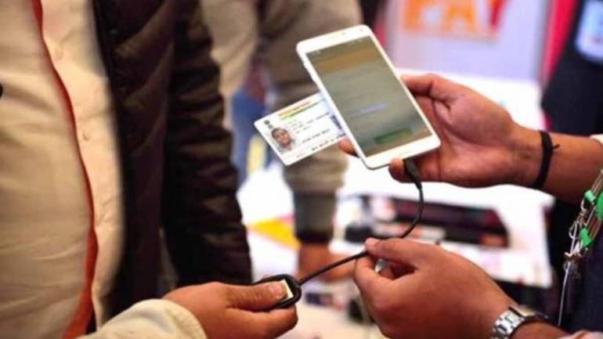
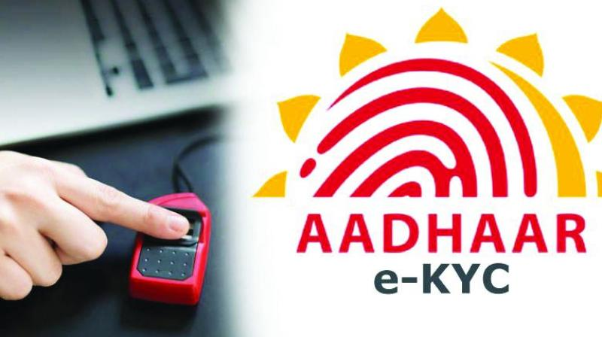
Final result
The final result shall be a device which can be connected to a mobile phone and carry out transactions via an app. It’s totally hands-free as the customer has to carry neither a card nor any device. A simple entry of pin and the customers fingerprint shall suffice.

Slide 6
FUTURE ENDEAVOURS
The device, once under production, will be simple and not highly sophisticated. It shall have a finger-print reader/scanner and a small numerical keypad. The device will have an option for C-type connectivity as well as micro-USB connectivity based on the retailers/merchants mobile device. An app to support the above transaction shall be designed. This app will be made available for android, iOS devices as well as the devices supporting the Hongmeng OS (Huawei’s new OS under development), once it releases. The app, much like the device, will be very simple and can be used by anyone. The app will be multilingual, that is, it will support a lot of languages.

