Slide 1
PEFT-Conformal FoV Prediction for 360° Video Streaming
Team 8

Slide 2
The 360° Video Bandwidth Problem
Massive data overhead: up to 12k resolution video
Limited Viewport: users only see around 1/6th of the total frame
Unpredictable motion:
Bandwidth and processing limitations
Real time constraints

Slide 3
Traditional ML Approaches
Point prediction: predict single viewport coordinates
Saliency-based: predict regions based on content
Trajectory extrapolation: Linear/polynomial fitting of movement
Static tiling: Fixed buffers around current viewport

Slide 4
Key Technologies
Transformers - Sequential Pattern Learning
Self-attention learns which past moments matter most
Captures complex temporal patterns in head movements
Parameter-Efficient Fine-Tuning
Personalization with less parameter cost per user
Scales to many users with efficient storage/compute
Conformal Prediction
Prediction sets with statistical guarantees
Makes risk controllable and measurable

Slide 5
Filling the Gaps in Existing Solutions
Per-user models allow personalization at scale
Conformal prediction provides statistical coverage guarantees
Alpha controller adjusts risk based on buffer health
Dual horizons for strategic and reactive planning
Geodesic distance throughout pipeline

Slide 6
The Central Tradeoff:
Coverage vs. Bandwidth
High Coverage (conservative):
Smooth playback
Wastes bandwidth and battery on safe tiles
Low Bandwidth (aggressive):
Efficient network and battery use
Risk of viewport misses, leading to stuttering

Slide 7
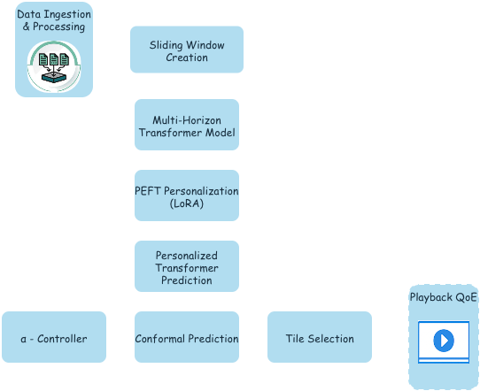
System Architecture

Slide 8
Data Ingestion & Preprocessing
data_loader.py - Converts AVTrack360 json files to a data frame
geometry_utils.py - Spherical geometry operations
datasets.py - PyTorch dataset that creates sliding windows
build_avtrack360_pooled.py - Aggregates data for pooled model training
data_cleaner.py - Linear interpolation and padding on dataset

Slide 9
Multi-Horizon Prediction Model
model.py - PooledFoVTransformer with 4-layer encoder, learned positional encoding, and dual prediction heads for prefetch (t+15) and deadline (t+3) horizons
Peft_wrapper.py - LoRA adapter wrapper that freezes base model weights and adds low-rank adaptation matrices for parameter-efficient per-user personalization

Slide 10
Two-Stage Training Pipeline
train_pooled.py - Stage 1 trains base transformer on multi-user pooled data using geodesic loss to learn general viewport prediction patterns across users
finetune_user.py - Stage 2 fine-tunes lightweight LoRA adapters on individual user trajectories to capture personal viewing habits while keeping base model frozen

Slide 11
Uncertainty Quantification
conformal.py - Calibrates prediction intervals using validation residuals, computes quantile-based radii for prefetch and deadline horizons with statistical coverage guarantees
controller.py - Adaptive alpha controller that adjusts conformal risk parameter based on buffer health

Slide 12
Adaptive Streaming System
tiling.py - Maps prediction radii to spherical viewport tiles by computing geodesic distance from predicted center to determine which tiles fall within the coverage set
evaluate_system.py - End-to-end streaming simulator with bandwidth variation, buffer dynamics, and adaptive radius control that measures hit rate, buffer stability, and system performance under realistic conditions

Slide 13
PEFT Personalization
What:
Adds lightweight LoRA adapter layers to the Transformer
Enables personalization without retraining the base model
Why:
Retraining the base model is infeasible under constraints
Many 360° devices cannot compute ML models in real-time
Many 360° devices run on battery life - not enough energy

Slide 14
PEFT Personalization
How:
Freeze’s base model parameters using a flag
Create three user-specific matrix parameters: lora_A, lora_B_pref, and lora_B_dead
On each forward pass, our model gets the base model’s prediction, recomputes user-specific parameters, then adjusts the prediction using these user-specific parameters
lora_A (hidden_dim, rank) - project from hidden space (from the transformer) to a smaller space
lora_B_pref (rank,2), - project from rank space to 2 for yaw, pitch
lora_B_dead (rank, 2)
trans_out (batch, hidden_dim) - summary of last timestep
adapter_pref = trans_out⛒lora_A⛒lora_B_pref
adapter_dead = trans_out⛒lora_A⛒lora_B_dead
Returns (base_pref+adapter_pref, base_dead+adapter_dead) which is (yaw, pitch) user FoV prediction.
Calculations are Low Rank making personalization feasible (~4,160 total trainable parameters vs ~7M)

Slide 15
Coverage / Bandwidth
Video is split up into tiles (default to 6 rows and 12 columns)
Tiles closest to the user’s predicted FoV center are fetched
Tile Distance Metrics:
Tile width = 360 / columns; tile height = 180 / rows
Tile center yaw = (col * tile_width + tile_width/2)
Tile center pitch = (row * tile_height + tile_height/2)
Yaw_pitch_to_unit_vector - Yields 3D unit vector
How we determine coverage:
Get all 3D unit vectors for each tile, then
Get 3D unit vector of the predicted FoV center
Compute angular separation using geodesic_distance : acos math function on the dot product between two vectors, fetch tiles whose center vector is within an angular radius margin centered around the FoV prediction (shown later)

Slide 16
Split Conformal Predictions
What:
Point prediction to sets of points to guarantee coverage
Separately done per horizon: prefetch(1.5s) and deadline(.3s)
How:
Collects residuals from predictions vs. ground truth
Compute quantile thresholds based on alpha
Fetches tiles within radius of predicted center

Slide 17
Adaptive Risk Control
Current implementation and configuration:
𝞪 = MIN+ (MAX - MIN) / (1.0 + np.exp(STEEPNESS * (buffer_level - MIDPOINT)
MIN = 0.01, MAX = 0.15, STEEPNESS = 0.15, MIDPOINT = 13
High buffer_level lowers 𝞪, adds coverage, lowers risk
Low buffer_level raises 𝞪, lowers coverage, adds risk
Result is feedback loop:
Buffer->Alpha->Radius->Tiles->Cost->Buffer

Slide 18
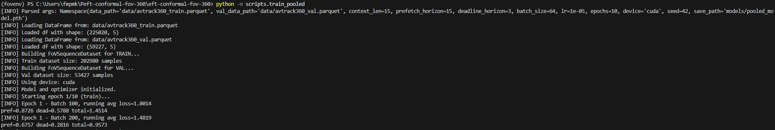
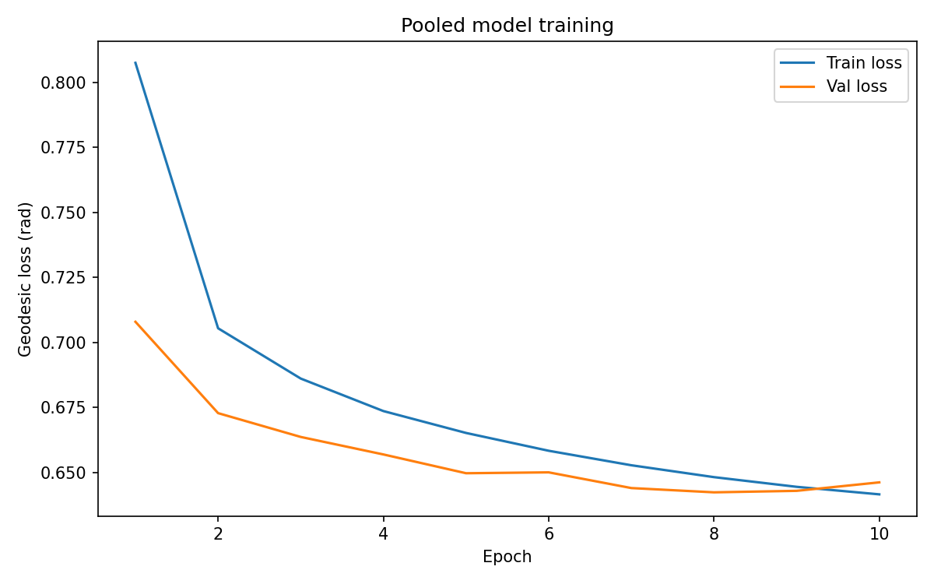
Base Model Training

Slide 19
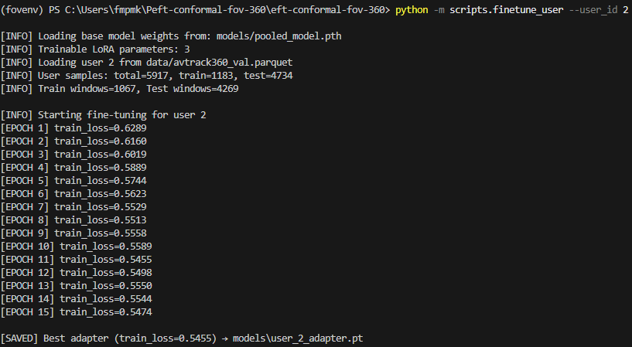
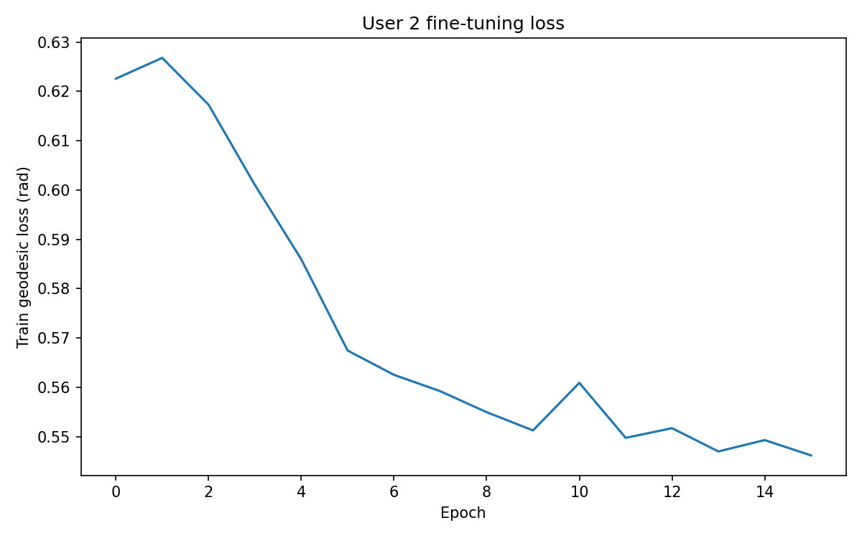
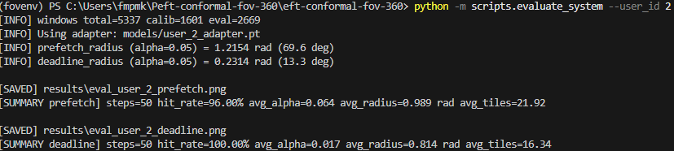
Personalization & Evaluation

Slide 20
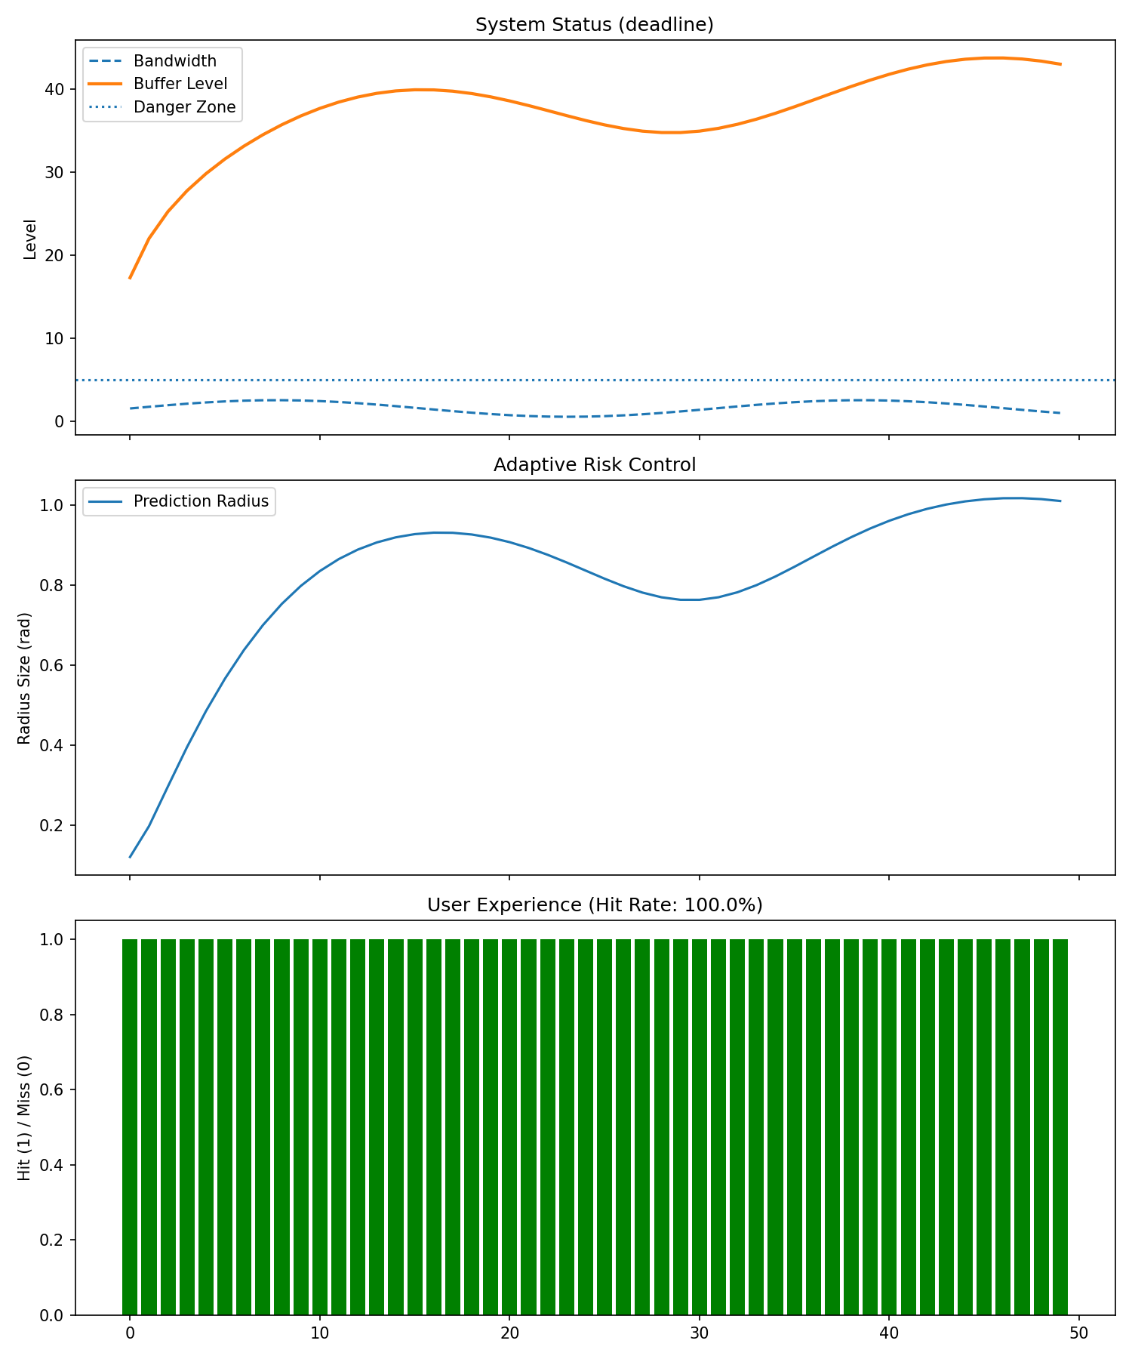
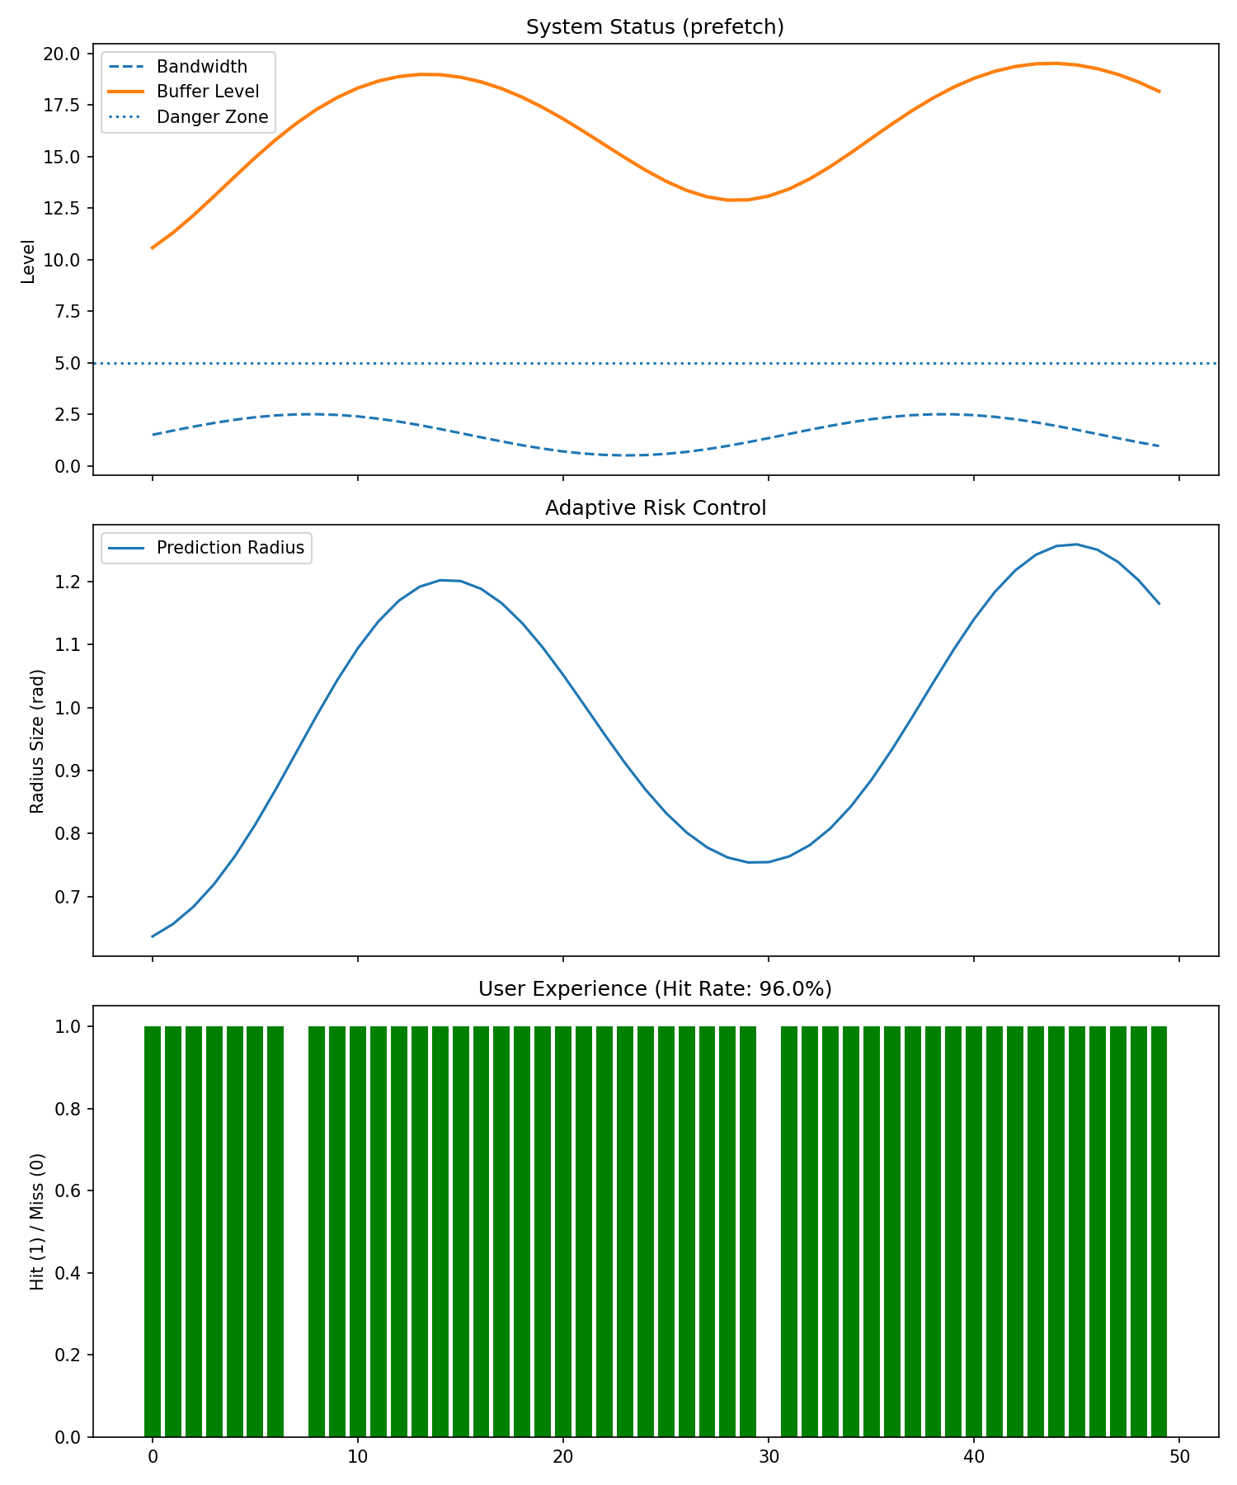
Evaluation Data (User 2)

Slide 21

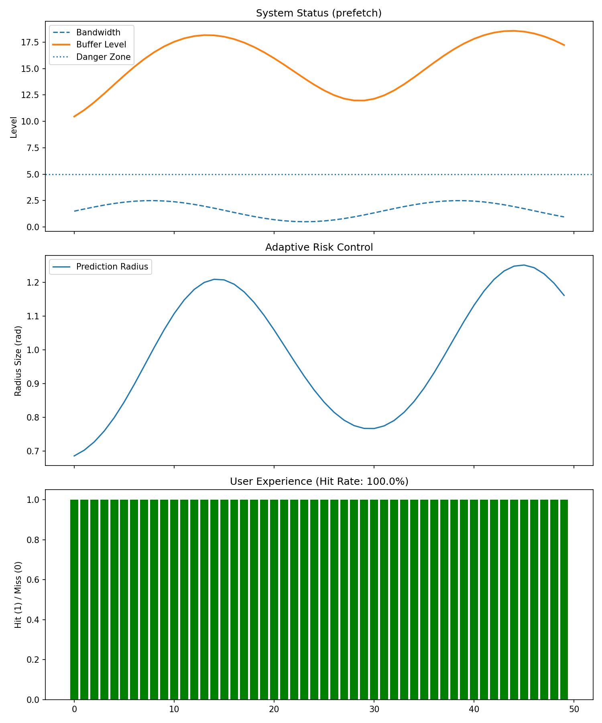
Evaluation Data (User 9)

Slide 22
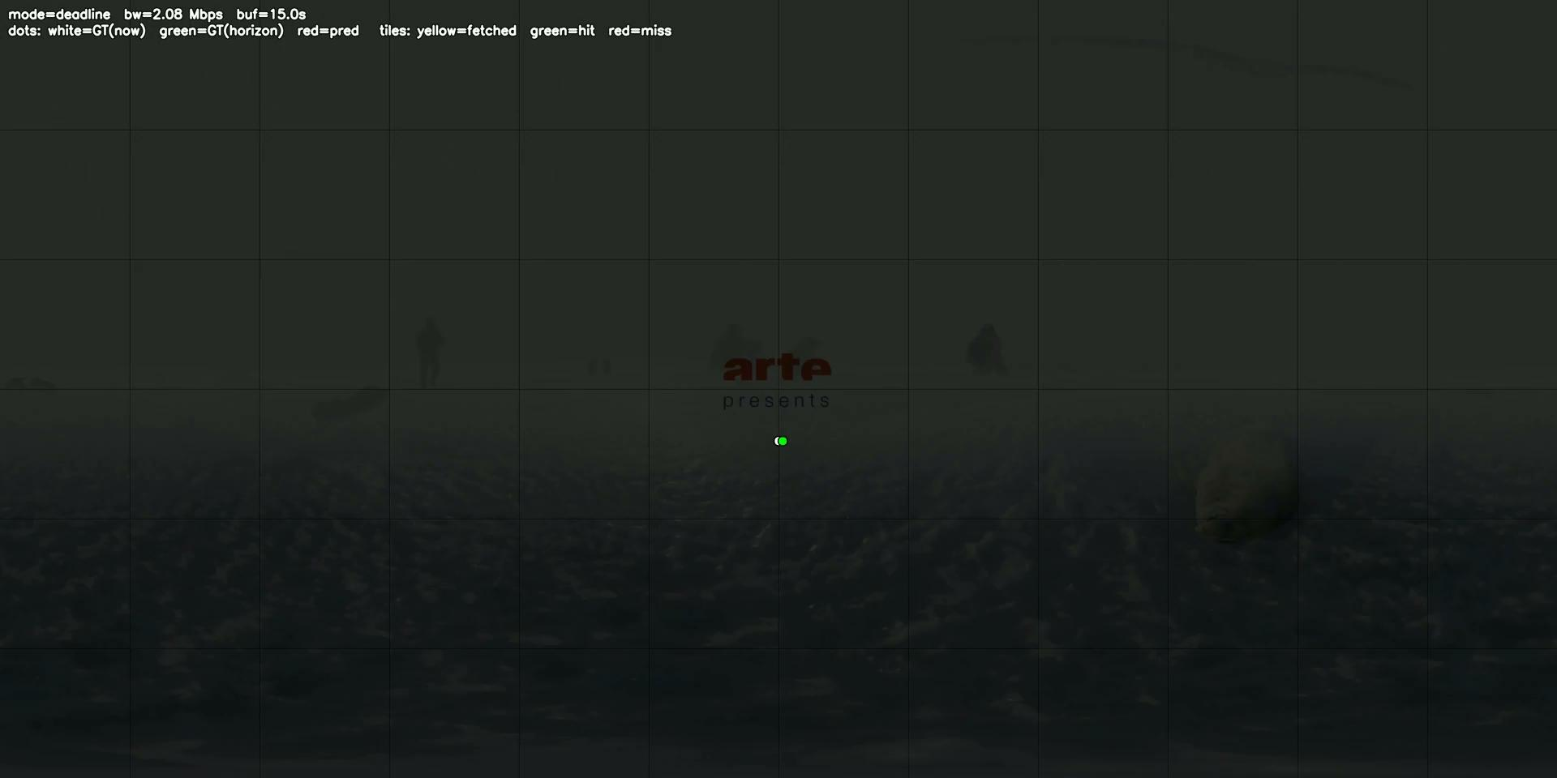
Deadline Simulation

Slide 23

Prefetch Simulation

Slide 24
System Strengths
Personalization Gains:
LoRA adapters capture individual viewing habits with minimal overhead
Users with predictable patterns see significantly improved hit rates
Scalable due to substantially lower per user data
Risk Control:
Alpha controller successfully balances coverage and bandwidth
Buffer remains stable across varying network conditions
Statistical guarantees hold: realized coverage matches target alpha

Slide 25
Known Limitations
Fast Head Turns:
Sudden, unpredictable movements exceed prediction horizon
Even conformal sets can’t cover instantaneous 180° turns
Temporal context (15 steps)
Severe Bandwidth Drops:
Extreme network degradation forces aggressive alpha
Lower coverage increases miss probability
Controller can’t create bandwidth that doesn’t exist

Slide 26
Inherent System Trade-offs
Prediction Set Size vs. Accuracy:
Larger sets give better coverage but download more tiles
Smaller sets are efficient but have higher miss risk
Personalization vs. Cold Start:
Strong personalization requires per-user training data
New users default to pooled model until sufficient history
Computational Overhead:
Conformal calibration requires validation pass
Real-time alpha adjustment adds control loop latency

Slide 27
Future Improvements
Incorporate Saliency models for hybrid approach
Model Predictive Control for lookahead optimization
Reinforcement learning for adaptive policy learning
Multi-objective optimization (coverage + battery + latency)

Slide 28
Deployment Considerations
Multi-User Scenarios
Test against actual mobile, local, and residential networks
Latency budget for prediction and tile selection pipeline
Handling model degradation over time

