Slide 1
HR management system on aws
- Team Aryan

Slide 2
Service selection (free tier constraints)
Amazon S3 - Host the static website and store documents
Free tier: 5GB storage, 20,000 GET, 2,000 PUT requests
Amazon Cognito - Handle user authentication
Free tier: 50,000 MAUs (Monthly Active Users)
Amazon API Gateway - Create API endpoints
Free tier: 1 million API calls per month
AWS Lambda - Run backend code for HRMS functions
Free tier: 1 million free requests per month, 400,000 GB-seconds of compute time
Amazon DynamoDB - Store HR data
Free tier: 25GB storage, 25 WCUs and 25 RCUs

Slide 3
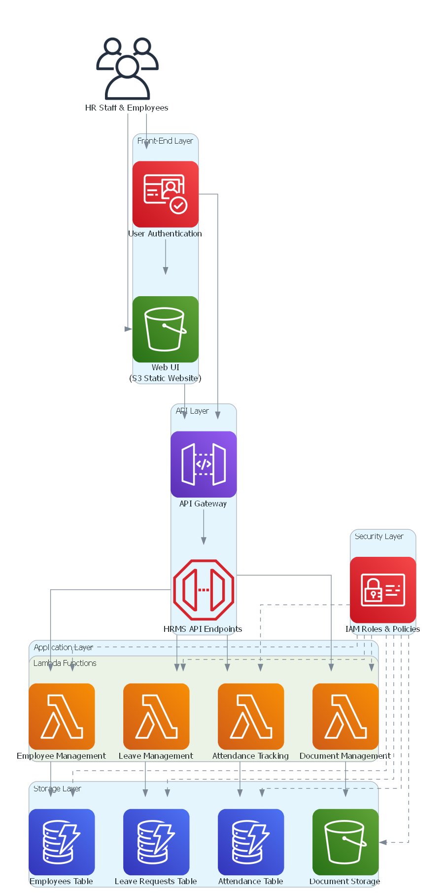
The proposed architecture diagram

Slide 4
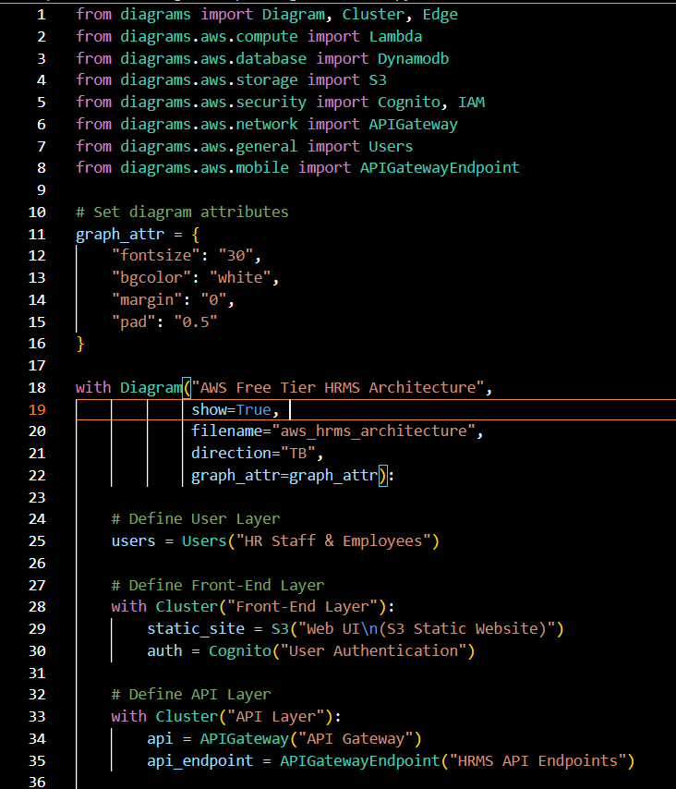
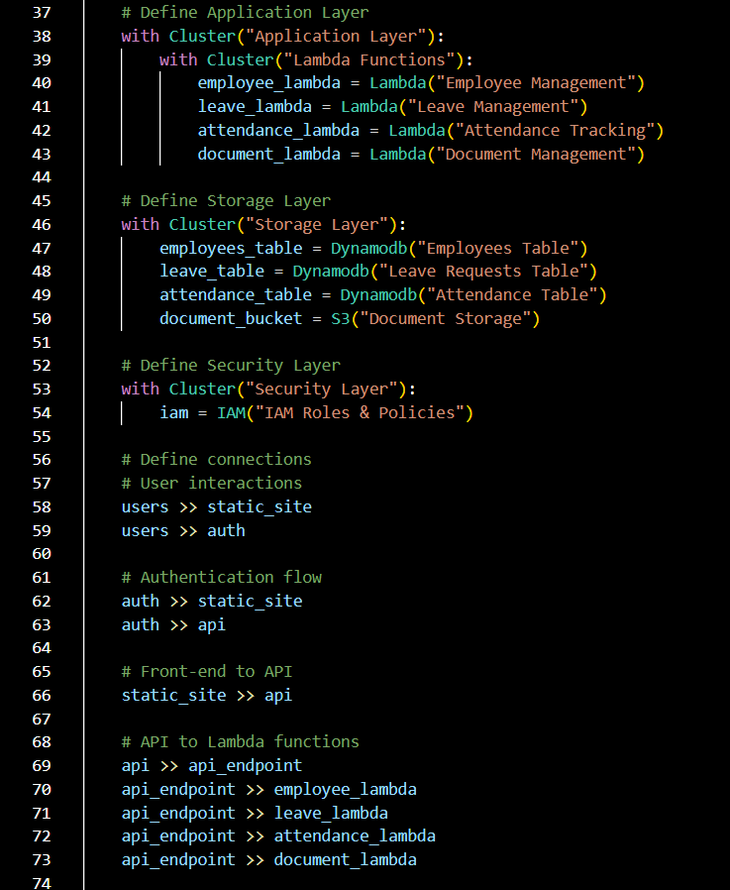
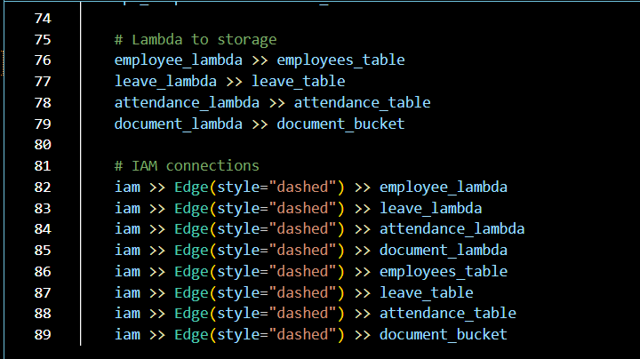
Diagram as code

Slide 5
DETAILED AND STEP-WISE IMPLEMENTATION

Slide 6
1. AWS Account and IAM Users setup
Create an IAM user with AdministratorAccess (for setup)
Set up IAM policies for your HRMS system:
# Create an IAM policy for Lambda functions
{
"Version": "2012-10-17",
"Statement": [
{
"Effect": "Allow",
"Action": [
"dynamodb:GetItem",
"dynamodb:PutItem",
"dynamodb:UpdateItem",
"dynamodb:DeleteItem",
"dynamodb:Query",
"dynamodb:Scan",
"s3:GetObject",
"s3:PutObject",
"s3:DeleteObject",
"s3:ListBucket"
],
"Resource": [
"arn:aws:dynamodb:*:*:table/hrms-*",
"arn:aws:s3:::hrms-documents/*"
]
}
]
}

Slide 7
2. Set Up DynamoDB Tables
2.1 : Employees Table : Table Name: hrms-employees
Primary Key: employeeId (String)
Attributes:
- firstName (String)
- lastName (String)
- email (String)
- phone (String)
- department (String)
- position (String)
- joinDate (String)
- managerId (String)
- status (String) - Active/Inactive

Slide 8
2. Set Up DynamoDB Tables
2.2 Leave Requests Table : Table Name: hrms-leave-requests
Primary Key: requestId (String)
Sort Key: employeeId (String)
Attributes:
- startDate (String)
- endDate (String)
- leaveType (String) - Sick/Vacation/Personal
- status (String) - Pending/Approved/Rejected
- reason (String)
- approverComments (String)

Slide 9
2. Set Up DynamoDB Tables
2.3 : Attendance Table :
Table Name: hrms-attendance
Primary Key: employeeId (String)
Sort Key: date (String)
Attributes:
- checkIn (String)
- checkOut (String)
- totalHours (Number)
- status (String) - Present/Absent/Half-day

Slide 10
3. Set Up S3 Buckets
Create S3 bucket for the static website:
Bucket Name: hrms-web-ui - Enable static website hosting - Configure public access
Create S3 bucket for document storage:
Bucket Name: hrms-documents - Keep default private access

Slide 11
4. Set Up Amazon Cognito
Create User Pool:
Pool Name: hrms-user-pool – Configure sign-in options (email, username) - Set password policies - Configure MFA (optional) - Add custom attributes for employee role (HR/Manager/Employee)
Create App Client:
App Client Name: hrms-app-client - Enable required OAuth flows - Configure callback URLs

Slide 12
5. Set Up API Gateway
Create a REST API:
API Name: hrms-api
Endpoint Type: Regional
Create the following resource paths:
/employees
/leaves
/attendance
/documents
For each resource, create appropriate methods (GET, POST, PUT, DELETE) and connect them to Lambda functions.

Slide 13
6. Create Lambda Functions
Core Functionalities:
6.1 : Employee Management
6.2 : Leave Management
6.3 : Attendance Management
6.4 : Document Management

Slide 14
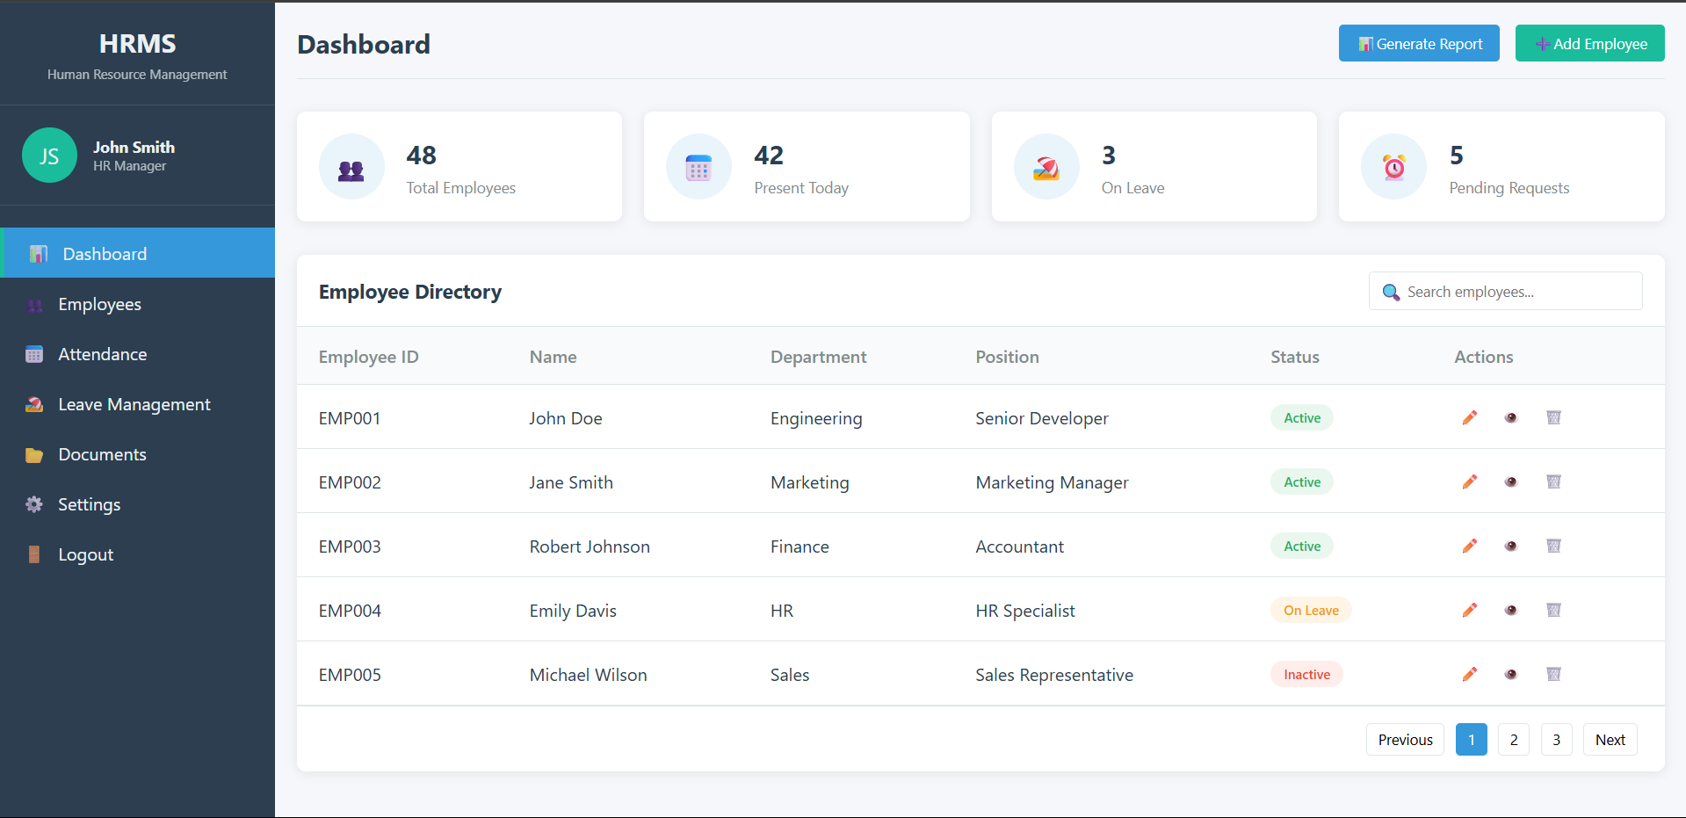
7. Create Web UI

Slide 15
7. CREATE WEB UI
7.1 : index.html :
Simple HTML file with inline/internal css commands for efficient frontend development.
7.2 : auth.js :
Handle authentication with cognito

Slide 16
8. Deploy the Application
Upload the static website to S3:
Compress your web files
Upload to the S3 bucket
Configure the bucket for static website hosting
Enable public access to read the website
Deploy the Lambda functions:
Create the functions in the AWS console
Upload the code for each function
Configure appropriate triggers via API Gateway
Configure API Gateway:
Create the API endpoints
Configure Lambda integration
Enable CORS
Deploy the API to a stage (e.g., 'prod')

