Slide 1
Prediction model for WWTP parameters (GUI)
Group: MOAV
WAREM - SS 2022
Ashwin Vijaya Kumar Yin Mon Aung

Slide 2
Project Proposal
Introduction
Collecting the wastewater treatment plant data (Nitrogen concentration, Phosphrous concentration, COD, etc…) from the ISWA.
Analyse and plot the parameters from the available data.
Predict the parameters by training the model (regression model??)
Plot the predicted data and quantify the variation with the tested data
Designing a GUI for the prediction model to display the results.

Slide 3
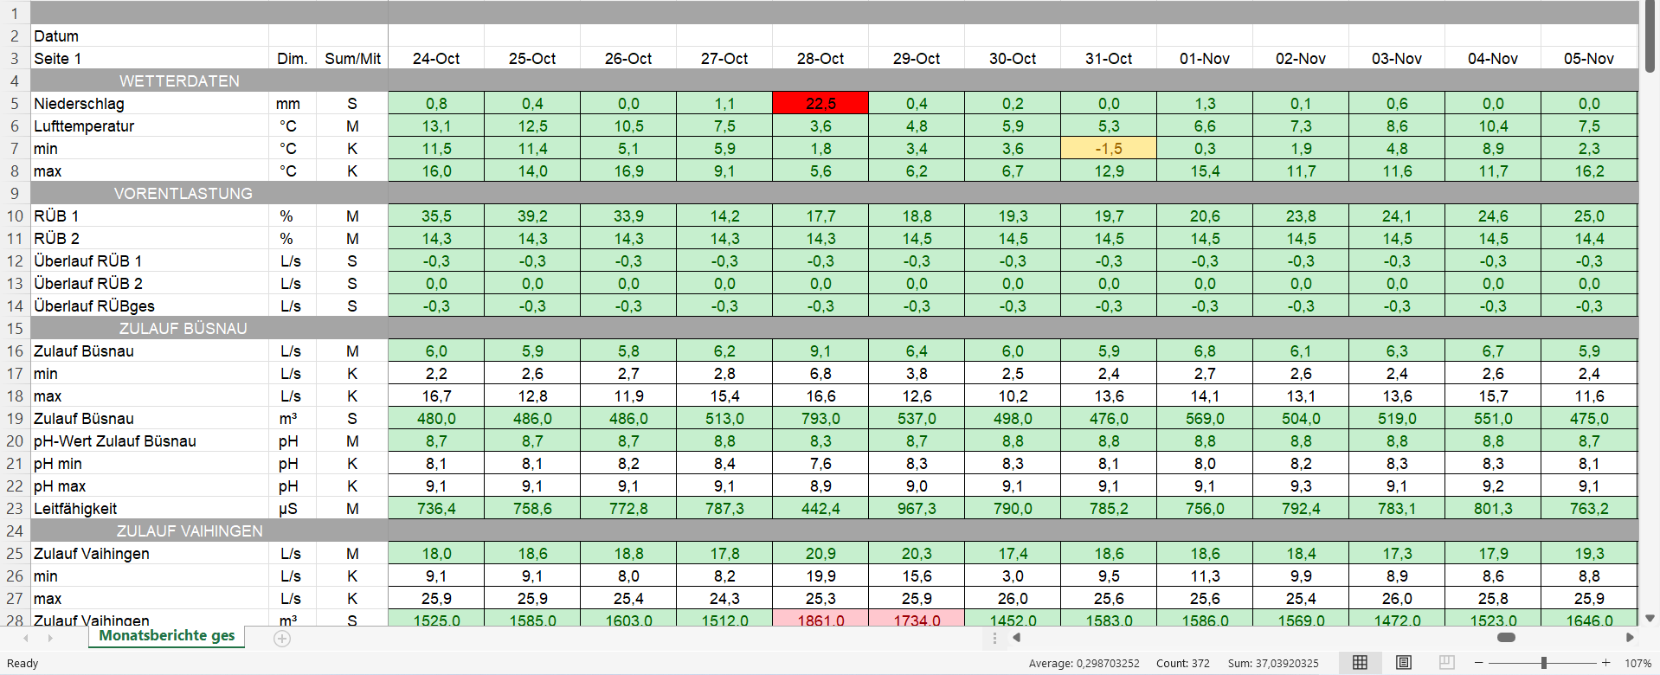
Introduction
WWTP Data (Source ISWA Annual Report 2018)

Slide 4

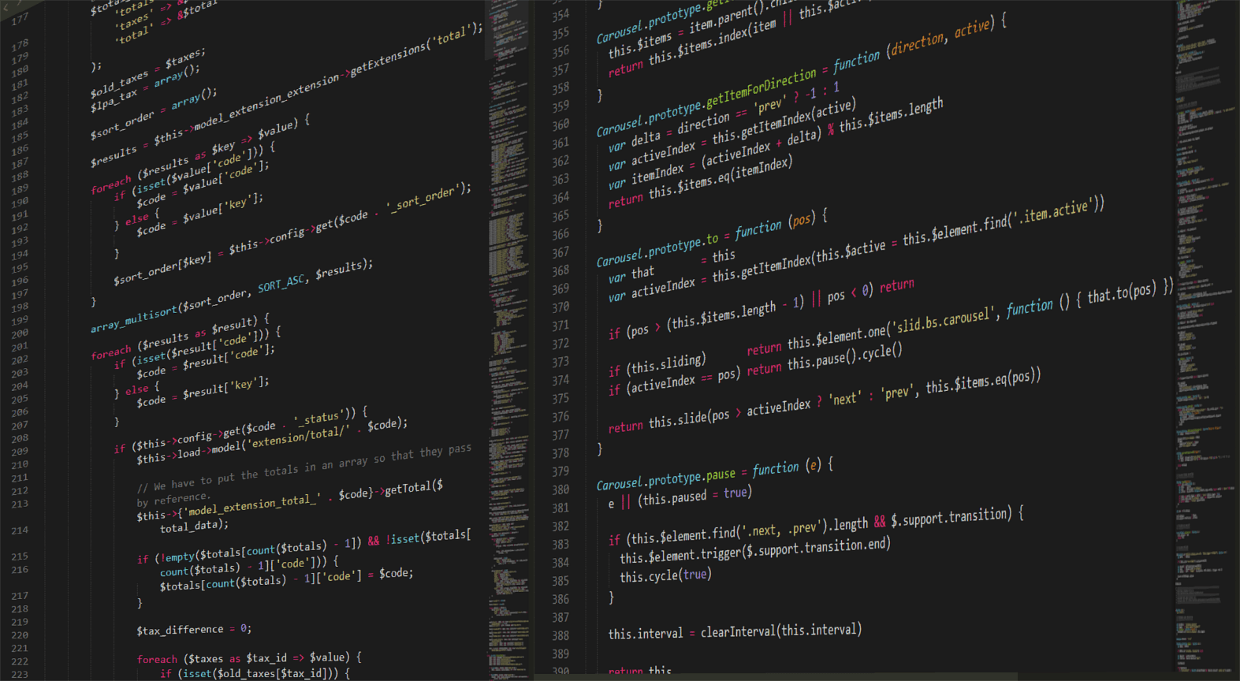

Problem Statements
Accuracy of the model to predict the real time data of the parameter
Use of Classes and Functions and Integration of main, and standalone script with GUI
To make a simple, structured and efficient code.

Slide 5
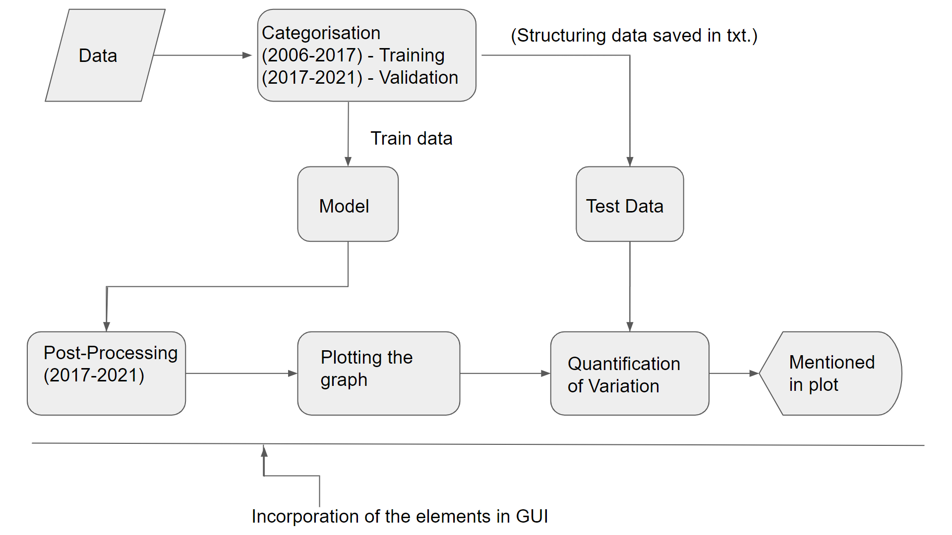
Workflow Diagram

Slide 6
Goals
Design an accurate model to predict WWTP parameters
Incorporate a GUI to work with the prediction model
Notes:
© Copyright PresentationGO.com – The free PowerPoint and Google Slides template library

Slide 7
Timeline for project development
Incorporate the classes for the programming
README Documentation
PEP 8 Styling
Write the standalone script
Week 1
Week 2
Week 3
Week 4(Final)
Collection of the data
Structure of the code
Writing the necessary function
Design the GUI
Implementation of the prediction model

Slide 8
Resource Allocation
Ashwin
main script
GUI
Prediction Model
Classes
README
Yin Mon
main script
Prediction Model
Custom Class
Auxiliary Components
PEP-8 Styling

Slide 9


Water Resources Engineering and Management (WAREM)
Ashwin Vijaya Kumar
e-mail
st172131@stud.uni-stuttgart.de
Yin Mon Aung
e-mail
st175810@stud.uni-stuttgart.de

