Slide 1
Project Topic
Automatic Washroom Light Switch

Slide 2
group members
STUDENT NAME ROLL NO
RITESH NEMADE 18161001
MANJU SHINDE 18161015
ATHARVA KULKARNI 18161024

Slide 3
Contents
Introduction
Components
Block diagram
Circuit Diagram
Working
Advantages
Disadvantages
Applications
Reference

Slide 4
INTRODUCTION
The operation of the project is Automatic switching On and Off of the washroom light.
When the door of the rooms are opened and closed , the circuit turns on the switches of the room using relay.
When the door opens and closes for the second time , the circuit turns off the light by turning off the relay.

Slide 5
Components Required
Reed Switch with Magnet
LM741 Op-Amp IC
IC CD4017 Decade counter
5V Relay Module
BC558 PNP Transistor
Lamp
2 resistors(10k ohm)
100 and 820 ohm
Connecting Wires
Breadboard
5V Power supply

Slide 6
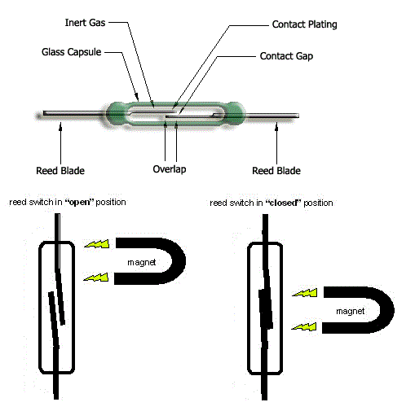
Reed switch
A Reed switch is a magnetically operated switch.
It Contains a magnetic sensitive switch , which when subjected to a small magnetic force , will either close or open the door.
The element which is used to detect the opening and closing of the door in this project is reed switch.

Slide 7
CD4017 Decade Counter IC
CD4017 IC is a CMOS decade counter and it is used in the applications of low range counting.
It is 16 pin and has 10 outputs.
Supply voltage- 3V to 15V.
The clock speed or operational speed of CD4017 IC is 5MHz.
It is compatible with TTL(Transistor-Transistor Logic).
Applications: Binary counter , decoder ,decade counter , frequency division , etc.

Slide 8
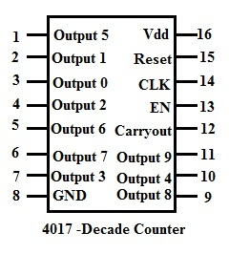
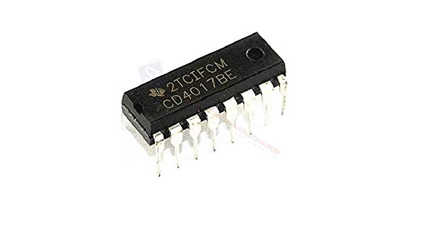
Pinout of cd4017 counter

Slide 9
PIN No. | NAME | DESCRIPTION
1 to 7 | Output pins | Output pins 5, 1, 0, 2, 6, 7 and 3 respectively
8 | GND | Ground pin
9 to 11 | Output pins | Output pins 8, 4 and 9 respectively
12 | Carry-OUT | It completes one full cycle for every 10 clock cycles
13 | Clock Enable | Enable pin enables the CD4017 IC
14 | Clock | Clock signal is provided at this pin
15 | Reset | Pin to reset the counter to 0
16 | VDD | 3 volts to 15 volts

Slide 10
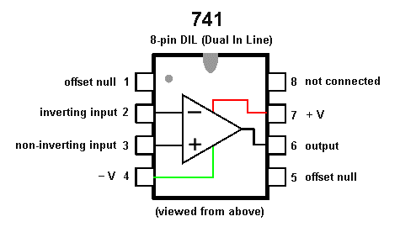
IC LM741
The circuit uses IC741 op-amp as a comparator arranged such that its output is high by default when the door is closed.

Slide 11
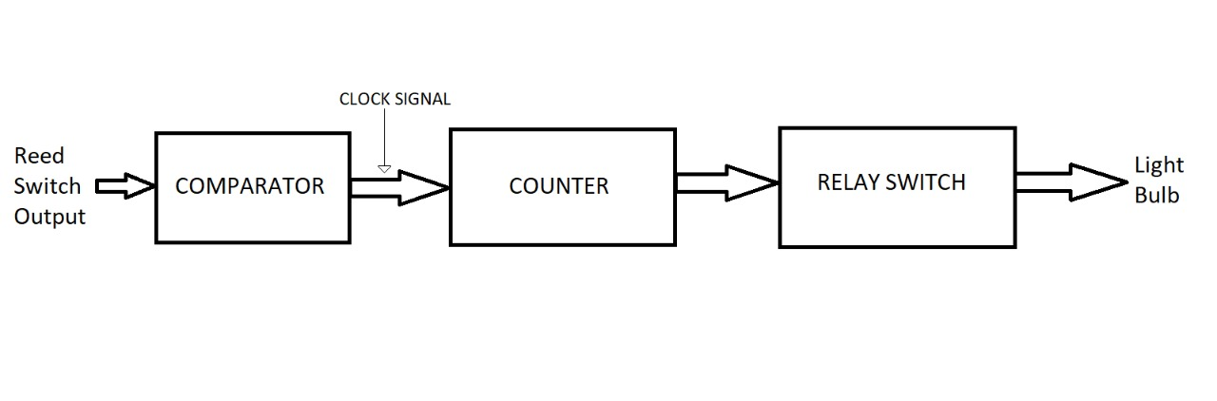
Block Diagram

Slide 12
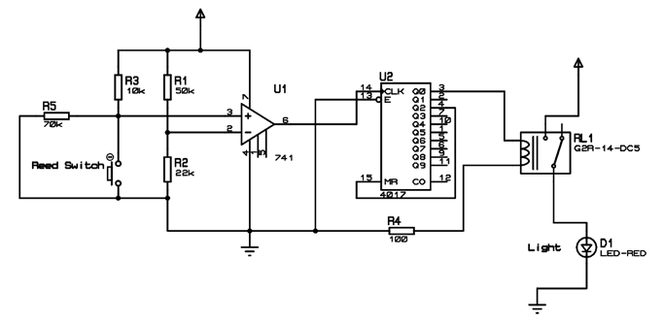
Circuit Diagram

Slide 13
Working of Automatic Washroom light Switch
The reed switch is fixed to the wall near the door the door while the magnet is fixed to the door
This means that the reed switch will always be in closed state as the door is closed, when the washroom is not in used (Which is assumed as starting point) And the magnet will be near the switch.
Assumed you opened the door an entered into the washroom and then closed the door behind you. This action will make the switch open (when the door is open first) and closed (when you closed the door).

Slide 14
As a result, the output of the opamp goes high (when you open the door) and Then goes low.
this in turn will cause the counter to produce a high output at its pin 2. Since pin 2 of CD4017 is connected to the relay, the light will be turn on.
Now, when you are done with your business in the washroom, you will once again open the door, come out of the washroom and closed the door.
As a result output of op-amp goes high and then goes low.
But, since the pin4 Of CD4017 is connected to the reset pin, all the out puts will become low and hence the relay will be turned off, which in turn switches of the light.

Slide 15
Advantages
Low Cost
Easy to use
Can be implemented in single door.
Can be used for automatic room light control.

Slide 16
Disadvantages
Works regardless of day and night.
Can only be used for specified purposes.

Slide 17
Applications
Useful for automatic out door lighting for garden shed lighting at home.
Useful for switching simple lightboards on and off automatically.

Slide 18
Reference
https://www.electronicshub.org/automatic-washroom-light-switch/
CD4017 datasheet
IC741 datasheet
Electronicshub.com

Slide 19
Thank you

