Slide 1
Machine Learning Techniques for Stock Price
Prediction:
A Grupo Bimbo Study in Descriptive and Predictive Analytics
José Eduardo Zárate Aranda
Farid Jácome Velasco

Slide 2

Introduction
The stock market -> The collection of markets that can develop actions like buying, selling and deploying shares.
Research on stock market prediction have been of great interest:
Impact on nation ́s economy.
Relation with companies.
Relation with Investors.

Slide 3

Introduction
The behaviour of Stock market:
Non-linear.
Highly volatile.
Influenced by different events.
Different approaches try to predict stock market prices:
Fundamental analysis.
Technical analysis.
Sentiment analysis.

Slide 4
Problem definition and research questions
The aim of this work is to compare two popular approaches (LSTM and ARIMA) for the prediction of Stock market prices.
Research questions:
Are these models sufficient to predict stock prices using historical data?
Is LSTM superior to ARIMA for Stock price prediction?

Slide 5
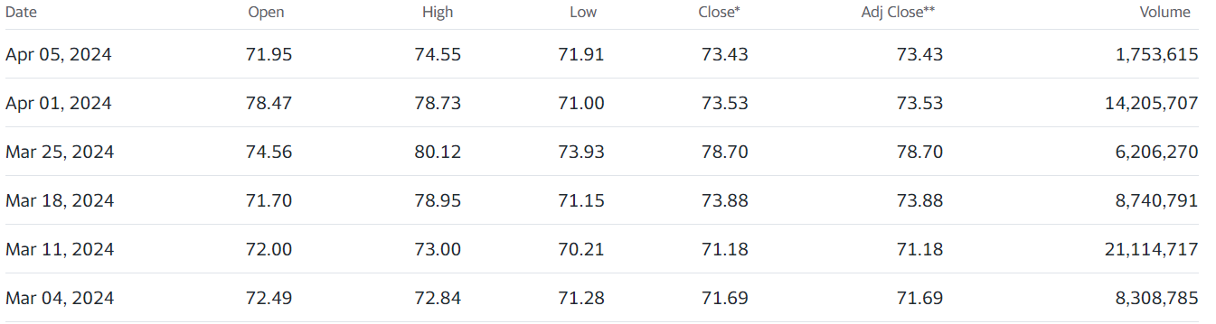

Data and Methods
Stock prices data of Grupo Bimbo, S.A.B. de C.V., retrieved from Yahoo! Finance repository the 6th of April 2024.
csv file was stored in a pandas dataframe inside an Interactive Python Notebook (ipynb).
The time series comprehends from 3 of March 2000 to 3 of April 2024, with a span of 8,797 days, 24 completed years and 289 months.

Slide 6
Model Generation
ANN
Artificial Neural Networks (ANN) are computational models inspired by the structure and function of biological neural networks (Zakaria, 2014). They consist of interconnected processing elements, or neurons, organized into layers (Uhrig, 1995). These neurons process input patterns and predict outputs, with the network being trained using input-output pattern associations (Zhu, 2017).
ARIMA
ARIMA, or Autoregressive Integrated Moving Average, is a time series modeling method that can be used for forecasting and analysis (Luceño, 2008; Tadokoro, 2013; Datta, 2012; Farhath, 2016). It is composed of three parts - AR (autoregressive), I (integrated), and MA (moving average) - which can be used individually or in combination (Luceño, 2008). The method is particularly useful for non-stationary time series data, as it can be differentiated to create a stationary ARMA process (Luceño, 2008; Dong-mei, 2010).

Slide 7
Model Generation (ARIMA Methodology)
Objective
Data Processing
Training
Forecasting and Evaluation
Ensure the data is stationary (i.e., its statistical properties do not change over time)
Identify the order of the ARIMA model employing automated tools like auto_arima to find the best-fitting model
Fit the ARIMA model to the historical data to capture underlying trends and patterns
Generate forecasts and assess the error of the predictions.
1
2
3
4

Slide 8
Model Generation (LSTM Methodology)
Objective
Data Processing
Model Architecture:
Training
Prediction and Evaluation
Model stock market data and make predictions based on historical patterns
Scale and normalize data to for consistent input for the LSTM. Split in train and test data sets.
Construct a sequential model with LSTM layers . Include dropout layers to prevent overfitting and dense layers for output.
Train the model using the training data to learn patterns and relationships
Use the trained model to predict and evaluate test data using metrics like MSE
1
2
3
4
5

Slide 9
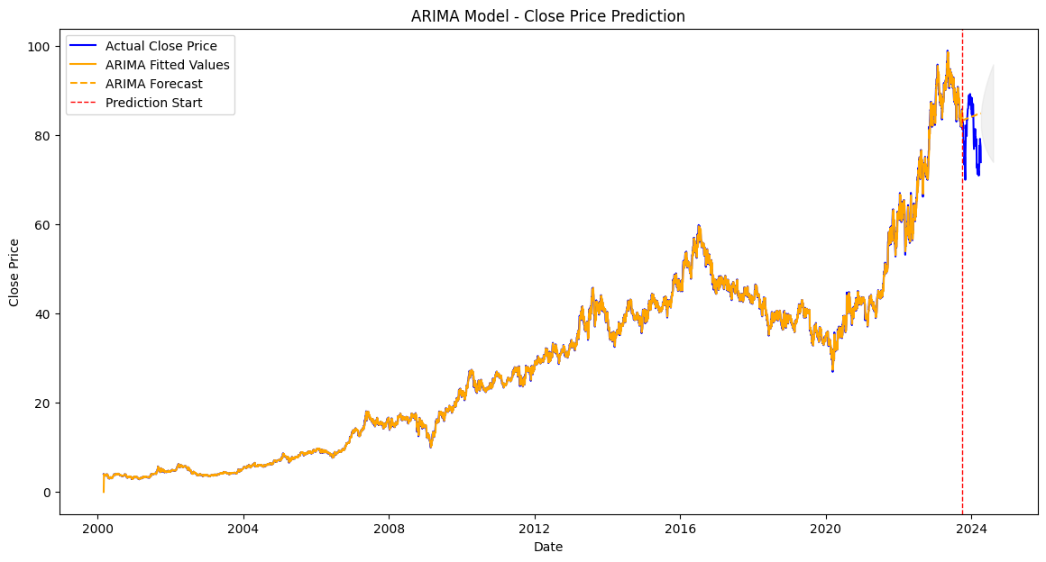
Auto Regressive Integrated Moving Average
ARIMA Model Summary
Model Order: ARIMA(2,1,4)
AIC: 11,652.797
BIC: 11,686.287
Log Likelihood: -5821.399

Slide 10
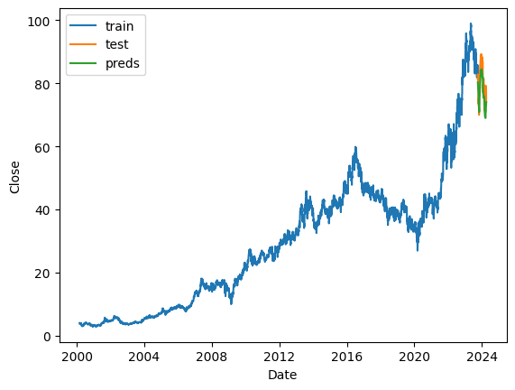
Long short-term memory model
Standard scaler
Architecture:
2 LSTM units=64
Dense = 32
Dropout = 0.3
Dense
Optimizer:
ADAM
Learning rate =0.01
Epochs = 10

Slide 11
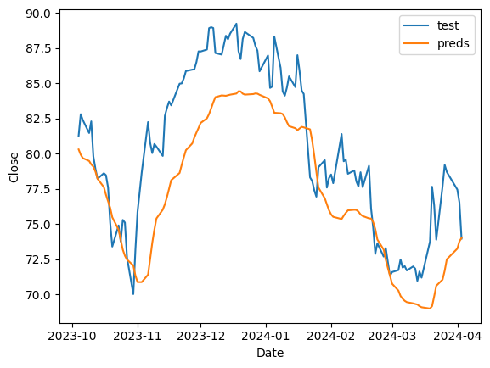
Predictions LSTM POV

Slide 12
ANN VS ARIMA
LSTM
ARIMA
MSE = 15.21
MSE = 40.19

Slide 13
Conclusions
Two popular models were utilized to predict the stock market prices of Grupo Bimbo over a 120-day period.
Both models delivered acceptable predictions, yet there was a clear difference in their performance.
The LSTM model significantly outperformed the ARIMA model, achieving a MSE of 15 compared to 40 for ARIMA.
LSTM are particularly effective in stock price prediction when provided with sufficient and high-quality training data, thus demonstrating their superiority over autoregressive models in such conditions
Finally a quarter-year of stock prices for Grupo Bimbo was successfully predicted, showcasing the effectiveness of the ANN model

Slide 14
References
Magdi Zakaria, M., Al-Shebany, M., & Sarhan, S. (2014). Artificial neural network: A brief overview.
Uhrig, R. E. (1995). Introduction to artificial neural networks. In Proceedings of IECON '95 - 21st Annual Conference on IEEE Industrial Electronics. IEEE.
Zhu, A. X. (2017). Artificial neural networks.
Datta, K. (2012). ARIMA forecasting of inflation in the Bangladesh economy.
Dong-mei, X. (2010). Application of the ARIMA model in time series analysis.
Farhath, Z. A., Arputhamary, B., & Arockiam, L. (2016). A survey on ARIMA forecasting using time series model.
Luceño, A., & Peña, D. (2007). Autoregressive integrated moving average (ARIMA) modeling.
Tadokoro, S. (2013). [Aripiprazole as "dopamine sensitivity stabilizer"]. Nihon rinsho. Japanese journal of clinical medicine.

