Slide 1
Machine Learning Techniques for Stock Price
Prediction:
A Grupo Bimbo Study in Descriptive and Predictive Analytics
José Eduardo Zárate Aranda
Farid Jácome Velasco

Slide 2

Introduction
The stock market -> The collection of markets that can develop actions like buying, selling and deploying shares.
Research on stock market prediction have been of great interest:
Impact on nation ́s economy.
Relation with companies.
Relation with Investors.

Slide 3
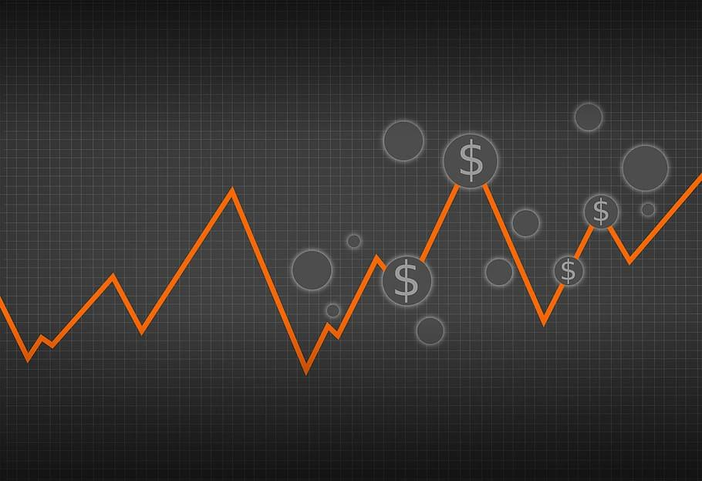
Introduction
The behaviour of Stock market:
Non-linear.
Highly volatile.
Influenced by different events.
Different approaches try to predict stock market prices:
Fundamental analysis.
Technical analysis.
Sentiment analysis.

Slide 4
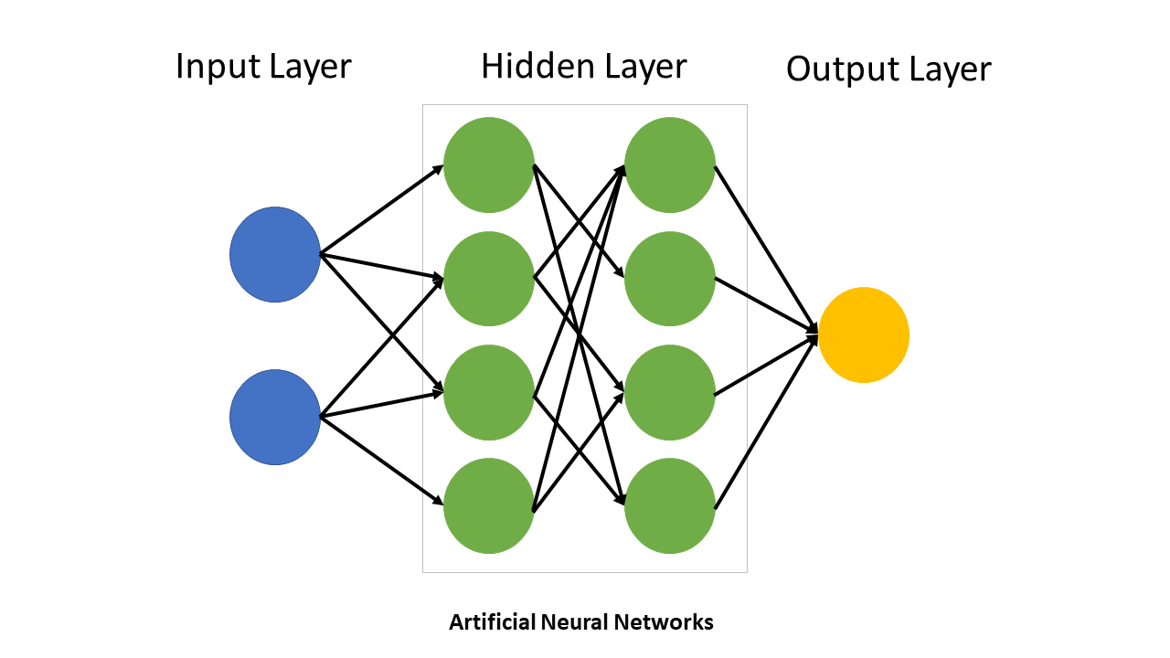
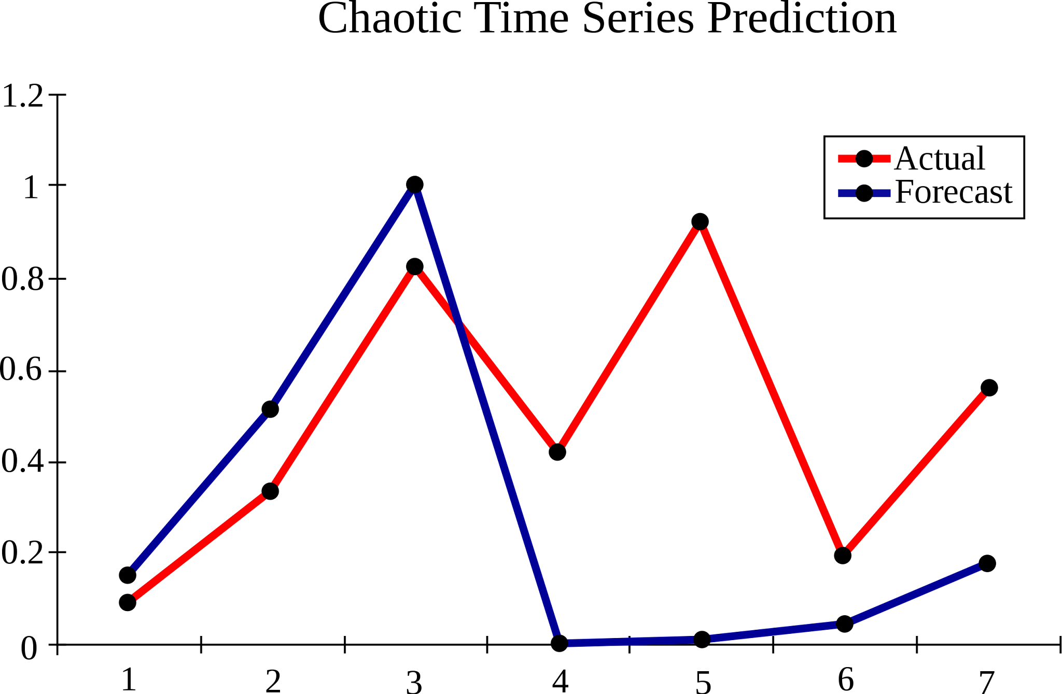
Related work
Rouf et al. 2021 review the most common approaches for stock market forecasting:
Artificial Neural Networks (ANN)
Support Vector Machine (SVM)
Na ̈ıve Bayes (NB)
Regression Algorithms (RA)
Fuzzy Algorithms (FA)
Hybrid Approaches (HA)

Slide 5
Related work
Nabipour et al. (2020) focused on reviewing ensemble and deep learning methods to forecast stock market group values, identifying LSTM as the superior model despite encountering runtime challenge.
In a 2021 study, Mukherjee et al. instead of using conventional models for classification like recurrent neural networks or transformers, they used CNNs to demonstrate that similar results could be achieved.
Kumar et al. (2022) emphasized the importance of hybrid approaches and machine learning techniques like Artificial Neural Networks (ANN)

Slide 6
Problem definition and research questions
The aim of this work is to compare three different popular approaches (ANN, SVM and ARIMA) for the prediction of Stock market prices.
Research questions:
Are these models sufficient to predict stock prices using historical data?
Is ANN superior to SVM and ARIMA for Stock price prediction?
What are the advantages and disadvantages of these techniques in terms of Stock price prediction?

Slide 7
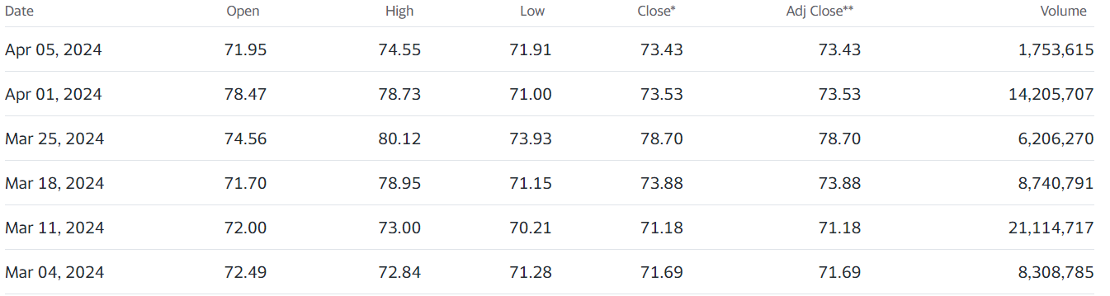

Data and Methods
Stock prices data of Grupo Bimbo, S.A.B. de C.V., retrieved from Yahoo! Finance repository the 6th of April 2024.
csv file was stored in a pandas data frame inside an Interactive Python Notebook (ipynb).
The time series comprehends from 3 of March 2000 to 3 of April 2024, with a span of 8,797 days, 24 completed years and 289 months.

Slide 8

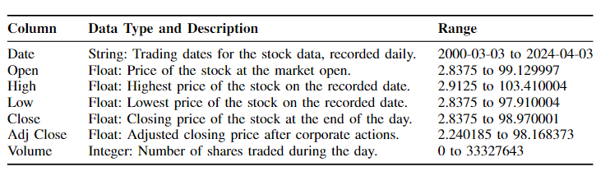
Data and Methods
The file 'BIMBO.MX.csv' consists of historical stock price data with the following characteristics:

Slide 9
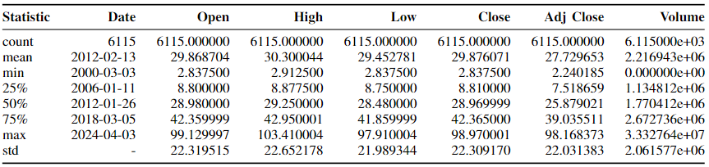
Data and Methods (Preliminar Analysis)
Summary statistics for the numeric columns in the 'BIMBO.MX.csv' dataset

Slide 10
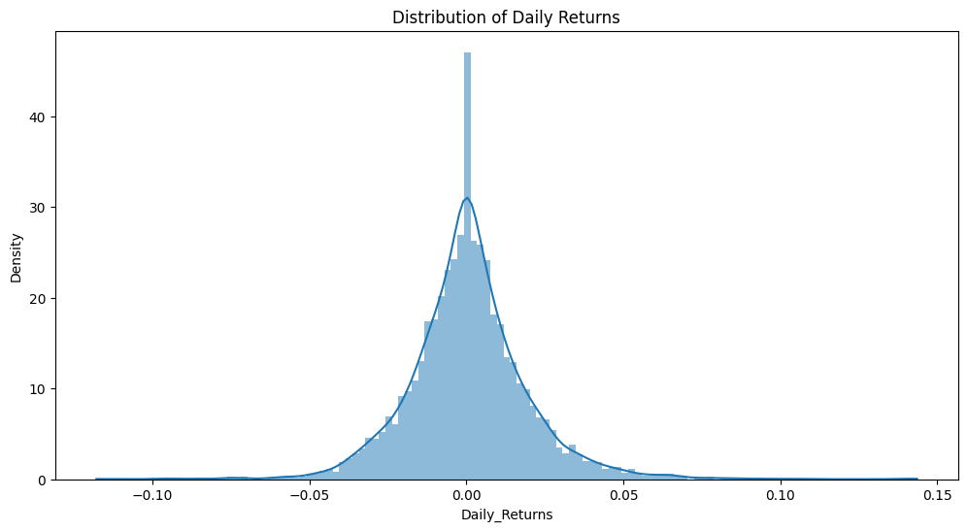
Data and Methods (Preliminar Analysis)

Slide 11
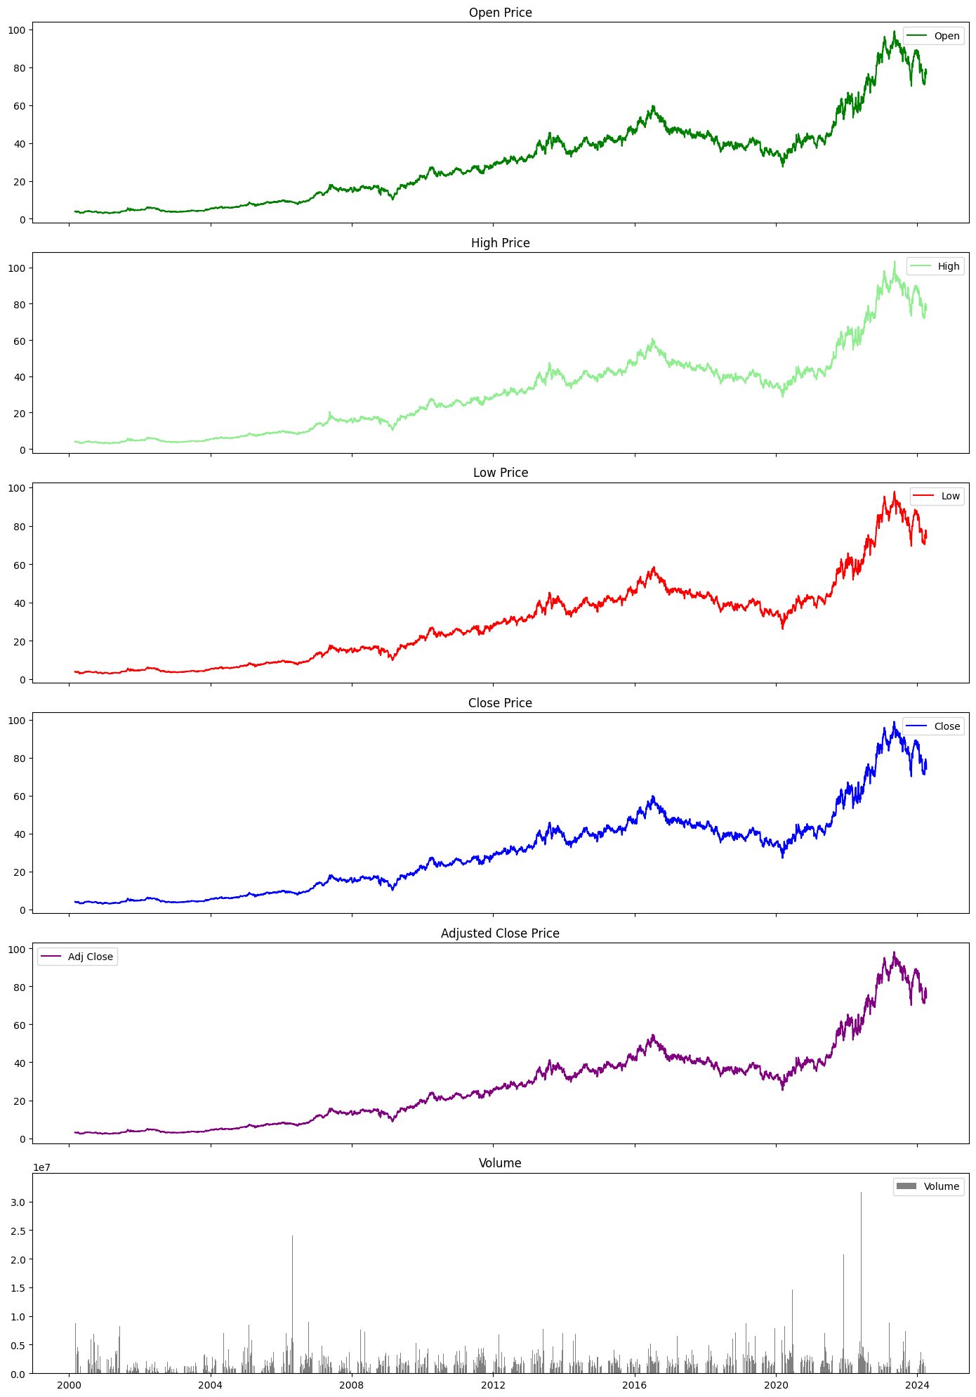
Data and Methods (Preliminar Analysis)

Slide 12
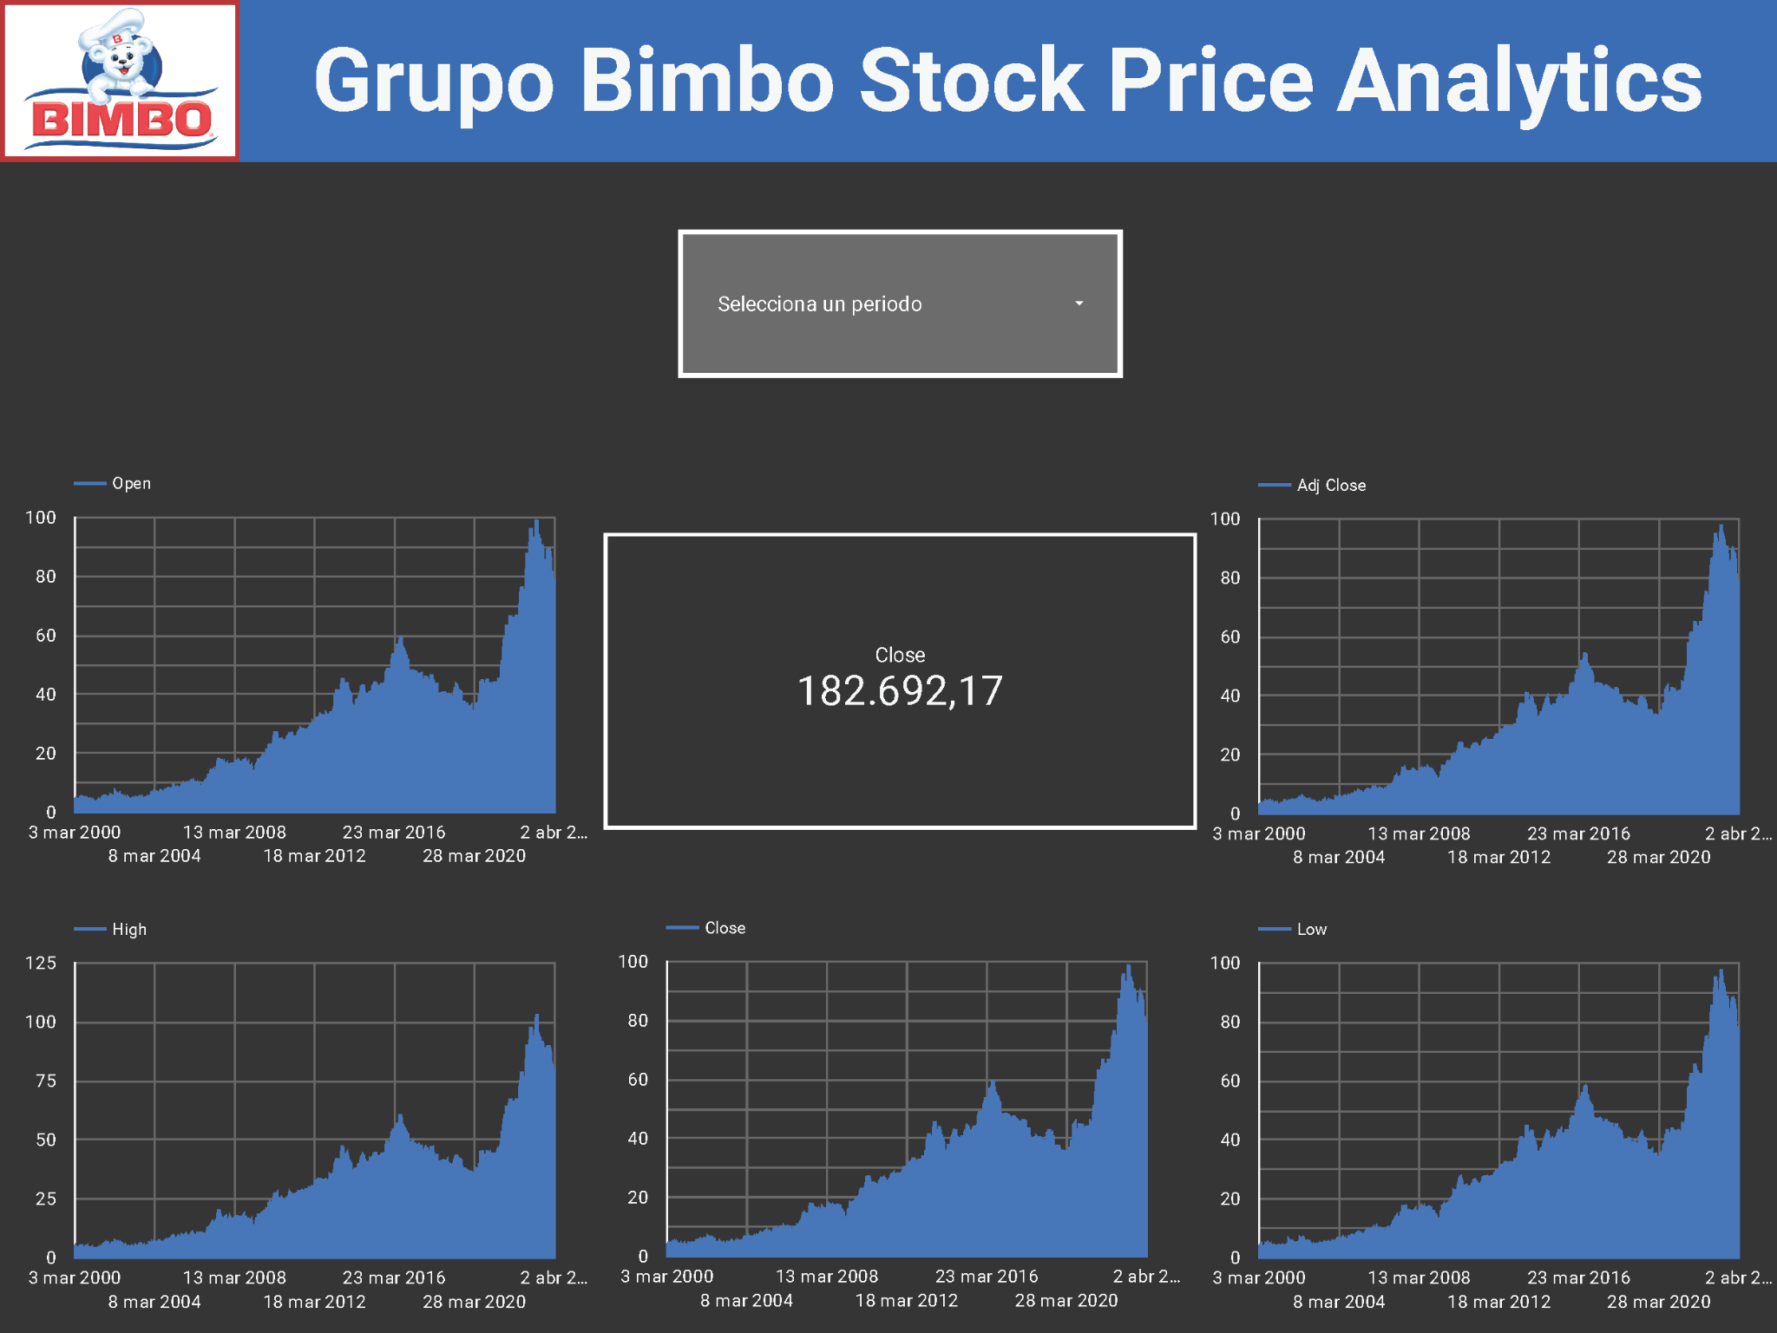

Data and Methods (Preliminar Analysis)

Slide 13
Predictive models
Support Vector Machine
Auto Regressive Integrated Moving Average
Artificial Neural Network

Slide 14
References
Mukherjee, S. , et al.: Stock market prediction using deep learning algorithms. CAAI Trans. Intell. Technol. 8(1), 82–94 (2023). https://doi.org/10.1049/cit2.12059
Rouf, N., Malik, M.B., Arif, T., Sharma, S., Singh, S., Aich, S., Kim, H.: Stock Market Prediction Using Machine Learning Techniques: A Decade Survey on Methodologies, Recent Developments, and Future Directions. Electronics 2021, 10, 2717. https://doi.org/10.3390/electronics10212717
Thakkar, A. \& Chaudhari, K. Fusion in stock market prediction: A decade survey on the necessity, recent developments, and potential future directions. Inf. Fusion 65, 95–107 (2021).
Kumar, D., Sarangi, P. K., \& Verma, R. (2022). A systematic review of stock market prediction using machine learning and statistical techniques. Materials Today: Proceedings, 49, 3187–3191. https://doi.org/10.1016/J.MATPR.2020.11.399
Nabipour M, Nayyeri P, Jabani H, Mosavi A, Salwana E, S. S. Deep Learning for Stock Market Prediction. Entropy. 2020; 22(8):840. https://doi.org/10.3390/e22080840
Long, J., Chen, Z., He, W., Wu, T., \& Ren, J. (2020). An integrated framework of deep learning and knowledge graph for prediction of stock price trend: An application in Chinese stock exchange market. Applied Soft Computing, 91, 106205. https://doi.org/10.1016/J.ASOC.2020.106205
Jiang, W. (2021). Applications of deep learning in stock market prediction: Recent progress. Expert Systems with Applications, 184, 115537. https://doi.org/10.1016/J.ESWA.2021.115537

