Slide 1
Using Parallel tools to accelerate drone’s mapping system

Slide 2
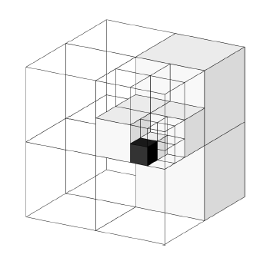
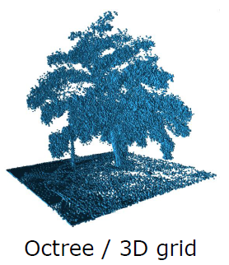
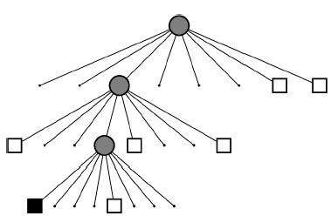
Background on Octomap
A drone’s mapping system that uses multi-level occupancy grid to represent the 3D space
Backend data structure: Octree. Supporting different resolution query
Each node in the Octree has an occupancy probability (to denote how much free / occupied)
Unknown space
Free space
Occupied space
Octree

Slide 3
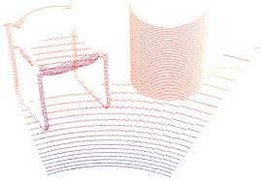
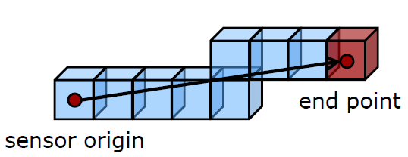

Octomap workflow
Occupied voxel
Free voxel
Point Cloud generated by sensor (Lidar)
Ray tracing for each point in point cloud
73.8% of total runtime
12.3% of total runtime
Update occupancy probability into Octree
Recursively updates all ancestors

Slide 4


Our proposal
Duplicated calculated free voxels from 2 threads
End Point 1
End Point 2
Use multi-thread method to accelerate the ray-tracing & octree insertion operation.
(Will see to workload, whether to perform both tasks)
Jobs to do:
Splitting into multiple threads (easy): e.g. 10 threads to deal with 10% tasks each
Aggregating (hard): to deal with concurrent memory accesses
Sensor Origin
Challenge in aggregating multi-thread ray tracing
Concurrent memory access
Challenge in synchronizing multi-thread Octree update

