Slide 1


MAR BASELIOS INSTITUTE OF TECHNOLOGY AND SCIENCE
NELLIMATTOM, KOTHAMANGALAM
DEPARTMENT
OF
COMPUTER SCIENCE AND ENGINEERING
KNOTBOOK
AN ONLINE LEARNING PLATFORM
Guided by Submitted By
MINNU ELIZABETH ITTAN Group No: 12
Assistant Professor GOKUL G NAIR (MBI21CS035)
CSE Department SHEENA S SAIJU (MBI21CS055)
Approved on: 20 February 2025 SOLAMAN AJI (MBI21CS056)
SUSAN PAUL (MBI21CS057)

Slide 2
Abstract
Introduction
Objectives
Literature Survey
Proposed System
Architecture Design
Module Details
Implementation
Dataset
Technology Stack
Conclusion
References
Contents

Slide 3
Abstract
Knotbook is an online platform that facilitates easy sharing of educational notes
Automatically creates various practice questions (multiple-choice and short-answer) from uploaded notes using NLP
The system generates a comprehensive collection of assessments without manual input
Answer validation and Progress Reporting is also carried out by the system.
Provides an interactive learning experience that boosts student involvement

Slide 4
Introduction
Online learning has evolved rapidly due to advancements in Internet and communication technology
Despite benefits, challenges like low engagement and high dropout rates remain
A Virtual Learning Environment is needed to enhance educational experience and improve student engagement
VLE automates, assessment and monitoring by generating diverse questions
This system has potential to transform education by improving student outcomes, increasing retention rates and enabling more personalized learning experiences

Slide 5
Objectives
To create a platform for faculty to upload, organize and share lecture notes with students
To enable students to take online exams with system-generated questions from uploaded notes
To allow students to use text-voice conversion facility during exams
To evaluate the assessments taken by learners and generate progress report

Slide 6
Literature Survey
Slno. | Paper | Technology Used | Advantages | Disadvantages
1. | MCQGen: A Large Language Model-Driven MCQ Generator for Personalized Learning [1] | Large Language Model Integration Retrieval-Augmented Generation | Feedback Mechanism Guided question generation | Struggles with complex mathematics Limited diversity and complexity
2. | UniRaG for Multimodal Question Answering With Pre-Trained Language Models[2] | LLaVA for Image-to-Text Pre-trained Language Model | High-quality answer generation Detailed image descriptions | Risk of overload Possibility of conversion errors
Notes:
Spiking Neural Networks (SNN) in-depth interview

Slide 7
Literature Survey
Slno. | Paper | Technology Used | Advantages | Disadvantages
3. | Opinerium: Subjective Question Generation Using Large Language Models [3] | Flan-T5 trained on local computers GPT-3 trained on OpenAI’s servers | Emphasizes personal insights in generation Fine-tuning improve working | Challenging quality assessment Significant computing costs
4. | Leveraging Structured Information from a Passage to Generate Questions [4] | Dataset: RACE4QG Encoder: GRU with GAT embeddings Decoder: Attention and Pointer Networks | Utilizes multiple input sources Combines template-based and neural techniques | Difficulty with unstructured data Limited question types
Notes:
Spiking Neural Networks (SNN) in-depth interview

Slide 8
Literature Survey
Slno. | Paper | Technology Used | Advantages | Disadvantages
5. | A Study on an Intelligent Algorithm for Automatic Test Paper Generation in University English Exams [5] | IGA for Question Selection Constraint-Based Test Paper Generation | Balanced Question Distribution Customizable Difficulty Levels | Subjective Limitations Algorithm Complexity
6. | Automatic Exam Correction Framework for the MCQs, Essays and Equations Matching [6] | Embeddings: Word2Vec, FastText Similarity:HMB-MMS-EMA, Cosine, Pearson | Hybrid Question Support Intelligent Equation Matching | Limited Complex Equation Support High Computation Needs
Notes:
Spiking Neural Networks (SNN) in-depth interview

Slide 9
Literature Survey
Slno. | Paper | Technology Used | Advantages | Disadvantages
7. | Toward Robust Evaluation: A Comprehensive Taxonomy for Open Domain Question Answering [7] | ODQA Techniques: - Retriever-Only - Generator-Only LLM-Based Evaluation | Comprehensive Evaluation Taxonomy Holistic ODQA Assessment | LLM-Focused Limited Real-Time Application Focus
8. | Automatic Question Generation from Given Paragraph [8] | Preprocessing: Tokenization, POS Model: Seq2Seq Evaluation: BLEU, Human Feedback | Personalized Learning Cross-Domain Application | Ambiguous Text Handling Limited Question Type
Notes:
SMIS 2.0 (Spill Management Information System 2.0): A 3D hydrodynamic and chemical spill modeling system.
GLLVHT Model: Provides hydrodynamic information for contaminant transport.
COSIM Model: Simulates chemical/oil spill impact.
GIS (Geographic Information Systems): Used for visualizing spill results and spatial queries.
ArcMap: A tool within ESRI’s ArcGIS suite for managing and displaying spill data.

Slide 10
Literature Survey
Slno. | Paper | Technology Used | Advantages | Disadvantages
9. | Investigating Educational and Noneducational Answer Selection for Educational Question Generation [9] | Data Preprocessing: Tokenization, POS Tagging Question Generation: Seq2Seq, Transformers | Dual-mode answer selection Ensures contextual relevance | Low accuracy Difficult to distinguish
10. | A Systematic Review of Automatic Question Generation for Educational Purposes[10] | Classification of Methods: Template-Based, Rule-Based Evaluation Metrics: BLEU, ROUGE, Human Assessments | Comprehensive review across domains Focuses on evaluation benchmarks | Limited AI capabilities Potential bias in selected literature
Notes:
Spiking Neural Networks (SNN) in-depth interview

Slide 11
Cons of Existing System
High Computational Requirements :
Needs powerful GPUs/CPUs for processing
Not suitable for low-resource environments
Difficulty with Complex Questions:
Struggles with subjective questions
Handles ambiguity poorly in generated questions
Dependence on Quality Data:
Requires structured, high-quality datasets
Poor performance with noisy or unstructured data
Notes:
Limited Regional Focus: Existing systems are often generalized and not tailored to specific regions, leading to less accurate predictions.
Lack of Real-Time Data Integration: Many systems rely on periodic updates, which delay responses to changing conditions.
Reactive Spill Management: Systems mostly offer pre-configured or manual responses, making them less efficient in real-time crisis management.
Inadequate Stakeholder Communication: Existing systems may not provide clear, actionable insights for all relevant stakeholders.
Simplified Models: Many systems use basic models, failing to capture the complexity of water flow dynamics and spill risks.
Inefficient Water Resource Management: Limited focus on optimizing water flow between dams and overall resource allocation.

Slide 12
Proposed System
Automated Question Generation : Uses T5 Large, FLAN-T5 and Sense2Vec models to generate MCQs and subjective questions from uploaded documents.
Online Examination Platform : Conducts tests based on the generated questions.
Automated Answer Evaluation : Analyses responses for accuracy and relevance.
Performance Analysis : Generates graphical insights on student performance.
Notes:
Limited Regional Focus: Existing systems are often generalized and not tailored to specific regions, leading to less accurate predictions.
Lack of Real-Time Data Integration: Many systems rely on periodic updates, which delay responses to changing conditions.
Reactive Spill Management: Systems mostly offer pre-configured or manual responses, making them less efficient in real-time crisis management.
Inadequate Stakeholder Communication: Existing systems may not provide clear, actionable insights for all relevant stakeholders.
Simplified Models: Many systems use basic models, failing to capture the complexity of water flow dynamics and spill risks.
Inefficient Water Resource Management: Limited focus on optimizing water flow between dams and overall resource allocation.

Slide 13
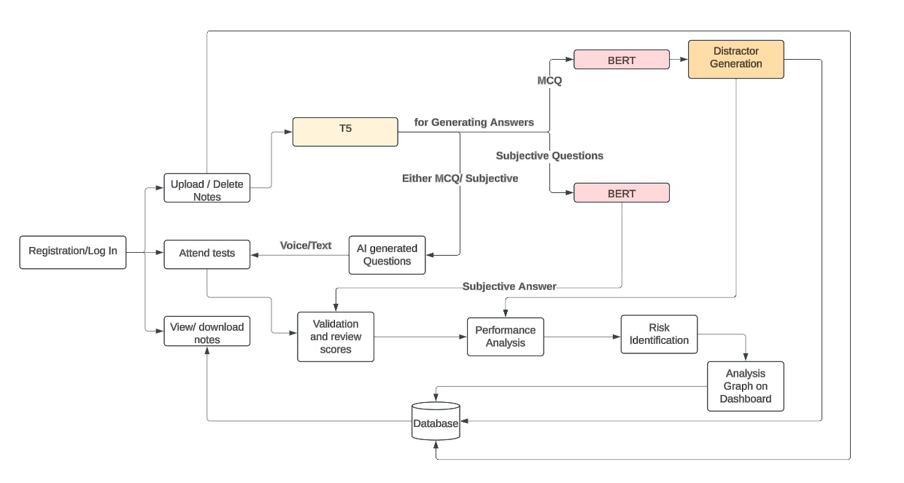
Architecture Design

Slide 14
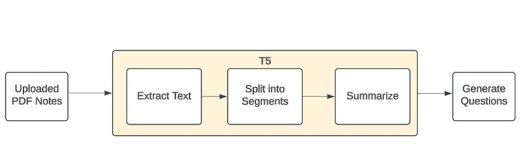
Architecture Design
T5-Model

Slide 15
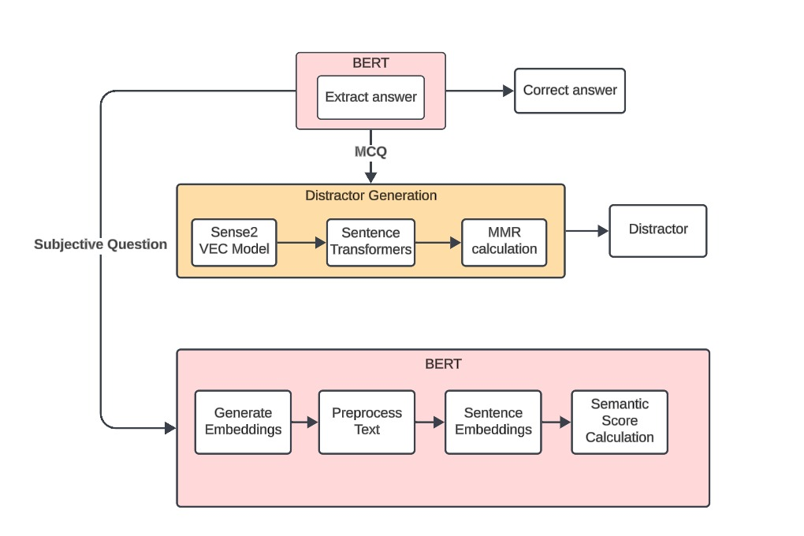
Architecture Design
BERT-Model

Slide 16
Module Details
Automatic Question Answer Generation
Text-Voice Conversion
Answer Validation
Progress Reporting

Slide 17
Module Details
Automatic Question Answer Generation:
Question Types: Multiple-choice and short answer questions.
Text Extraction: Extract text content from PDF notes using PyPDF2.
Question and Answer Generation
- MCQ : Using Flan-T5 Transformer Model
- Subjective Question : Using T5 Large Transformer Model
Distractor Generation for MCQ: Using Gemini API

Slide 18
Module Algorithm
1.A. T5 Question Generation
Step 1: Text Preprocessing: Tokenize text, remove stop words and punctuation,convert
text to lowercase
Step 2: Encode Text: Load T5 Encoder model,convert processed text into embeddings
Step 3: Question Generation: Load T5 Decoder model,generate question from encoder
output
Step 4: Post-processing: Remove special tokens & punctuation,capitalize first letter of
question
Step 5: Display Questions: Rank generated questions based on relevance

Slide 19
Module Algorithm
1.B. BERT Answer Extraction
Step 1: Text Preprocessing: Tokenize summarized text & question,Convert to lowercase,
remove special tokens & punctuation
Step 2: Generate BERT Embeddings: Load BERT model,Obtain embeddings for text &
question
Step 3: Contextualized Embeddings: Use BERT encoder to get contextualized
embeddings
Step 4: Answer Prediction: Use BERT classifier to predict the answer
Step 5: Post-processing: Remove special tokens & punctuation,Convert answer to
lowercase

Slide 20
Module Details
2. Text-Voice Conversion:
Text-to-Voice Engine: Integration with text-to-speech (TTS) services.
Voice-to-Text Engine: Integration with speech-to-text (STT) services.
Web Speech API: TTS and STT services
TTS: speechSynthesis interface
STT: SpeechRecognition interface

Slide 21
Module Details
3. Answer Validation:
Automatic Grading: Validate and score student answers
Grading System: Assign scores based on correctness
For MCQ questions: correct answer is stored in database
For subjective questions: semantic score is calculated and stored in database\
Sentence transformer is used for finding similarity score

Slide 22
Module Algorithm
3.A. Sentence Transformers
Algorithm Sentence_Similarity(text1, text2):
Step 1: preprocessed_text1 ← Preprocess_Text(text1)
Step 2: preprocessed_text2 ← Preprocess_Text(text2)
Step 3: model ← Initialize_Model()
Step 4: embeddings1 ← Generate_Embeddings(model, preprocessed_text1)
Step 5: embeddings2 ← Generate_Embeddings(model, preprocessed_text2)
Step 6: similarity_score ← Compute_Similarity(embeddings1, embeddings2)
Step 7: Return similarity_score

Slide 23
Module Details
4. Progress Reporting:
Student Performance Tracking: Track and display student progress.
Performance Analytics: Detailed analysis of student performance over time.
Progress Dashboard: Visualize student performance metrics.

Slide 24
Implementation
PDF Upload and Text Extraction
Text Extraction: PyPDF2 to extract text from the uploaded PDF document.
Segmenting Text: Split the extracted text into manageable segments or paragraphs
Text Summarization
Load Flan-T5 Model: Use the Flan-T5 model for text summarization.
Summarization Process: For each segment of text, feed it into the Flan-T5 model to generate a concise summary.

Slide 25
Implementation
Question Generation
Load Flan-T5 Model : Use the Flan-T5 model specifically for generating MCQs.
Load Large T5 Model : Use Large T5 model for Subjective Question Generation
Answer Extraction for Questions
Large T5 Model Integration: Use Large T5 model to extract the correct answer from the summarized text.
Storing Questions and Answers: Store the generated questions and their corresponding correct answers in a database

Slide 26
Implementation
Distractor Generation for MCQs
Gemini API: Generates contextually relevant and diverse distractors using advanced language understanding.
Final MCQ Options: Combine the correct answer with generated distractors to form the final answer choices.

Slide 27
Implementation
Answer Validation
MCQ Validation: Compare the user's answer with the correct answer stored in the database.
Subjective Answer Validation:
Semantic Score Calculation:
- Generate Embeddings
- Preprocess Text
- Compute Semantic Score
- Validation Criteria

Slide 28
Pros of Proposed System
Optimized Computational Efficiency:
Efficient on both powerful and low-resource environments
Advanced Handling of Complex and Subjective Questions:
Improved processing complex, ambiguous and subjective queries.
Context-aware reasoning and enhanced natural language understanding.
High-Quality Distractor Generation:
Advanced distractor generation mechanism
Improved training and testing quality.
Notes:
Limited Regional Focus: Existing systems are often generalized and not tailored to specific regions, leading to less accurate predictions.
Lack of Real-Time Data Integration: Many systems rely on periodic updates, which delay responses to changing conditions.
Reactive Spill Management: Systems mostly offer pre-configured or manual responses, making them less efficient in real-time crisis management.
Inadequate Stakeholder Communication: Existing systems may not provide clear, actionable insights for all relevant stakeholders.
Simplified Models: Many systems use basic models, failing to capture the complexity of water flow dynamics and spill risks.
Inefficient Water Resource Management: Limited focus on optimizing water flow between dams and overall resource allocation.

Slide 29
Dataset
The SQuAD (Stanford Question Answering Dataset) is a widely used benchmark dataset in NLP.
Used especially for tasks related to reading comprehension, question answering and question generation.
SQuAD enhances AQG by training Seq2Seq models to generate answer-aware and context-aware questions.
Fine-tuning, paraphrasing and reinforcement learning improve fluency, coherence and diversity, making it a crucial dataset for question generation.
Notes:
SQuAD (Stanford Question Answering Dataset) is a widely used dataset in natural language processing for training and evaluating question-answering systems.
To use SQuAD with T5 for extracting questions and answers from a PDF, start by extracting and preprocessing the text from the PDF.
Fine-tune T5 on the SQuAD dataset, which contains question-answer pairs and contexts, to train the model in generating relevant questions.
After fine-tuning, input the cleaned PDF text into the model to generate questions and extract answers based on the context provided.

Slide 30
Dataset
Column Name | Description | Data Type
id | Unique question ID | Integer
title | Article title | String
context | Article text | String
question | Question text | String
answers | Answer(s) to the question | List of Strings
answer_start | Starting character index of answer | Integer
answer_end | Ending character index of answer | Integer
Notes:
SQuAD (Stanford Question Answering Dataset) is a widely used dataset in natural language processing for training and evaluating question-answering systems.
To use SQuAD with T5 for extracting questions and answers from a PDF, start by extracting and preprocessing the text from the PDF.
Fine-tune T5 on the SQuAD dataset, which contains question-answer pairs and contexts, to train the model in generating relevant questions.
After fine-tuning, input the cleaned PDF text into the model to generate questions and extract answers based on the context provided.

Slide 31
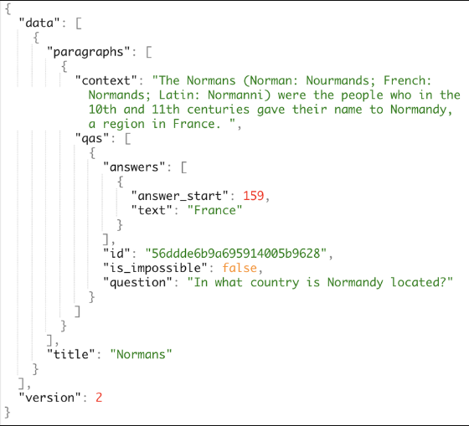
Dataset
Notes:
SQuAD (Stanford Question Answering Dataset) is a widely used dataset in natural language processing for training and evaluating question-answering systems.
To use SQuAD with T5 for extracting questions and answers from a PDF, start by extracting and preprocessing the text from the PDF.
Fine-tune T5 on the SQuAD dataset, which contains question-answer pairs and contexts, to train the model in generating relevant questions.
After fine-tuning, input the cleaned PDF text into the model to generate questions and extract answers based on the context provided.

Slide 32
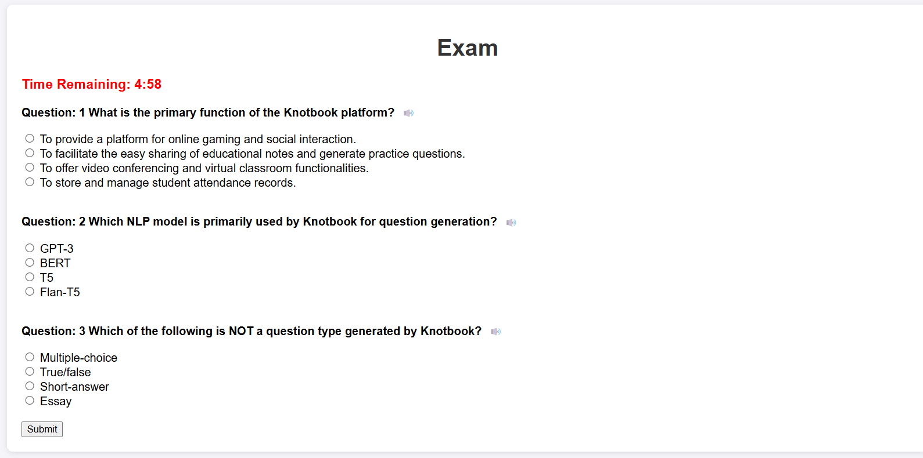
Output
Generated MCQ Questions and options

Slide 33
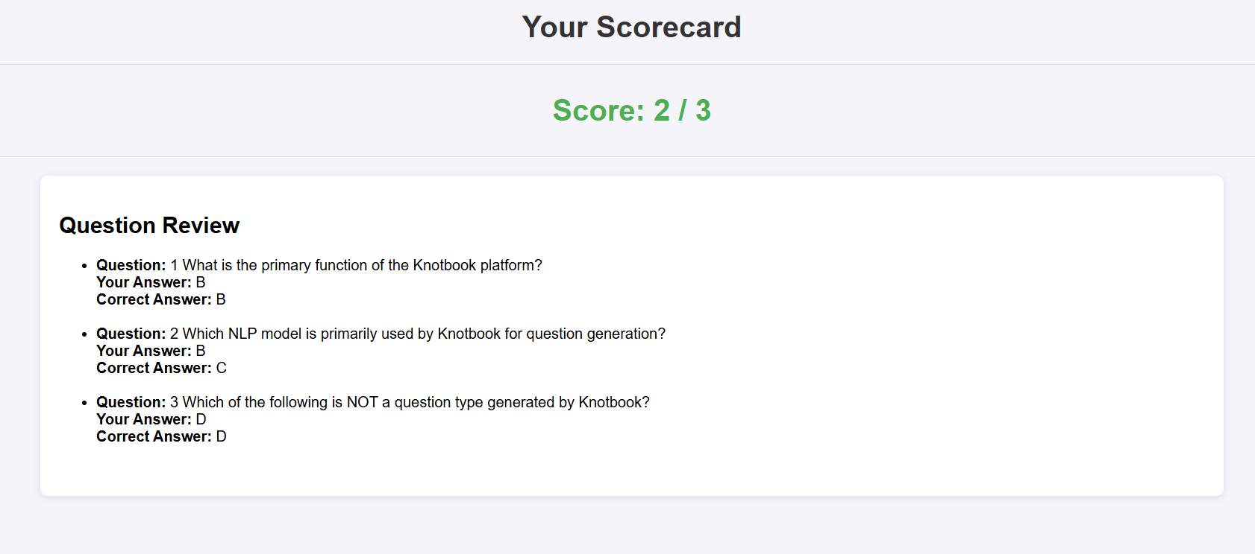
Output
Scorecard of MCQ

Slide 34
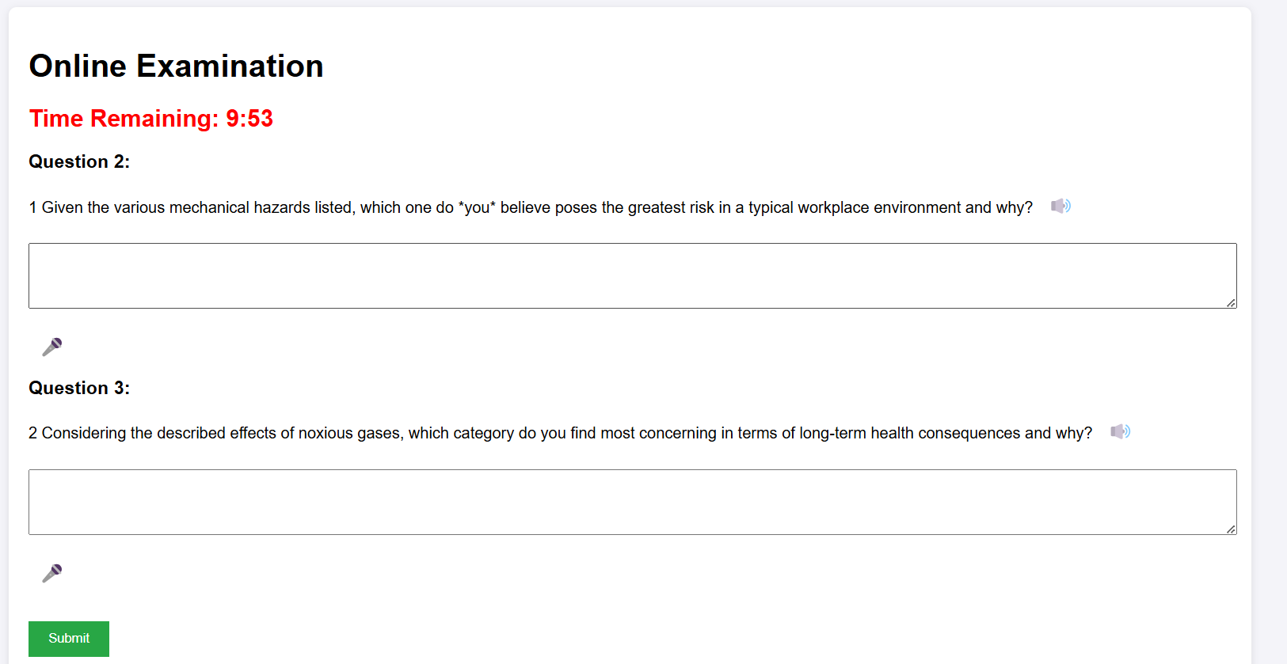
Output
Subjective question generator

Slide 35
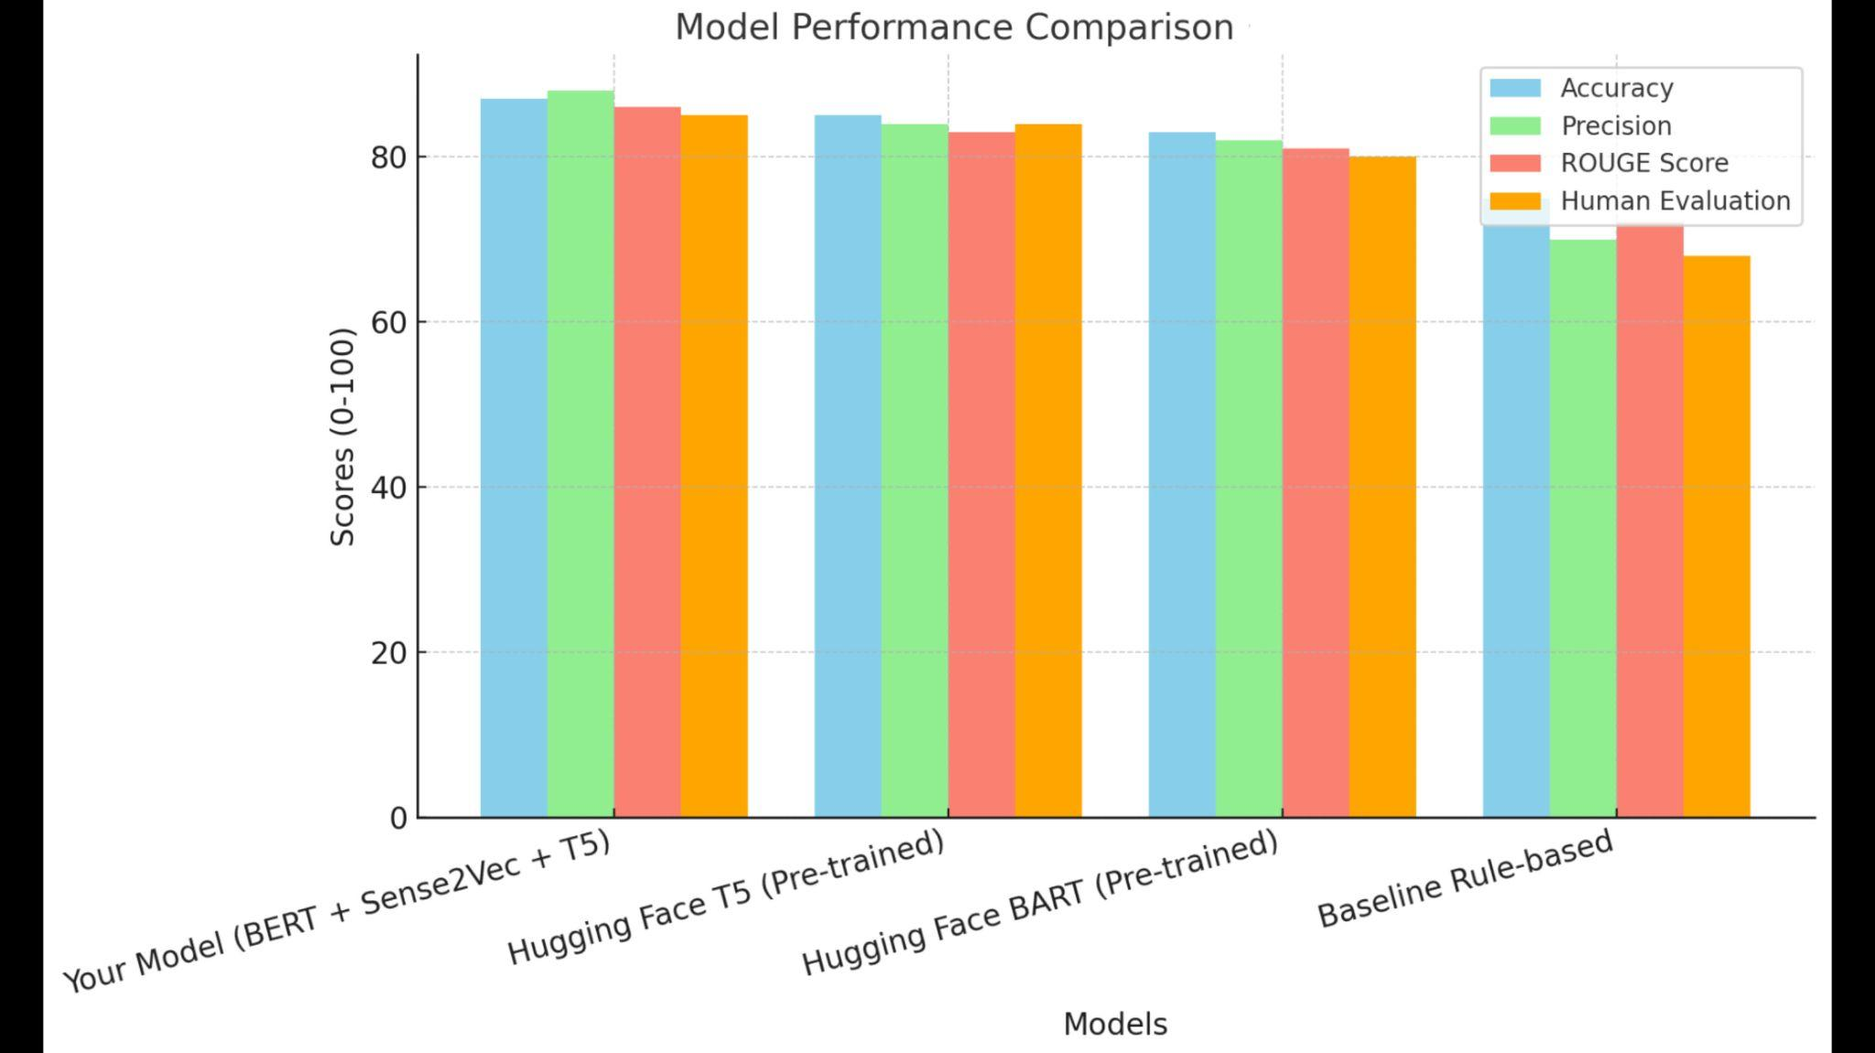
Model Comparison
MCQ generator model

Slide 36
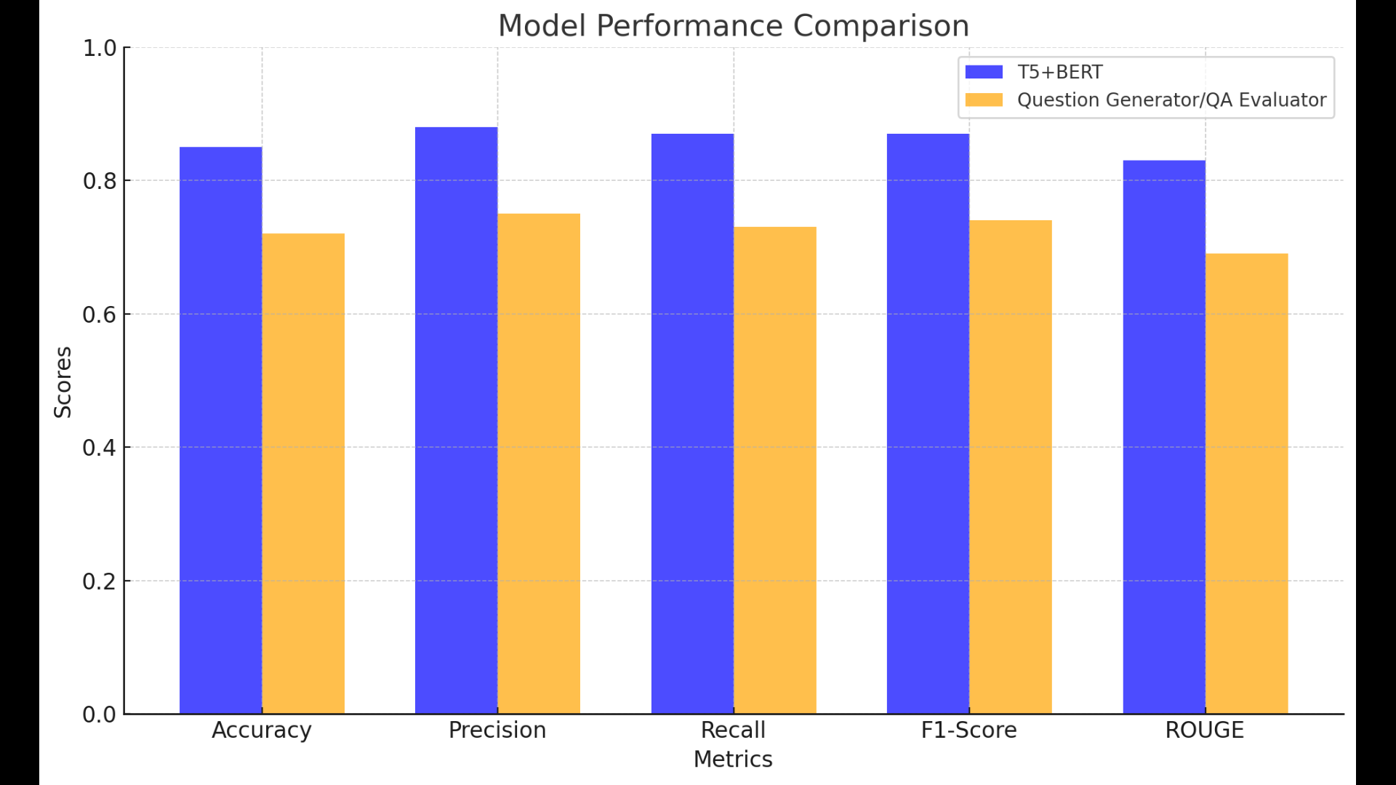
Model Comparison
Subjective question model

Slide 37
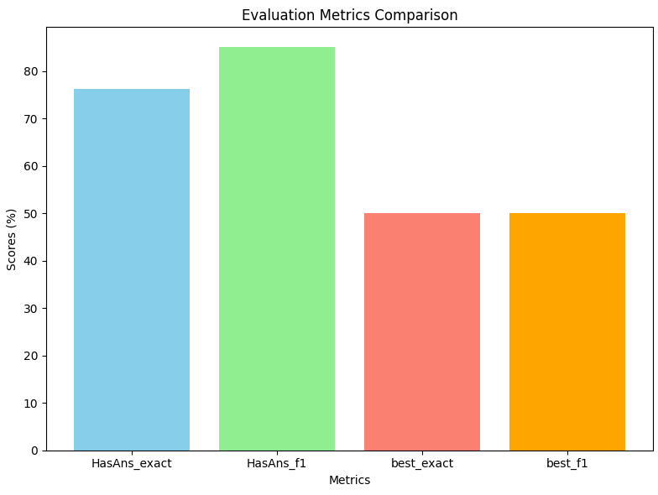
Model Comparison
BERT model after fine tuning

Slide 38
Technology Stack
Software Requirements
Operating System: Windows 8 or above
Programming language:Python 3.9
IDE:Visual Studio Code,Google Colab
Front-end:HTML,CSS,Python
Back-end:Django
Database:MysQL

Slide 39
Technology Stack
Hardware Requirements
Processor: 12th Gen Intel Core i7
Processor Speed: 2.4GHz
Memory: 32 GB RAM
Graphics Card: NVIDIA RTX A4000
Hard Disk Capacity: 1 TB

Slide 40
Conclusion
Automates question generation from PDF notes, improving efficiency and saving educator’s time.
Identifies at-risk students, enabling personalized interventions and support.
Provides analysis of student performance with evaluation information.
Future enhancements include attention tracking, sentiment analysis, adaptive learning modules, collaborative features and gamification.
Contributes to an inclusive learning environment, enhancing academic performance and supporting quality education.

Slide 41
References
[1]Ching Nam Han, Chee Wei Tan ,Pei Duo-You ,” MCQGen: A Large Language Model-Driven MCQ Generator for Personalized Learning”,IEEE Access,Vol12,pp,102261-102273,2024, Doi:10.1109/ACCESS.2024.3420709
[2]Q. Z. Lim, C. P. Lee, K. M. Lim, and A. K. Samingan, "UniRaG: Unification, Retrieval, and Generation for Multimodal Question Answering With Pre-Trained Language Models," IEEE Access, vol. 12, pp. 71505–71512, May 2024, doi: 10.1109/ACCESS.2024.3403101

Slide 42
References
[3]Babakhani, P., Lommatzsch, A., Brodt, T., Sacker, D., Sivrikaya, F., & Albayrak, S. "Opinerium: Subjective Question Generation Using Large Language Models," IEEE Access, vol. 12, pp. 66085–66092, May 2024, doi: 10.1109/ACCESS.2024.3398553
[4]J. Xu, Y. Sun, J. Gan, M. Zhou, and D. Wu, “Leveraging Structured Information from a Passage to Generate Questions” ,Tsinghua Science and Technology, vol. 28, no. 3, pp. 464–474, Jun. 2023, doi: 10.26599/TST.2022.9010034​

Slide 43
References
[5]H. Yang, "A Study on an Intelligent Algorithm for Automatic Test Paper Generation and Scoring in University English Exams," *Journal of ICT Standardization*, vol. 11, no. 4, pp. 391-402, 2023. doi: [10.13052/JICTS2245-800X.1144]
[6]H. M. Balaha and M. M. Saafan, "Automatic Exam Correction Framework (AECF) for the MCQs, Essays, and Equations Matching," IEEE Access, vol. 9, pp. 32368-32372, Feb. 2021, doi: 10.1109/ACCESS.2021.3060940​

Slide 44
References
[7] A. Srivastava and A. Memon, "Toward Robust Evaluation: A Comprehensive Taxonomy of Datasets and Metrics for Open Domain Question Answering in the Era of Large Language Models," IEEE Access, vol. 12, pp. 117483-117489, Sep. 2024, doi: 10.1109/ACCESS.2024.3446854​
[8]H. G. Deokate, P. P. Jogdand, P. S. Satpute, and S. B. Shaikh, "Automatic Question Generation from Given Paragraph," International Journal for Scientific Research & Development (IJSRD), vol. 7, no. 3, pp. 1521-1523, Mar. 2019

Slide 45
References
[9] T. Steuer, A. Filighera, and T. Tregel, "Investigating Educational and Noneducational Answer Selection for Educational Question Generation," IEEE Access, vol. 10, pp. 63522-63536, Jun. 2022, doi: 10.1109/ACCESS.2022.3180838​
[10]G. Kurdi, J. Leo, B. Parsia, U. Sattler, and S. Al-Emari, "A Systematic Review of Automatic Question Generation for Educational Purposes," International Journal of Artificial Intelligence in Education, vol. 30, pp. 121-147, 2019, doi: 10.1007/s40593-019-00186-y

Slide 46
THANK YOU

