Slide 1
CAU-IIKH
20182705 고주형, 20185784 김호성, 20182610 손희승, 20162874 이준협, 20142611 이하람

Slide 2
What “IIKH” is
Abbreviation of “Interactive intelligent kitchen helper”
It helps the user do kitchen work by giving a hand in searching for recipes or planning your diet

Slide 3

What we focused on
Being able to read saved recipes or diet plans and save what the user wants
Using advanced UX to improve the users experience in using this program
Why?
If the builded up database or the interface lacks intuition or is in a messy shape it’s difficult to present proper service to the user

Slide 4
IIKH Project

Slide 5
Design
What we needed
User Interface including Greeter
Function that reads and writes CSV files
Function that manages data that has been read
Process
Making structure of recipe and plan data that has its ID , Description , etc
Making Class for recipes and plans
Making functions that can return condition matching data , instantiate new items
또한 각 데이터베이스가 행하는 기능 중 일부가 중복되어 있으므로, database interface를 만들어서 이를 상속하도록 했다.

Slide 6
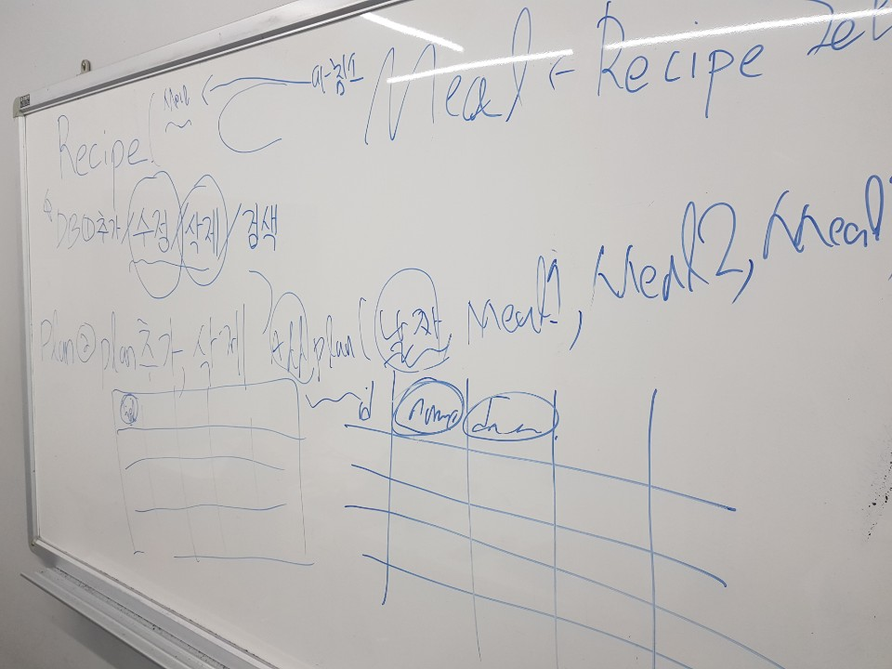
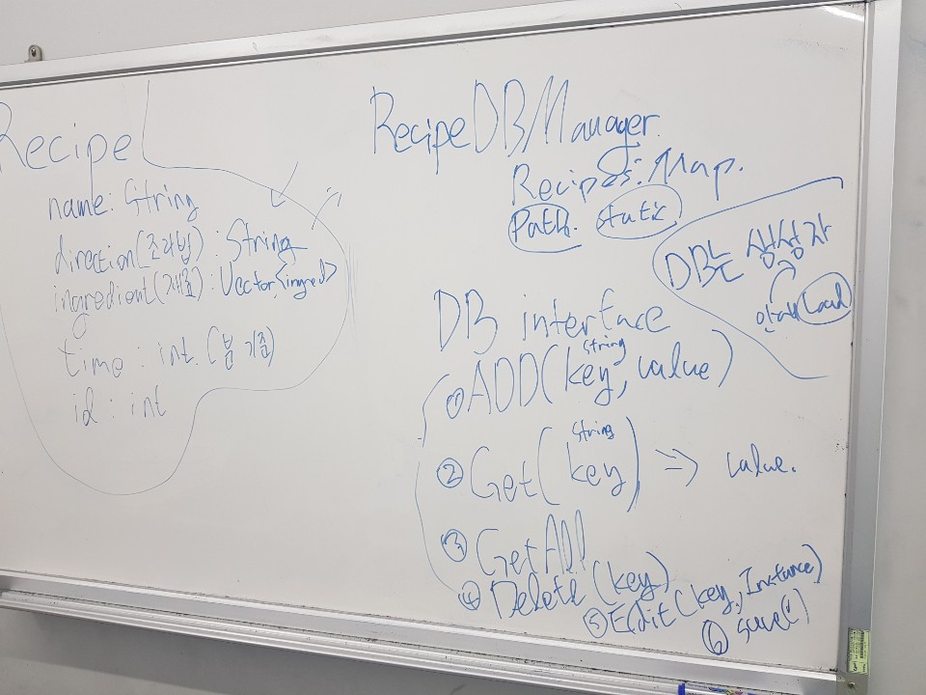
Data and database structure we designed before getting started

Slide 7
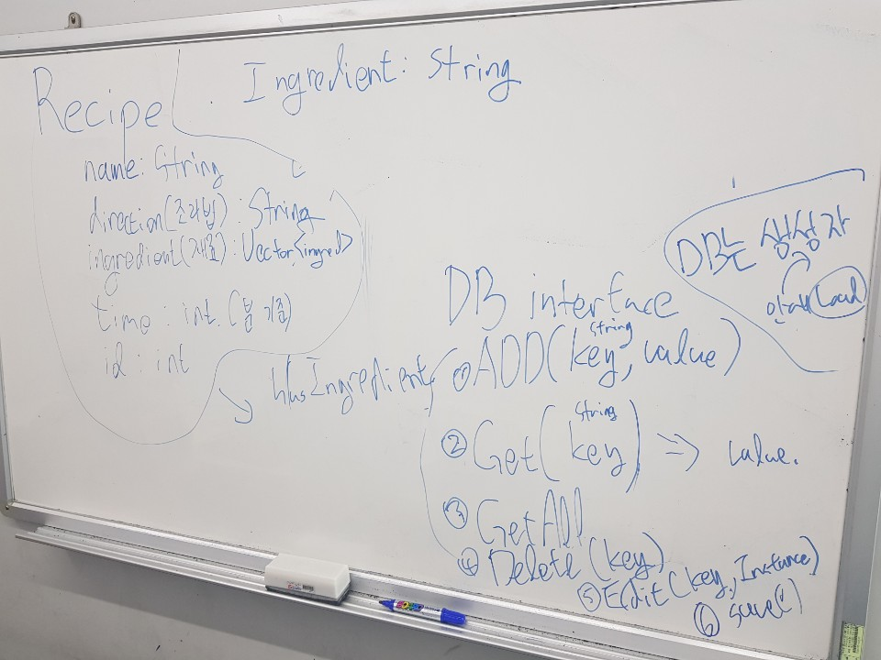
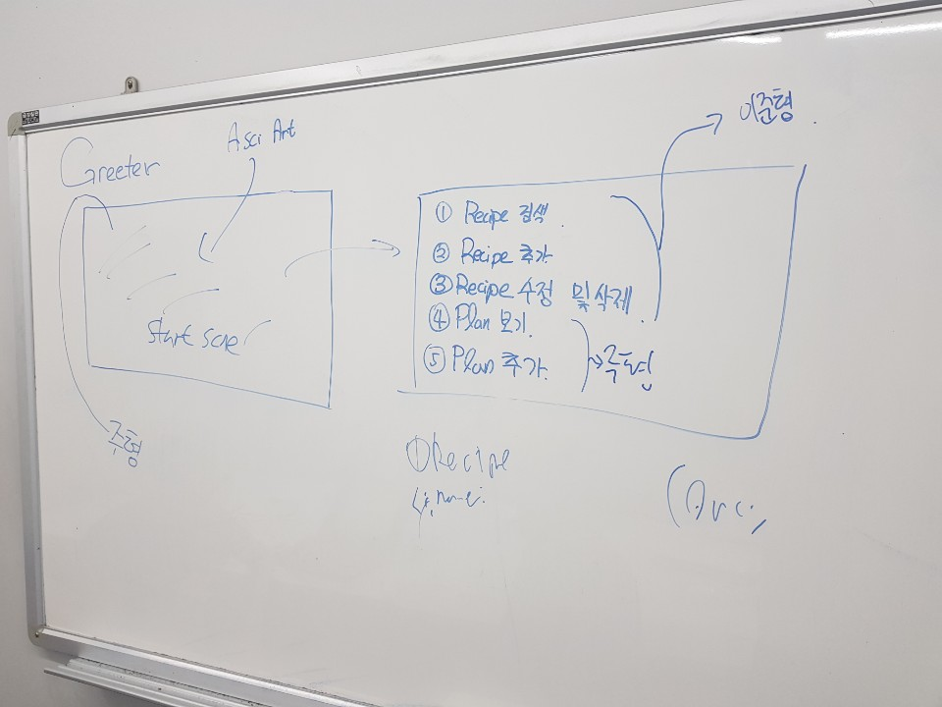

Slide 8
(데이터 / 데이터베이스 스트럭쳐 도형화)
(구조와 함께 Encapsulation이 잘되어 있음을 보여주면 좋을듯)

Slide 9
UML
We drew a UML based on our design

Slide 10
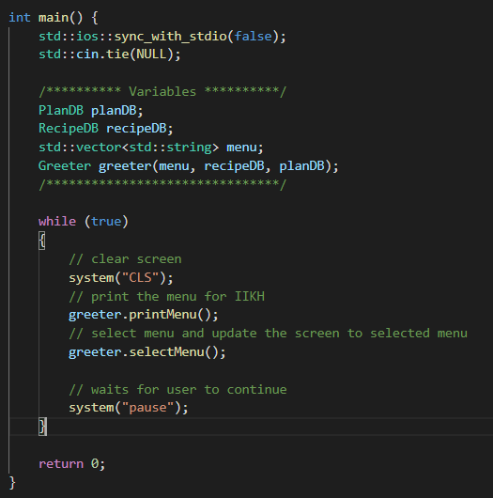
Functions
Externally, it seems that only
printMenu( ) and selectMenu( )
functions are running in
infinite loop.
printMenu( ) - shows menu
user interface
selectMenu( ) – receives user
input and calls function that
matches user selection.

Slide 11
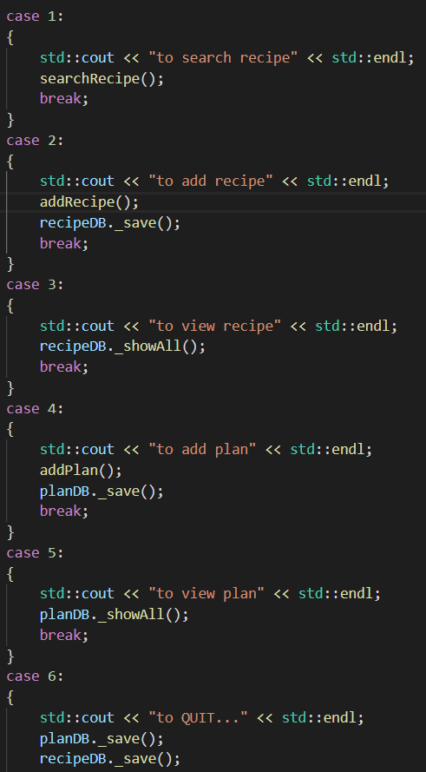
Functions
selectMenu( )
In selectMenu function,
each function (searchRechipe,
addRecipe, addPlan etc)
,that depends on user input,
will be executed through switch
statement.

Slide 12
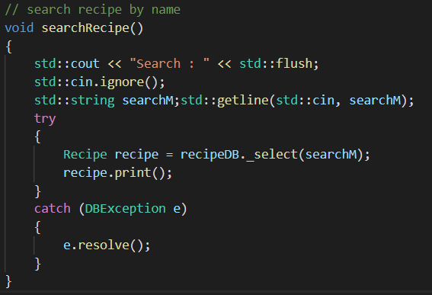
Functions
searchRecipe( )
Uses getline() to receive user input (recipe name)
Then search corresponding recipe in recipeDB through _select function. If there is any problem with searching, DBException will find out the cause, else we will print the recipe information.

Slide 13
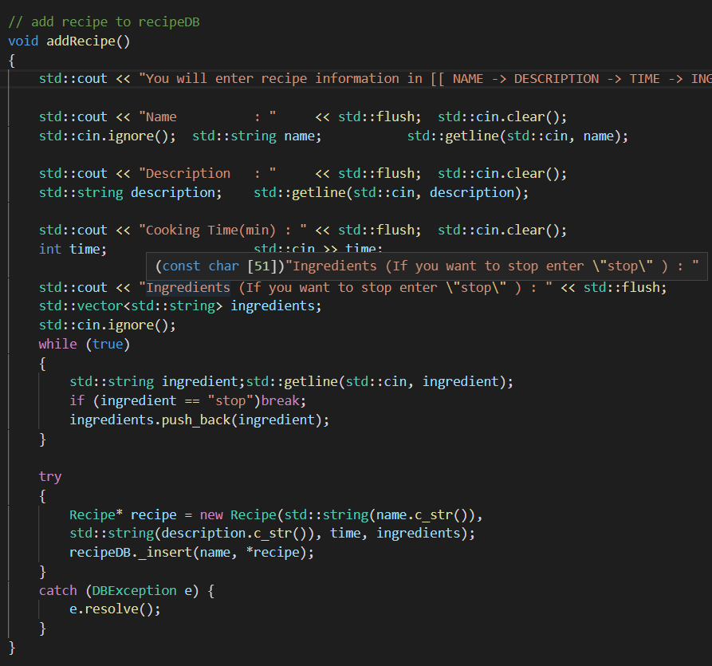
Functions
addRecipe( )
Requires recipe’s name, description, expected time and ingredients to add new recipe.
There is no limit to number of ingredients. Just enter “stop” if you are done with entering ingredients. After entering all the information, we create instance following the construction form and put it in the database.

Slide 14
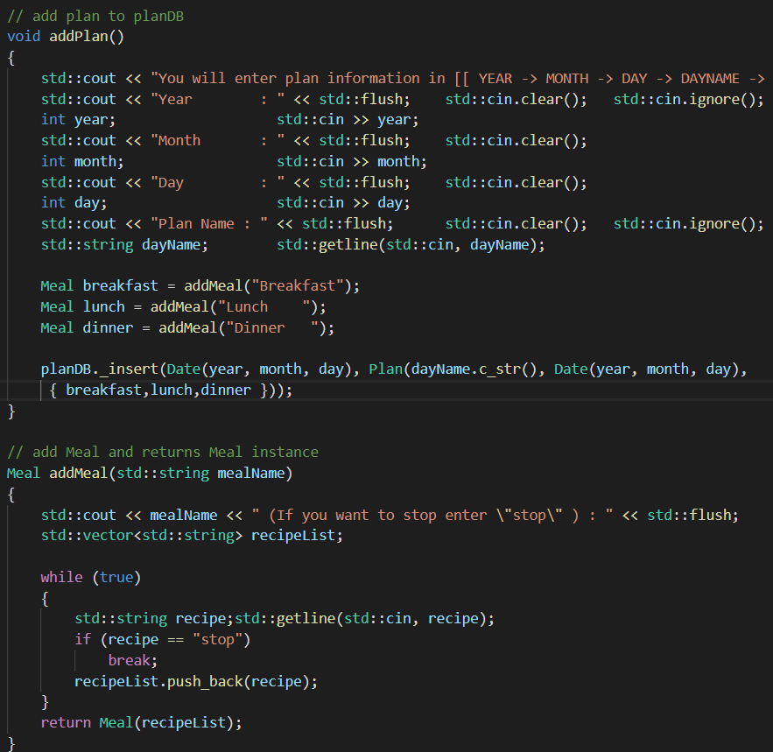
Functions
addPlan( ) & addMeal( )
addMeal( ) is a simple function that helps you make meal instance. (Meal is necessary to make a plan)
addPlan( ) is very similar
to addRecipe( ). It receives all the information needed for making plan. Then add to planDB.

Slide 15
Functions
_showAll( )
It prints out all the information stored in the database neatly
_save( )
Store the current database information to the external file

